Slide 1


Department of Information Technology
V R Siddhartha Engineering College
A Multimodal Explainable AI Framework for Depression Detection
using PHQ-9 and Eye-Based Features
B.Tech in Information Technology
Major Project Review Presentation
Presented by
ALLA HANVITHA SAI (228W1A1202)
NELLAPALA MANVITHA (228W1A1241)
Under the guidance of
Dr. G SrinivasaRao
Assistant Professor(SG)

Slide 2
Agenda
Introduction
Problem statement
Objectives and Outcomes of the Project
Literature Review
Research Gap
Datasets and Requirements
Algorithms used in the Project
Architecture Diagram
Implementation Steps and Execution
Results obtained
Conclusion and Future work
References

Slide 3
Introduction
Depression is one of the most prevalent mental health disorders worldwide and often remains undiagnosed in its early stages due to lack of awareness and hesitation in expressing emotional distress. Traditional screening methods such as PHQ-9 rely heavily on self-reported responses, which may not always reflect the true mental state of an individual [1].
Recent research highlights that physiological signals, particularly eye-based features, can provide objective insights into emotional conditions [2]. However, many existing AI-based systems lack transparency in their decision-making [3].
This motivates the development of a reliable, multimodal, and explainable depression detection system.

Slide 4
Problem statement
Accurate and early detection of depression remains a challenge due to the limitations of single-modality systems.Questionnaire-based methods are subjective and may lead to biased responses, while physiological signal-based approaches lack contextual clinical information. Furthermore, most deep learning models used in mental health analysis operate as black boxes, reducing user trust. Therefore, there is a need for a robust, multimodal framework that integrates clinical and visual data with explainable AI techniques to improve accuracy and interpretability

Slide 5
Objectives
Outcomes
To develop a Random Forest model using PHQ-9 questionnaire data for depression classification.
To implement a Vision Transformer (ViT) for analyzing eye images and extracting visual features.
To combine both models using fusion technique with Explainable AI support
Successfully built and trained multimodal models (RF + ViT) for depression detection.
Achieved improved performance with a Fusion Accuracy.
Generated interpretable results using SHAP feature importance and attention maps.

Slide 6
Literature Review
S.NO | Publication Details | Datasets | Algorithms | Limitations
1. | Effective Depression Detection using ML, DL, NLP and XAI (Masud et al., 2025)[1] | Student dataset (survey-based, 1602 samples) | Random Forest, Logistic Regression, CNN, MLP, BERT, RoBERTa, SHAP, LIME | relies on a single survey-based dataset, bias in answers
2. | Artificial Intelligence-Based Depression Detection (Kiss & Viktor, 2026) [2] | Pupillometry and eye movement data from 242 participants | CNN-LSTM model | Requires specialized sensors and real-time eye-tracking setup

Slide 7
3. | Explainable AI Models for Predicting Depression using PSG Data (Enkhbayar et al., 2025)[3] | Polysomnographic dataset (153 participants) | Random Forest, XGBoost, CatBoost, LightGBM | domain-specific (sleep data),requires specialized equipment
4. | Explainable AI-driven Depression Detection from Social Media (Hameed et al., 2025) [4] | Social media text data (Twitter, Reddit, etc.) | SVM, Random Forest, XGBoost, ANN +LIME | Relies on textual data only,lacks clinical validation
5 | PupilSense: Detection of Depressive Episodes Through Pupillary Response in the Wild (Islam & Bae, 2024)[5] | Real-world pupillary response data collected using mobile/portable sensor | Signal processing of pupil dynamics + Machine Learning classifiers | sensitive to lighting conditions, lack of multimodal inputs.

Slide 8
Research Gap
Lack of Multimodal Integration: Most systems use only one type of data,
survey (Masud et al., 2025)
text (Hameed et al., 2025)
physiological signals (Kiss & Viktor, 2026; Islam & Bae, 2024)
sleep data (Enkhbayar et al., 2025) which cannot capture the complete mental state.
2)Lack of Explainability :
Many models act as black-box (Kiss & Viktor, 2026)
have limited explanations (Islam & Bae, 2024)
Reduces trust in real-world use
There is a need for Multimodal + Explainable AI-based system

Slide 9
Datasets and Requirements
Participants: Individuals providing Patient Health questionnaire-9 responses
Data Collected: • PHQ-9 Responses: 9-item questionnaire scores (0–3 per question) • Total Score: Used as an additional feature for classification • Severity Labels: Minimal, Mild, Moderate, Moderately Severe, Severe • Eye Images: Collected and categorized into corresponding severity classes
Data Storage: Stored in labels.csv with fields: ParticipantID, Responses, TotalScore, Severity
Image Details: • Resolution: Resized to 224×224 pixels (for ViT model) • Format: JPG • Organized into class-wise folders

Slide 10
Software Requirements:
Programming Language: Python Libraries Used: • NumPy, Pandas – Data Processing • scikit-learn – Random Forest Model • PyTorch, Torchvision – Vision Transformer • Matplotlib – Visualization • SHAP – Explainable AI
Hardware Requirements:
• System with minimum 8GB RAM
• Storage for datasets and model files

Slide 11
Algorithms used in the Project:
Random Forest (Patient Health Questionnaire-9 Data)
Ensemble model using multiple decision trees
Works well on structured questionnaire data
Reduces overfitting
Output:
Predicts depression severity
Provides feature importance (SHAP)

Slide 12
Vision Transformer (Eye Images)
Splits image into patches
Uses self-attention mechanism
Captures global visual features
Output:
Classifies eye images into severity levels
Generates attention maps for explanation

Slide 13
Fusion Model and Explainability
Combines RF + ViT outputs
Uses weighted averaging
Improves robustness
Explainability:
Shapely Additive Explanations for questionnaire features
Attention maps for image regions

Slide 14
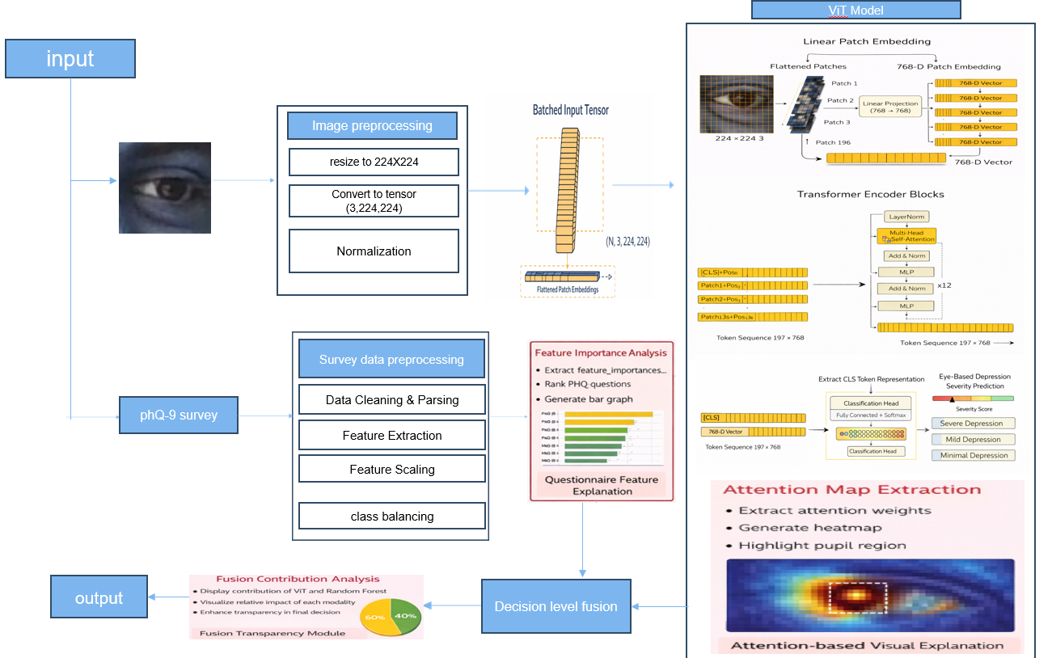
Architecture Diagram

Slide 15
Implementation Steps and Execution
Implementation of Random Forest Model
Load PHQ-9 dataset (labels.csv)
Convert responses into feature columns
Encode severity labels
Split into training & testing data
Train Random Forest model
Generate predictions & evaluate

Slide 16
Implementation – ViT & Fusion Model
Load eye image dataset
Apply preprocessing (resize, normalization)
Train pretrained ViT model (AdamW optimizer)
Generate predictions & probabilities
Fusion:
Combine RF + ViT probabilities
Apply weighted averaging
Generate final prediction

Slide 17
Parameters | Base Paper (Masud et al., 2025) | Proposed Model
Dataset | Student survey dataset | PHQ-9 dataset + Eye image data
Data Nature | Subjective (self-reported) | Hybrid (subjective ,objective)
Features Used | Demographic ,textual features | PHQ-9 responses ,eye features
Models Used | Random Forest, BERT, CNN | Random Forest + Vision Transformer (ViT)
Explainability | SHAP, LIME | SHAP ,Attention Maps
Fusion Technique | No fusion | Weighted Fusion
Evaluation Metrics | Accuracy, F1-score, Recall | Accuracy, Precision, Recall, F1-score

Slide 18
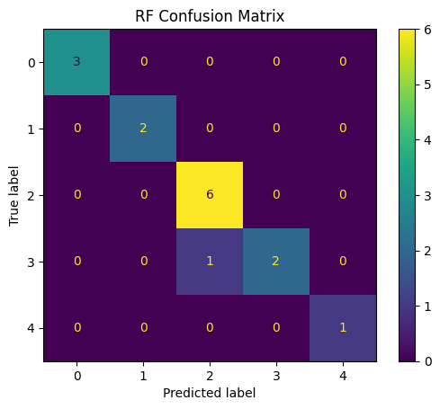
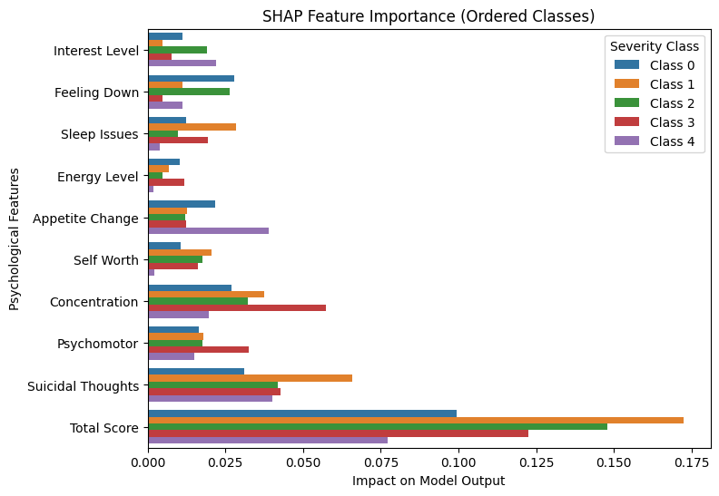
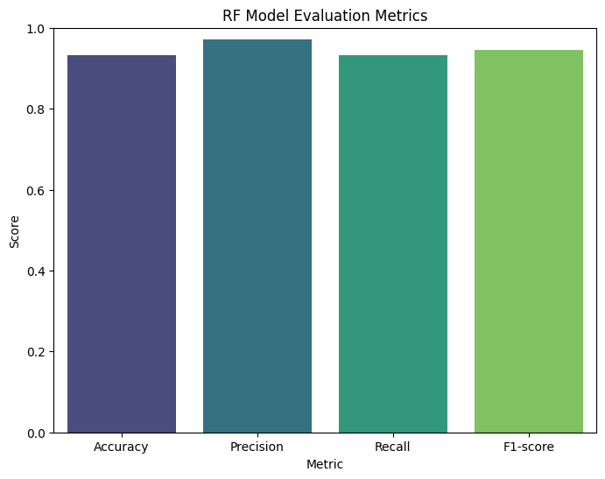
Result Obtained

Slide 19
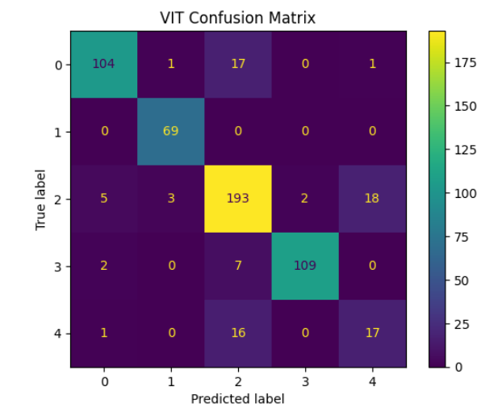
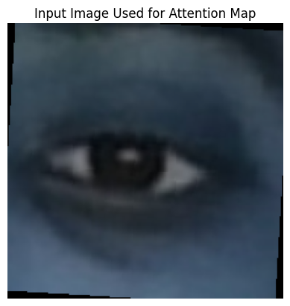
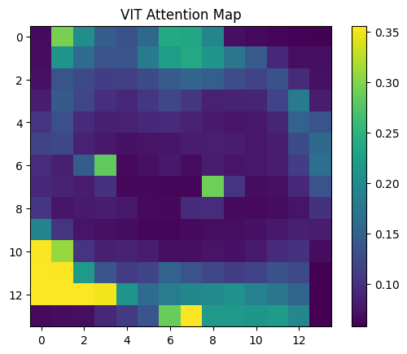
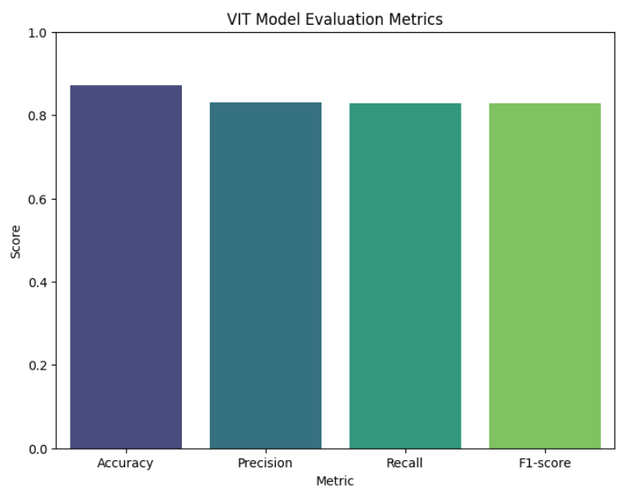
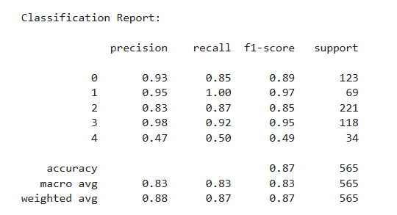

Slide 20
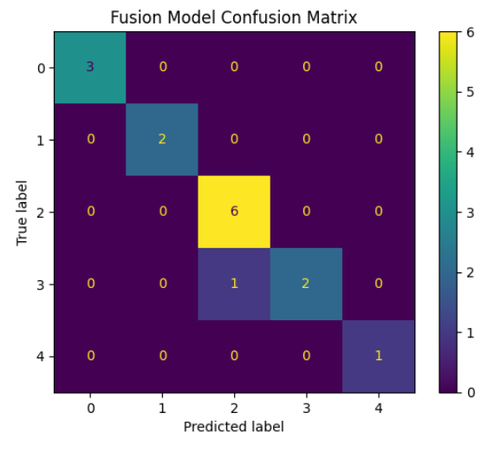
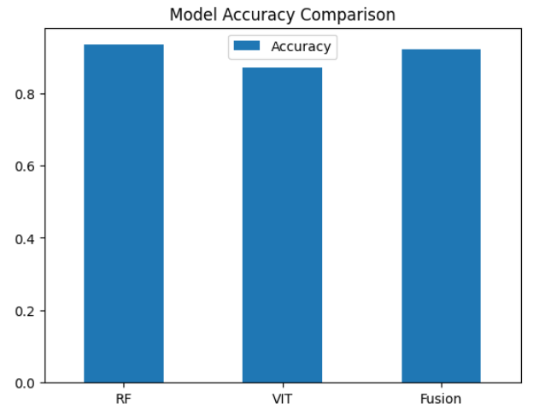
Model | Accuracy
Random Forest | 0.93
ViT | 0.87
Fusion | 0.92
Random Forest(Masud et al., 2025 | 0.91
BERT(Masud et al., 2025) | 0.85
CNN(Masud et al., 2025) | 0.83

Slide 21
Result Analysis
Random Forest achieved the highest accuracy (93%) using PHQ-9 data
Vision Transformer achieved 87%, capturing eye-based features
Fusion model achieved 92% by combining both modalities
Key Insight:
Although the fusion model has slightly lower accuracy than Random Forest, it provides a more reliable and balanced prediction by integrating both subjective (PHQ-9) and objective (eye features) data, making it more suitable for real-world depression detection.

Slide 22
Conclusion
This work highlights the importance of developing an accurate and reliable system for early depression detection by addressing the limitations of traditional and single-modality approaches. By integrating clinical inputs with objective visual features such as eye-based signals, the proposed multimodal framework enhances the robustness and accuracy of detection. Furthermore, the incorporation of Explainable AI techniques ensures transparency in decision-making, thereby increasing user trust and interpretability of the model’s predictions.

Slide 23
Future work
Larger and Diverse Dataset It is possible to focus future work on training and validating the model with larger and more diverse dataset The introduction of data related to other age groups, ethnicities, and environmental factors will allow minimizing bias and make sure that performance in real-world conditions is reliable.
Early Intervention and Recommendation System This would help the model to offer individual coping skills, therapy, and referral to professional assistance, which would turn it into a fully-fledged system of mental health.
Real-Time Implementation:
The next possible improvement is the creation of a real-time system or mobile-based application which would constantly track the user inputs and make real-time predictions, which would make the system more practical and accessible.

Slide 24
References
[1] G. H. A. Masud, R. I. Shanto, I. Sakin, and M. R. Kabir, “Effective depression detection and interpretation: Integrating machine learning, deep learning, language models, and explainable AI,” Array, 2025
[2] G. Kiss and P. Viktor, “Artificial intelligence-based depression detection,” Sensors, 2026.
[3] Enkhbayar, K., Petrov, K., Ivanov, M., and Kim, J., “Explainable AI Models for Predicting Depression using PSG Data,” 2025.
[4] S. Hameed, M. Nauman, N. Akhtar, M. A. B. Fayyaz, and R. Nawaz, “Explainable AI-driven depression detection from social media using natural language processing and machine learning models,” Frontiers in Artificial Intelligence, 2025.
[5] R. Islam and S. W. Bae, “PupilSense: Detection of depressive episodes through pupillary response in the wild,”
Sensors Mobile Health Journal, 2024.

Slide 25
[6] Mi Li, Yanbo Chen, Zeying Lu, Fan Ding, Bin Hu “Method and Device for Automatically Detecting Early Depression Using Multimodal Physiological Signals Evoked and Perceived via Various Emotional Scenes in Virtual Reality “ IEEE Member Publication, 2024
[7]Z. Zheng, L. Liang, X. Luo, J. Chen, M. Lin, G. Wang, and C. Xue, “Diagnosing and tracking depression based on eye movement in response to virtual reality,” Frontiers in Psychiatry, 2024.
[8] Rahul Islam, Sang Won Bae “PupilSense: Detection of Depressive Episodes Through Pupillary Response in the Wild “Sensors or Mobile Health Journal, 2024)
[9] A. M. Spaeth, C. P. Weinkauf, B. P. Alloy “Are Depressive Symptoms Linked to a Reduced Pupillary Response to Novel Positive Information?” Journal of Affective Disorders, 2023)
[10] O. Alshanskaia, K. Petrov, M. Ivanov Using Cognitive Load from Pupil Dilation Human Factors in Computing, 2023

Slide 26
Thank You

