Slide 1


CS209: Artificial Intelligence
Course Project Title:Anemia Classification Using CBC Data
Submitted by:
Sai Sreeharsha Bolloju (CS23BT058)
Middepogu Manvitha (CS23BT061)
Priyanshu Sharma (IS22BM030)
Paturi Surya Chaitanya (CS23BT046)
Course Instructor: Prof. Dileep. A.D
Mentor Name: Sujeet Kumar

Slide 2
Outline
Introduction
Methodology
Experimental Setup
Results
Conclusion

Slide 3
Introduction
▶ CBC dataset with hematological parameters.
▶ Goal: Classify anemia types using ML.
▶ Motivation: Early diagnosis via automation.

Slide 4
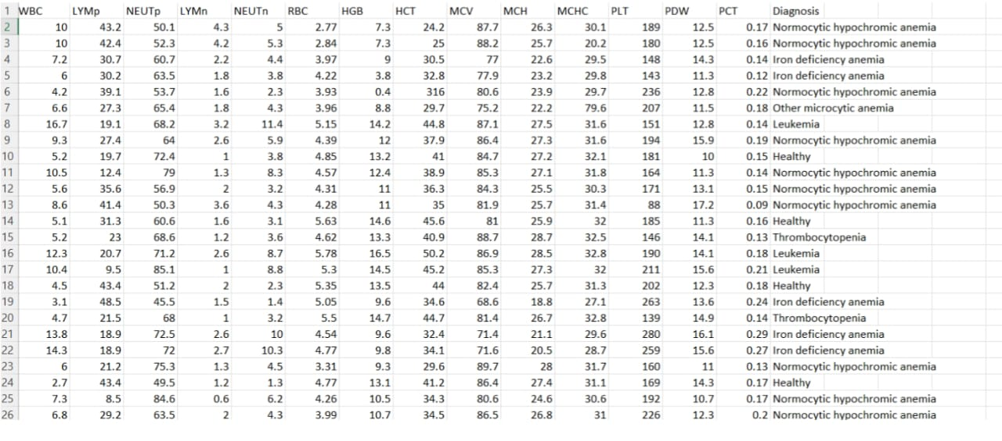
Dataset

Slide 5
Dataset Description
Source: 25.csv
Features:
▶ Hematological: HGB, PLT, WBC, RBC, MCV, MCH, MCHC, PDW, PCT
▶ Additional: LYMp, NEUTp, LYMn, NEUTn
▶ Target: Diagnosis (Anemia type)

Slide 6
Data Preprocessing
▶ Nulls checked (none).
▶ Replaced negatives in HGB/RBC.
▶ Normalized numerical features.
▶ Encoded categorical target.

Slide 7
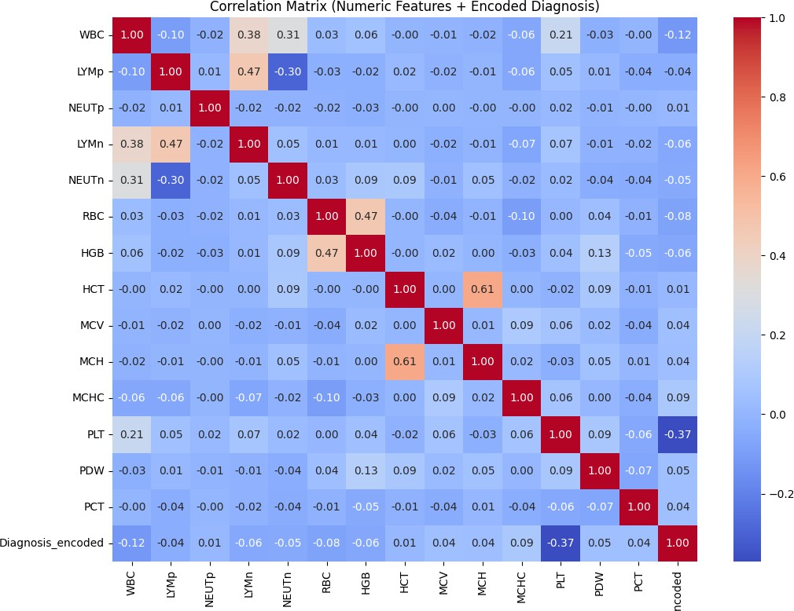
Feature Selection
▶ Correlation with diagnosis.
▶ Top 5 features: PLT, WBC, MCHC, RBC, HGB

Slide 8
Model Training
Algorithms Used:
▶ Random Forest, Decision Tree
▶ SVM, Naive Bayes
▶ MLPs: (16,8), (32,16), (64,32), (128,64)
Train-Test Split: 80-20

Slide 9
Model Performance
Model | Accuracy | Precision | Recall | F1-Score
Decision Tree | 0.887 | 0.908 | 0.887 | 0.894
Support Vector Machine | 0.463 | 0.411 | 0.463 | 0.408
Naive Bayes Random Forest | 0.603 0.926 | 0.575 0.931 | 0.603 0.926 | 0.541 0.925
MLP (16, 8) | 0.642 | 0.607 | 0.642 | 0.616
MLP (32, 16) | 0.665 | 0.615 | 0.665 | 0.633
MLP (64, 32) | 0.681 | 0.640 | 0.681 | 0.652
MLP (128, 64) | 0.510 | 0.494 | 0.510 | 0.426
Table: Model Evaluation Results

Slide 10
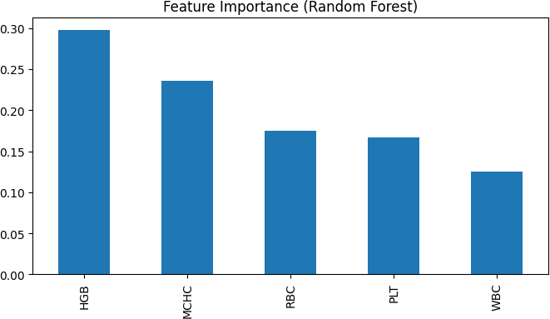
Feature Importance

Slide 11
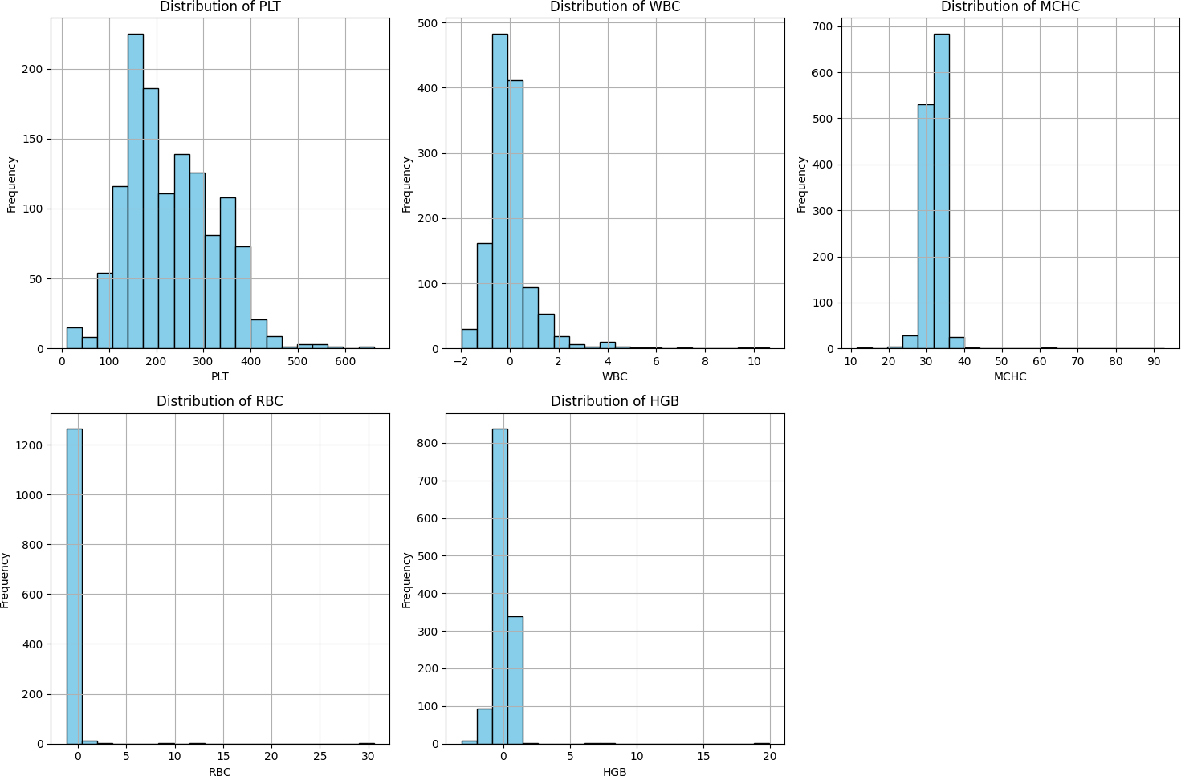
Histogram

Slide 12
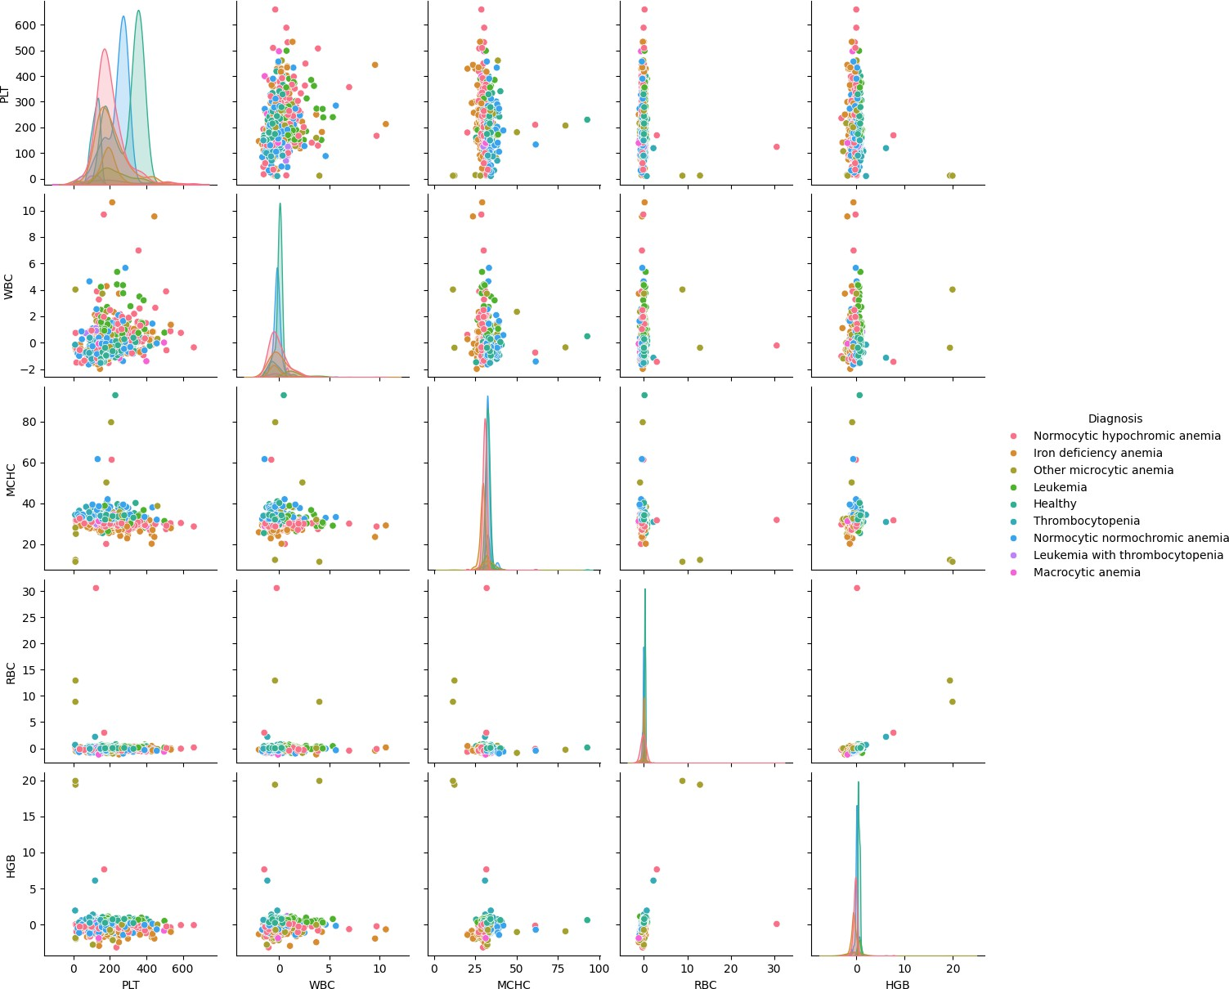
Scatter Plots

Slide 13
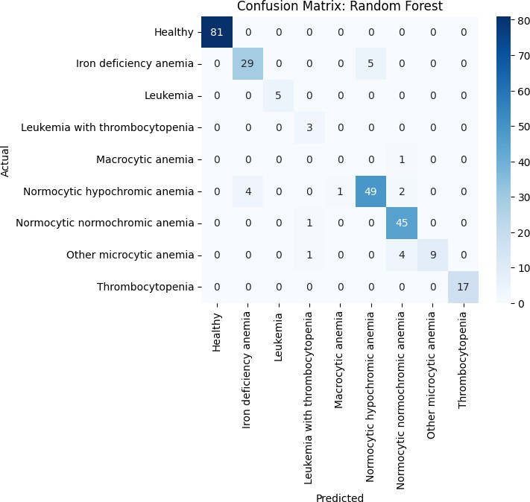
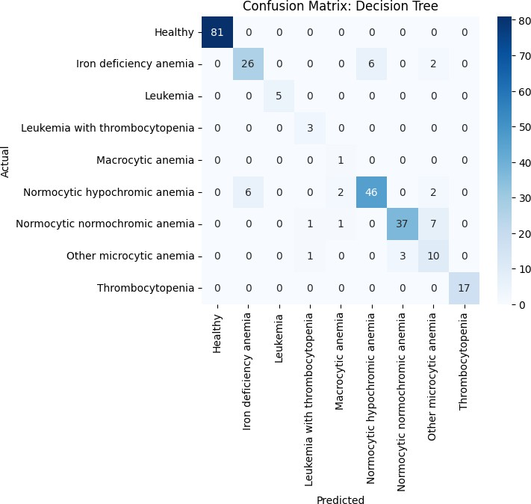
Confusion Matrices
Random Forest
Decision Tree

Slide 14
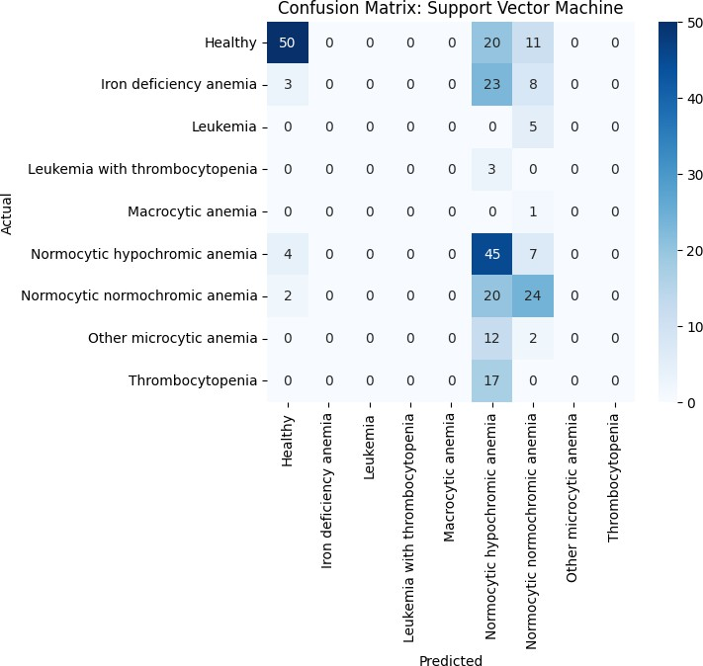
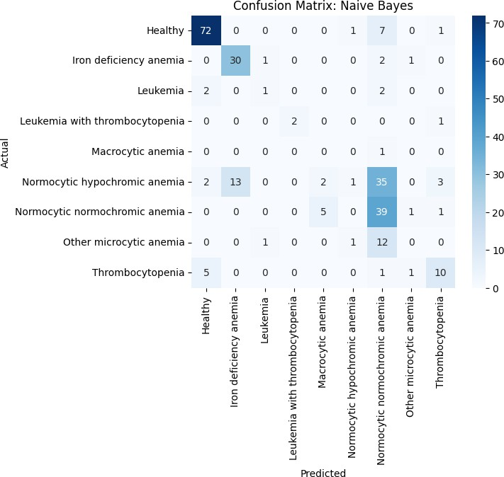
More Confusion Matrices
SVM
Naive Bayes

Slide 15
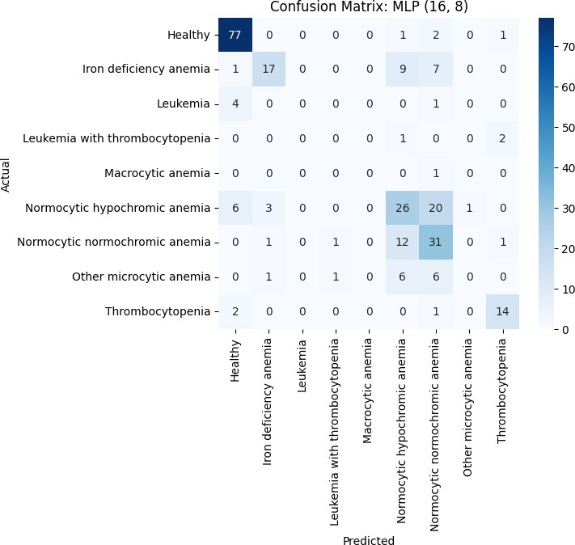
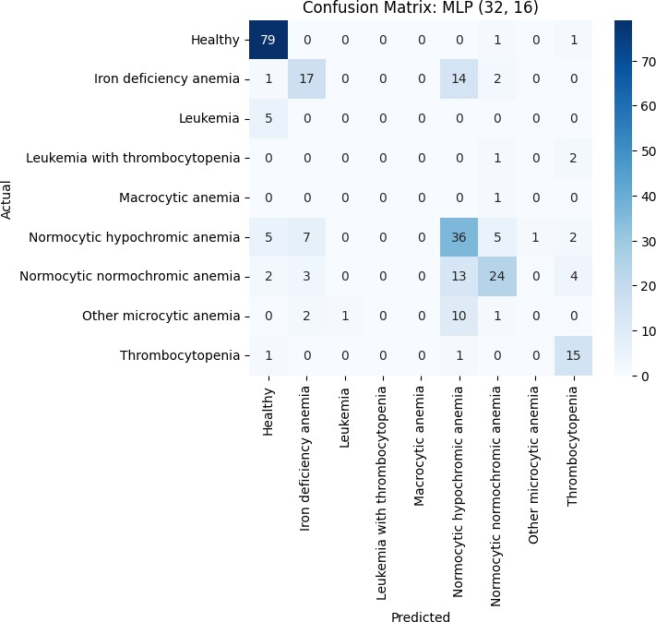
MLP Confusion Matrices
MLP (16,8)
MLP (32,16)

Slide 16

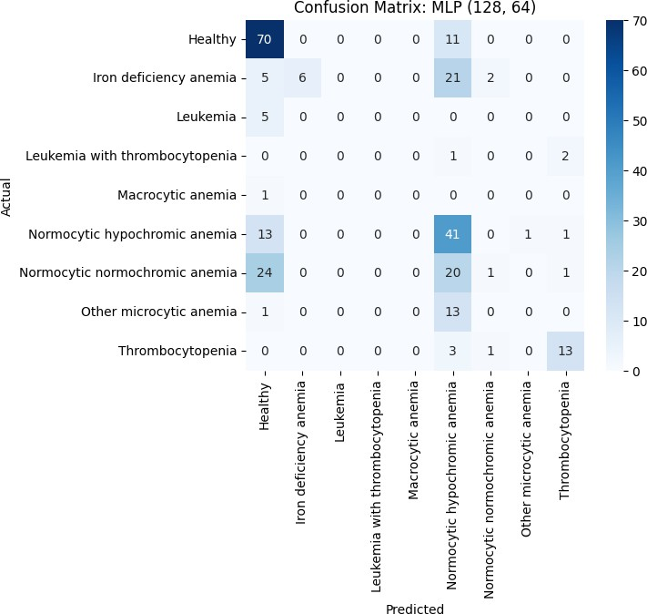
MLP Confusion Matrices (Contd.)
MLP (64,32)
MLP (128,64)

Slide 17
Conclusion
▶ Random Forest performed best overall.
▶ Important features: HGB, RBC, MCHC.
▶ ML helps in early anemia detection.

Slide 18
Future Work
▶ Try advanced models like XGBoost.
▶ Use SHAP/LIME for explainability.
▶ Deploy as a clinical web tool.

Slide 19
References
▶ Dataset: 25.csv
▶ Notebook: Anemia classification.ipynb
▶ scikit-learn documentation

