Slide 1

E-Commerce Sales Analysis & Business Insights
A data-driven exploration of revenue, orders, customer behavior, and performance trends to support smarter business decisions.
2024 ANALYSIS REPORT

Slide 2


Project Objective
This analysis dives deep into an e-commerce dataset to uncover what's driving revenue, where opportunities lie, and how operational efficiency can be improved.
The goal is to translate raw transactional data into clear, actionable business insights across four key dimensions:
Revenue Performance
Order Behavior
Track total and category-level earnings
Understand volume, status, and fulfillment
Customer Patterns
Geographic Reach
Identify demand signals and seasonal shifts
Map state-level revenue concentration

Slide 3
Dataset Overview
The dataset captures a comprehensive view of e-commerce transactions, providing the foundation for all downstream analysis.
Order ID
Product Category
Quantity
Unique identifier for each transaction
Classification of items sold
Units ordered per transaction
Total Revenue
Order Status
Shipping State
Revenue generated per order
Delivered, cancelled, or returned
Geographic origin of each order
Order Date
Timestamp enabling trend analysis

Slide 4
Key Performance Indicators
Five core KPIs were defined to measure and monitor overall business health at a glance.
Total Revenue
Total Orders
Qty Sold
Gross income generated across all orders
Volume of transactions processed
Total units moved across categories
Avg. Order Value
Cancellation Rate
Revenue per order — a key efficiency signal
Share of orders cancelled before fulfillment

Slide 5
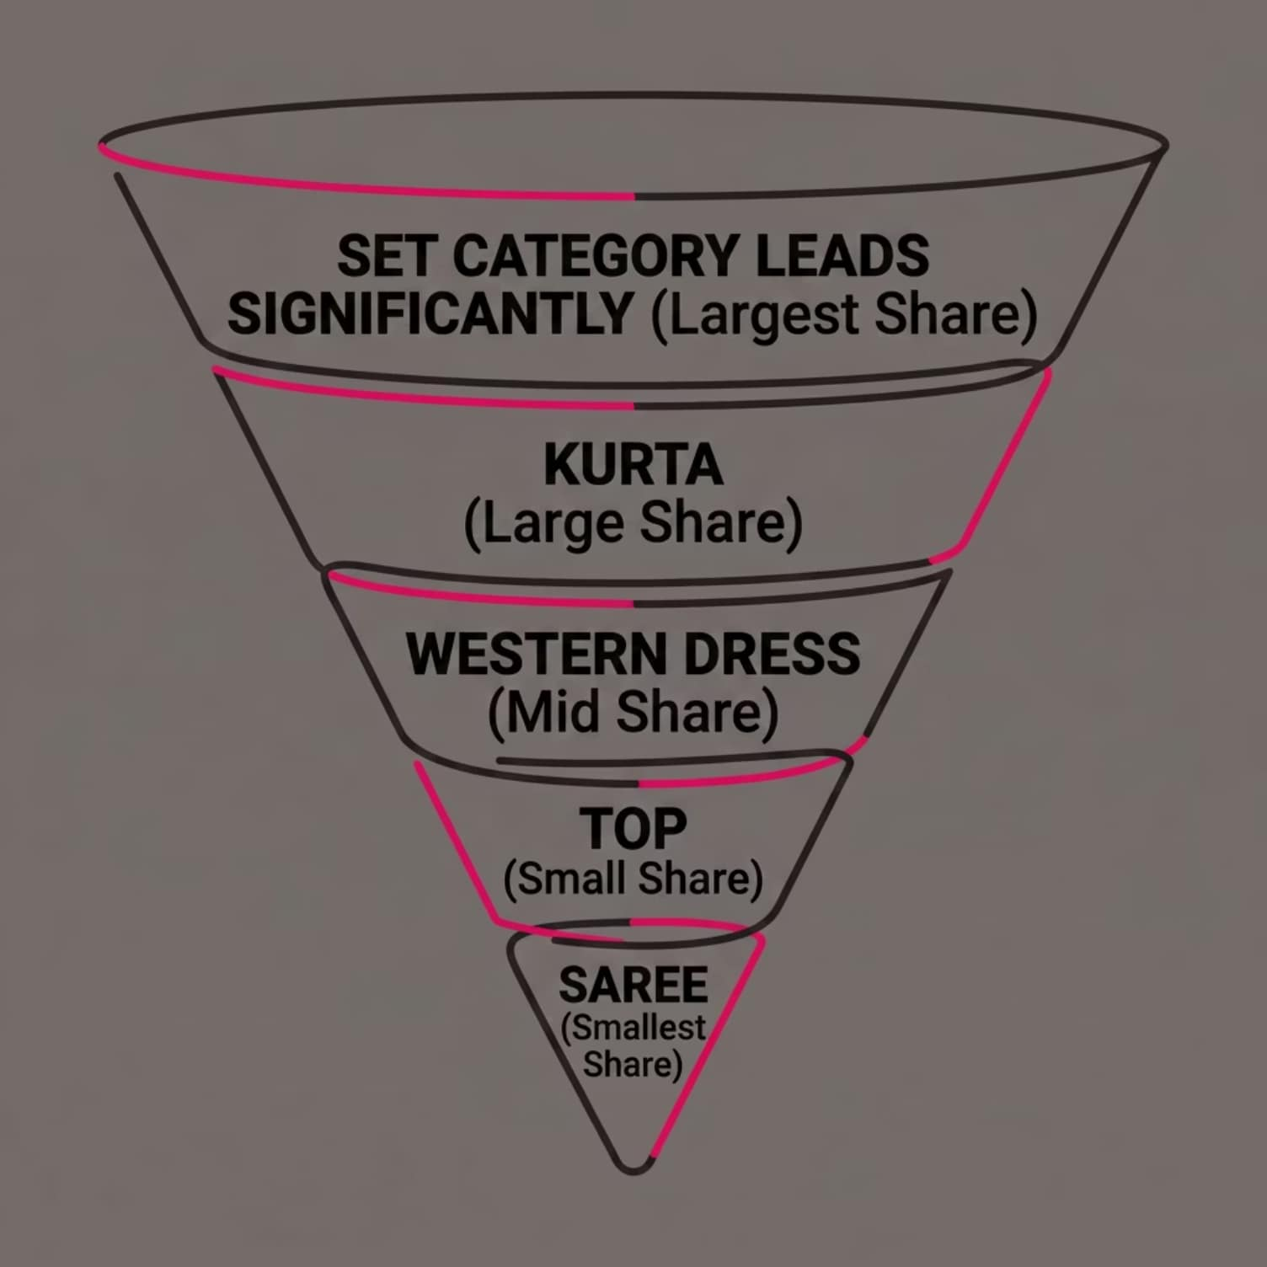


Category Performance Analysis
Revenue by Category
What the Data Tells Us
Category-level analysis reveals a pronounced revenue concentration effect — a small number of categories are responsible for driving the majority of total sales.
The "Set" category consistently outperforms all others, signaling strong customer preference and high purchase frequency in this segment.
Top 2–3 categories likely account for the majority of total revenue. This imbalance presents both a risk and an optimization opportunity.

Slide 6

Monthly Revenue Trends
Reading the Trend
Monthly revenue is not uniform — clear peaks and troughs emerge throughout the year, signaling seasonal demand cycles.
Peak Season
Mid-Year Dip
Mar–Apr highest revenue.
May–Jun declining demand.
Certain months consistently outperform others
Demand dips suggest promotional opportunities
Peaks should inform inventory and staffing plans
Early Year Ramp-Up
Late Year Recovery
Jan–Feb building momentum.
Jul onwards stabilizing revenue.

Slide 7
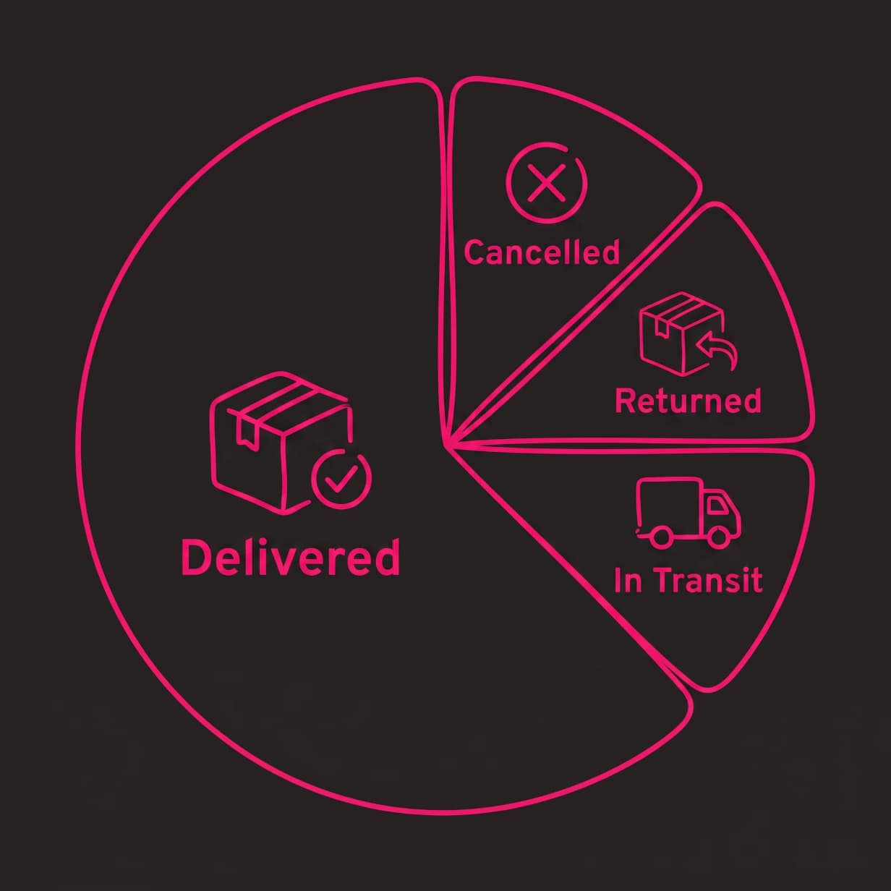

Order Status Breakdown
Fulfillment Health
The vast majority of orders reach customers successfully, reflecting efficient operational execution across logistics and fulfillment pipelines.
✅ Strong Delivery Rate
⚠️ Cancellation Impact
🔄 Return Management
Most orders fulfilled without issue — a positive signal for customer satisfaction
Though small in percentage, cancellations represent lost revenue worth addressing
Returns are minimal but should be monitored to protect margins

Slide 8

State-Wise Revenue Distribution
Geographic analysis reveals that revenue is heavily concentrated in a handful of states — a pattern with major strategic implications.
Top States
A few high-performing states contribute a disproportionate share of total revenue
Underserved Regions
Many states show minimal activity — representing significant untapped market potential
Concentration Risk
Over-reliance on a few states creates vulnerability to regional disruptions
Expansion Opportunity
Targeted marketing in low-revenue regions could drive meaningful growth

Slide 9
Key Insights & Hypothesis Validation
What the Data Revealed
Hypothesis Result
1
Category Concentration
Hypothesis: A small number of categories contribute most of the total revenue.
A small number of categories — led by "Set" — drive the majority of revenue, validating our core hypothesis
Finding: The "Set" category generates significantly higher revenue than all others — revenue distribution is highly uneven.
2
Seasonal Variation
Verdict: Hypothesis fully supported by the data.
Monthly trends confirm predictable demand cycles that can be planned around
3
Operational Efficiency
High delivery success rates signal a strong fulfillment backbone
4
Geographic Gaps
Revenue concentration in a few states points to clear expansion opportunities

Slide 10
Recommendations & Next Steps
Based on the analysis, four strategic actions can drive meaningful improvement in revenue, efficiency, and market reach.
Expand into Underserved Regions
Double Down on Top Categories
Deploy targeted campaigns in low-performing states to diversify revenue sources and reduce geographic concentration risk
Prioritize inventory, marketing, and promotions for the "Set" category and other high-revenue segments to maximize returns
Plan Around Seasonal Peaks
Reduce Order Cancellations
Use monthly trend data to time promotions, stock up inventory, and align staffing ahead of demand surges
Improve order management workflows, payment processes, and customer communication to lower cancellation rates

