Slide 1
A/B Testing Analysis
Task-4 : Data Storytelling & Statistical Validation
Business Problem :
An e-commerce company conducted an A/B test to determine whether a new landing page design improves user conversion rates compared to the existing page.
The dataset contains user interaction data where visitors were randomly assigned to either the control group (old page) or the treatment group (new page).
The goal of this analysis is to determine whether the new page significantly increases conversions.

Slide 2
A/B Testing Analysis
Task-4 : Data Storytelling & Statistical Validation
Dataset Overview:
Column | Description
User_id | Unique identifier for each user.
Timestamp | Time when user visited the page.
Group | Control / Treatment Group
Landing_Page | Oldpage / Newpage
Converted | Whether the user converted (1) / not (0)

Slide 3
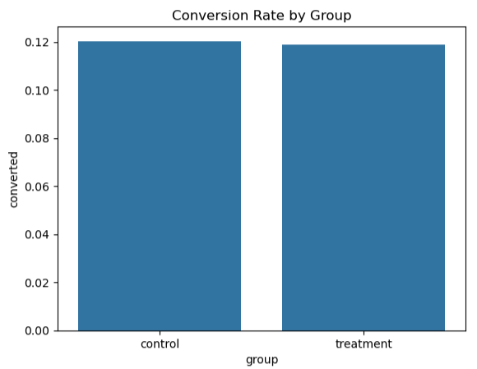
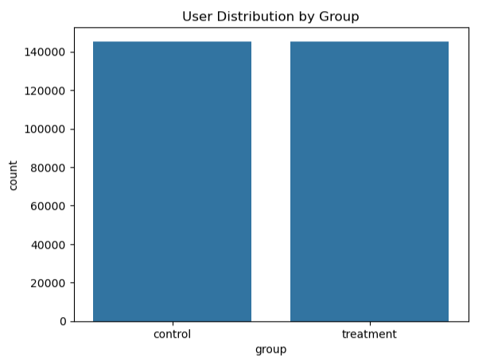
A/B Testing Analysis
Task-4 : Data Storytelling & Statistical Validation
Dataset Exploration:

Slide 4
A/B Testing Analysis
Task-4 : Data Storytelling & Statistical Validation
Hypothesis Testing :
Null Hypothesis (H₀) - The new landing page does not increase the conversion rate compared to the existing page Alternative Hypothesis (H₁) - The new landing page improves the conversion rate compared to the existing page 📈 Statistical Test Used :
A Z-test for proportions was used to compare the conversion rates of the control and treatment groups.
This test determines whether the difference between two proportions is statistically significant.
If p-value < 0.05 → Reject H₀ If p-value ≥ 0.05 → Fail to reject H₀

Slide 5
A/B Testing Analysis
Task-4 : Data Storytelling & Statistical Validation
Results :
Control Conversion Rate: 12.02%
Treatment Conversion Rate: 11.88%
p-value: 0.226 Since p-value = 0.226 > 0.05 -- We fail to reject the null hypothesis
Business Recommendation :
Based on the results of the A/B test-
The company should continue using the current landing page design.
Further experimentation or design improvements may be required before implementing a new page.

Slide 6
A/B Testing Analysis
Task-4 : Data Storytelling & Statistical Validation
Conclusion :
The statistical analysis shows that the new landing page does not significantly improve the conversion rate compared to the existing page.
Although the conversion rates are close, the difference is not statistically significant

