Slide 1
OOPS
OBJECT ORIENTED PROGRAMMING LANGUAGE

Slide 2
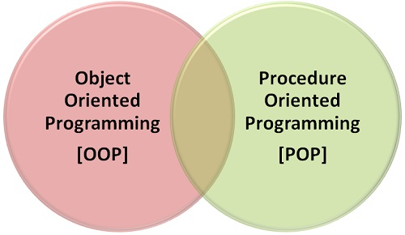
OOPs and POP are programming approaches using high level language
Programming Approaches

Slide 3
Procedure Oriented Programming
Data Security is at risk
Code reusability is not achieved
Large programs lead to more bugs, and it increases the time of debugging.
All these flaws lead to a new approach namely “object-oriented programming”.

Slide 4
Why we started using OOPs?
Object Oriented Language enables Programmers to think like they are working with the real-life entities.
Simplifies software development and maintenance.
Reduce the complexity.
Improves maintainability of the system.

Slide 5
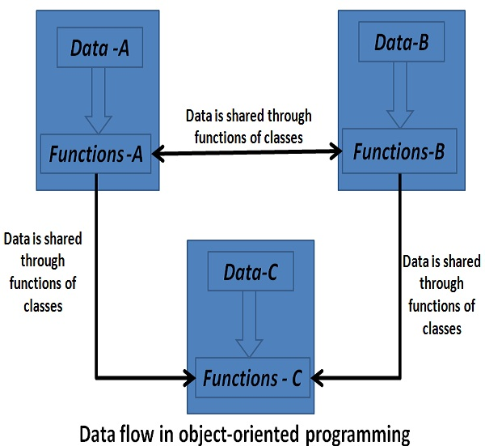

Slide 6
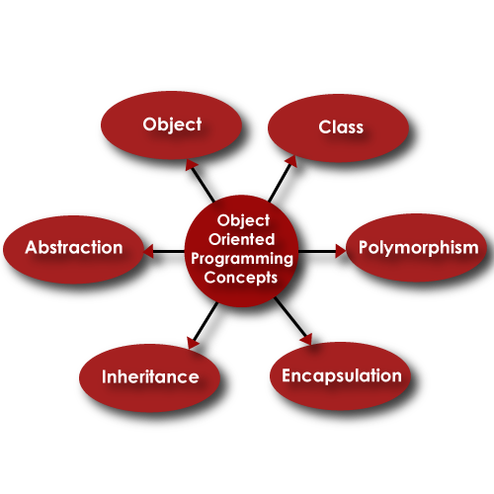
Basic Concepts
These are the basic terms and features that are used and provided by oops.

Slide 7
Thank You!!

