Slide 1
KEYLOGGER
CAPSTONE PROJECT
Presented By:
1. KARTHIK RAJA S
2. University College Engineering, kanchipuram.
3. B.E(CSE).

Slide 2
OUTLINE
Problem Statement
Proposed System/Solution
System Development Approach
Algorithm & Deployment
Result (Output Image)
Conclusion
Future Scope
References

Slide 3
PROBLEM STATEMENT
In today's digital age, where cybersecurity threats loom large, one of the significant concerns is the proliferation of keyloggers, stealthy software tools designed to monitor and record keystrokes on a user's computer without their knowledge. Keyloggers pose a severe threat to individuals and organizations as they can capture sensitive information such as passwords, credit card details, and other personal data, leading to identity theft, financial loss, and privacy breaches.

Slide 4
PROPOSED SOLUTION
4. **Efficient Performance Optimization**: Optimize data handling processes to minimize performance impact on the host system. Implement selective logging features to start and stop logging based on predefined criteria, reducing data volume and improving relevance.
5. **Compliance and Ethics Features**: Incorporate clear user consent mechanisms to ensure ethical use of the keylogger. Provide comprehensive documentation and guidelines on lawful applications, emphasizing respect for privacy and adherence to legal requirements.
6. **Educational Resources**: Develop tutorials and guides to educate users on cybersecurity, programming, and system monitoring using the keylogger. Foster a culture of responsible and ethical use, promoting awareness of privacy concerns and best practices.

Slide 5
SYSTEM APPROACH
1. System Requirements Analysis:
- Identify stakeholders and their requirements, including end-users, administrators, and legal/regulatory bodies.
- Define functional and non-functional requirements, such as logging capabilities, user interface design, security measures, and compliance with privacy laws.
2. System Architecture Design:
- Design a modular and scalable architecture that separates concerns and promotes maintainability and extensibility.
- Define components such as the user interface, keylogging engine, data storage, encryption modules, and authentication mechanisms.
- Specify interfaces and protocols for communication between components, ensuring interoperability and flexibility.
3. Security Integration:
- Integrate security measures throughout the system architecture, including encryption for logged data, secure authentication mechanisms, and access control policies.
- Conduct threat modeling and risk assessment to identify potential vulnerabilities and mitigate them through appropriate security controls.
- Implement secure coding practices to prevent common security vulnerabilities such as injection attacks, buffer overflows, and privilege escalation.

Slide 6
4.Ethical Considerations:
- Incorporate ethical considerations into the system design and development process, including user consent mechanisms, transparency about data collection practices, and safeguards against misuse.
- Provide clear documentation and guidance on ethical use and legal compliance, emphasizing respect for privacy and individual rights.
- Implement accountability measures, such as audit trails and user activity logging, to promote transparency and accountability in system usage.
5. Cross-Platform Compatibility:
- Ensure compatibility with multiple operating systems by designing platform-independent components and leveraging cross-platform development frameworks or technologies.
- Conduct thorough testing and validation across different operating environments to identify and address platform-specific issues or dependencies.
6. Performance Optimization:
- Optimize system performance through efficient data handling, resource utilization, and algorithmic optimizations.
- Employ techniques such as caching, batching, and parallel processing to minimize latency and maximize throughput.
- Monitor system performance in real-time and apply tuning adjustments as needed to maintain optimal operation under varying workloads.

Slide 7
ALGORITHM & DEPLOYMENT
1. Algorithm Selection:
Choose machine learning algorithms capable of detecting patterns indicative of keylogger activity, such as anomaly detection algorithms, deep learning models, or ensemble methods.
Prioritize algorithms with high accuracy, scalability, and efficiency to effectively identify and mitigate keylogger threats.
2. Data Input:
Collect diverse datasets containing keystroke dynamics and contextual information from users' systems, including timestamps, application usage, and user interactions.
Ensure data input pipelines are robust and secure, protecting sensitive information from interception or tampering by potential keyloggers.
3. Training Process:
Preprocess input data using techniques such as normalization, feature extraction, and dimensionality reduction to enhance model performance.
Train machine learning models using labeled datasets, emphasizing the importance of representative samples and balanced class distributions to improve detection accuracy.
Validate models using cross-validation techniques to assess generalization performance and identify potential overfitting or underfitting issues.
4. Prediction Process:
Deploy trained models to continuously monitor user keystroke activities in real-time, leveraging efficient prediction algorithms to detect suspicious behavior indicative of keylogger activity.
Implement mechanisms to trigger alerts or responses when keylogger threats are detected, enabling rapid mitigation actions to prevent data compromise and mitigate potential damages.

Slide 8
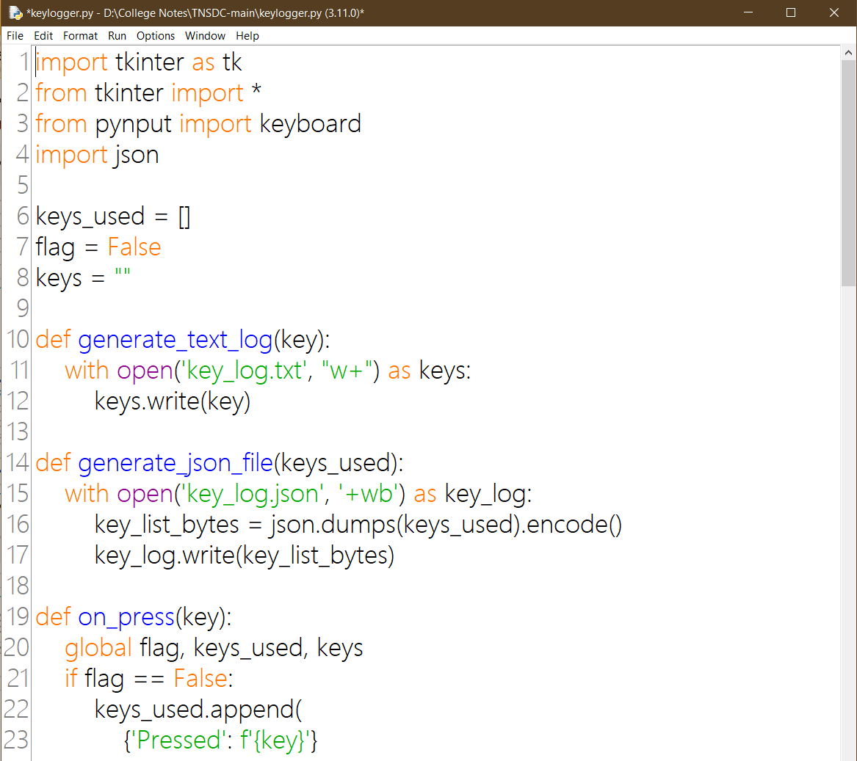
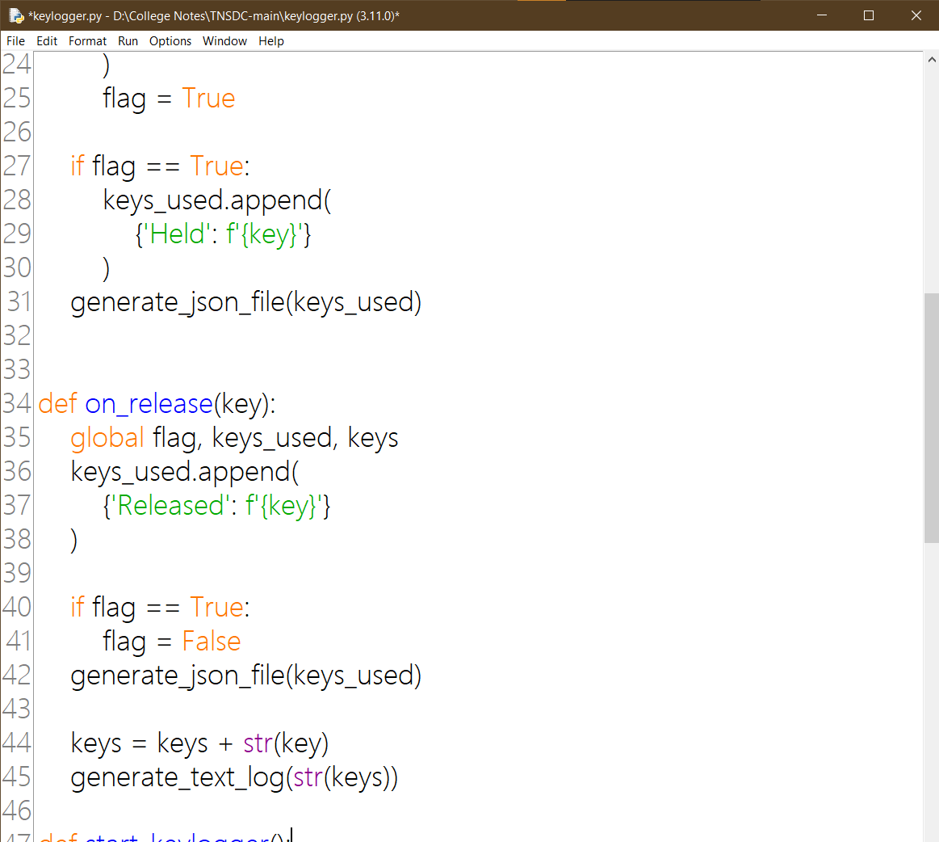
PROGRAM :

Slide 9
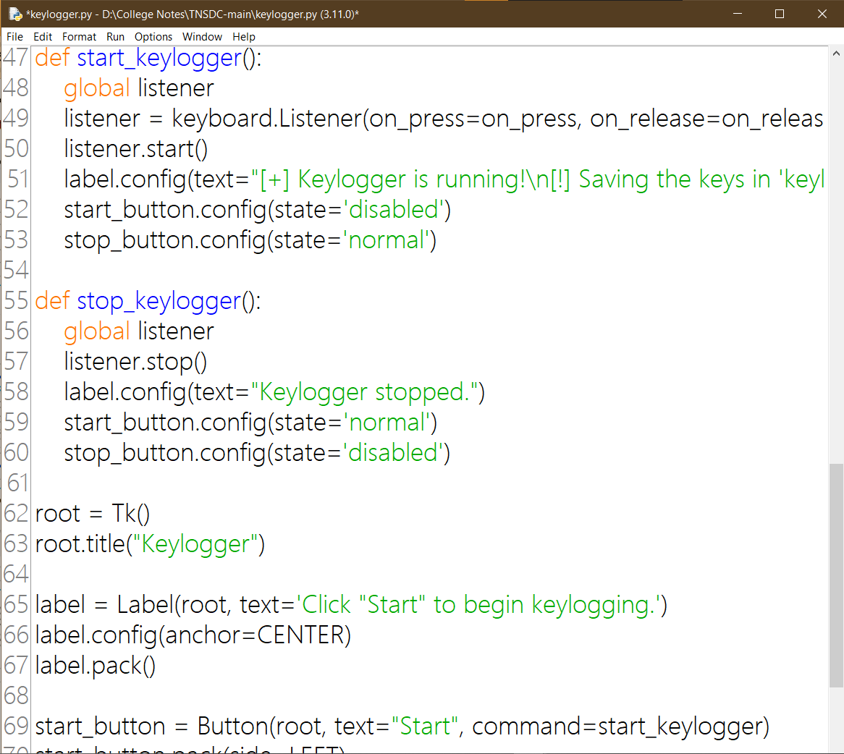
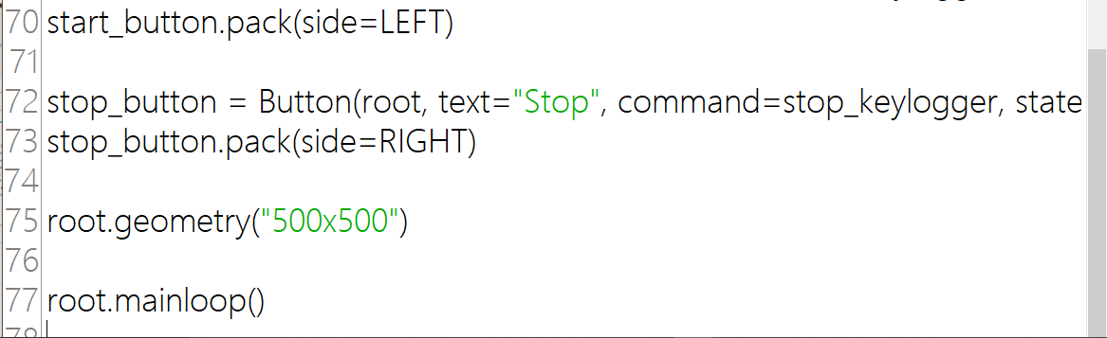
PROGRAM :

Slide 10


RESULT :

Slide 11
RESULT
Implementing a comprehensive framework for mitigating keylogger threats involves careful selection of ensemble learning techniques like Random Forest and Gradient Boosting to detect patterns efficiently. Collecting diverse datasets and ensuring secure data input pipelines are vital for robustness. Rigorous preprocessing and training processes enhance model accuracy, validated through cross-validation techniques. Deploying trained models for real-time monitoring and automating alert mechanisms ensure rapid response to keylogger threats, safeguarding against identity theft, financial loss, and privacy breaches in today's digital age.

Slide 12
CONCLUSION
In conclusion, the potential future scope for a keylogger encompasses a wide array of possibilities, from advanced data analysis and security measures to enhanced user interfaces and educational applications. However, it's paramount to emphasize ethical considerations and legal compliance in the development and use of such tools. As technology evolves, so too do the responsibilities associated with it. Thus, while the capabilities of keyloggers continue to expand, so must our commitment to safeguarding privacy and ensuring ethical use in all contexts.

Slide 13
FUTURE SCOPE
1. Performance Optimization
Efficient Data Handling: Optimize the way data is written to and read from the storage medium to minimize performance impact on the host system.Selective Logging: Develop features to start and stop logging based on specific criteria, such as active applications or time of day, to reduce data volume and increase relevance.
2. Compliance and Ethics Features
User Consent Mechanisms: Implement clear user consent mechanisms to ensure the tool is used ethically and in compliance with legal requirements.Audit Trails: For scenarios where monitoring is legal and ethical (e.g., workplace monitoring with consent), implement audit trails that log access to the data and actions taken by administrators.
3. Cross-Platform Support
Extend the application to work seamlessly across different operating systems, including Windows, macOS, and Linux, with considerations for platform-specific features and limitations.
4. Educational Use
Tutorials and Guides: Provide comprehensive documentation, tutorials, and guides on how to use the keylogger for educational purposes, such as learning about cybersecurity, programming, and system monitoring.

Slide 14
REFERENCES
https://www.youtube.com/watch?v=V5-LSvv2erk
https://pypi.org/project/pynput/
https://docs.python.org/3/library/tkinter.html
Christodorescu, Mihai, et al. "Semantics-aware malware detection." Proceedings of the 2005 ACM SIGPLAN conference on Programming language design and implementation. 2005.
This paper discusses the importance of semantics-aware malware detection techniques, which can be applicable in detecting keyloggers.

Slide 15
THANK YOU

