Slide 1
Integrated Common Services To Common People
By Team MediAI
Jagadam Poojitha (22311A6617)
Shri Nitya Boini (22311A6647)
Pallavi Rajan (22311A6638)
Manvitha Pola (22311A6671)
P. Harshita (22311A66B9)
Department of CSE-AI&ML
Mentor:
Dr. T V Rajini Kanth
Professor and Head of the department, CSE AI&Ml

Slide 2

Problem Statement
In today's fast-paced world, accessing efficient and comprehensive healthcare services remains a formidable challenge for many. Common obstacles such as long wait times, limited access to specialized care, lack of personalized treatment options, and fragmented healthcare systems persistently hinder patient outcomes. These challenges are compounded by the increasing complexity of healthcare needs, necessitating coordinated efforts across multiple providers and services. This is particularly acute for underserved and rural populations, where timely and accurate medical attention is often elusive. Addressing these gaps requires an integrated approach that streamlines healthcare services, ensuring equitable access and timely interventions for all individuals. By bridging these gaps through innovation and technology, healthcare can become more responsive and effective, ultimately improving health outcomes and enhancing the overall quality of care provided to diverse communities.

Slide 3
Abstract
Access to efficient healthcare services is a significant challenge, especially for individuals in underserved and rural areas. Common people face issues like long waiting times, limited access to specialized care, lack of personalized treatment, and fragmented healthcare services, resulting in delayed diagnoses and poorer health outcomes. Our project aims to address these challenges by integrating artificial intelligence (AI) technologies into a unified healthcare platform. This solution includes predictive analytics for early health issue detection, symptom entry and prediction, and an AI-driven chatbot for immediate assistance with symptoms and health queries. Users benefit from seamless registration and login processes, detailed doctor profiles, and efficient appointment management. We created a web/GUI application to facilitate this integration, ensuring users can access these services through an intuitive and user-friendly interface. By leveraging AI, our platform enhances healthcare accessibility and efficiency, providing common people with proactive, personalized, and streamlined medical services. Ultimately, our solution seeks to revolutionize healthcare services, making them more accessible and effective, thus improving overall patient outcomes and quality of life.

Slide 4
Proposed Solution
Our project addresses these challenges by integrating artificial intelligence (AI) technologies into healthcare services to create a unified, accessible, and efficient web/GUI healthcare platform. By leveraging AI, we aim to provide:
Predictive Analytics: Early detection and prediction of health issues for proactive management.
Enhanced Accessibility: Advanced healthcare services for underserved and rural areas, ensuring equitable access.
Symptom Entry and Prediction: Users can enter symptoms, and AI algorithms will analyse and predict potential health issues.
Registration and Login: Easy and secure user registration and login process.
Choosing Doctor: Detailed profiles of doctors, including specializations and availability.

Slide 5
Appointment Management: Efficient booking, viewing, and managing of medical appointments.
AI Chatbot: Interactive chatbot for immediate assistance with symptoms, general health questions, and appointment bookings.
We created a web/GUI application and integrated these features to ensure that users can access these services through an intuitive and user-friendly interface. Our platform seeks to revolutionize healthcare services, making them more accessible, efficient, and personalized for all individuals, ultimately leading to better health outcomes and an improved quality of life.

Slide 6
Features Offered:
User Registration and Login
Registration: Users can create an account by providing essential information such as name, email, password, and other relevant details. The registration process includes email verification to ensure authenticity.
Login: Users can log in to their account using their email and password. The login process includes security measures such as rate limiting to prevent brute force attacks.
User Profile Management
Profile Viewing and Editing: Users can view and update their profile information, including personal details, contact information, and preferences

Slide 7
Appointment Management
Booking Appointments: Users can book appointments with doctors by selecting available time slots. The system checks for conflicts and confirms the booking.
View and Manage Appointments: Users can view their upcoming and past appointments, reschedule, or cancel appointments as needed.
Doctor Profiles and Search
Doctor Directory: Users can browse through a list of available doctors, view their profiles, specializations, and availability.
Search and Filter: Users can search for doctors based on name, specialty, location, and availability to find the most suitable healthcare provider.
Symptom Entry and Analysis
Symptom Entry Form: Users can enter their symptoms through a user-friendly form that includes various symptom categories.
Symptom History: Users can view their past symptom entries and any related recommendations or diagnoses.
Analysis and Prediction: The system analyzes the entered symptoms using machine learning models to provide possible diagnoses and recommendations

Slide 8
AI Chatbot
Interactive Chat: Users can interact with the AI chatbot for immediate assistance with symptoms, general health questions, and appointment bookings
Natural Language Processing: The chatbot understands and responds to user queries using a NLP techniques, providing a conversational experience.
Security and Compliance
Data Encryption: All user data is encrypted in transit and at rest to ensure confidentiality and integrity.
User Authentication: Secure authentication methods, including JWT and OAuth, are implemented to protect user accounts.
Compliance: The application adheres to healthcare regulations such as HIPAA and GDPR to ensure the privacy and security of user data.

Slide 9
Process Flow:
Initialization:
The app is initialized using Flask(_name_).
The home() route is defined to handle requests to the root URL (/).
Homepage Rendering:
When the user visits the root URL (/), the home() function is executed.
It prepares a list of symptoms and renders the index.html template, passing the symptoms data to it.
The index.html template displays the list of symptoms and likely provides a form or interface for user input.
User Input:
The user interacts with the web page, likely entering a message in the provided form.
This input is submitted to the /chat route via a POST request.
Chat Route Handling:
The /chat route, defined by the chat() function, receives the POST request.
.

Slide 10
It extracts the user's message from the request body using request.json.get('message').
The generate_response() function is called to process the user's message.
Response Generation:
The generate_response() function implements a simple logic:
If the user's message contains "hello" (case-insensitive), it returns a greeting.
If the user's message contains "bye" (case-insensitive), it returns a farewell message.
Otherwise, it returns a generic "I don't understand" message.
Response Transmission:
The chat() function returns the generated response to the user as JSON data using jsonify({'response': response_message}).
This response is likely handled by JavaScript in the index.html template, displaying it on the webpage.
Looping:
The process repeats as the user continues to interact with the chat interface, sending new messages and receiving responses.

Slide 11
Key Components:
Flask: The web framework for creating and running the web application.
Routes: URLs that map to specific functions to handle requests.
Templates: HTML files used to structure the webpage, potentially using Jinja2 templating for dynamic content.
JSON: Data format used for communication between the client (web browser) and the server.
User Input: User interaction with the web page, likely through a form or chat interface.
Response Logic: The generate_response() function determines the appropriate response based on user input.
Further Improvements:
Implement more sophisticated response logic using natural language processing (NLP) techniques.
Use a database to store and retrieve user data and chat history.
Design a more user-friendly chat interface with features like message history and user authentication.
Integrate external APIs for accessing information or services related to the chatbot's purpose

Slide 12
Three-Tier-Architecture
Frontend
HTML and CSS
Registration /
Login service
(Django Views)
User
Service
Appointment
Services
Doctor
Service
Symptom
Diagnosis
Chatbot
Integration
Database
(MySQL and PHP}
Symptom
Analysis
Machine Learning
Models and NLP

Slide 13
Technologies used:
Frontend: HTML and CSS
HTML: The structure of the web application will be developed using HTML, ensuring a clear, semantic, and accessible layout for all users.
CSS: Styling and design will be managed with CSS to create an intuitive, visually appealing, and responsive interface. This will ensure that the application is user-friendly and accessible on various devices, including desktops, tablets, and smartphones.
Middleware: Python
Python: The backend of the application will be powered by Python, leveraging its extensive libraries and frameworks for AI and machine learning. Python will handle data processing, AI model integration, and backend logic to ensure smooth operation and efficient performance.
Flask/Django: One of these frameworks will be used to develop the backend infrastructure, facilitating RESTful API creation, server management, and integration with the frontend and database.
Backend(Data Storage): MySQL and PHP
MySQL: The primary data storage will be managed using MySQL, a reliable and efficient relational database management system. It will store patient records, AI-generated data, and other relevant information securely.
PHP: PHP will be used for server-side scripting to manage database interactions, ensure data integrity, and provide secure access to stored data.

Slide 14
Team Members and Contribution
Poojitha and Nithya
Backend and Middleware:
Django Development: Developed backend services using Django, including user authentication, appointment management, symptom entry, and AI chatbot integration.
Integration: Integrated the frontend and backend, ensuring smooth data flow and functionality.
Pallavi, Manvitha and Harshitha
Frontend and Middleware:
Developed pages for registration, login, appointments, doctor profiles, symptom entry, and the AI chatbot.
Chatbot Development: Implement the AI chatbot using libraries like ChatterBot or Rasa, ensuring it can handle symptom queries and general health questions.

Slide 15
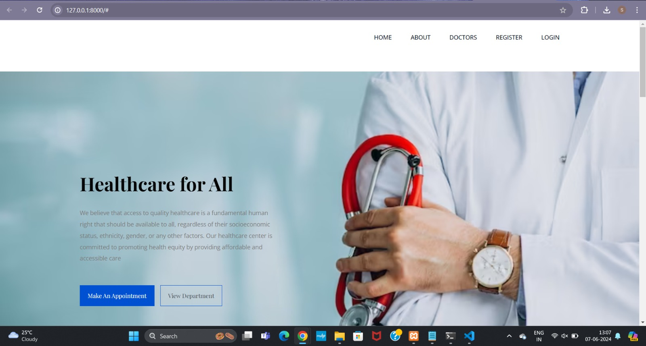
Results:

Slide 16
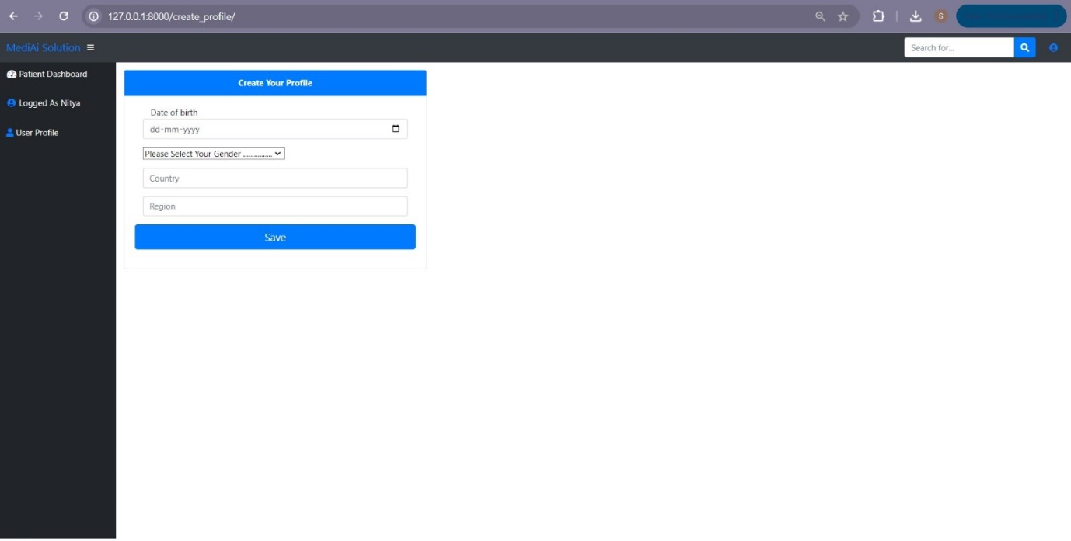
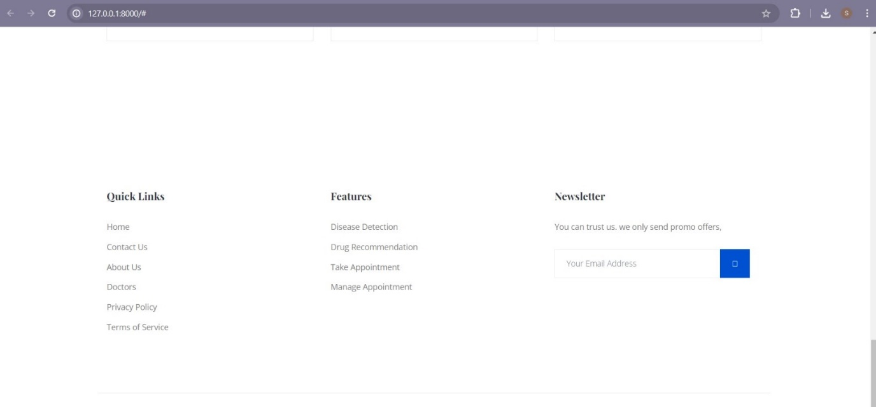

Slide 17
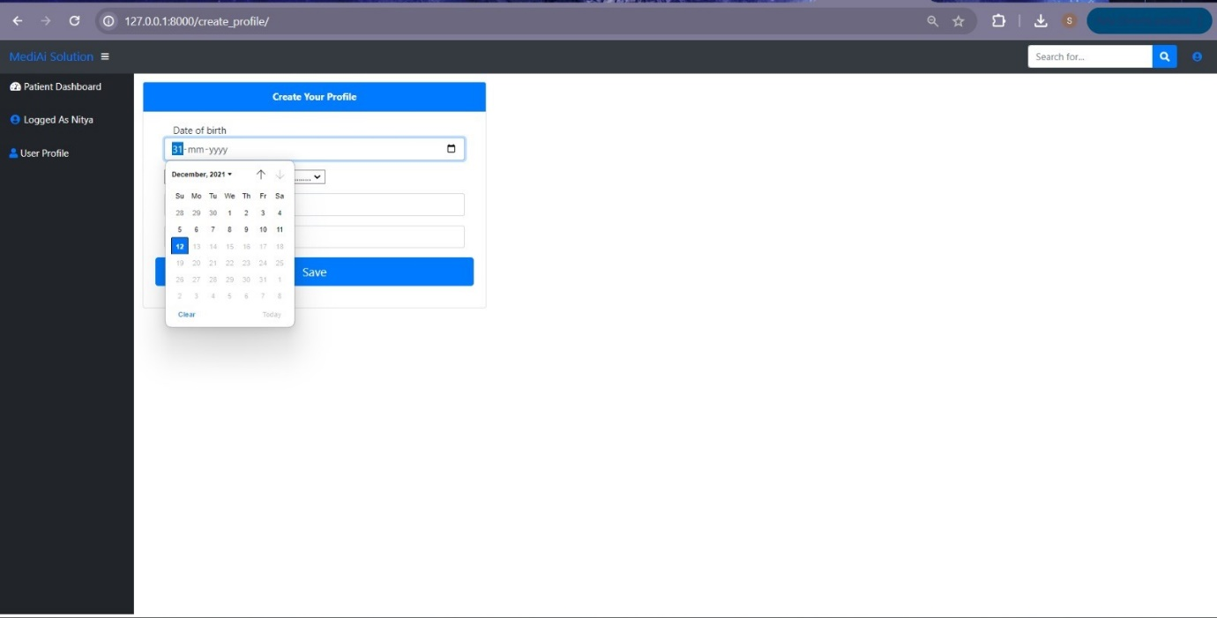
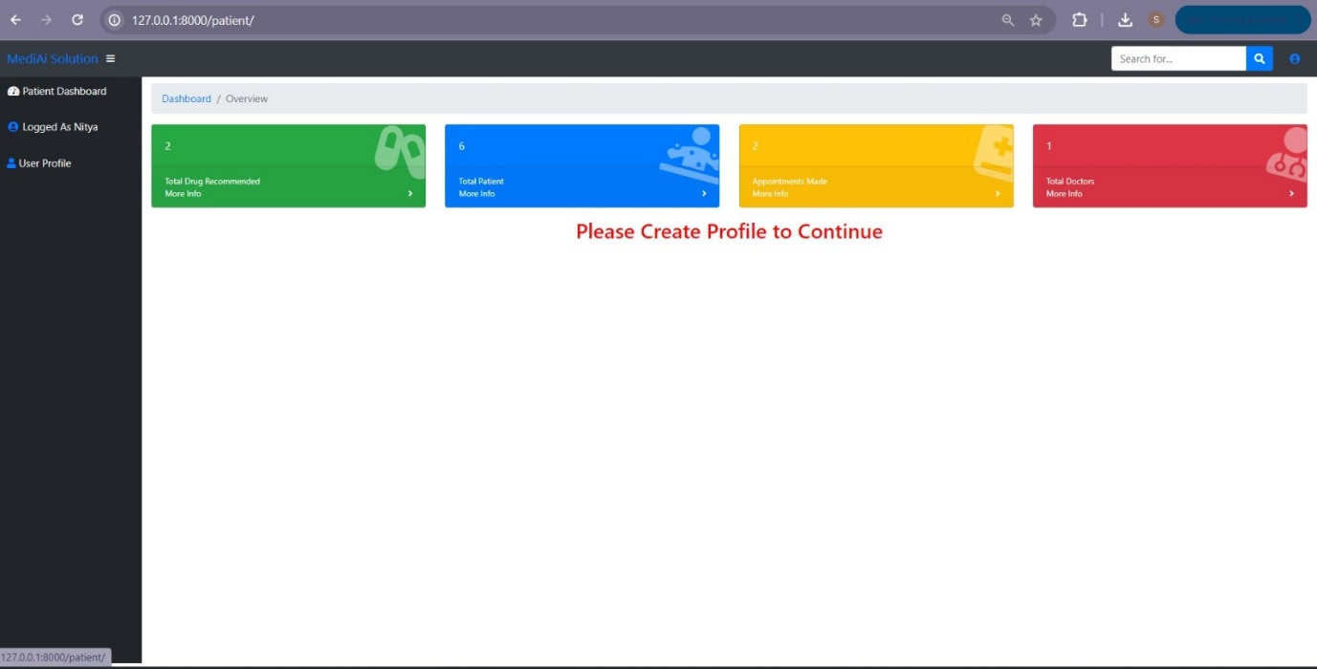

Slide 18
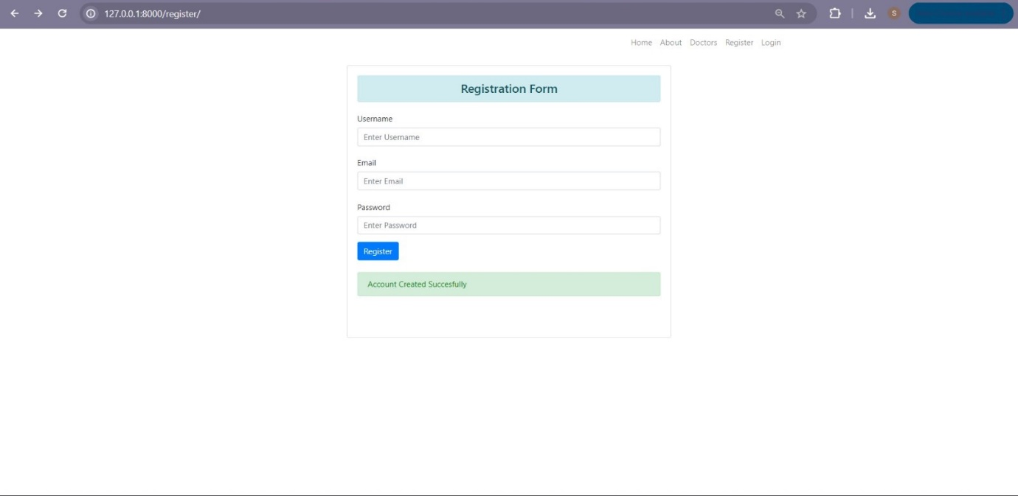
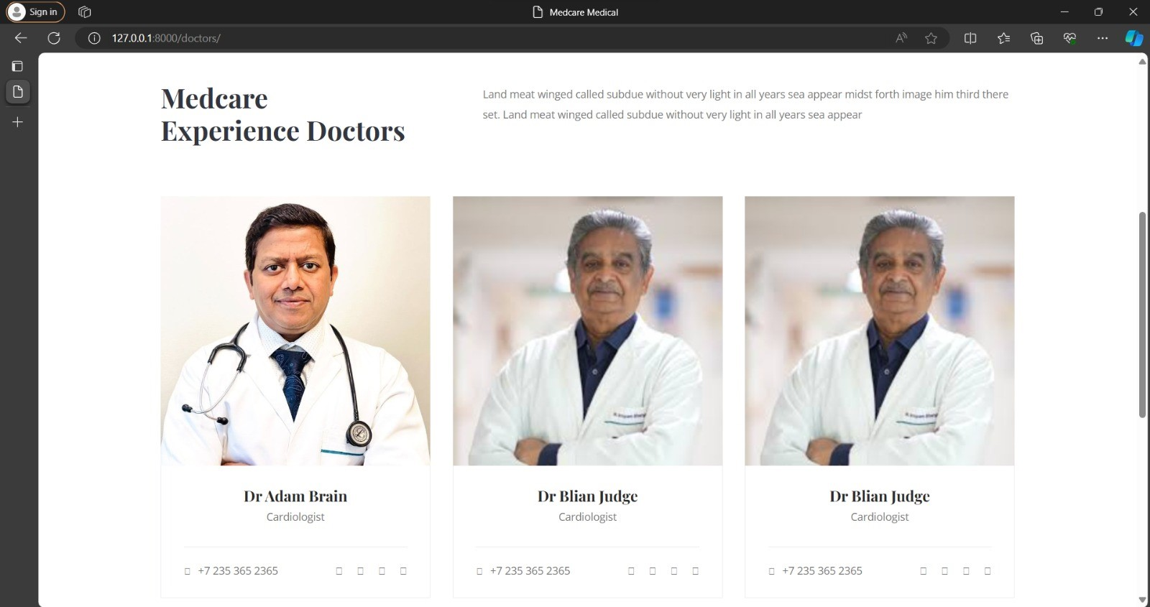

Slide 19
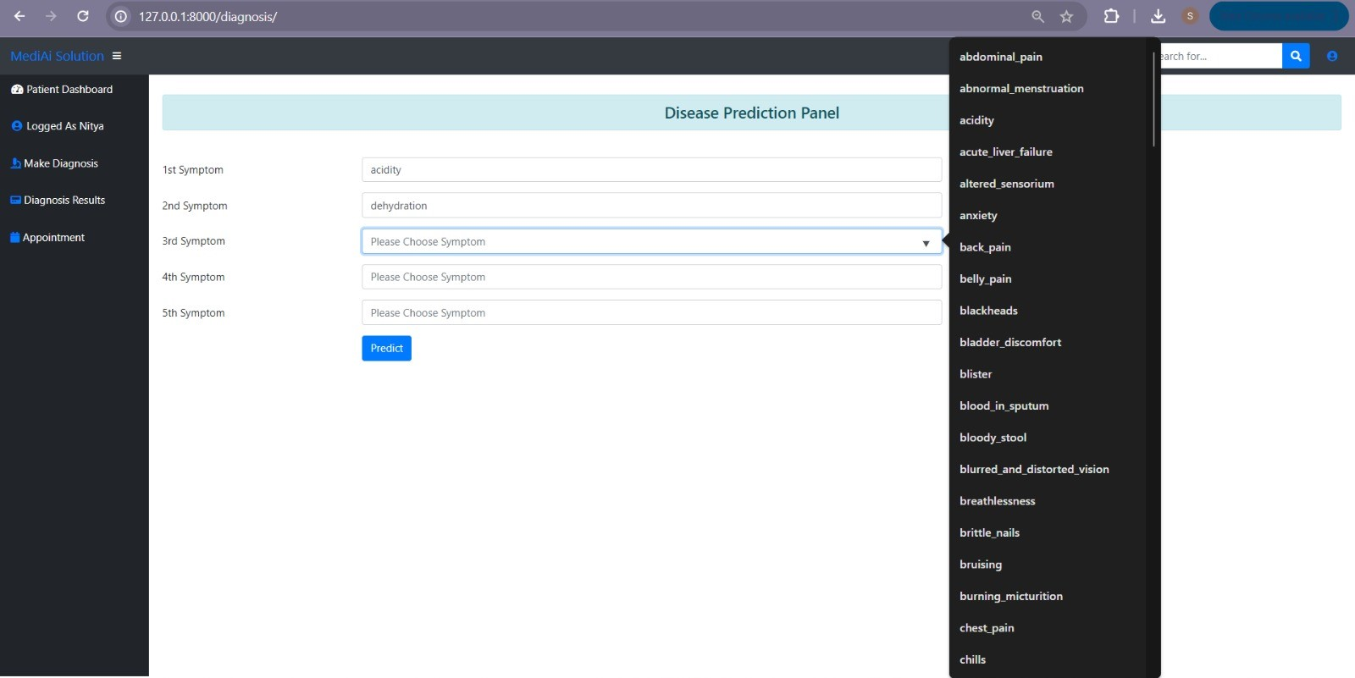
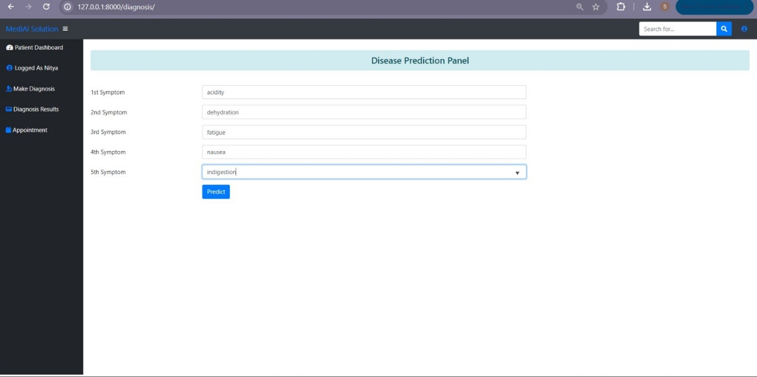

Slide 20
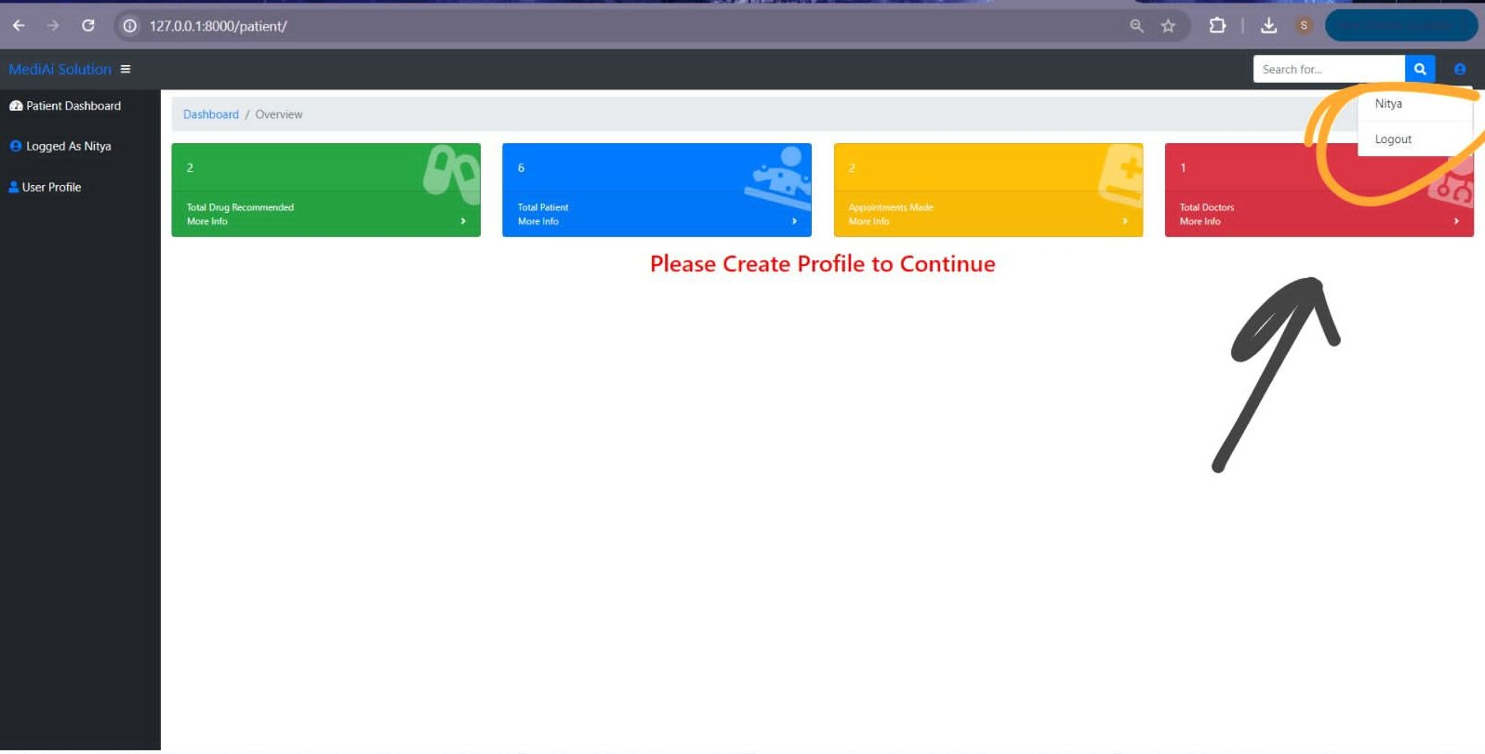

AI Chatbot

Slide 21
URL for our Website:
https://github.com/positiveonly/healthcare
Conclusion
In summary, the MediAI project presents a transformative solution to the critical challenges of healthcare accessibility and efficiency. By integrating essential services such as, registration, appointment scheduling, symptom entry and AI chatbot into a cohesive, user-friendly platform, MediAI enhances the overall healthcare experience. This innovative approach ensures timely access to healthcare services, leading to improved health outcomes and heightened patient satisfaction. The platform stands out by offering comprehensive features that cater to diverse patient needs with unparalleled ease of use, setting it apart from other healthcare applications.
This project marks a significant stride towards addressing the gaps in healthcare accessibility and efficiency. MediAI’s dedication to improving patient care and promoting proactive health management positions it as a pivotal tool in modern healthcare, empowering users to take control of their health and wellness in an increasingly digital world

Slide 22
Future Enhancements
This project aims for broad applicability and impact, with future plans to improve AI capabilities within the web application through more accurate health prediction as well as diversification beyond pneumonia detection, implementing a telemedicine solution to allow consultation over longer distances while increasing data analytics available in order detect additional patient trends. The platform could also offer seamless health monitoring through wearable device integration and include multilingual support to accommodate more users. The AI algorithms will improve further and more learning curves shall be added, to provide personalized healthcare depending on the patient requests which change with every new discovery in medical sciences.
.

Slide 23
References
1. Balla Sahithya, Guru Prasad M S, Balla Sahithi, Madhu Krishna K, Ajay Charan Devarlla, Yashavanth T R, "Empowering Healthcare with AI: Advancements in Medical Image Analysis, Electronic Health Records Analysis, and AI-Driven Chatbots", 2024 3rd International Conference for Innovation in Technology (INOCON), pp.1-7, 2024.
2. I. Bouazzi, M. Zaidi, M. Usman, M. Z. M. Shamim, V. K. Gunjan and N. Singh, "Future trends for healthcare monitoring system in smart cities using LoRaWAn-based WBAN", Mobile Information Systems, 2022.
3. C. K. Gomathy and M. A. R. Naidu, "The prediction of disease using machine learning", International Journal of Scientific Research in Engineering and Management (IJSREM), vol. 5, no. 10, 2021.
4. Niyar R Barman, Krish Sharma, Ranjay Hazra, "A transformer-based approach to automate disease prediction from patient descriptions", 2023 IEEE 7th Conference on Information and Communication Technology (CICT), pp.1-5, 2023.

Slide 24
Acknowledgement
we would like to express our sincere gratitude to our supporting Professor Dr. T V Rajini Kanth Sir , our Mentor P. Narayana Babu Sir and mentors from intel , for their valuable guidance and support throughout the duration of this project on “Integrated Common Services to Common People”. Their expertise and insights have been instrumental in shaping the direction and outcomes of this research endeavor.
We would also like to thank our Head of the department of CSE AI&ML, Dr. T V Rajini Kanth Sir for providing us
Opportunity and Required resources for the project and providing us with mentors for guidance.

Slide 25
Thank You, from Team_MediAI

