Slide 1
Fake News Detection using Machine Learning
Technical Seminar
by
Manvith S Rao
251100610009
Computer Science and Engineering
Under the guidance of
Panel Member 1: | Panel Member 2:
Dr. Sathyendranath Malli | Dr. Deepak Rao
Associate Professor | Associate Professor
Manipal School of Information Sciences | Manipal School of Information Sciences
MAHE, Manipal | MAHE, Manipal

Slide 2
Presentation Outline
Introduction
2. Objectives
3. Literature Review
4. Proposed Methodology
5. Results and Analysis
6. Conclusion and References
7. Q&A

Slide 3

1. Introduction
"Every second, millions of posts are shared online. But how many of them tell the truth?"
"Fake news" refers to false or misleading information presented as real news.
Why Machine Learning?
Scalable: Can analyze millions of articles quickly.
Smart: Learns patterns of fake news from past data.
Adaptive: Improves over time as new data is added.
Core Idea:
Feed the algorithm examples of both real and fake news.
Extract patterns from text, source credibility, and writing style.
Predict whether new, unseen news is likely to be fake or real.

Slide 4
2. Objectives
To examine the importance of machine learning algorithms in fake news detection.
To analyze and study the performance of four different algorithms: Logistic Regression, Decision Tree, Random Forest and Gradient Boost Classification.
To outline the best algorithm with highest accuracy in fake news detection.

Slide 5
3. Literature Review
Authors and Title | Dataset | Purpose of Study | Key Findings
M. Nirmala et al. [1] — Machine Learning Techniques to Detect A Fake News In An Article.
S. Saxena et al. [2] — Detection of Fake Profiles and News on Social Media Using Machine Learning Algorithms.
J. Y. et al. [3] — A benchmark study of ML models for online fake news detection”
ISOT Fake News Dataset
Social media profile & news dataset
Multiple public datasets (incl. LIAR/ISOT variants)
Survey ML methods for fake news detection; evaluate traditional models: Naive Bayes, Logistic Regression, Decision Tree, Random Forest, SVM
Propose a unified ML approach for detecting fake news and fake social media profiles Random Forest, SVM, Neural Network, Naive Bayes, KNN, Poisson, LSTM.
NB, SVM, LR, RF, GBM; CNN/LSTM/BERT variants.
NB: 95.27%, LR: 98.84%, DT: 99.58%, RF: 99.30%, SVM: 99.40%; Decision Tree performed best.
NB: 87%, KNN: 88.3%, Poisson: 91.2%, NN: 94.3%
NB: ~93%; Bi-LSTM/C-LSTM: ~95%; RoBERTa: ~96%; RoBERTa >90% even with 500 samples, while NB drops to ~65%

Slide 6
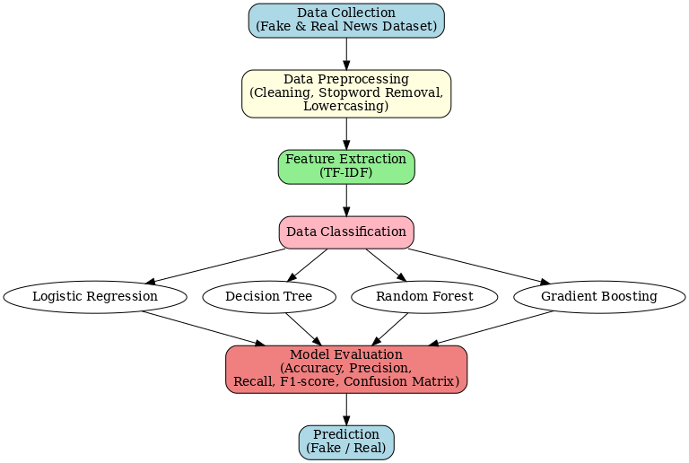
4. Methodology
Figure 1. Flowchart of methodology

Slide 7
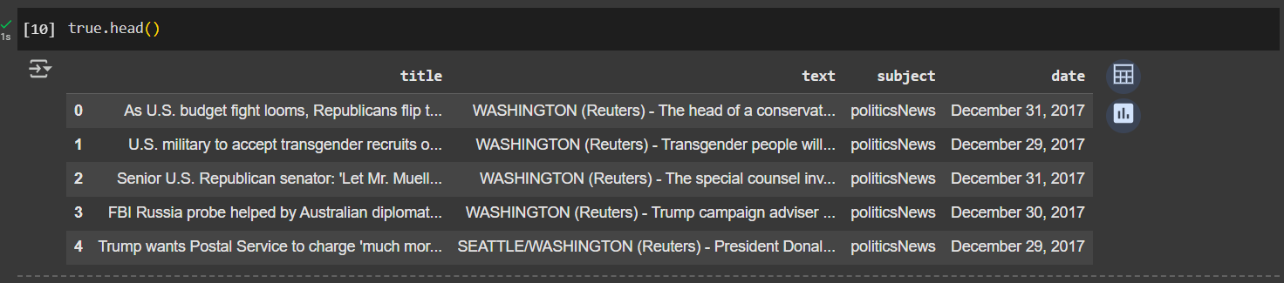
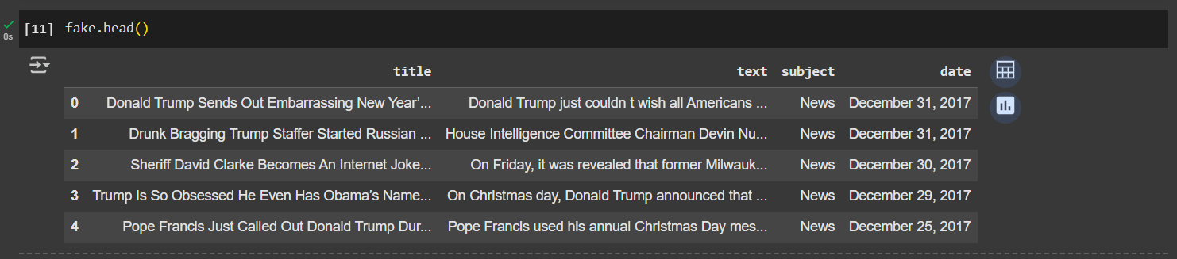
4.1 Description
1.Dataset Description
The dataset has been taken from the Kaggle website which consist of different sets of reliable and unreliable news.

Slide 8
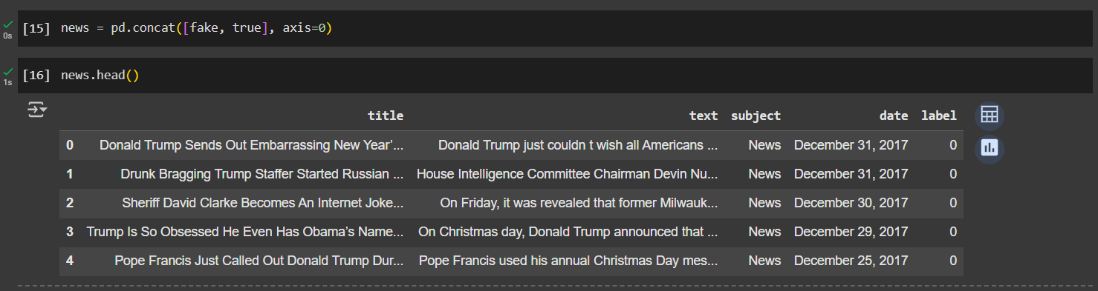
4.2 Description
2.Data Preprocessing :
Steps Involved:
Add class labels to each data set:
1 = True
0 = Fake
Label column is required for the model to distinguish between fake and real news.
Concatenate the unreliable dataset and reliable dataset into a single dataset.

Slide 9
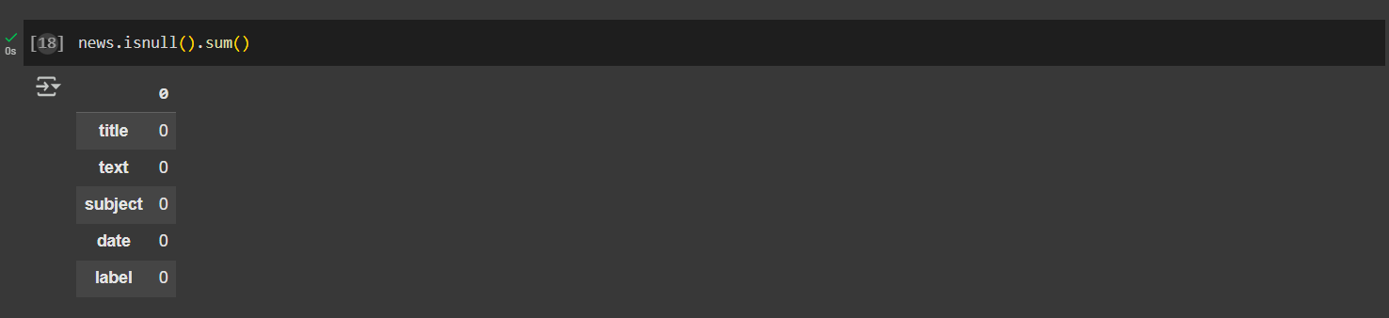
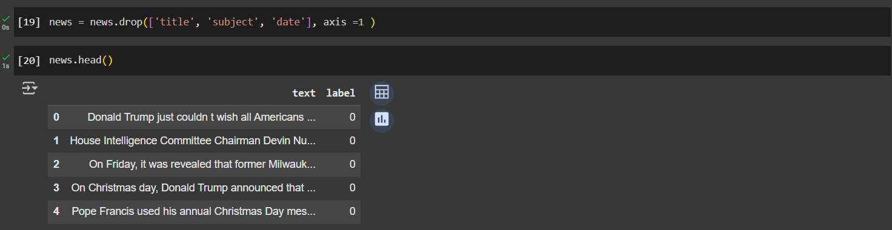
Check for any null values in the dataset
Columns such as: Title, Subject, Date are dropped keeping only the main text and label.

Slide 10
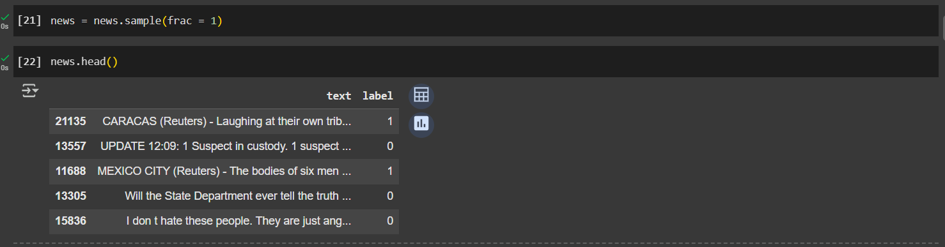
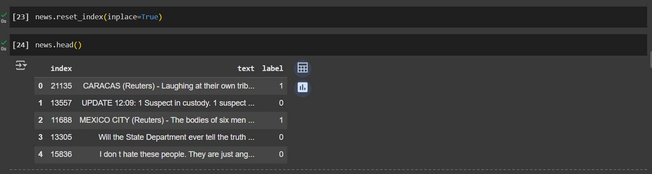
Randomly rearranges the rows of the DataFrame.
reset_index() → Resets the row index of the DataFrame.
inplace=True → Updates the DataFrame directly instead of creating a new one.

Slide 11
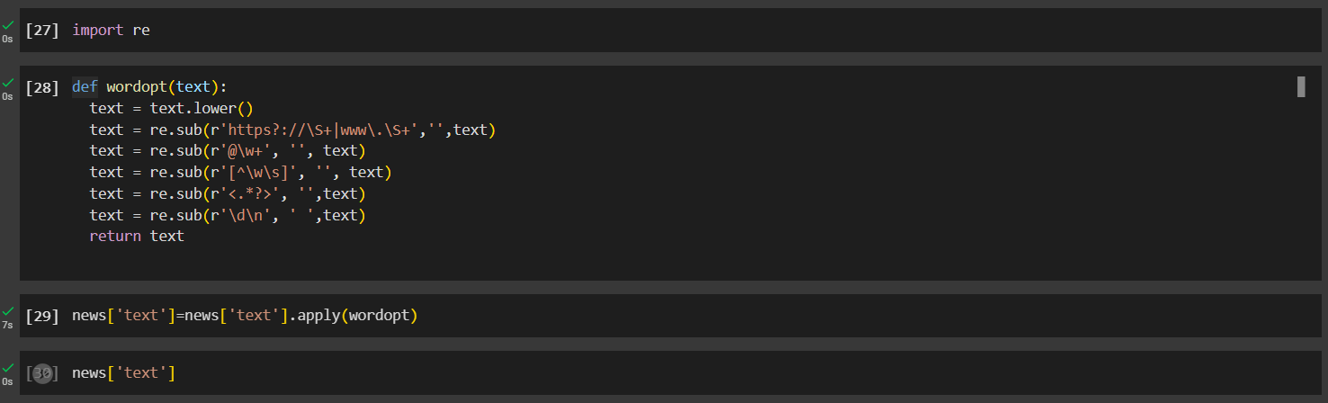
Text Preprocessing (Cleaning Step)
Lowercasing → Ensures uniformity by converting all words to lowercase.
Remove URLs → Eliminates unnecessary web links from news articles.
Remove Mentions → Deletes usernames/handles (e.g., @user).
Remove Punctuation/Special Characters → Reduces noise in the dataset.
Remove HTML Tags → Cleans raw text obtained from web sources.
Remove Digits → Removes irrelevant numbers that do not affect context.
Final Cleaned Text → Produces simplified and standardized text for feature extraction (TF-IDF).

Slide 12
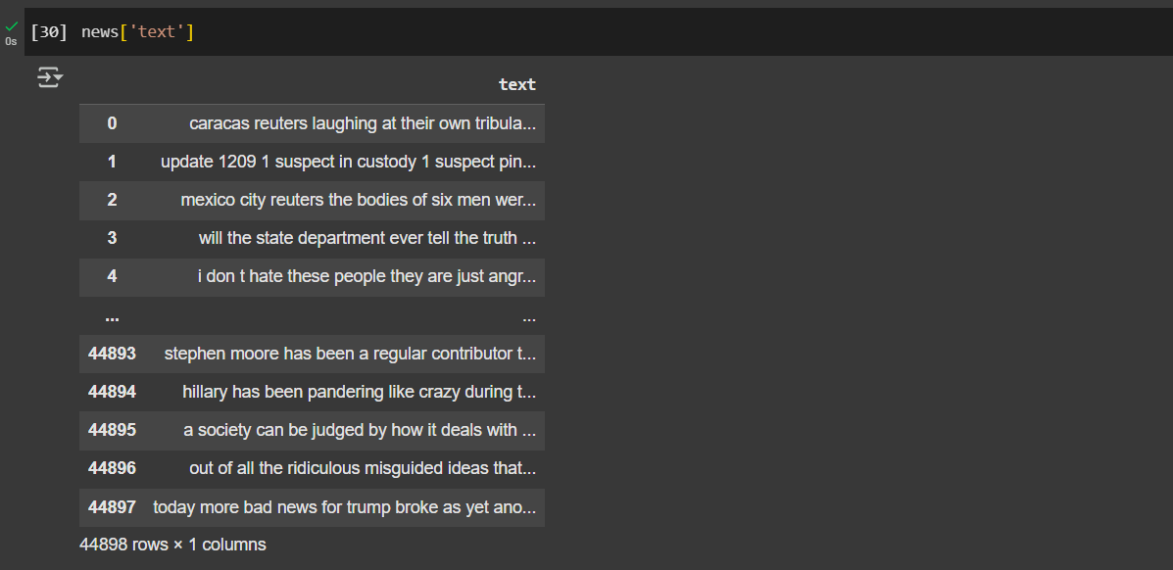
Before:
"Breaking News!!! Visit https://abc.com for details @John123 <div> 2025 elections"
After:
"breaking news visit for details elections"

Slide 13
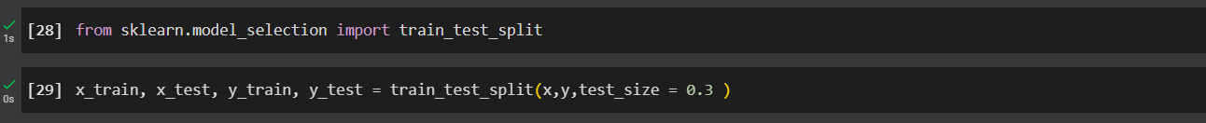
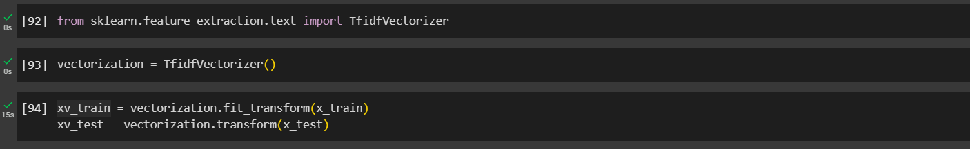
Next step is splitting the dataset into training and testing sets: 30% of the data will be used for testing and 70% for training.
TF-IDF is a technique that converts text into numerical values so machine learning models can work with it.
Term Frequency (TF): How often a word appears in a document.
Inverse Document Frequency (IDF): How rare or unique the word is across all documents.

Slide 14
4.3 Description
3. Algorithms Used:
Logistic Regression – A simple algorithm that predicts whether news is fake or real using probabilities(logistic function).
Decision Tree – A tree-structured model that splits news data on important keywords/features, making classification easy to interpret.
Random Forest – Random Forest is collection of many decision tree from random subsets of data and each decision tree provides an outcome. The random forest chooses the decision of the majority of the trees as the final decision.
Gradient Boosting – A sequential model where each tree corrects the mistakes of the previous one, providing high accuracy for complex fake news patterns.

Slide 15
Results and Analysis
The classifiers are judged based on various performance metrics like accuracy score, confusion matrix, classification report.
The .score() function for each model — calculates the accuracy on the test data. This tells us the percentage of news articles that the model correctly classified as fake or real. Comparing these scores helps us understand which model performs best for fake news detection.”

Slide 16
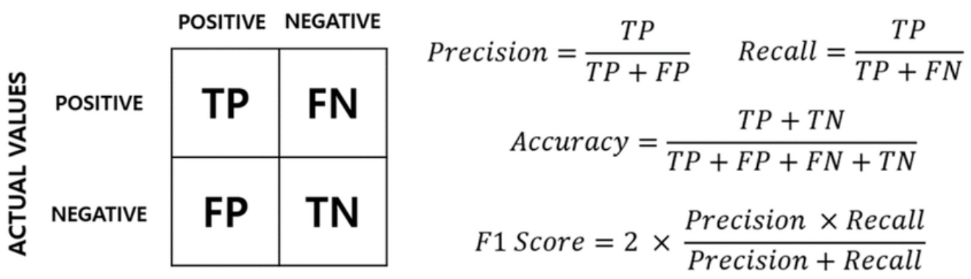
5.Results and Analysis
Confusion matrix is a table that shows where the model was correct and where it made mistakes.
1. True Positive (TP):It means Prediction is yes, and the actual answer is also yes.
2. True Negative(TN): It means Prediction is no, but the actual answer is yes.
3. False Positive (FP):It means Prediction is yes, but the actual answer is no.
4. False Positive (FP): It means Prediction is no, and the actual answer is also no.
Accuracy tells us overall correctness. Precision checks how reliable the model is when it says an article is Fake. Recall checks how well the model captures all Fake articles. F1-score balances both Precision and Recall, giving us a single measure of overall performance.

Slide 17
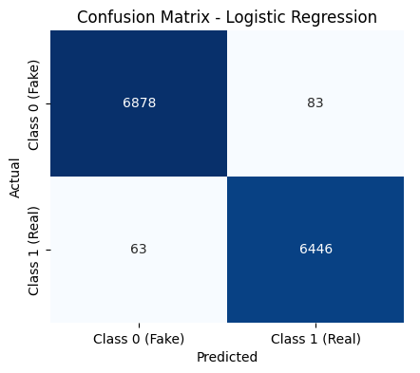
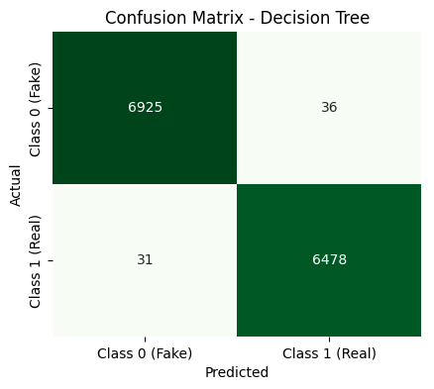
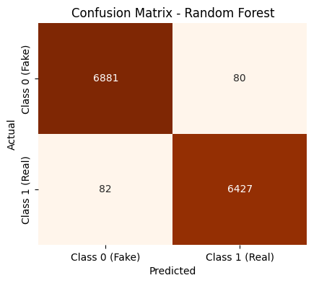
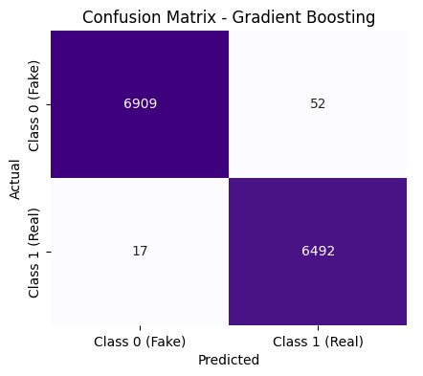
The ML classifiers performed well as the Logistic Regression achieved an accuracy which is equal to 98.91%, Decision Tree achieved 99.50%, Random Forest achieved 98.79%, and Gradient Boosting Classifier achieved 99.48%.
We can conclude that Decision Tree algorithm performed the best by achieving 99.50% accuracy.
“Usually Random Forest or Gradient Boosting give better accuracy because they use multiple trees. But in our project, the Decision Tree actually performed better. This might be because of our dataset size and the way features were represented. So, the simplest model turned out to be the most effective here.”

Slide 18
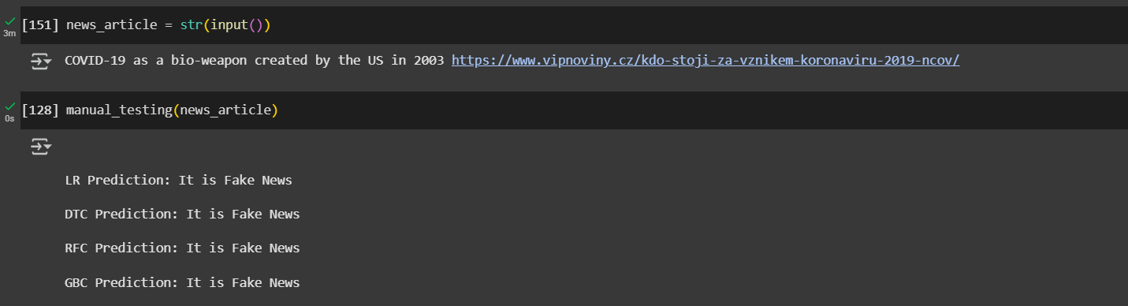
Predict whether new, unseen news is likely to be fake or real.
What it does
Takes a new unseen news article from user input.
Cleans and preprocesses it (remove stopwords, punctuation, etc.).
Converts text into numerical vectors using the trained vectorizer (TF-IDF/Count Vectorizer).
Passes it to all four trained models (Logistic Regression, Decision Tree, Random Forest, Gradient Boosting).
Prints whether each model predicts the news as Fake or Real.

Slide 19
6.Conclusion
Fake news detection is crucial in today’s digital world to maintain credibility of information.
We experimented with multiple machine learning models: Logistic Regression, Decision Tree, Random Forest, and Gradient Boosting.
Decision Tree achieved the best accuracy in our case, showing that even a simple model can sometimes outperform more complex ones.
Performance was evaluated using Accuracy, Confusion Matrix, and Classification Report. Results show that machine learning can successfully classify news articles as Fake or Real with good accuracy.
Future improvements can include using deep learning models, larger datasets, and advanced NLP techniques for even higher reliability.

Slide 20
7. References
[1] J. C. Reis, A. Correia, F. Murai, A. Veloso, and F. Benevenuto,“Supervised learning for fake news detection,” IEEE Intelligent Systems, vol. 34, no. 2, pp. 76–81, 2019.
[2] S. Gilda, “Notice of violation of IEEE publication principles: Evaluating machine learning algorithms for fake news detection,” in 2017 IEEE15th student conference on research and development (SCOReD).IEEE, 2017 , pp. 110–115.
[3] H. Ahmed, I. Traore, and S. Saad, “Detection of online fake news using n-gram analysis and machine learning techniques,” in International conference on intelligent, secure, and dependable systems in distributed and cloud environments. Springer, 2017, pp.127–138.
[4] M. Granik and V. Mesyura, “Fake news detection using naive bayes classifier,” in 2017 IEEE first Ukraine conference on electrical and computer engineering (UKRCON). IEEE, 2017, pp. 900–903.
[5] K. Shu, S. Wang, and H. Liu, “Understanding user profiles on social media for fake news detection,” in 2018 IEEE conference on multimedia information processing and retrieval (MIPR). IEEE, 2018,pp. 430–435.
[6] R. K. Kaliyar, A. Goswami, and P. Narang, “Fakebert: Fake news detection in social media with a bert-based deep learning approach”, Multimedia tools and applications, vol. 80, no. 8, pp. 11 765–11 788,2021.

Slide 21
Queries
&
Suggestions

Slide 22
THANK YOU!!!

