Slide 1
ManyPrimates 3 Inference by Exclusion

Slide 2
The Experiment

Slide 3
Present containers
Occlude
Bait
Remove occluder
Reveal empty
Reveal baited
Reveal none
Empty condition
Baited condition
No Info condition

Slide 4
The Data

Slide 5
Additional predictors
specific to individual,
site or species
Conditions are blocked
in sessions
site | subject_site | … | session | trial | condition | … | correct
leipzig | manuel_leip |  | 1 | 1 | baited |  | 1
leipzig | manuel_leip |  | 1 | 2 | baited |  | 1
leipzig | manuel_leip |  | 1 | 3 | baited |  | 1
leipzig | manuel_leip |  | … | … | … |  | …
leipzig | manuel_leip |  | 2 | 1 | no_information |  | 0
leipzig | manuel_leip |  | 2 | 2 | no_information |  | 1
leipzig | manuel_leip |  | 2 | 3 | no_information |  | 0
leipzig | manuel_leip |  | … | … | … |  | …
leipzig | manuel_leip |  | 3 | 1 | empty |  | 0
leipzig | manuel_leip |  | 3 | 2 | empty |  | 0
leipzig | manuel_leip |  | 3 | 3 | empty |  | 1
8 Trials per session
Binary outcome

Slide 6
The Analysis

Slide 7
Analytic strategy
Bayesian model comparison using LOO
Baseline (null) model vs. one or more full models
Focus on elpd difference and associated SE
Model is substantially better if elpd_diff > 2*SE

Slide 8
3 Steps
Condition effects
Phylogenetic signal
External predictors

Slide 9
Condition effects
Use all the data
Do conditions differ in the predicted way?
baited > empty > no-info
Empty condition
Baited condition
No-info condition

Slide 10
Condition effects
Null model:
correct ~ 1 + (condition | subject + site + species)
Full model:
correct ~ condition + (condition | subject + site + species)

Slide 11
Condition effects
No additional covariates in the model because subjects cannot respond systematically in no-info condition
Effect of condition → model comparison
Predicted order → Condition estimates with empty condition as reference

Slide 12
Condition effects - covariates
Do standard covariates predict performance
Exclude no-info condition from the data because subjects cannot respond systematically

Slide 13
Condition effects - covariates
Null model:
correct ~ condition + (condition | subject + site + species)
Full model:
correct ~ condition + trial + session + age + task_experience + test_situation + (condition | subject + site + species)

Slide 14
Phylogenetic signal
Only data from empty condition is used
If inference by exclusion is an evolved capacity we should see a substantial phylogenetic signal

Slide 15
Phylogenetic signal
Null model:
correct ~ 1 + (1| subject + site + species)
Full model:
correct ~ 1 + (1| subject + site + gr(species, cov=vcv.phylo(tree))
vcv.phylo(tree) = expected correlations between species based on primate phylogeny

Slide 16
Phylogenetic signal
If phylogeny matters, full model should win
In addition, Blomberg’s 𝛫 and Pagel’s 𝜆 should be non-zero

Slide 17
External predictors
Testing evolutionary/ontogenetic hypothesis
Influence of predictors over and above phylogeny
Run separate models for empty and baited condition
If predictor matters for both conditions = relates to performance in experimental tasks more broadly
If predictor matters only for empty condition = specific to inference by exclusion

Slide 18
External predictors
Each predictor gets its own model
Compare all model to a baseline model
All models include phylogeny
Compare result of model comparison qualitatively for the two conditions

Slide 19
External predictors
Each predictor gets its own model
Compare all model to a baseline model
All models include phylogeny

Slide 20
External predictors
Null model:
correct ~ 1 + (1| subject + site + gr(species, cov=vcv.phylo(tree))
Full model:
correct ~ predictor + (1| subject + site + gr(species, cov=vcv.phylo(tree))

Slide 21
External predictors
Some predictors have different values for species (wild) and individual (captive)
E.g. Group size – there is an average group size in the wild and a size of the group the individual lives in
Both may influence performance

Slide 22
External predictors
We assume the wild type influences the captive type
Actual
Wild
Perfor- mance

Slide 23
External predictors
Null model:
correct ~ 1 + (1| subject + site + gr(species, cov=vcv.phylo(tree))
Full model:
correct ~ actual_predictor + wild_predictor + (1| subject + site + gr(species, cov=vcv.phylo(tree))+ (actual_predictor | subject + site + gr(species, cov=vcv.phylo(tree))

Slide 24
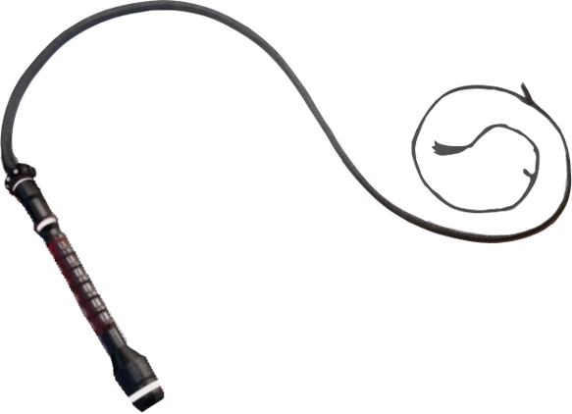

The End

