Slide 1


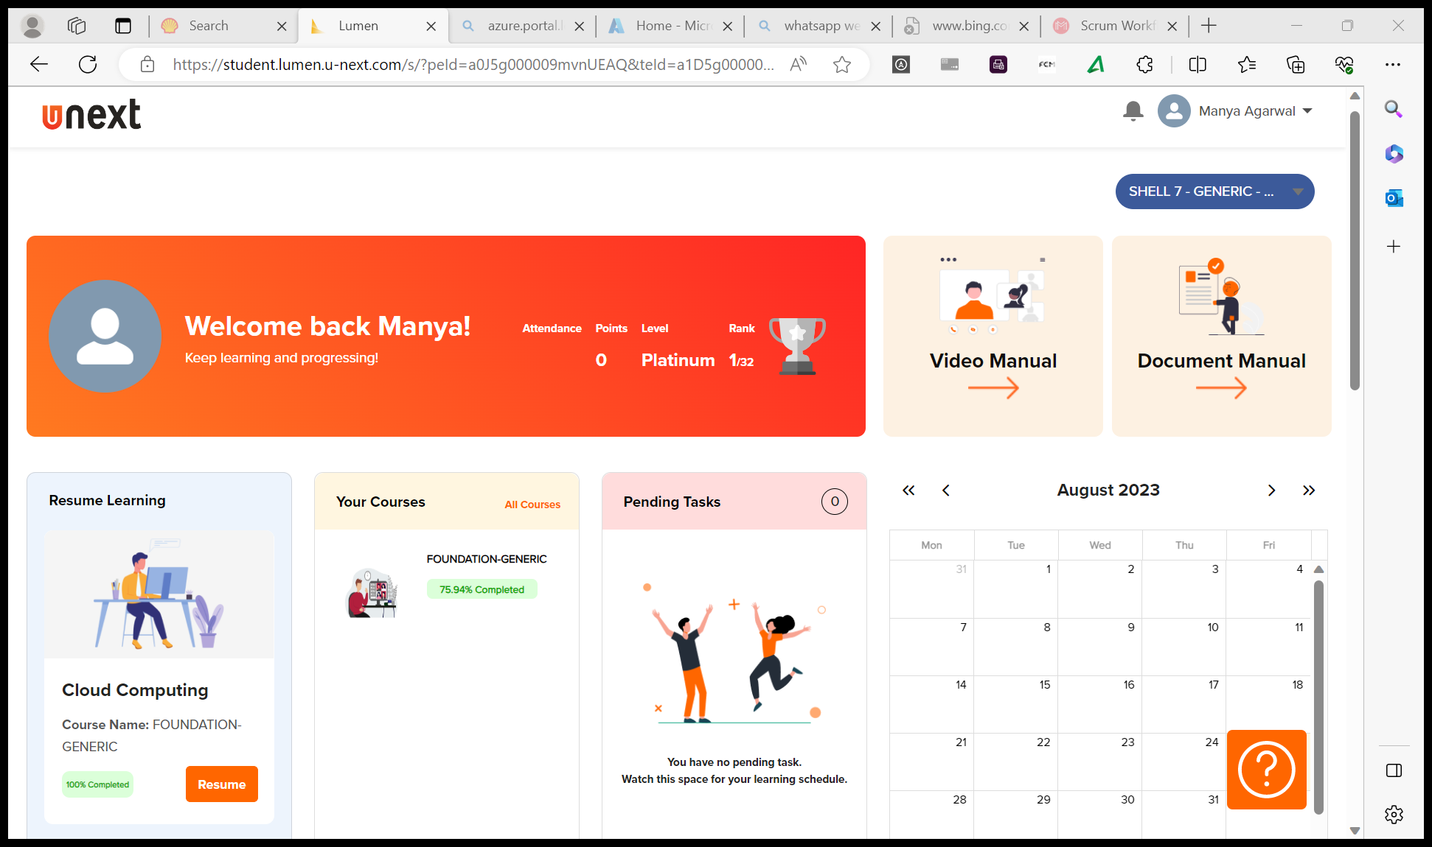
Journey Presentation
Submitted By:
Manya Agarwal
Employee No. : 654801

Slide 2
Journey Presentation Week-1

Slide 3
Day 1 : 18-Aug-23 (Friday) – BA Requirements and Agile
Introduction to Business Analysis : Business Analysis is the practice of enabling change in the organizational context, by defining needs and recommending solutions that deliver value to stakeholders.
Requirement Modeling : Scenario Based, Class Based, Data Based
Waterfall Model : Easy to understand and use, provides structure to inexperienced staff, good for management control, sets requirement stability.
Agile Methods : Adaptive software development, feature driven development, crystal clear, DSDM, RAD, Scrum, XP, RUP, Kanban
Scrum : Scrum is an agile project management framework that helps teams structure and manage their work through a set of values, principles, and practices.
Scrum roles : Product owner, scrum master, scrum team members, stakeholders.
Scrum Flow/Events : Sprint, Sprint Planning, Daily Scrum, Sprint Review, Sprint Retrospective.
Benefits of Scrum : Adaptability, Continuous Improvement, Sustainable Pace, Motivation, Faster Problem Resolution, Customer Centric, High Velocity, Efficient Development Process.

Slide 4
Day 2 : 21-Aug-23 (Monday) – BA Requirements and Agile
Epic – Story – Task – Sub Task
User story and Enabler story
Story points are units of measurement used to determine how much effort is required to complete a PBI or any piece of work.
The Definition of Ready(DoR) defines the ready state i.e., a user story needs to meet some criteria before it can be picked up for a sprint.
The Definition of Done(DoD) is a specific type of working agreement.
Scrum Board and Kanban Board
Product Backlog represents feedback from multiple sources like other developers, sales, business development, and users.
Sprint Backlog is a set of product backlog items selected for the current sprint.

Slide 5
Day 3 : 22-Aug-23 (Tuesday) – DBMS
SQL performs DDL, DQL, DML, DCL, TCL.
Normalization : Process of effectively organizing data into multiple relational tables to minimize data redundancy. Types – 1NF, 2NF, 3NF, Boyce Codd Normal Form, 4NF, 5NF.
JOIN is the process where the contents of one or more table gets combined to form the output. Types – Equi Join, Inner Join, Natural Join, Outer Join, Cross Join, Self Join.
Outer Joins can be used to fetch matching and non-matching data from tables.
The same table can be used multiple times using self join in SELECT statement.
SUBQUERY is a query that is nested inside a SELECT, INSERT, UPDATE or DELETE statement.
Using EXISTS PREDICATE with SUBQUERY.

Slide 6
Day 4 : 23-Aug-23 (Wednesday) – Unit Testing TDD
Software Testing is an activity that helps in identifying bugs/defects/errors in a software system under development.
Automated Testing : Executes faster and cost saving, doesn’t require human intervention.
Automation Testing Tool : Selenium.
Unit Testing : Testing a smallest piece of code.
Unit Testing Tools : Junit, Nunit, TestNg, Karma, Jtest, Emma, Parasoft.
Test Driven Development(TDD) is a software development practice that focuses on creating unit test cases before developing the actual code.
White vs Grey vs Black Box Testing.

Slide 7
Day 5 : 24-Aug-23 (Thursday) – Devops
DevOps is a combination of two words Development and Operations.
Fills the gap between operations and coding teams.
Lifecycle – continuous development, continuous integration, continuous testing, continuous deployment, continuous monitoring, continuous feedback, continuous operations.
Principles – Automation, Iteration, Continuous Improvement, Collaboration.
DevOps tools – Plan(Jira), Build(Puppet), SCM(GitHub), CI & CD(Jenkins, AWS), Monitoring(Nagios).
GitHub Actions components – Workflows, Events, Jobs, Actions, Runners.
GitHub Actions uses YAML syntax to define the workflow. Stored in a directory named .github/workflows

Slide 8
Day 6 : 25-Aug-23 (Friday) – Cloud Computing
Shared pool of configurable computing resources.
The platform provides on demand services, pay for use and as needed, elastic and scalable.
Characteristics – Remotely hosted, ubiquitous, commodified.
Cloud Service Models – Software as a Service(Saas) (SalesForce CRM), Platform as a Service(PaaS) (Windows Azure), Infrastructure as a Service(IaaS) (Amazon Web Services).
Advantages – lower computer cost, improved performance, reduced software cost, unlimited storage capacity, data reliability, universal access.
Disadvantages – features might be limited, does not work well with low-speed connections, can be slow, stored data can be lost.

