Slide 1


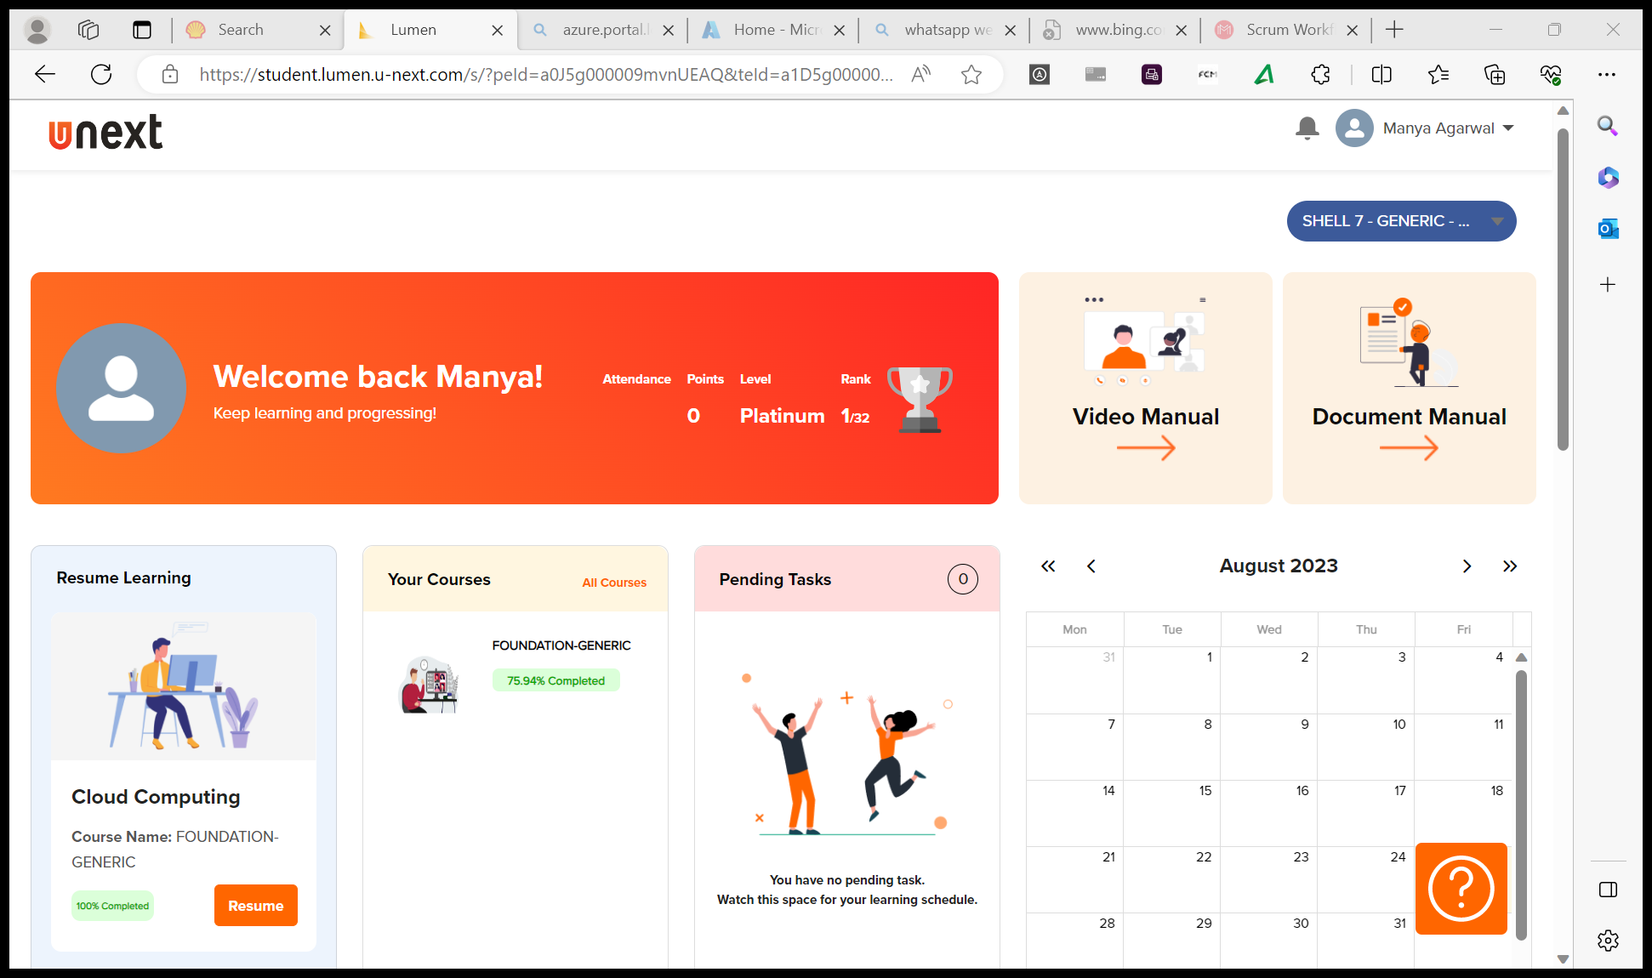
Journey Presentation
Submitted By:
Manya Agarwal
Employee No. : 654801

Slide 2
Journey Presentation Week-2

Slide 3
Day 7 : 28-Aug-23 (Monday) – Case Study
Implementing a Seamless CI/CD Workflow for a Spring Boot Application using Azure Boards, Azure, Git, Maven, Docker, Github, Github Actions.
Project Management Setup
GitHub Repository and Feature Branching
Azure VM Configuration
Maven-Based Build Process
Prometheus Monitoring Integration
Docker Containerization
Azure Web App Configuration
Pull Request Collaboration
GitHub Actions Workflow Implementation
Local Testing of Azure Web App

Slide 4
Day 8 : 29-Aug-23 (Tuesday) – Data Fundamentals
Data Warehouse is a collection of integrated, subject oriented database designed to support the DSS function, where each unit is relevant to some moment in time.
OLTP VS OLAP Requirements, Structure, Query
Dimensional modeling is a logical design technique that seeks to present the data in a standard framework that is the intuitive and allows for high performance access.
Star schema, Snow-Flake Schema, Galaxy Schema.
Slowly Changing Dimensions – Type 1 (No history), Type 2 (full history), Type 3 (partial history).
Surrogate key is the primary key in dimension table.
Data Mart – subset of data warehouse.
Enterprise architecture – IT Users, Operational data, Data transformation, ODS layer, Enterprise warehouse, Data Marts/DW, Business User.

Slide 5
Day 9 : 30-Aug-23 (Wednesday) – Big Data Fundamentals
No SQL DB TYPES:
Key value db – eg: Redis
Document driven db – eg: mongodb
Wide column db – eg: Cassandra
Graph based db – eg: neo4J
Data Lake (Unstructured data): After ELT(extract load transform) whatever data collected is data lake. Part of data lake:
Process part – track process
Orchestrate part – manage meta data
Data swamp: unmanaged and messed up data lake.
Data governance: Manage the meta data (both structured and unstructured after extraction)
Data lake house: data after ETL from data lake sent into data warehouse (warehouse + lake).
More flexible than data warehouse. Another adv: can be used for data sci too. Disadv: very new concept.

Slide 6
Day 10 : 31-Aug-23 (Thursday) – Azure SQL
Activity :
Customer gives order (1 to many, 1 to 1)
Employee work on order (1 to many , 1 to 1)
Every order has shipping details(1 order to many prod, 1 product in many order)
Product supplied by supplier (1 supplier to many prod, 1 prod by 1 supplier)
Worked on Azure SQL Database.
Worked with DMLs – Insert, Update, Delete and Truncate operations, Filtering data, grouping data by group and having clause. Sorting the final data, group the data after aggregation.
Few Queries eg :
**How many times each product is ordered.
select product_id, COUNT(order_id)
FROM order_details
GROUP BY product_id;
**What is the max no of times any prod being ordered.
SELECT product_id FROM order_details GROUP BY product_id HAVING COUNT(product_id) =
(SELECT MAX(q.cnt) FROM
(SELECT product_id, COUNT(order_id) cnt
FROM order_details
GROUP BY product_id) q);

Slide 7
Day 11 : 1-Sep-23 (Friday) – Azure SQL Cont…
Worked on Joins, Union, Union ALL, Intersection and Subqueries.
Worked on Correlated queries
Fan trap occur in a situation when a model represents relationship between entity types however a path between certain entity occurrences is ambiguous.
Example: (Staff)-1:N-has-1:1-(Division)-1:1-operates-1:N-(Branch)
Chasm trap occur when a model suggests relationship between entity types however a path between certain occurrences does not exist.
Example: (Branch)-1:1-has-1:N-(Staff)-0:1-oversees-0:N-(PropertyForRent)
Few queries we reflected :
/*Name of employees who have salary more than their department avg salary*/
SELECT E.ENAME, E.SAL, E.DEPTNO
FROM EMP E ( SELECT DEPTNO, AVG(SAL) AS 'SAL’ FROM EMP GROUP BY DEPTNO) Q
WHERE E.DEPTNO = Q.DEPTNO AND E.SAL > Q.SAL;
OR
SELECT ename, deptno from EMP A WHERE sal > (SELECT avg(SAL) from EMP B where B.deptno = A.deptno);

