Slide 1


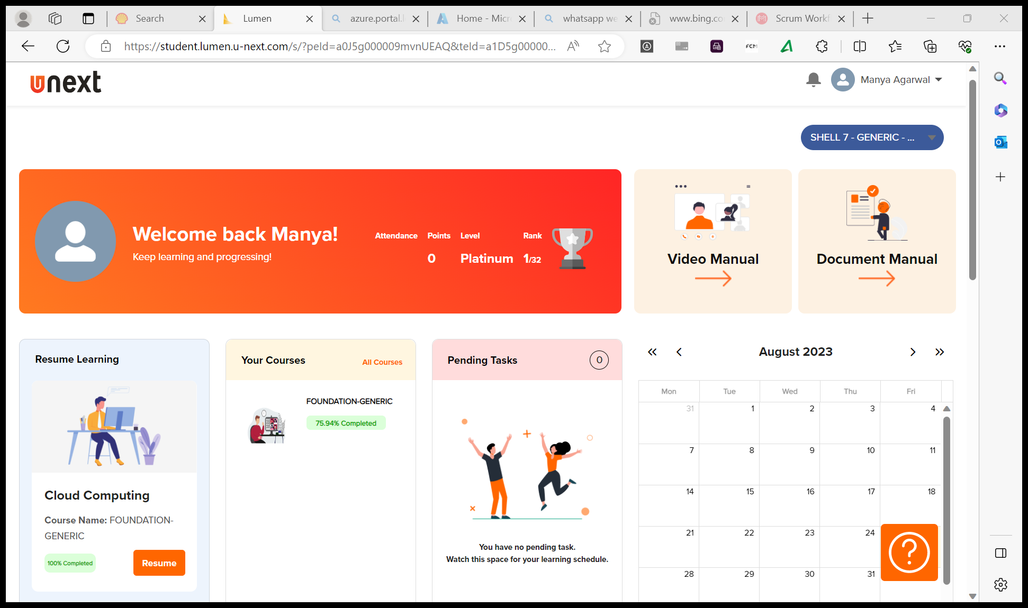
Journey Presentation
Submitted By:
Manya Agarwal
Employee No. : 654801

Slide 2
Journey Presentation Week-7

Slide 3
3-Oct-23 (Tuesday) – ML Studio
Introduction to Machine Learning
Exploring online ML Softwares: Teachable Machine, H20.ai
Steps to create a pipeline:
Import dataset
Select columns
Edit metadata → data type conversion
EDA: clean missing data, filter/join/partition
Split data: training and testing
Model: logistic regression
Tune model: Hyperparameter tuning→ random sampling/ grid sampling/ Bayesian sampling
Train model
Score and evaluate

Slide 4
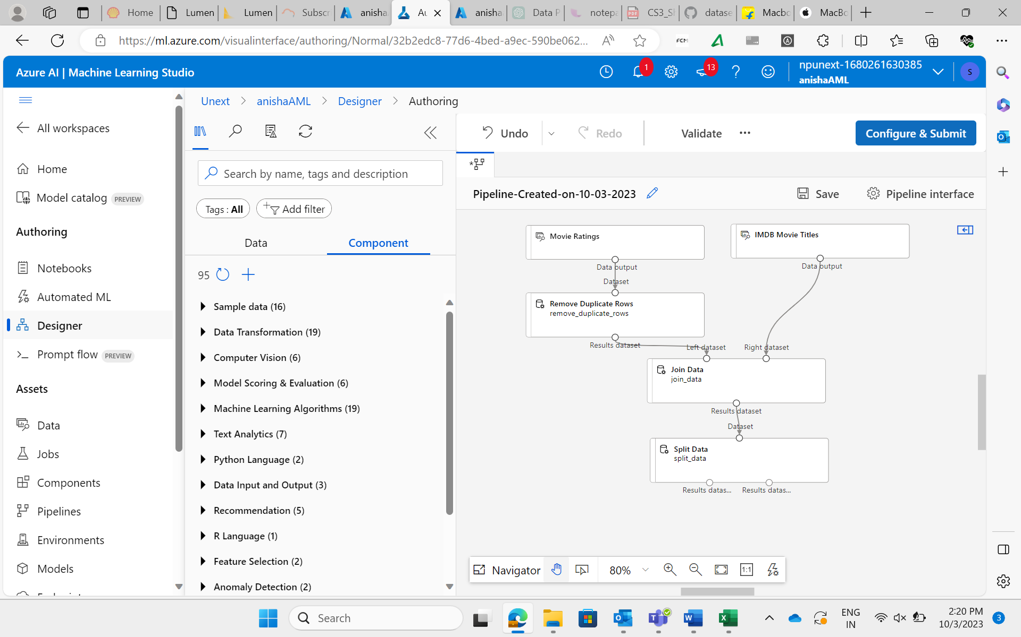
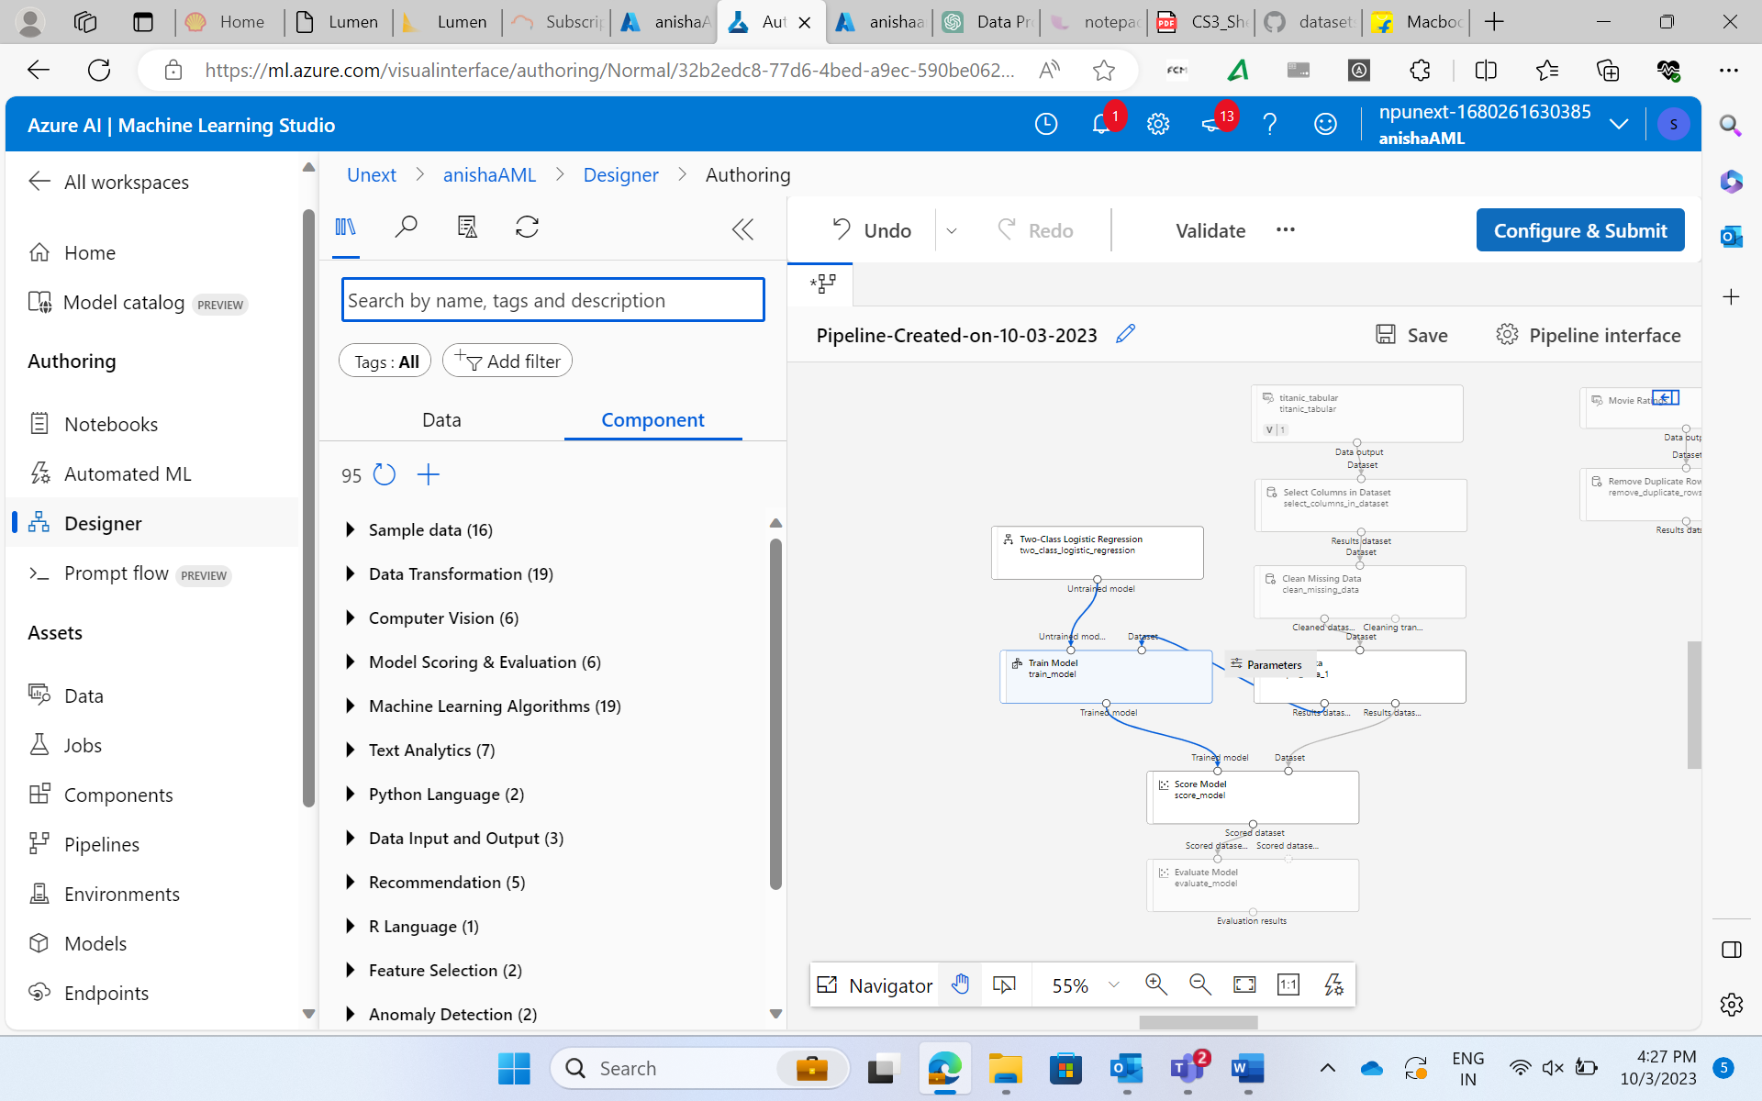
3-Oct-23 (Tuesday) – ML Studio
Classification Algorithms on Titanic dataset for survival prediction
Exploratory Data Analysis on Movie Datasets

Slide 5
4-Oct-23 (Wednesday) – ML Studio
Automated ML setup for setting automated workflow
Conducted Hyperparameter tuning on Adult Sensor Income Binary Classification
Explored other Exploratory Data Analysis methods like: Edit metadata, Normalize data (using methods like Z Score, MinMax, Logistic, Tanh), Partition and sample
Case Study: Developed a model to predict customer purchasing behavior, split data, train a suitable ML algorithm, and optimize its performance through hyperparameter tuning to enhance personalized marketing strategies.

Slide 6
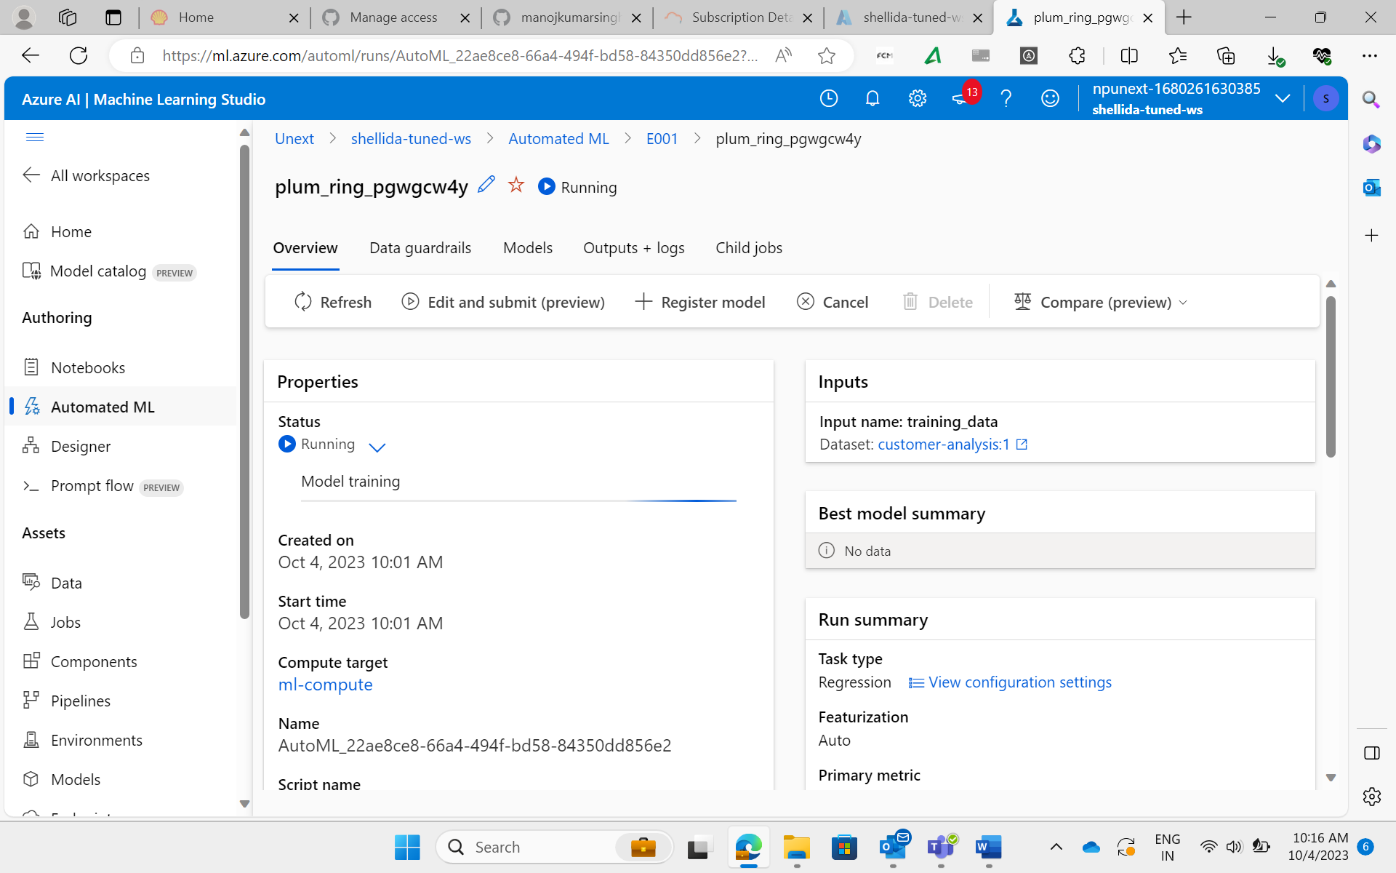
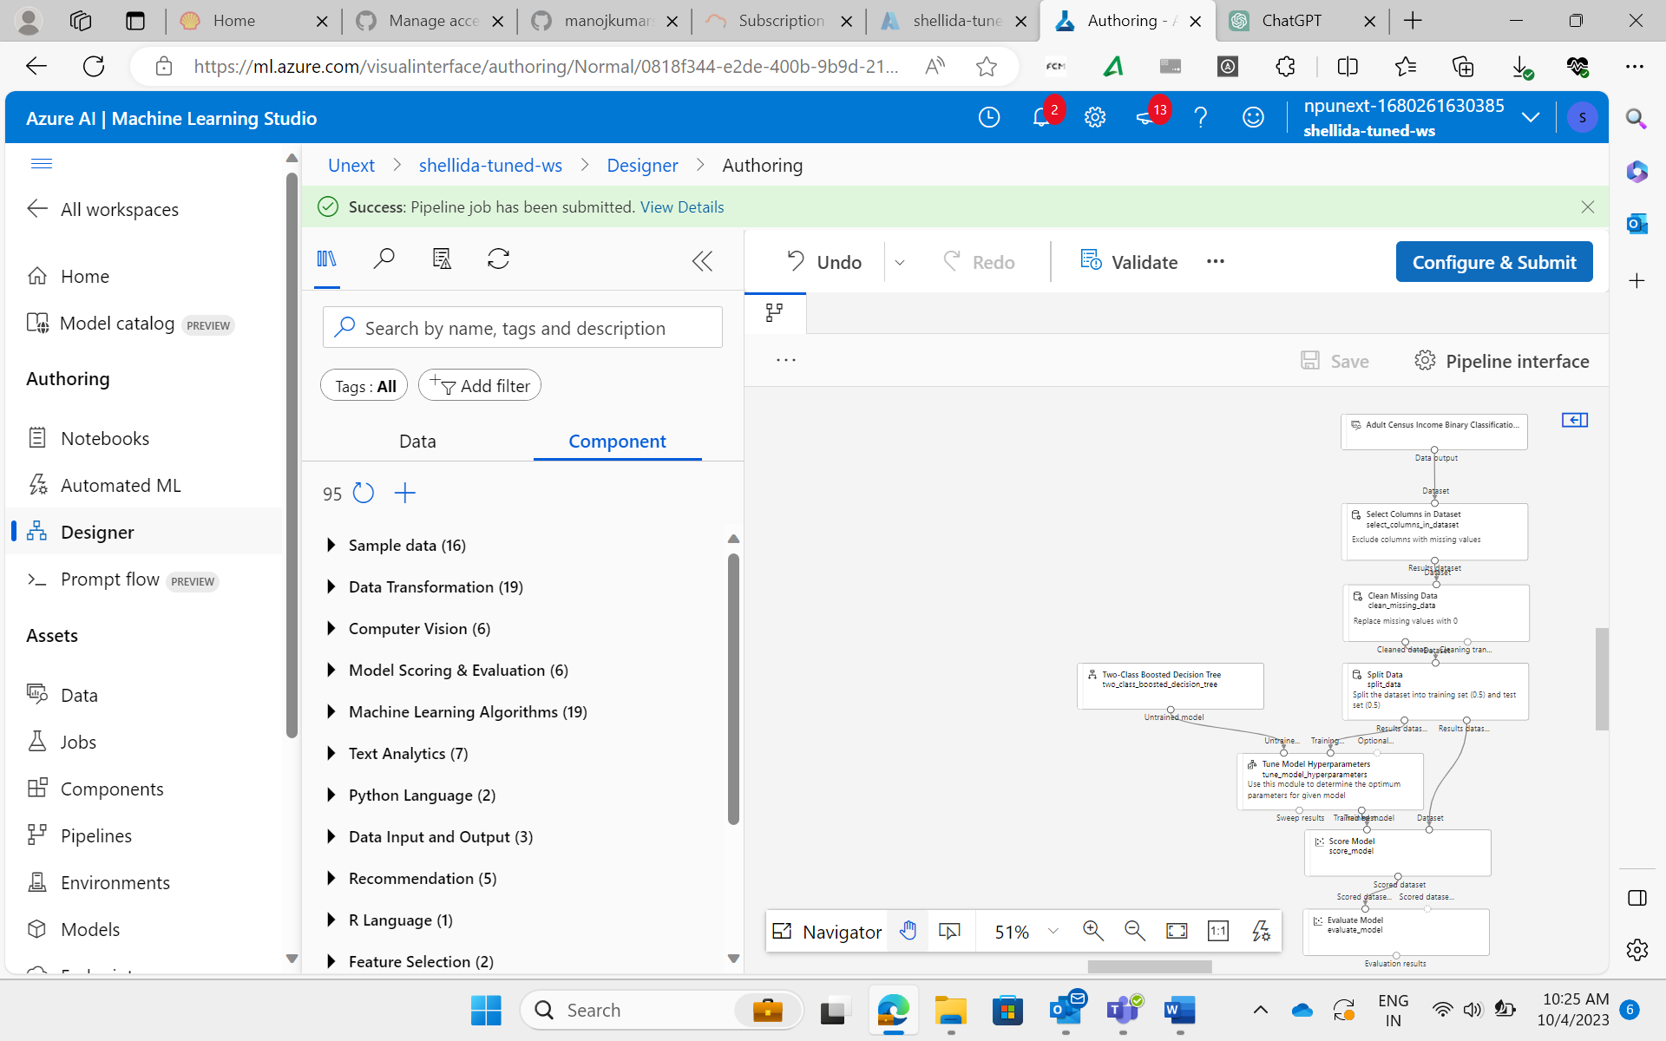
4-Oct-23 (Wednesday) – ML Studio
Pipeline for Adult Sensor Income Binary Classification using Hyperparameter Tuning

Slide 7
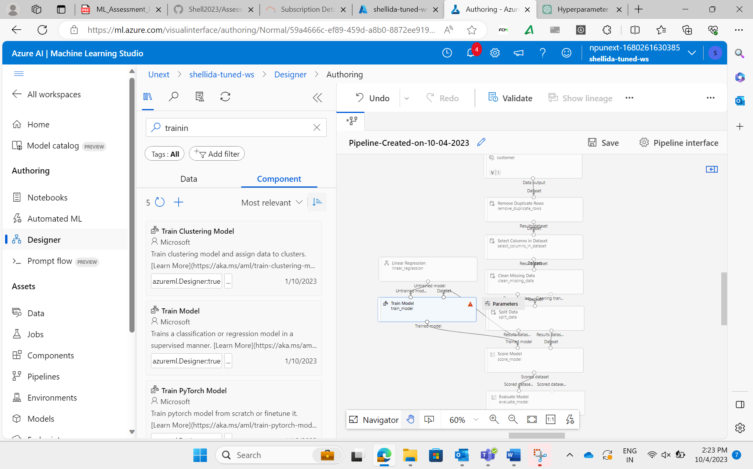
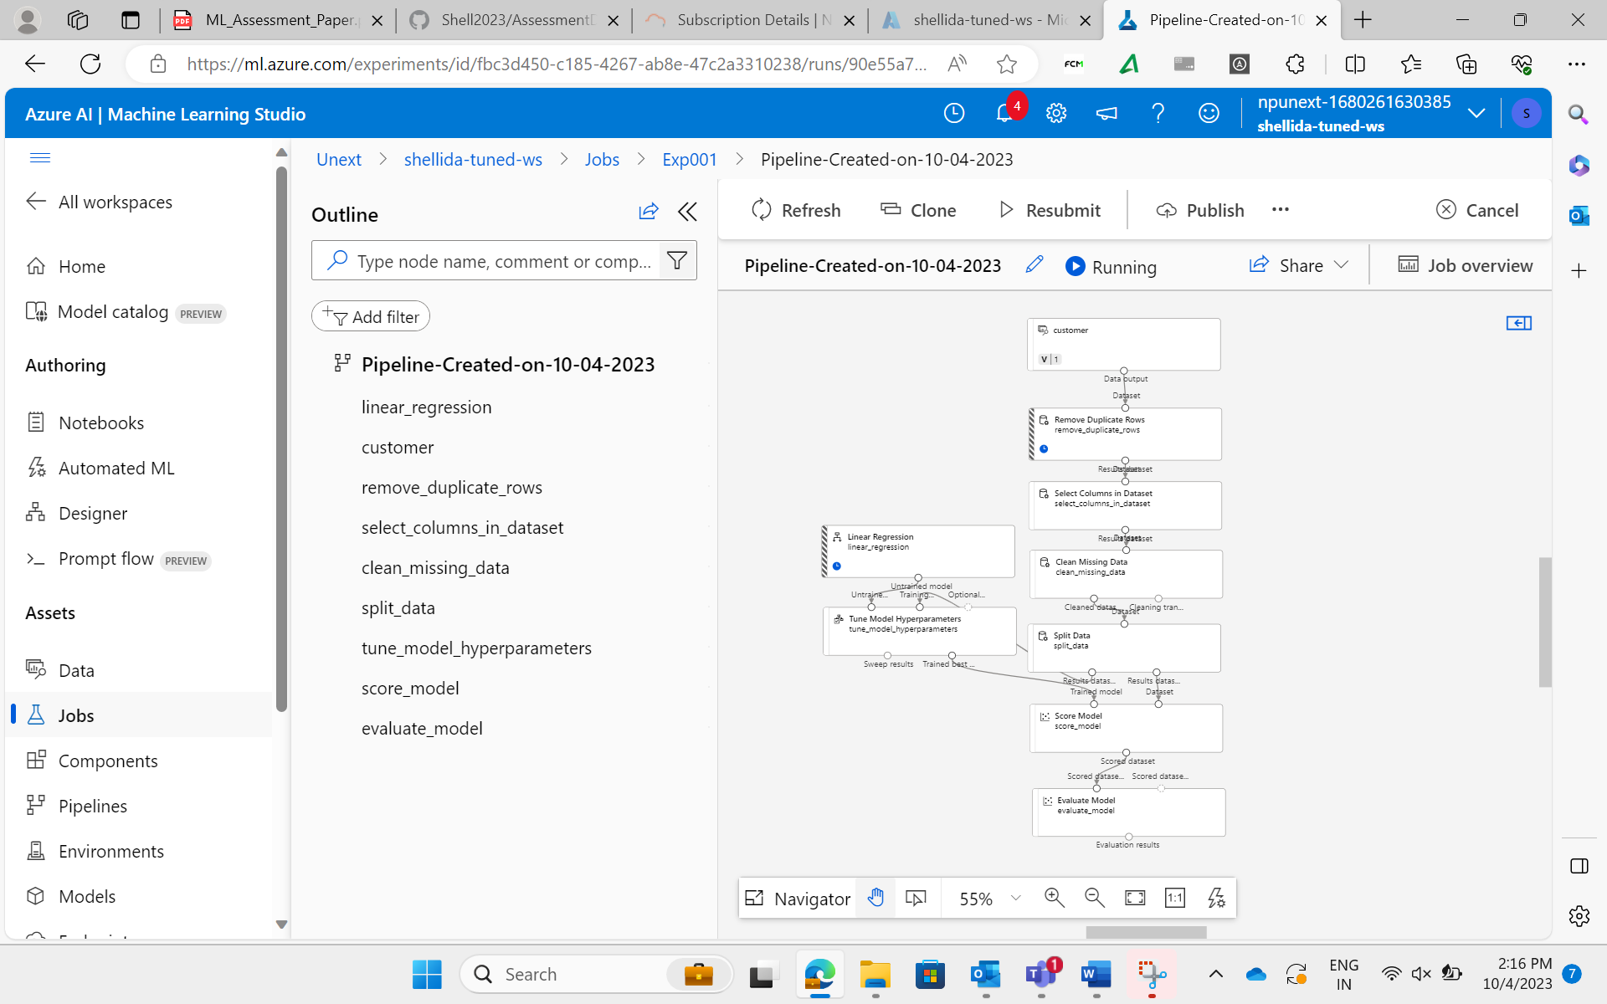
4-Oct-23 (Wednesday) – ML Studio
Pipeline with Hyperparameter Tuning

