Slide 1

COURSE REGISTRATION
SYSTEM
Presented by:
Group No. 1
(July 30, 2021)

Slide 2

1
Our Team
2
Jedi-6 : Framework
3
Our Journey
4
Project Goals
Agenda
5
Tech Stack
6
Development
7
Challenges
8
Demo
9
Questions

Slide 3

Our Team & Responsibilities
Piyush Palta
Manya Goel
Parth Anand
Tooba Zameer
Saksham Chhabra

Slide 4
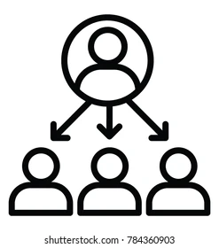
Stakeholders
Sponsors
Flipkart
SMEs
Amit Balyan
Other Coordinators
Deepika Gajaraj
Khushboo
Pooja

Slide 5
JEDI-6 : Framework
DAY 1
Introduction to UNIX/LINUX
12 Days plan
Everyday discussion about topics followed by doubt clearance
Daily Assignments and 15 min test based on the last topic covered
Demonstration of Project progress & transformation based on UML & Technologies
DAY2
Introduction to Git and GitHub
DAY 3
Agile Principles and SDLC Overview
DAY 5
CORE JAVA Programming
DAY 10
REST API
DAY 11
DROPWIZARD
DAY 12
Presentation

Slide 6
Our Journey
Understanding Project Goals (Know Requirement)
Design Thinking (UML Diagrams)
Project Demo (Backend Project)
Decide the Technologies (JAVA, REST API, DropWizard)
Development (Java Code)

Slide 7

Project Goals
To make UML diagrams for “Course Registration System” for a university portal.
Student can choose courses and complete registration by completing Fee payment
To develop a JAVA project for Student, Professor and Admin operations.
Use RESTful backend services for Student, Professor and Admin operations.
Using Dropwizard and Apache Jersey.
‹#›

Slide 8






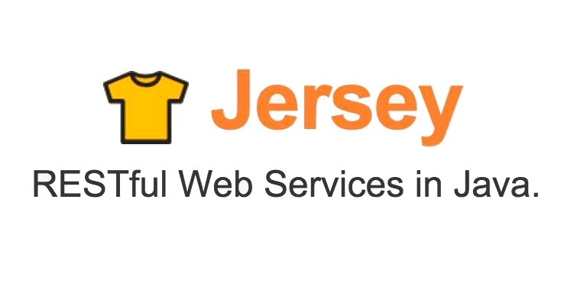




Tech Stack
Core Language
Collaboration + Version Control
SQL Database
Application Server
Framework
API Testing

Slide 9
Development
Requirement understanding
Research and analysis
Estimation
Sprint Planning
Sprint Grooming
Delivery
Sprint Implementation
LLD
Development
Code Review
Commit
Integrate
Deploy
Test

Slide 10
UML Diagrams
https://github.com/piyush-palta/JEDI6-Flipkart/tree/master/CRS-JEDI-Flipkart-UMLArtifacts

Slide 11
Challenges
Code collaboration and resolving merge conflicts in Git.
Installation issues over specific environments and OS.
Adding proper dependencies and resolving jar file errors for mysql and log4j drivers.
Resolving exceptions and errors over Postman API testing platform.
Working collaboratively in a virtual environment.

Slide 12
Learnings
UNIX/Linux commands
Git commands
Unified Modelling Language(UML) Diagrams
Java 8 features
Exception Handling in JAVA
SQL using MySQL
REST API development using Jersey and DropWizard
Testing REST APIs using Postman Service.
Maven

Slide 13

Demonstration

Slide 14


Slide 15
THANK YOU !!

