Slide 1
Predictive Maintenance of Industrial Machinery
CAPSTONE PROJECT
Presented By:
Student Name - Manya Vasudeva
College Name - Jamia Hamdard University
Department – BTECH (CSE)

Slide 2
OUTLINE
Problem Statement (Should not include solution)
Proposed System/Solution
System Development Approach (Technology Used)
Algorithm & Deployment
Result (Output Image)
Conclusion
Future Scope
References

Slide 3
Problem Statement
To develop a predictive maintenance model for a fleet of industrial machines to anticipate failures before they occur. This project will involve analyzing sensor data from machinery to identify patterns that precede a failure. The goal is to create a classification model that can predict the type of failure (e.g., tool wear, heat dissipation, power failure) based on real-time operational data. This will enable proactive maintenance, reducing downtime and operational costs.

Slide 4
Proposed Solution
Develop a machine learning model that classifies industrial machine failures using real-time sensor data. The model will analyze operational measurements to identify the type of failure quickly and accurately, enabling proactive maintenance and minimizing downtime.
Key Components:
Data Collection: Gather data from the Kaggle dataset on industrial machines.
Preprocessing: Clean, normalize, and engineer features from sensor data to improve model quality.
Model Training: Train a classification model (e.g., Random Forest, XGBoost, or LSTM) to predict failure types.
Evaluation: Validate the model using metrics like accuracy, precision, recall, and F1-score.

Slide 5
System Approach
The "System Approach" section outlines the overall strategy and methodology for developing and deploying the predictive maintenance model for industrial machines.
System requirements:
IBM Cloud : for secure , scalable cloud infrastructure
IBM Watson Studio : For building, training and deploying machine learning models.
IBM Cloud Storage

Slide 6
Algorithm & Deployment
Algorithm Selection:
Snap Random Forest Classifier
Data Input:
Sensor data such as torque, rotational speed, temperature, tool wear, and vibration readings from industrial machines
Training Process:
Supervised learning using labeled data that indicates the type of machine failure .
Prediction Process:
Model deployed on IBM Watson Studio with a REST API endpoint to enable real-time failure prediction and proactive maintenance.

Slide 7
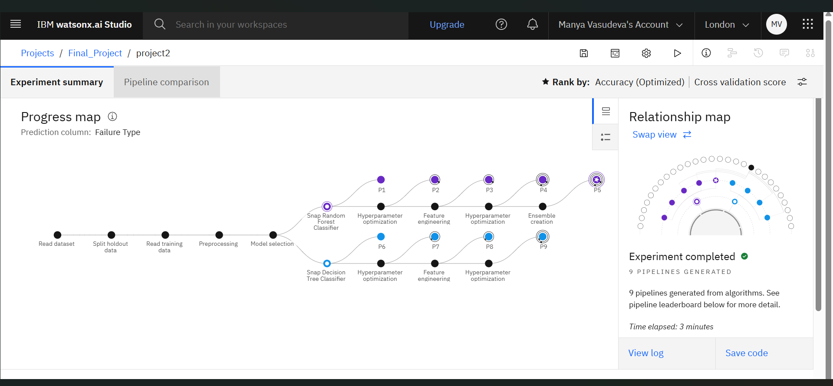
Result

Slide 8
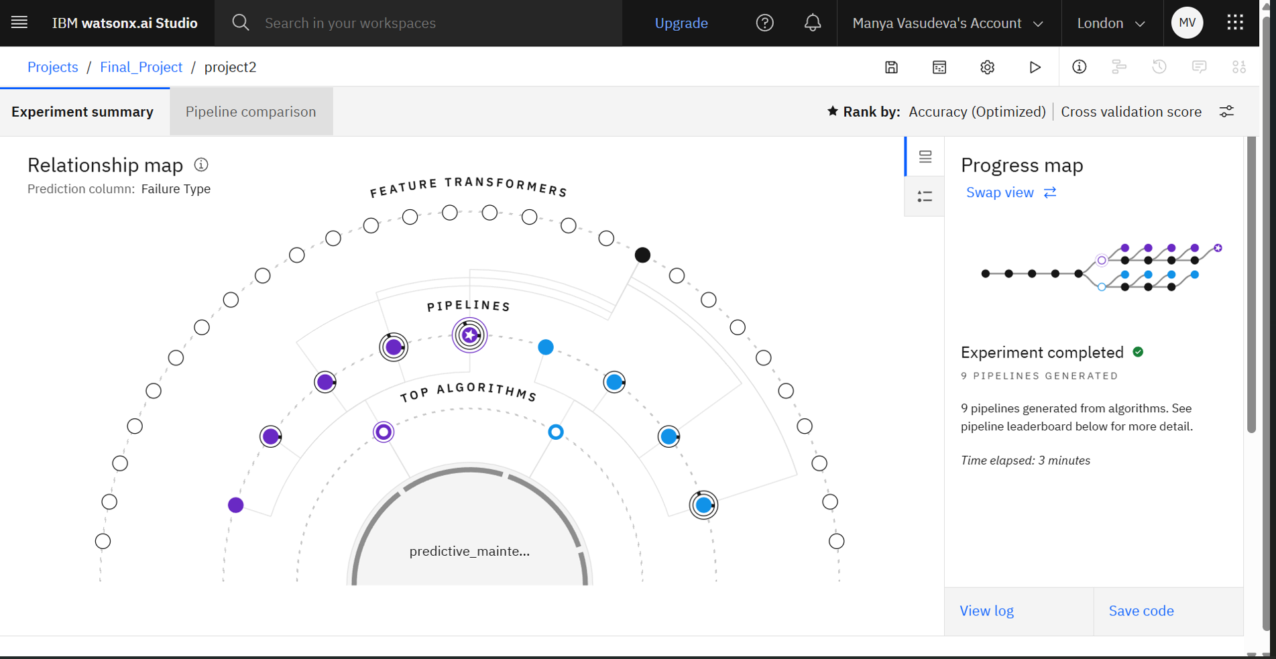

Slide 9
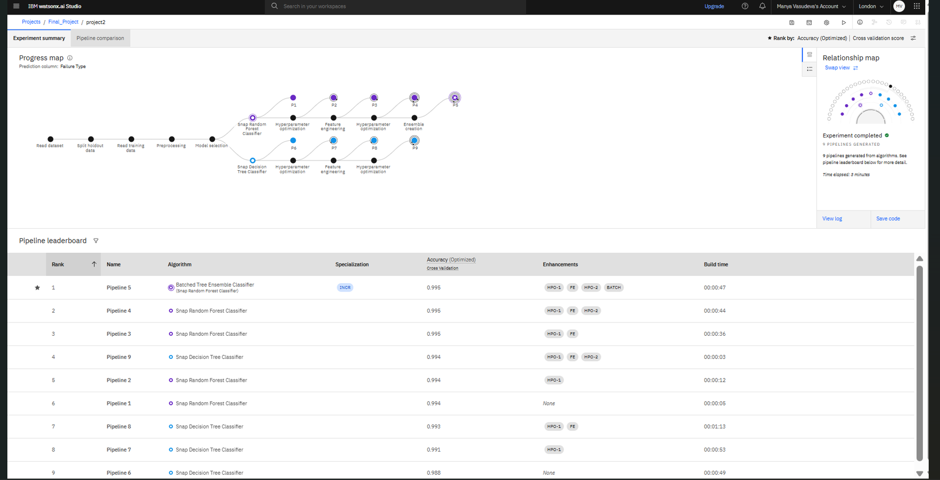

Slide 10
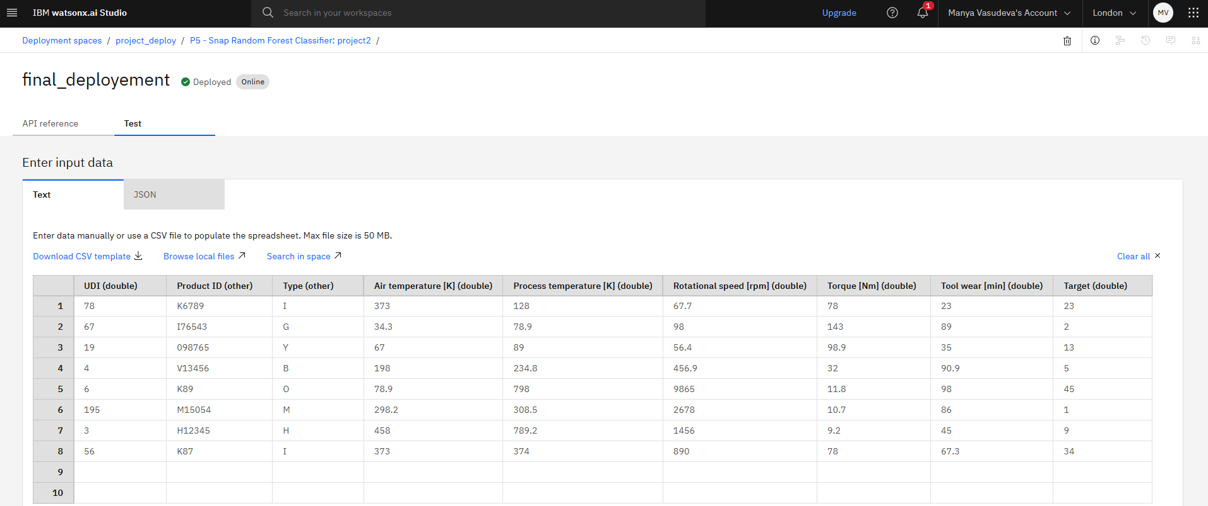

Slide 11
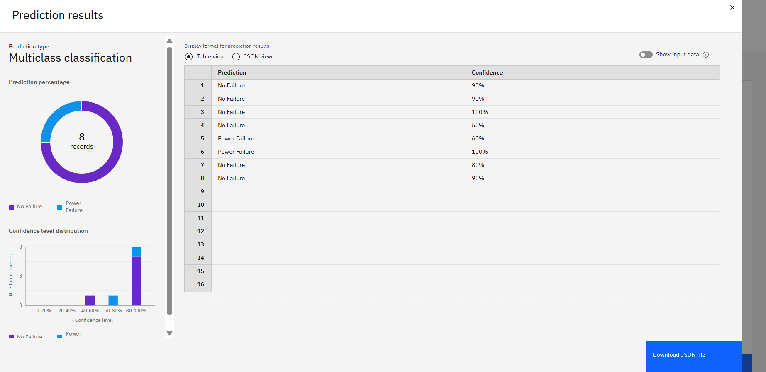
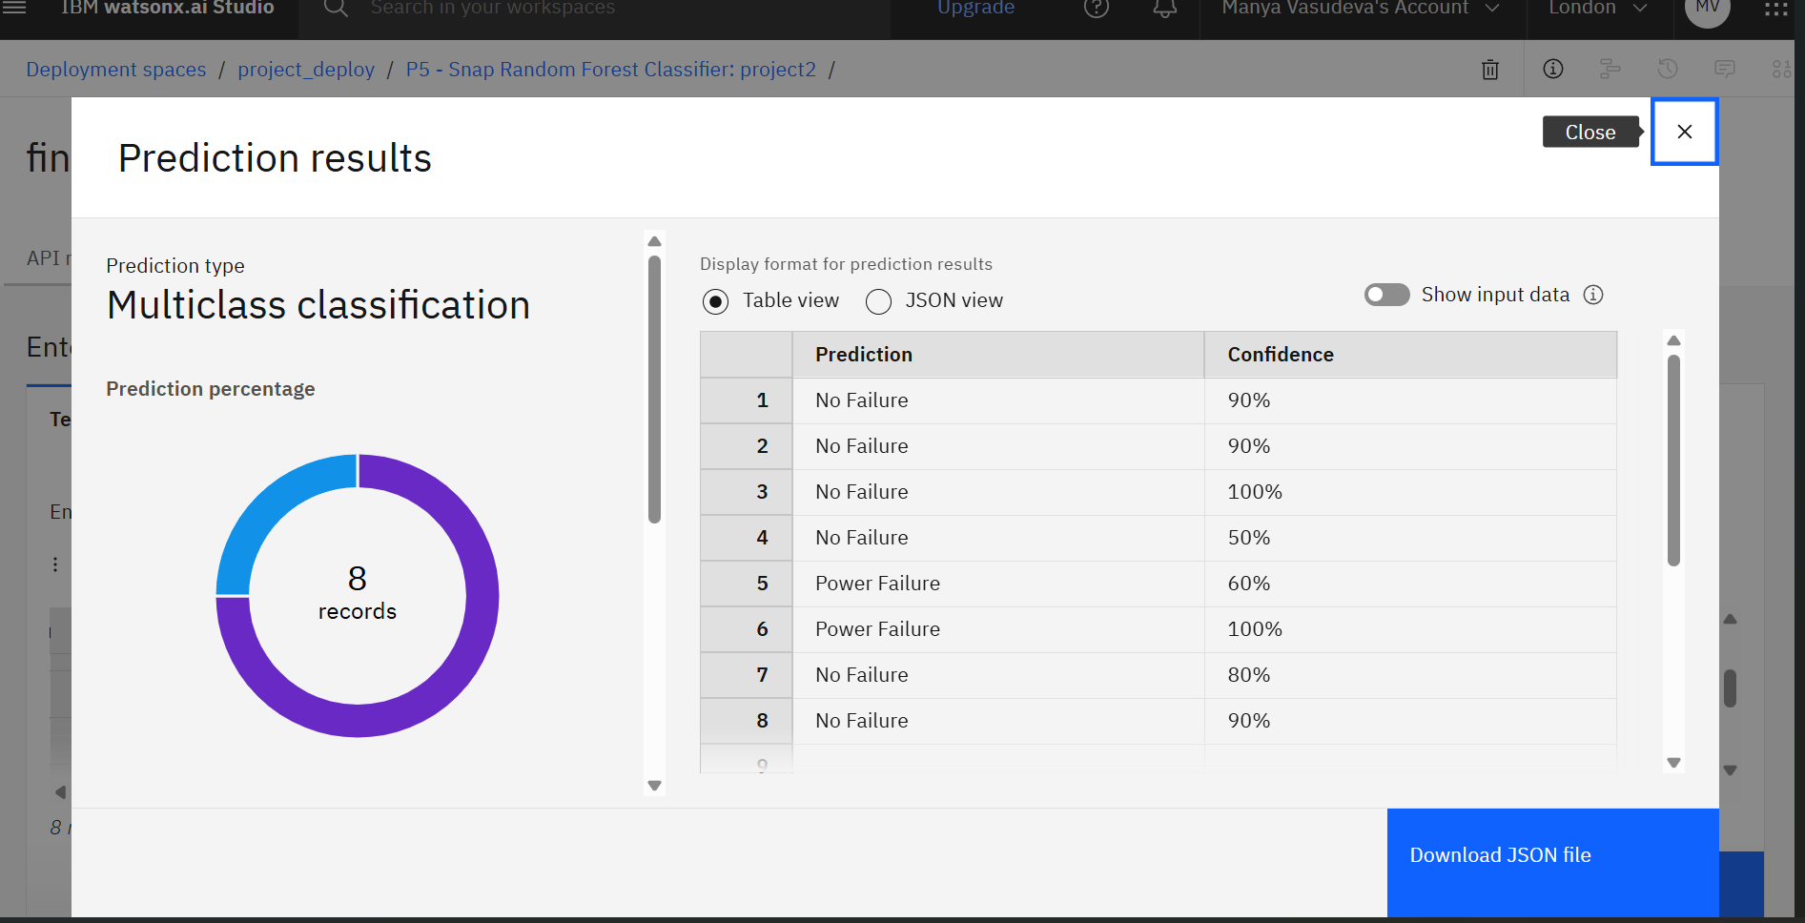

Slide 12
Conclusion
The proposed predictive maintenance solution effectively utilizes machine learning to anticipate failures in industrial machines based on real-time sensor data. By classifying different failure types (e.g., tool wear, power failure, overstrain) with high accuracy, the model enables proactive maintenance, reducing unexpected downtime and operational costs.
Accurate failure prediction not only enhances machine reliability but also significantly optimizes maintenance schedules, leading to improved productivity and cost savings in industrial operations.

Slide 13
Future scope
Integrate additional sensor and operational data
Optimize algorithm for faster, more accurate predictions
Scale system across multiple machines or sites
Leverage edge computing for real-time decision-making
Explore deep learning for complex failure patterns

Slide 14
References
https://www.ibm.com/cloud/watson-studio
https://www.kaggle.com

Slide 15
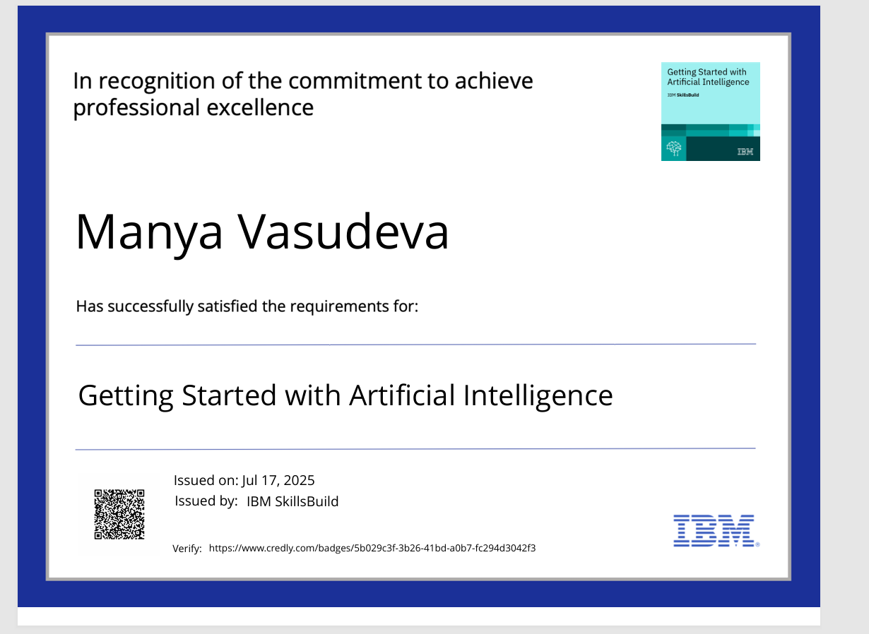
IBM Certifications

Slide 16

IBM Certifications

Slide 17
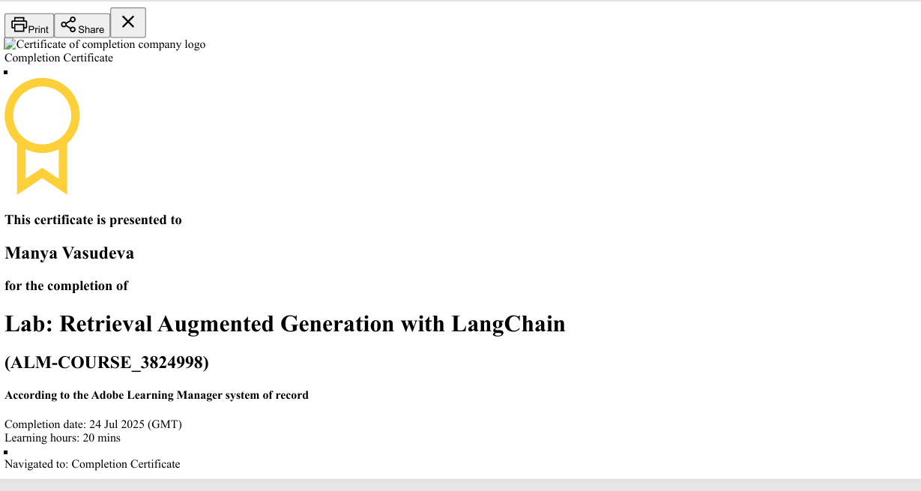
IBM Certifications

Slide 18
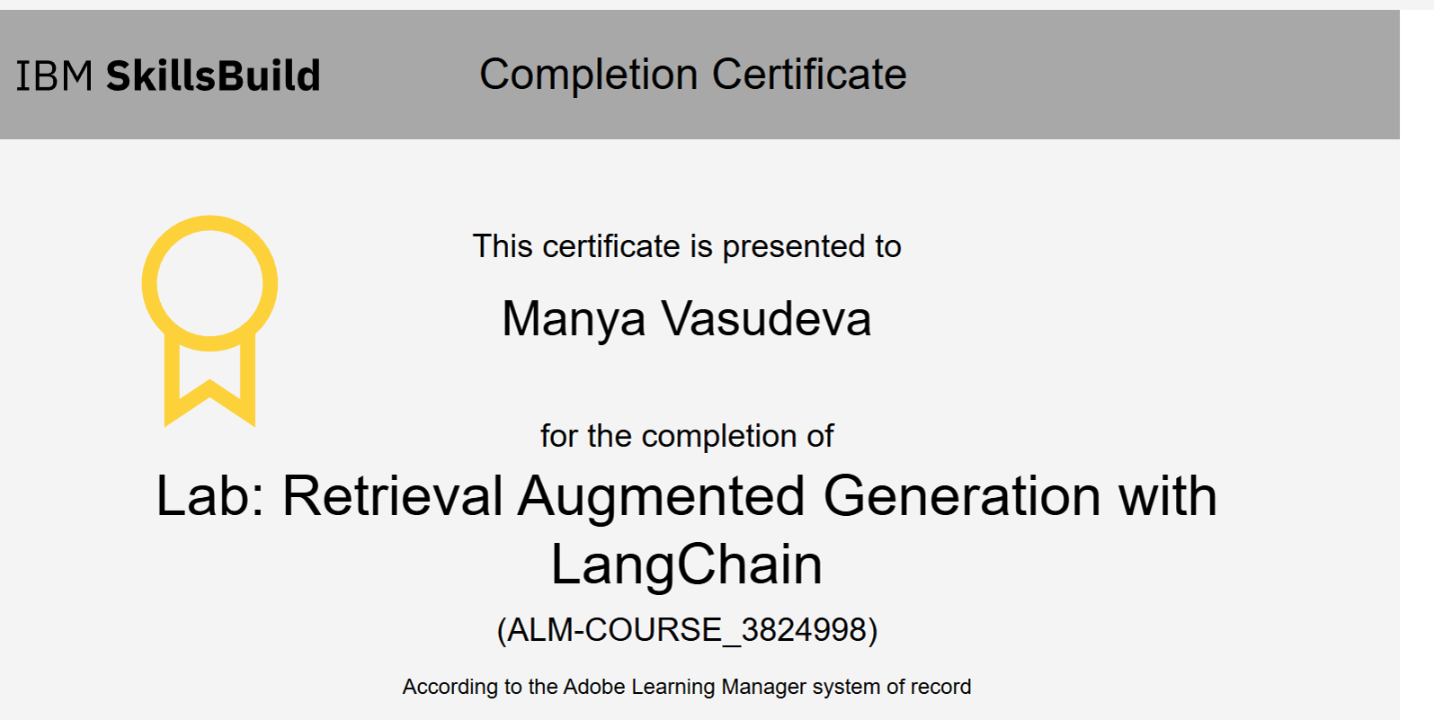

Slide 19
THANK YOU

