Slide 1
Salary Prediction System
Title: Predicting Salary Based on Experience and Age.
Subtitle: A Regression-based Machine Learning Project
Name: Manya Jain
Enrollment Number: TCA2265023
Date: 25 – November - 2024

Slide 2
Project Overview
Objective: To predict salary based on age and years of experience using regression models.
Tools and Libraries:
Python
Pandas, Seaborn, Matplotlib
Scikit-learn (for machine learning models)
Joblib (for model persistence)
Dataset: "hr_salary_data.csv"

Slide 3
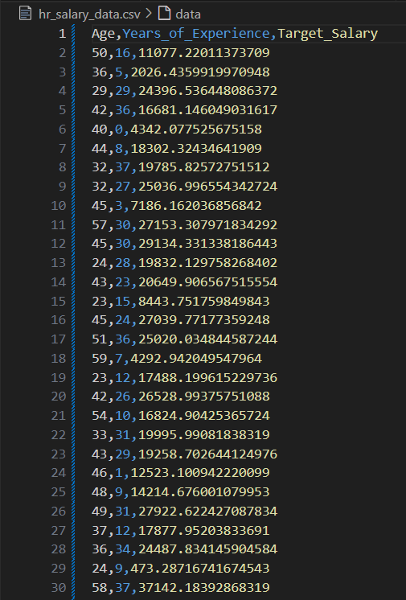
Dataset and Feature engineering
Dataset Description:
The dataset contains employee details, with features like age, years of experience, and target salary.
Features Selected:
Age
Years_of_Experience
Target Variable:
Salary (Target_Salary)

Slide 4
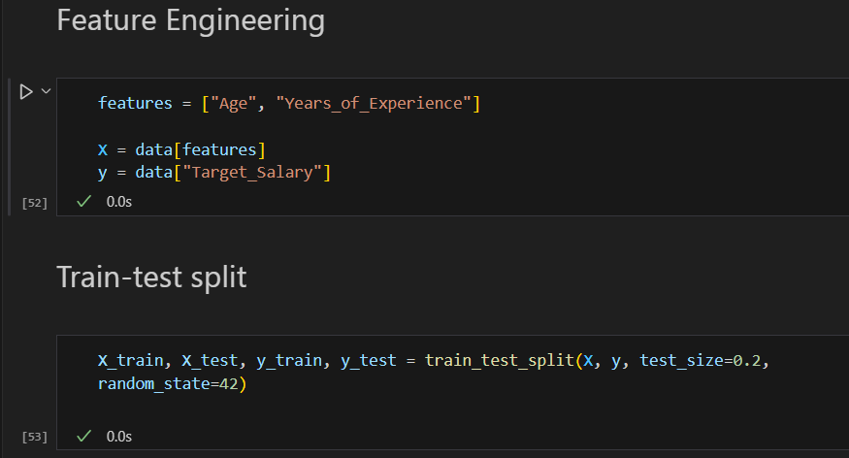
Data preprocessing
Data Splitting:
Training and testing data split (80% training, 20% testing).
Feature Selection:
Chose "Age" and "Years_of_Experience" as features for model prediction.
Target Variable: Salary (Target_Salary)

Slide 5
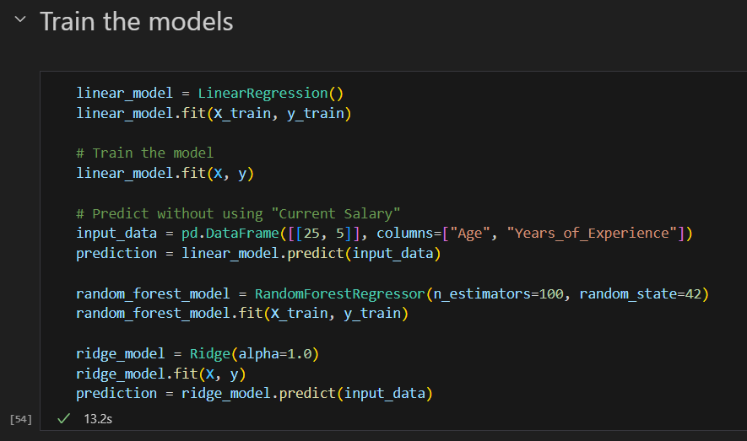
Model training
Linear Regression:
Fit model using LinearRegression().
Trained using training data (X_train, y_train).
Random Forest Regressor:
Fit model using RandomForestRegressor().
Trained using training data (X_train, y_train).
Ridge Regression:
Fit model using Ridge().
Trained using all data (X, y).

Slide 6
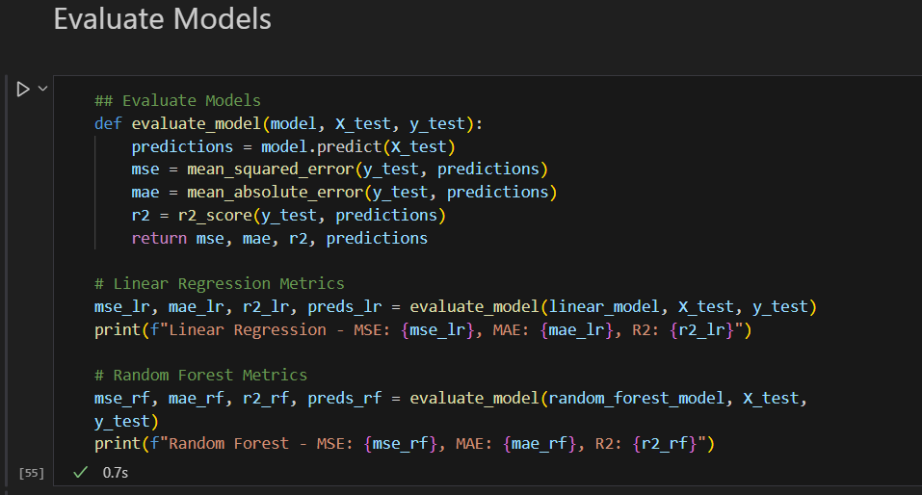
Model evaluation metrics
Evaluation Metrics Used:
Mean Squared Error (MSE)
Mean Absolute Error (MAE)
R-Squared (R2)
Model Performance:
Linear Regression and Random Forest results compared.
Display results for both models.

Slide 7
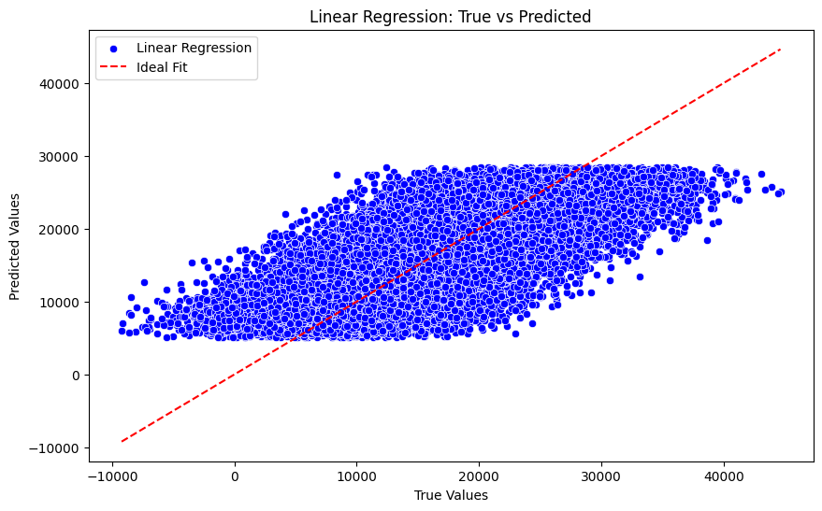
Model comparison: True vs predicted
Linear Regression:

Slide 8
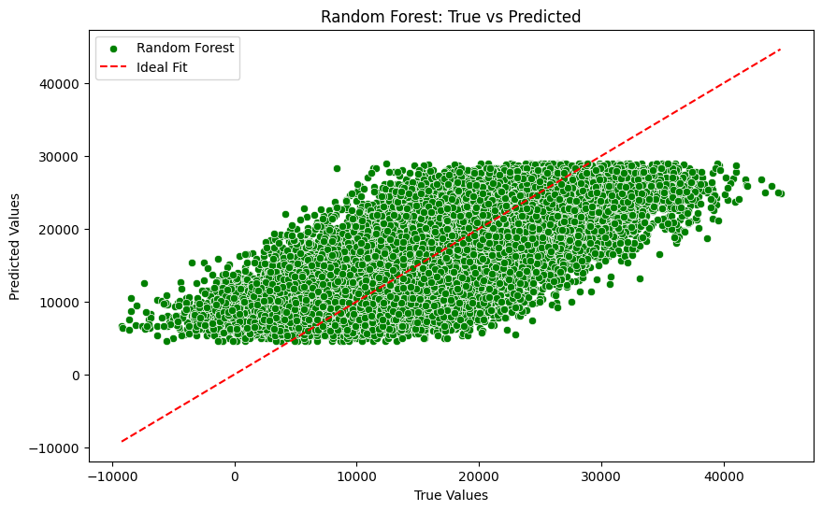
Random Forest Regressor:

Slide 9
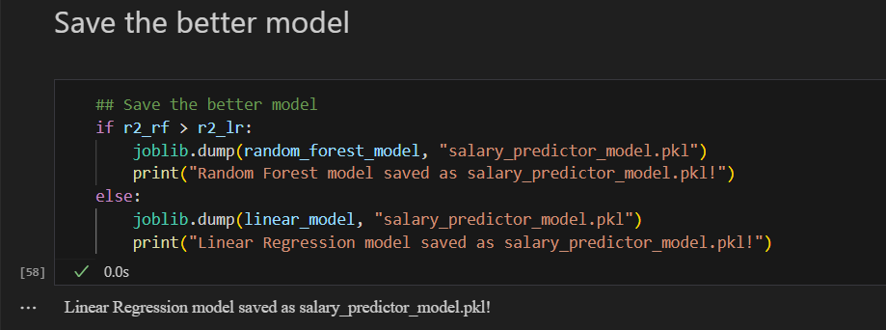
Final Model Selection
Model Chosen: Linear Regression.
Reason: Linear Regression had a higher R2 score.
Model Saving:
Using joblib.dump(), the best model is saved as “salary_predictor_model.pkl”.

Slide 10
Conclusion
Summary of Findings:
After evaluating multiple models, Linear Regression proved to be the better choice for predicting salaries based on age and years of experience.
Despite testing advanced models like Random Forest and Ridge Regression, Linear Regression demonstrated better accuracy (higher R2 score) in predicting the target salary.
The model's simplicity, interpretability, and performance make it suitable for the current dataset.
Key Insights:
Linear Regression provided a straightforward approach with consistent predictions, making it ideal for salary prediction in this scenario.
Other models like Random Forest showed good results but were not able to outperform the linear model, possibly due to the relatively simple nature of the dataset.
Next Steps:
Consider scaling the model for larger, more complex datasets.
Experiment with feature engineering to include other variables such as education or industry to enhance prediction accuracy.
Hyperparameter tuning could be applied to further optimize the Linear Regression model.

Slide 11
FUTURE IMPROVEMENTS and references
Consider incorporating additional features such as education level, industry, etc.
Experiment with other models like Support Vector Machines (SVM) or Gradient Boosting.
Optimize the models further using hyperparameter tuning.
LINKS:
Project repository:
https://github.com/Manya14Jain/TCS-ion-HRSalaryPrediction
Report:
https://github.com/Manya14Jain/TCS-ion-HRSalaryPrediction/blob/main/ManyaJainTCS-iON_Report.docx
Presentation:
https://github.com/Manya14Jain/TCS-ion-HRSalaryPrediction/blob/main/ManyaJainTCS-iON_ppt.pptx

Slide 12
THANK YOU !!

