Slide 1
SmartCert
Blockchain Solution for Educational Certificates
By - XanBell

Slide 2





Typical Existing Process
Issuer
Consumer
Intermediaries
Apply to Verify Records
Seek verified docs
Provide verified record
Convey the report
University
Request Authentication
Employer BV Agencies
Participant
Certificates
Share Certificates
Student

Slide 3










Case Study I
Challenges faced by Universities
Issue cryptographically-sealed records that cannot be faked
All academic records in one place, digital wallet
Cut down unplanned time to transmit official records to consumers
Instant verification. No dependency on issuing authority to verify records
Own and share official records easily as regular process
No risk of losing records since the transaction is recorded on distributed blockchain
Third parties can check records anytime
Easy managing revocation and expiry of certificates
Certificate document storage and indexing
Random Certificate requests by students
Verification overhead (Retrieve and verify)
Fraud and Forged documents
Maintain strict confidentiality and privacy

Slide 4
Case Study 2
Student Challenges
Why SmartCert - Student
Own and share cryptographically sealed records
All academic records in one place, digital wallet
No waiting time to request authenticated official records
Instant verification. No dependency on issuing authority to verify records
Virtual verification process for employers and background verification agencies
No risk of losing records since the transaction is recorded on distributed blockchain
Access of certificates and mark sheets anytime
Easily integrated blockchain lookup services to verify latest record
Challenges
Certificate authentication requested by employer / Universities for higher education.
Risk of damage of loss of certificates.
Waiting time for Background verification as Universities will take time to respond back to BGV firms .

Slide 5

Case Study III
Employer Challenges
Why SmartCert - Employer
No waiting time to request authenticated official records
Access of certificates and mark sheets anytime
All academic records of prospective employee one place, digital wallet
Effective verification bypassing background verification agencies
Weeding out candidates with fake academic certificates
Instant verification. No dependency on issuing authority to verify records
Rampant fake certificates
Require background verification
Time consuming verification process(3rd party)

Slide 6
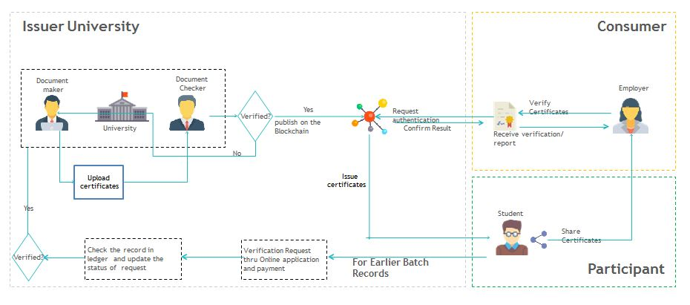
SmartCert - High level workflow

Slide 7
Thank you
By - XanBell

