Slide 1
Influence
Maximization
MINOR PROJECT-2
Submitted By:
Navdeep Kaur 20103187
Unnati Jain 20103195
Manya Garg 20103197

Slide 2

INTRODUCTION
Our website works on the idea of understanding the influence maximization on different networks. This is a learning platform where you can implement and visualise working of linear threshold model and independent cascade using various centrality measures . This website helps you learn about centrality measures like degree centrality , closeness centrality , betweenness centrality , Page Rank centrality and eigenvector centrality.

Slide 3


Concept Used
Centrality:
Degree
Betweenness
Closeness
Page Rank
EigenVector
Models Used:
1.Linear Threshold Model
2. Independent cascade
Tip
Don’t forget to read about these concepts on our websites specially made for your understanding and learning !!!!!!!

Slide 4
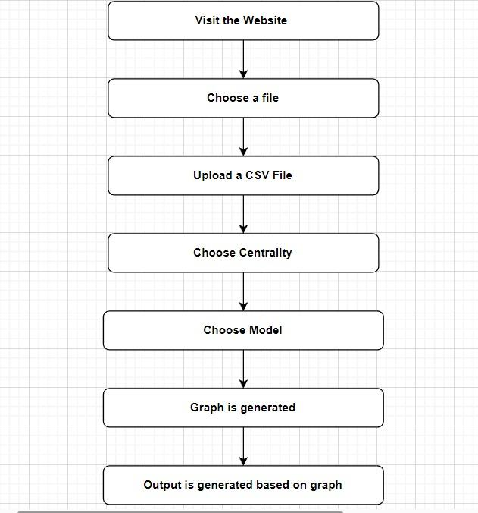
Control
Flow:

Slide 5
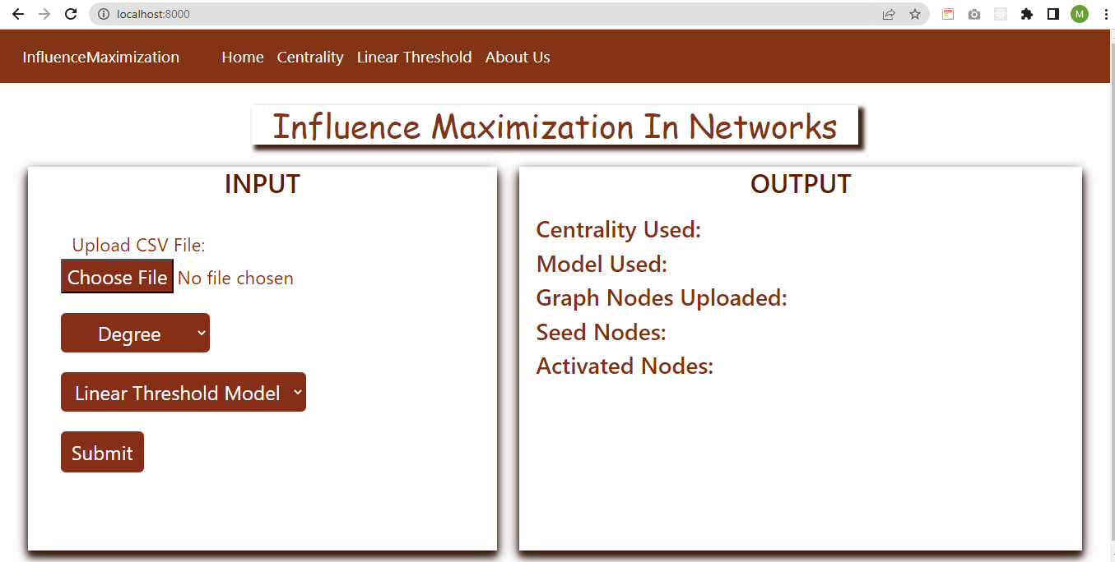
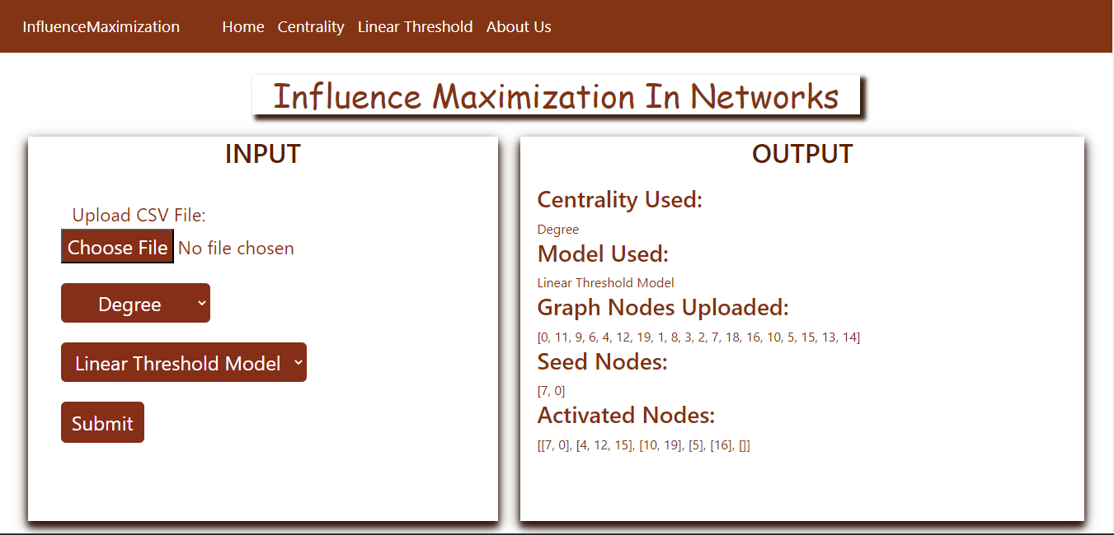

Slide 6
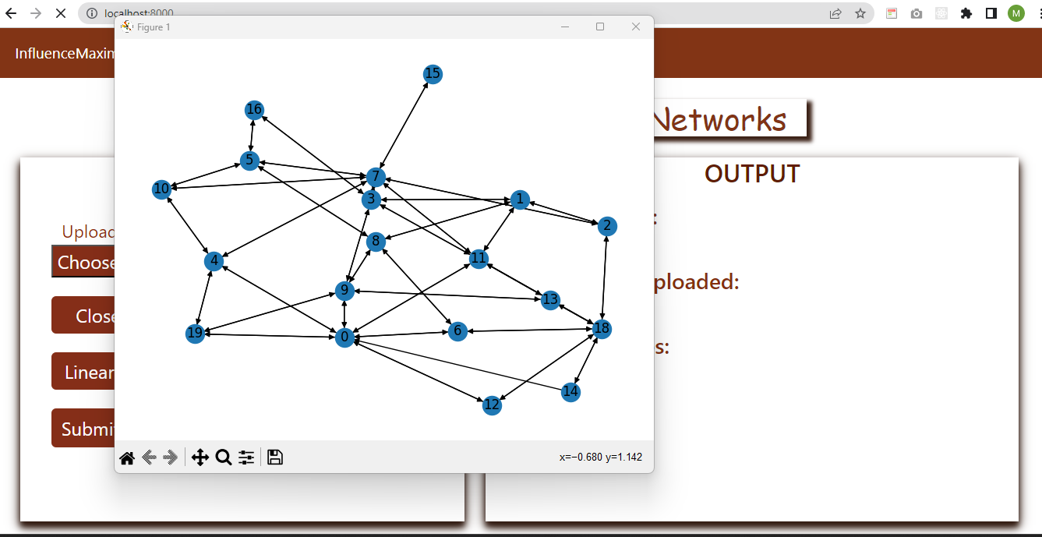
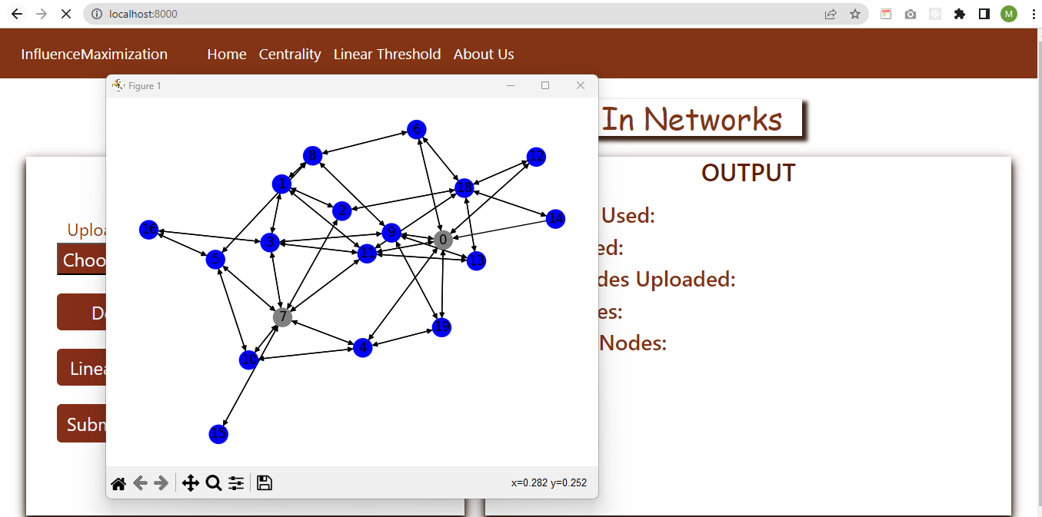
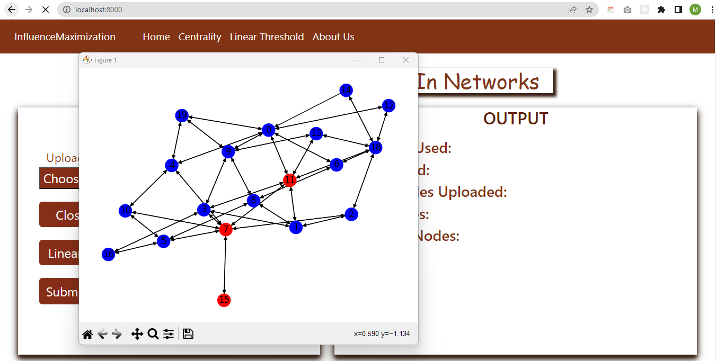

Slide 7
Conclusion
Our project on influence maximization using degree, betweenness, closeness, PageRank, load, and eigenvector centrality measures, as well as the linear threshold and independent cascade models, has explored different ways to identify influential nodes in a network and simulate the spread of influence through the network. The project has revealed that each centrality measure and diffusion model has its own strengths and limitations, and the choice of which measure and model to use depends on the specific characteristics of the network and the goals of the analysis. The project has also highlighted the importance of appropriate evaluation metrics to compare the performance of different centrality measures and diffusion models on the given network. For future scope, researchers can consider exploring other centrality measures and diffusion models to improve the accuracy of influence maximization. They can also focus on developing new evaluation metrics to better capture the effectiveness of different approaches in identifying influential nodes in a network. Additionally, researchers can explore real-world applications of influence maximization, such as identifying key individuals in social networks for marketing or public health interventions

Slide 8
THANK YOU!

