Slide 1
Category review: Chips
Retail Analytics

Slide 2
Executive summary
Task 1
Customer Purchasing Behavior Analysis
Task 2
Store Trial Evaluation

Slide 3
01
Category

Slide 4
Highest-Value Customer Segment
Mainstream Young Singles/Couples contributed the largest share of sales and should remain a priority for marketing campaigns.
Most Popular Pack Size
170–175g packs accounted for a significant proportion of purchases, suggesting customers prefer medium-sized packs.
Top Performing Brands
Kettle, Smiths, and Pringles dominated sales and should be prioritized for promotions, shelf placement, and inventory planning.
Business Opportunity
Targeted promotions focusing on high-value customer segments and popular brands can help increase sales and improve category performance.

Slide 5
Affluence and Its Effect on Chip Purchasing Behaviour
Key Findings
Mainstream customers accounted for the largest share of chip purchases, making them the primary revenue-driving segment.
Budget customers contributed consistently to category sales, indicating that affordability remains an important purchasing factor.
Premium customers represented a smaller share of total purchases but generally preferred higher-value brands and premium chip products.
Purchasing behaviour varied across life stages, with Young Singles/Couples and Mid-age Singles/Couples contributing the highest sales across all affluence segments.
Key Callouts
Mainstream shoppers are the largest contributor to overall chip sales and should remain the primary target for promotional campaigns.
Premium shoppers are more likely to purchase premium brands, creating opportunities for premium product promotions and value-added offers.
Budget shoppers respond well to competitive pricing and promotional discounts, making price-based campaigns effective for this segment.
Marketing strategies should be tailored according to both customer affluence and life stage to maximize category growth.

Slide 6
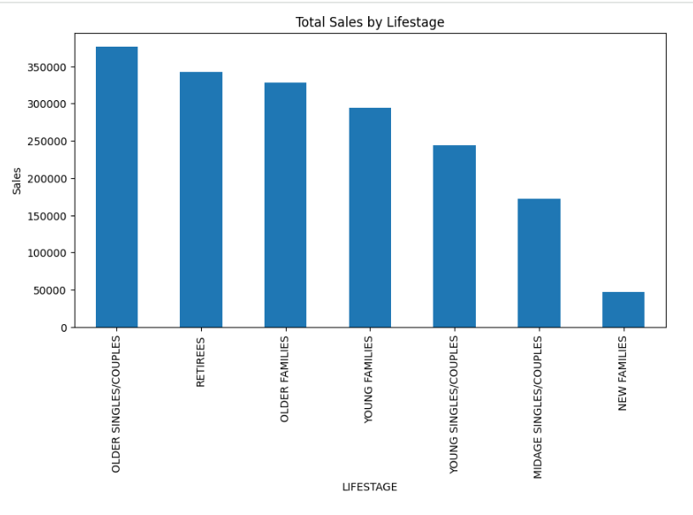

Slide 7
02
Trial store performance

Slide 8
Explanation of the Control Store vs Other Stores
Why were control stores used?
To accurately measure the impact of the store trial, each trial store was compared with a control store that had similar sales performance before the trial. This comparison helped isolate the effect of the trial from normal seasonal or market fluctuations.
How were control stores selected?
Monthly sales performance during the pre-trial period was analyzed.
Pearson correlation was used to identify stores with similar historical sales patterns.
The store with the highest similarity score was selected as the control store for each trial store.

Slide 9
Callout: Performance of the Trial Stores
Trial Performance Summary
Store 77 – Successful Trial
Store 77 outperformed its matched control store during the trial period.
The increase in total sales indicates that the trial had a positive impact on store performance.
This store provides the strongest evidence that the trial strategy was effective.
Store 86 – Limited Impact
Store 86 showed performance like its control store throughout the trial.
No clear improvement was observed, suggesting that the trial had a limited effect.
Store 88 – Further Validation Required
Although Store 88 showed changes during the trial period, the selected control store differed substantially in sales magnitude.
As a result, the effectiveness of the trial cannot be confirmed without selecting a more appropriate control store.

Slide 10
Key Takeaways
Successful Trial: Store 77 demonstrated the strongest positive response to the trial.
Limited Evidence: Store 86 showed minimal change relative to its control store.
Additional Analysis Required: Store 88 should be reassessed using a better-matched control store before making strategic decisions.
Recommendation
Expand the trial strategy used in Store 77 to similar stores.
Review the implementation in Store 86 to identify opportunities for improvement.
Re-evaluate the control store for Store 88 and repeat the analysis before considering a broader rollout.

