Slide 1
Capstone Project 1
Title: Most Streamed Spotify Songs 2023
Presented by : Manya Avasthy
Date: 10/01/2024

Slide 2
About Spotify
Spotify is a Swedish audio streaming and media services provider founded on 23 April 2006 by Daniel EK and Martin Lorentzon .It is one of the largest music streaming service providers, with over 590 million monthly active users , including 226 million paying subscribers, as of September 2023. Spotify is listed through a Luxembourg City -domiciled holding company, Spotify Technology S.A. on the New York Stock Exchange in the form of American depositary receipts.

Slide 3
Introduction
In 2023, the music industry witnessed a dynamic landscape shaped by the digital streaming era, with Spotify serving as a prominent platform for music consumption. The dataset on the most streamed songs of Spotify in 2023 encompasses 954 entries across 23 columns, offering a detailed glimpse into the characteristics and popularity of each track. From track names and artist collaborations to streaming metrics and audio features, the dataset enables a comprehensive exploration of trends, influences, and user preferences. This introduction sets the stage for a deeper analysis, uncovering the melodies that resonated most with audiences during this vibrant and evolving musical year.

Slide 4
OUTLINE
Overview of the data
Number of releases in each month
Audio Features
Top 10 Songs based added in Spotify Playlists
Top 10 artists based on total streams
Finding underrated songs on Spotify
Music mode
Relationships between energy levels and Acousticness
Number of tracks released each month in 2023 varied over time
Future Scope of Most Streamed Spotify Songs 2023: Predictions and Insights
Conclusion

Slide 5

Overview of the Data
Number of Rows : 953
Number of Columns: 23

Slide 6
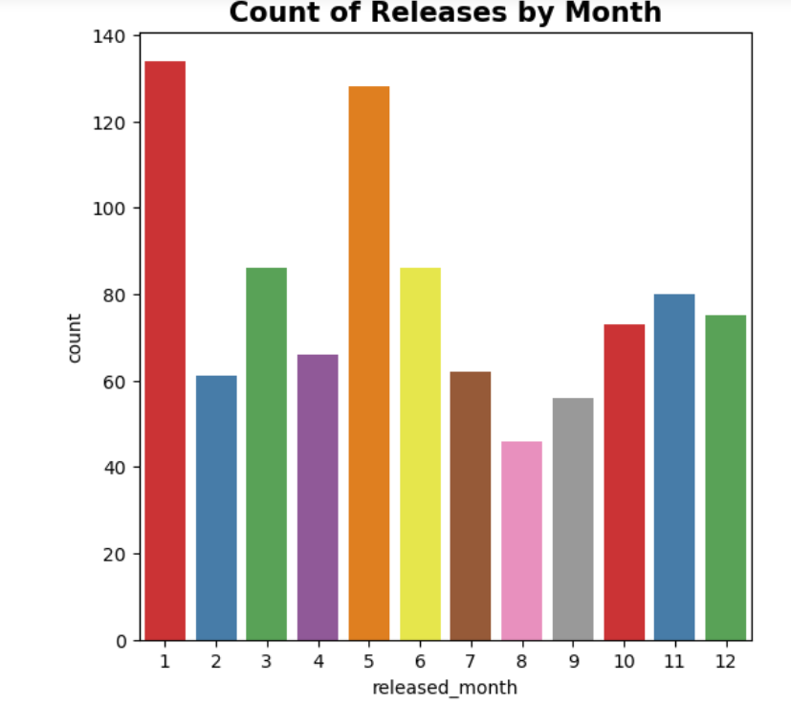
Number of releases in each month
As we unveil the data, an intriguing pattern emerges — a rhythmic dance of musical expression that varies from month to month. Our analysis reveals that January takes the lead as the month with the highest number of releases, signaling a vibrant start to the year with artists sharing their latest creations and setting the tone for what's to come.

Slide 7
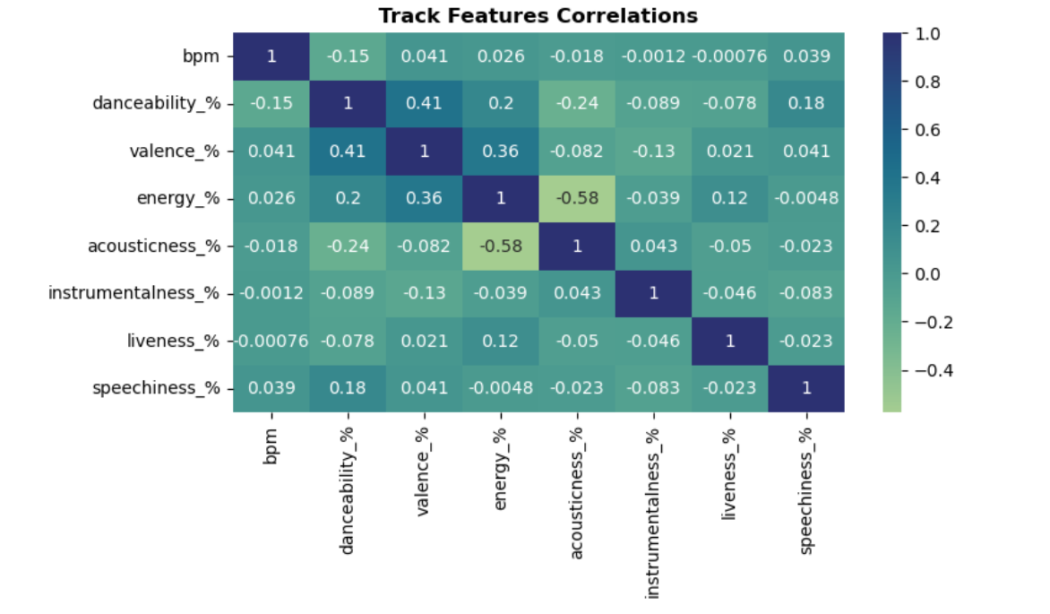
Audio Features
In this presentation, we'll dive deep into the audio features that Spotify analyzes to help us understand and connect with music on a whole new level. From the tempo that makes us tap our feet to the energy that sparks our emotions, these features are the building blocks of the soundscape that accompanies our daily lives.
But what are these audio features, and how do they shape our listening experience? From danceability to acousticness, valence to instrumentalness, Spotify's analytical tools provide us with a nuanced understanding of the music we consume. As we explore each feature, we'll uncover the science and artistry behind the songs that resonate with us.

Slide 8
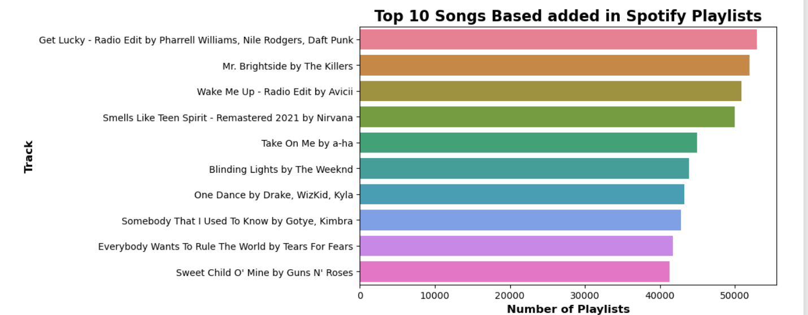
Top 10 Songs based added in Spotify Playlists
In this presentation, we'll shine a spotlight on the songs that captured our collective playlists, showcasing not only the diversity of musical tastes but also the tracks that resonated most with listeners around the globe. These aren't just songs; they are the anthems that accompanied our moments of joy, contemplation, and celebration.
Our exploration will lead us through the rhythm and beats that have earned a place in the hearts and playlists of millions. From genre-defying hits to chart-toppers that dominated the airwaves, each song on this list represents a unique thread in the rich tapestry of musical expression.

Slide 9
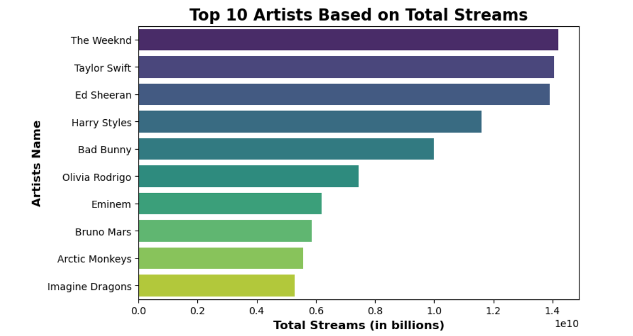
Top 10 artists based on total streams
Our analysis dives deep into the data, revealing the undeniable impact these artists have had on the streaming landscape. From chart-toppers to genre-defying trailblazers, the diversity of talent is as vast as the playlists they dominate.
So, without further ado, join us as we count down the top 10 artists of 2023 based on total streams in Spotify playlists. From groundbreaking hits to timeless melodies, these artists have undoubtedly left an indelible mark on the ears and hearts of listeners worldwide.

Slide 10
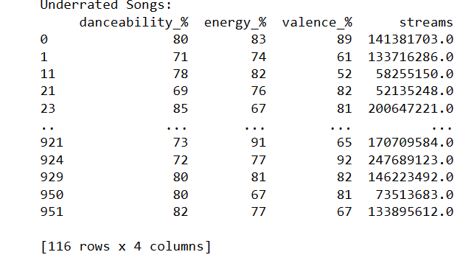
Finding underrated songs on Spotify
Explore these underrated songs with their danceability, energy, and valence percentages. The first track, with a danceability of 80, energy at 83, and valence at 89, amassed over 141 million streams. Another gem, scoring 71, 74, and 61, reached 133 million streams. Each song is a unique find, like the one with 78, 82, and 52, gathering 58 million streams. Don't miss the track with 85, 67, and 81, which hit over 200 million streams. In total, these lesser-known tunes offer a diverse musical experience, blending various rhythms and emotions, adding up to millions of streams worldwide.

Slide 11
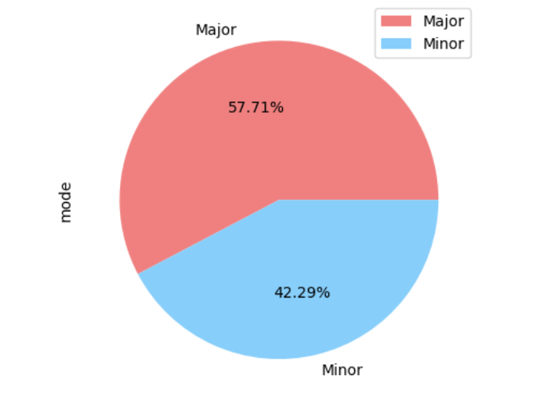
Music mode
In our exploration of Spotify's 2023 music data, a fascinating pattern has emerged — the prevalence of major and minor keys across various genres and artists. We're here to uncover the dynamics of these musical modes and understand how they contribute to the emotional tapestry of the songs we love.
As we delve into the data, it becomes evident that certain months or genres might lean heavily towards the uplifting and triumphant tones of major keys, while others may embrace the more introspective and emotive qualities found in minor keys.

Slide 12
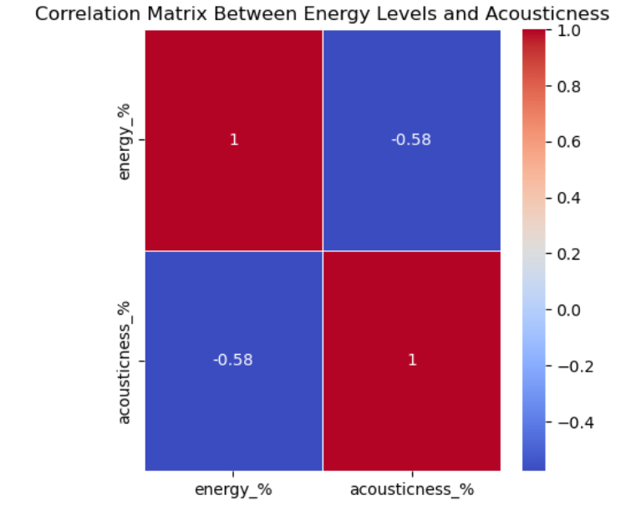
Relationships between energy levels and Acousticness
As we delve into the analysis of Spotify's 2023 data, we will uncover how energy levels, representing the intensity and activity of a track, interplay with acousticness, which captures the presence of acoustic elements in the music. Do high-energy tracks tend to be less acoustic, or is there a sweet spot where energy and acousticness converge to create a unique listening experience?
Our presentation aims to shed light on these questions and more. Through visualizations, statistics, and thoughtful analysis, we'll unravel the trends, patterns, and surprises that lie within the music ecosystem of 2023. Whether you're a music aficionado, data enthusiast, or someone simply curious about the science behind the tunes, this exploration promises to resonate with you.

Slide 13
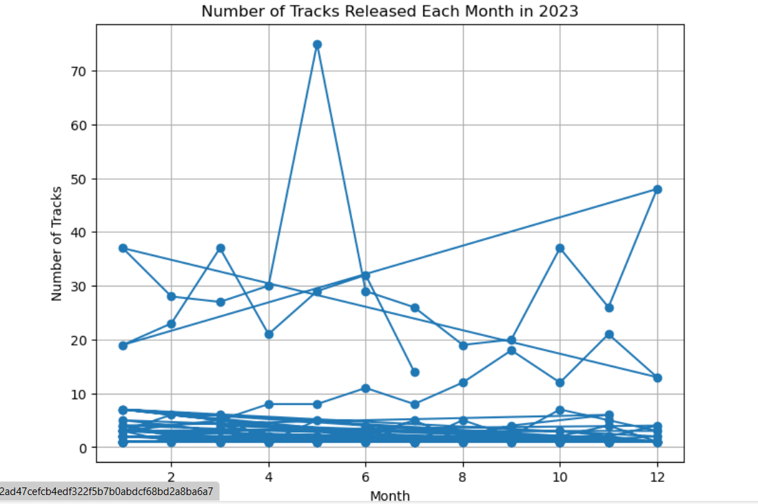
Number of tracks released each month in 2023 varied over time
January: The Crescendo of Releases
January kicks off the year with a burst of creativity and excitement. Artists, old and new, launch their latest creations, contributing to a surge in the number of releases on Spotify. As listeners eagerly embrace the fresh sounds, January becomes a crescendo of musical innovation.
February - July: The Melodic Flow
In the following months, the flow of releases maintains a melodic rhythm. Artists continue to share their work, and the Spotify platform becomes a diverse canvas of genres and styles. From heartwarming ballads to upbeat anthems, each month brings its unique flavor to the musical landscape.
August: A Tranquil Interlude
As we reach the month of August, there is a noticeable dip in the number of releases. The musical scene takes a tranquil interlude, allowing listeners to savor and appreciate the existing catalog of songs. It's a time for reflection and a breather before the musical tempo picks up again.
September - December: Building Crescendo
With the end of summer, the musical scene gradually builds momentum once more. Artists prepare for the final crescendo of the year, delivering a variety of releases that lead us into the festive season. The Spotify platform becomes a hub of anticipation and celebration.

Slide 14
Future Scope of Most Streamed Spotify Songs 2023: Predictions and Insights
The dataset on the most streamed songs of Spotify in 2023 presents exciting opportunities for future analysis. Predictive models can harness historical streaming data, artist trends, and audio features to forecast potential hits. Monitoring evolving genres, artist collaborations, and cross-platform comparisons can unveil emerging trends. Anticipating the influence of specific artists, predicting global versus local patterns, and considering societal influences offer insights into future music preferences. Advancements in technology, such as improved recommendation algorithms and immersive audio experiences, may reshape how users engage with music. Exploring collaboration dynamics and user engagement patterns provides a glimpse into potential shifts, making this dataset a valuable resource for forecasting the evolving landscape of music consumption.

Slide 15
Conclusion
In conclusion, the data presented highlights the impressive growth and impact of Spotify in the music streaming industry. With a user base spanning millions globally, the platform's diverse content and personalized recommendations continue to resonate with music enthusiasts. The insights gathered underscore Spotify's role in shaping modern music consumption habits, emphasizing its significance as a key player in the digital entertainment landscape. As the platform evolves and adapts to changing trends, its influence on the music industry is likely to persist, making Spotify a fascinating subject for ongoing observation and analysis.

Slide 16
THANK YOU !

