Slide 1




NEXT GEN EMPLOYABILITY PROGRAM
Creating a future-ready workforce
Team Members
College Name
Student Name: Manyam Thulasi Prakash
Student ID :720921104055
Jct College of Engineering & Technology-Coimbatore

Slide 2

CAPSTONE PROJECT SHOWCASE
Project Title
Notes Sharing Web Application using Django Framework
Abstract | Problem Statement | Project Overview | Proposed Solution | Technology Used | Modelling & Results | Conclusion

Slide 3
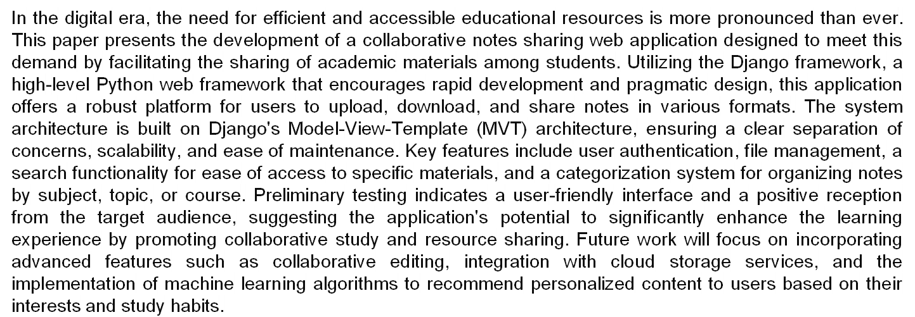
Abstract
Source :Gpt 4

Slide 4
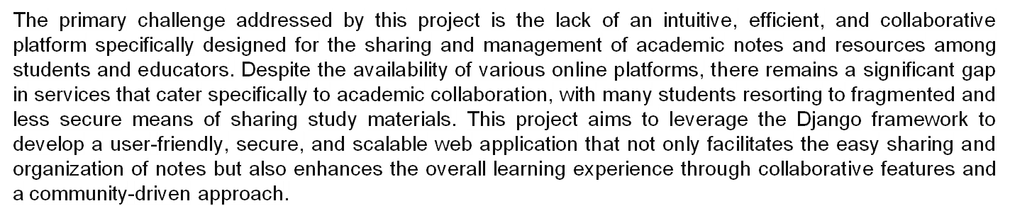
Problem Statement
Source :

Slide 5
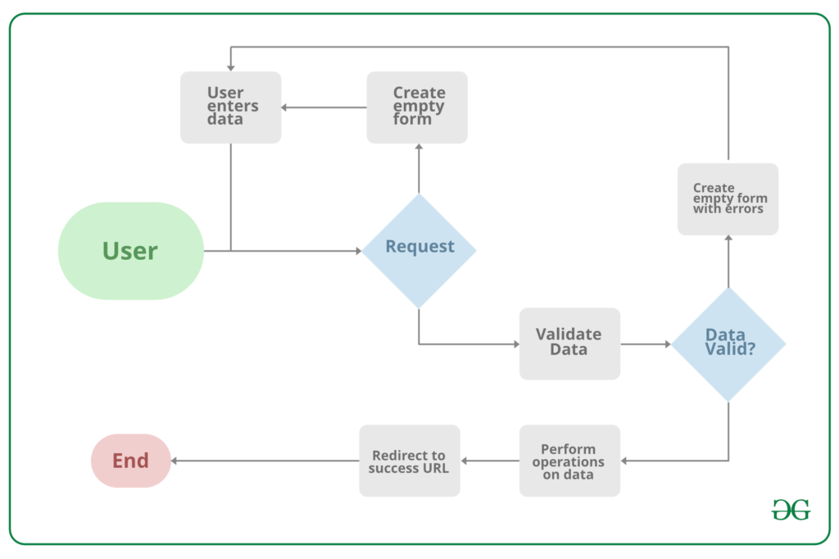
Project Overview
Source :google

Slide 6
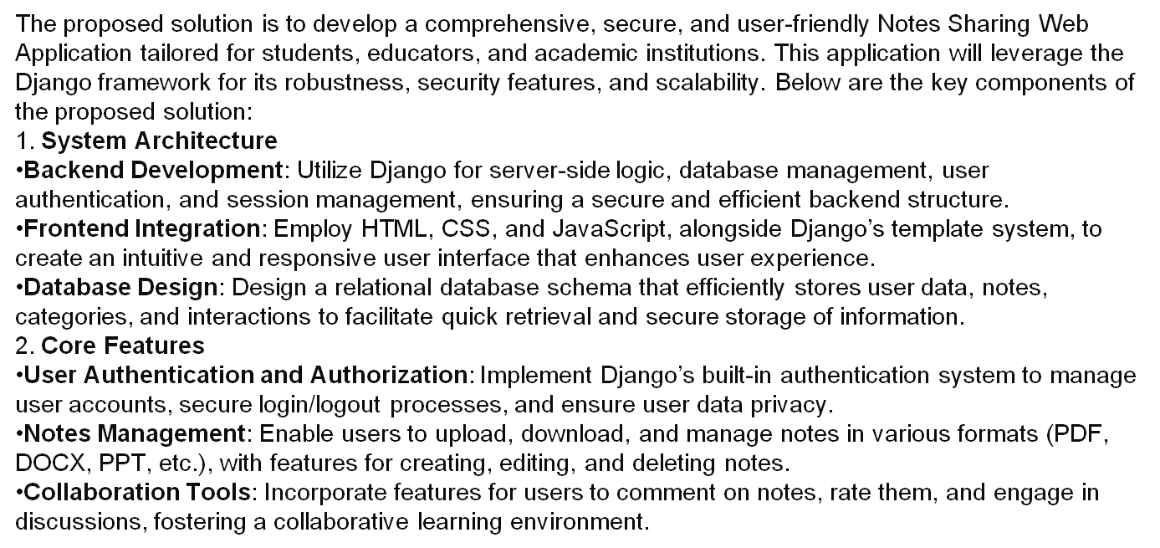
Proposed Solution
.
Source : GPT 4

Slide 7
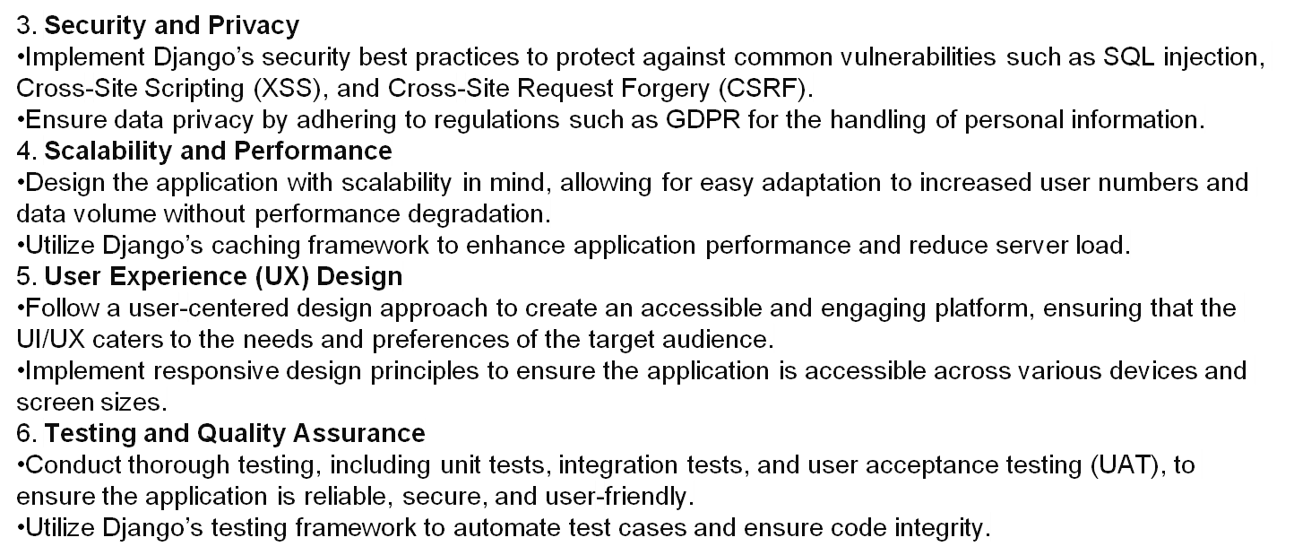
Source :GPT 4

Slide 8

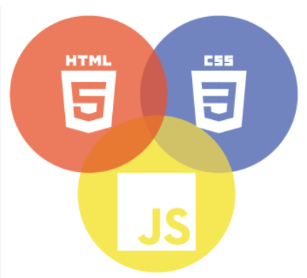

Technology Used
Front-end
Back-end
Source :

Slide 9
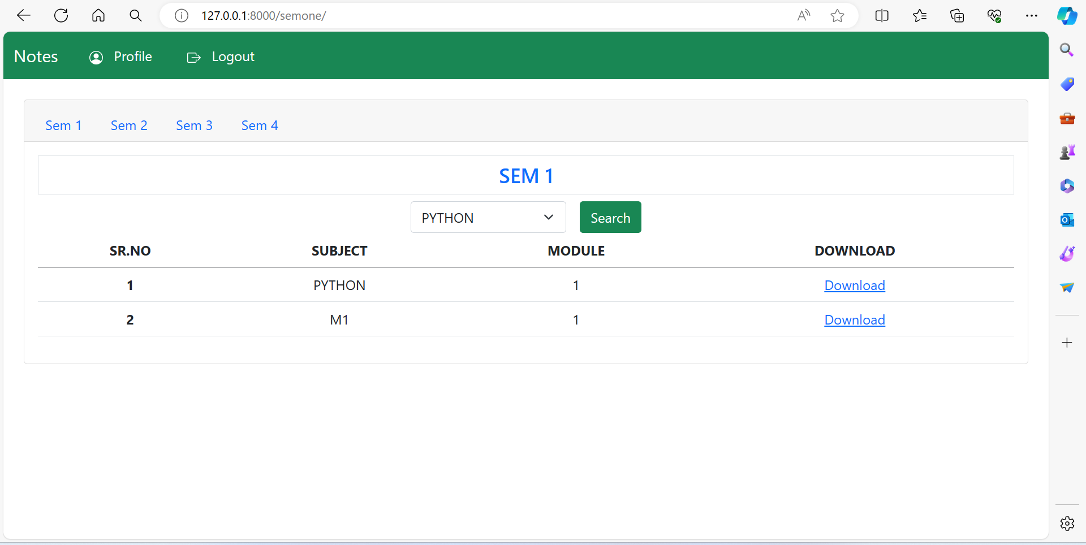
Modelling & Results
Source :

Slide 10
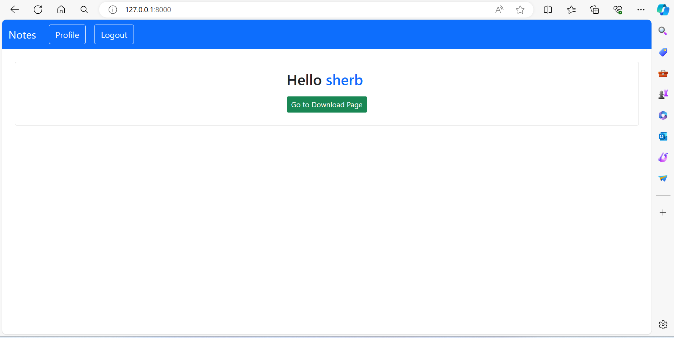
Homepage

Slide 11
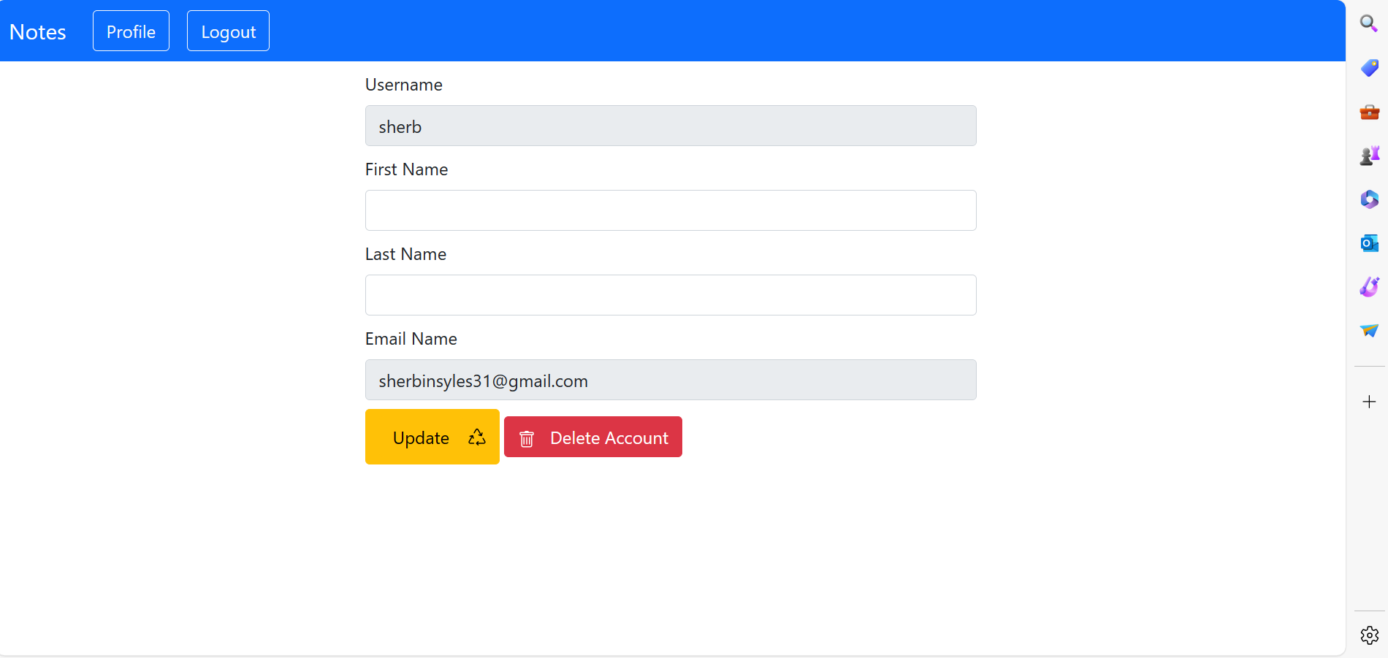
User-Profile

Slide 12
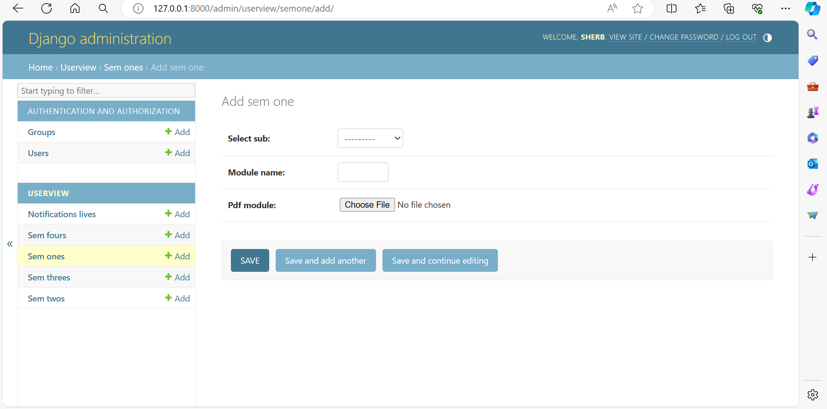
Admin-Page

Slide 13
Departments-Page

Slide 14
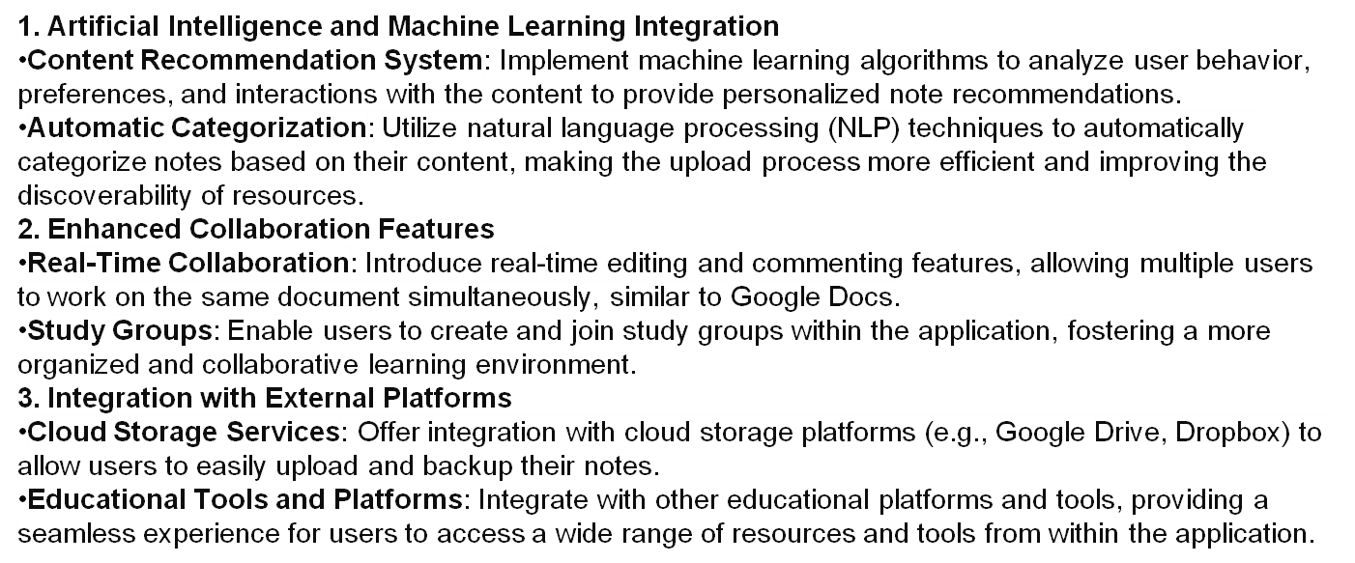
Future Enhancements:

Slide 15
Conclusion
In conclusion, note sharing applications serve as versatile tools that facilitate collaboration, knowledge exchange, and organization across various domains. Whether utilized for educational purposes, professional endeavors, or personal organization, these platforms offer a centralized hub for users to create, share, and collaborate on notes. By promoting efficient communication, enhancing productivity, and fostering learning and growth, note sharing applications play a crucial role in empowering individuals, teams, and communities to connect, collaborate, and succeed in today's digital age. As technology continues to evolve, the significance and impact of note sharing applications are expected to grow, providing invaluable support for collaboration and knowledge sharing in diverse contexts.
Source :

Slide 16
Thank You!
Notes:
Thank You !!

