Slide 1

Project Presentation on AyurSense: An Intelligent Ayurvedic Recommendation System
Presented by :
Manya Thapliyal (2200950100048)
Prashant Bisht (2200950100059)
Under the Guidance of : Mrs. Roovi Goswami
DEPARTMENT OF COMPUTER SCIENCE & ENGINEERING
MGM’s College of Engineering & Technology, Noida

Slide 2

AyurSense
Ayur = Taken from Ayurveda, meaning knowledge of life. Sense = Stands for intelligent, understanding, awareness or perception. In today’s fast-paced world, lifestyle-related disorders such as obesity, diabetes, hypertension, and stress have become increasingly common due to unhealthy eating habits, lack of physical activity, and rising stress levels. While people often turn to quick fixes or random online remedies, these solutions are usually not personalized and may not provide effective results. Ayurveda, the ancient Indian system of medicine, offers natural, holistic, and preventive approaches to health. However, the lack of accessibility and personalization has limited its widespread adoption in modern lifestyles. To bridge this gap, AyurSense is designed as a personalized Ayurvedic health recommendation system that combines traditional Ayurvedic wisdom with modern technology, making health guidance simple, accessible, and user-friendly for everyone.

Slide 3




PROBLEM STATEMENT
01 Many people remain unaware of the rich knowledge Ayurveda offers for maintaining health and preventing diseases. Due to limited awareness, individuals often overlook natural remedies that could effectively support their well-being.
02 Most available Ayurvedic suggestions are generic in nature, failing to consider individual body types, lifestyle, and health conditions. This lack of personalization often reduces the effectiveness of such remedies.
Lack of awareness about Ayurveda and its benefits
Generic remedies fail to provide personalized solutions
04 Because of this lack of awareness and the absence of proper solutions, people often rely on regular medicines or keep changing treatments frequently.
03 Such as business consulting for startups, financial planning for individuals, academic help for students, and skill development for professionals.
Frequent Shift in Treatment
No accessible platform for personalized Ayurvedic guidance

Slide 4
OBJECTIVES
To provide personalized Ayurvedic recommendations based on a user’s health quiz. The system analyzes individual responses to suggest remedies, yoga asana, and diet tips tailored to each person.
To promote natural remedies, yoga, and diet for maintaining good health. Users can adopt healthy lifestyle practices without relying on chemical-based medicines or generic advice.
To bridge the gap between modern lifestyle and Ayurvedic knowledge. AyurSense makes traditional Ayurvedic guidance accessible and practical for people with busy lives.
To create a user-friendly web application. The platform is designed to be simple, intuitive, and easy to navigate for all types of users.:
To raise awareness about Ayurveda and its benefits. The platform educates users about Ayurvedic principles, encouraging them to explore natural and holistic approaches to health.
To build trust through accurate and reliable recommendations. By using intelligent analysis and authentic Ayurvedic knowledge, AyurSense ensures users receive effective and dependable guidance.

Slide 5
Aspect | Existing System | Proposed System (AyurSense)
User Approach | People rely on Google, YouTube, or random online sources. Most advice is generic and not tailored to an individual’s specific health needs. | AI-powered quiz analyzes user responses. Recommendations are personalized for each user.
Remedies | Difficult to find trusted and authentic Ayurvedic remedies. Users may follow incorrect or ineffective tips. | Provides reliable and authentic Ayurvedic remedies. Suggestions include yoga and diet tailored to the user’s health profile.
Accessibility | Information scattered across multiple sources. Users spend time searching and verifying. | All information centralized in one user-friendly website. Users can easily access personalized guidance anytime.
Awareness | Low awareness of Ayurveda and its benefits. | Educates users about Ayurveda and its personalized benefits

Slide 6


Requirement Analysis Studied user needs and identified problems in existing systems.
Testing Module-wise testing for functionality. Ensured accuracy of recommendations.
System Design Designed workflow, architecture, and database schema. Divided the system into modules
METHODOLOGY
Deployment Hosted as a web application for accessibility.
Feedback & Improvement User feedback used for refining remedies and quiz questions.
Development Phase Frontend: HTML, CSS, Bootstrap. Backend: Flask (Python) / JS AI integration for personalized recommendations.

Slide 7
SYSTEM ARCHITECTURE
Feedback Module: Allows users to submit feedback on the recommendations for future improvement.
User: The person who interacts with the system by logging in and taking the health quiz.
1
6
Quiz Module: Collects information about the user’s health, lifestyle, and preferences through a simple questionnaire.
2
5
Output / Dashboard: Displays the recommendations in a user-friendly format, allowing users to view and follow them.
Backend (Flask/Node.js): Processes quiz responses, applies logic/AI to generate personalized recommendations.
3
4
Recommendation Engine: Analyzes user data and provides Ayurvedic remedies, yoga asana, and diet tips based on individual needs.

Slide 8
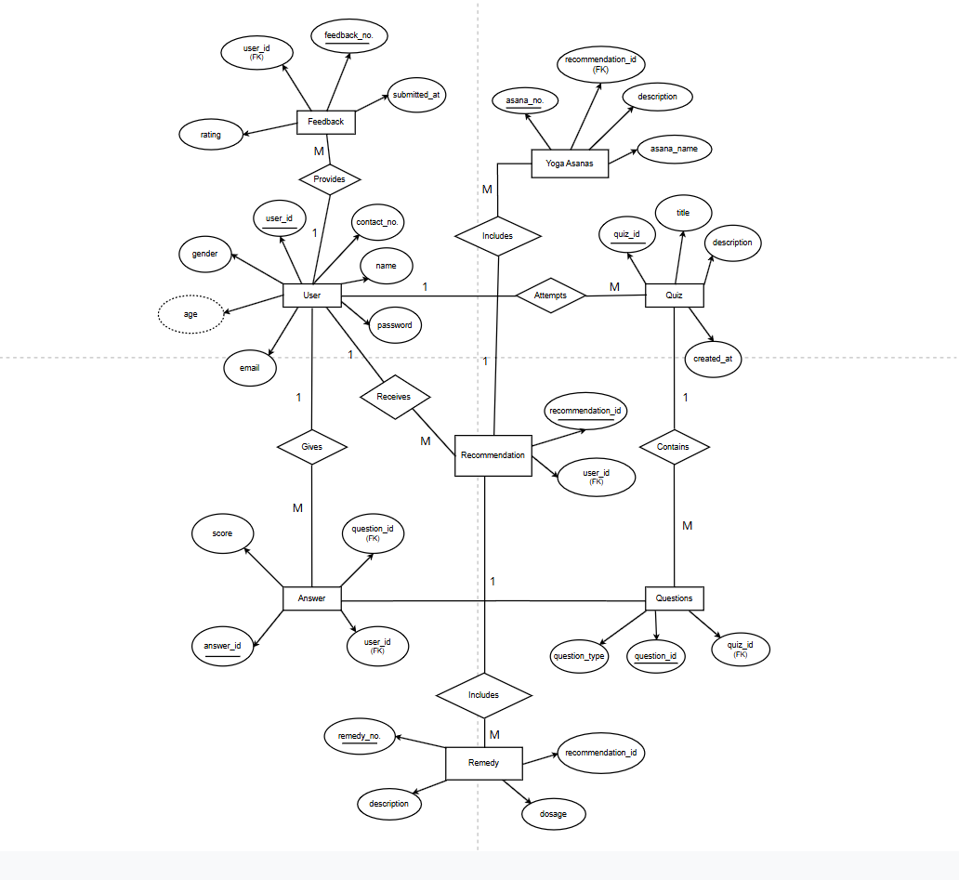
Entity-Relationship Diagram

Slide 9
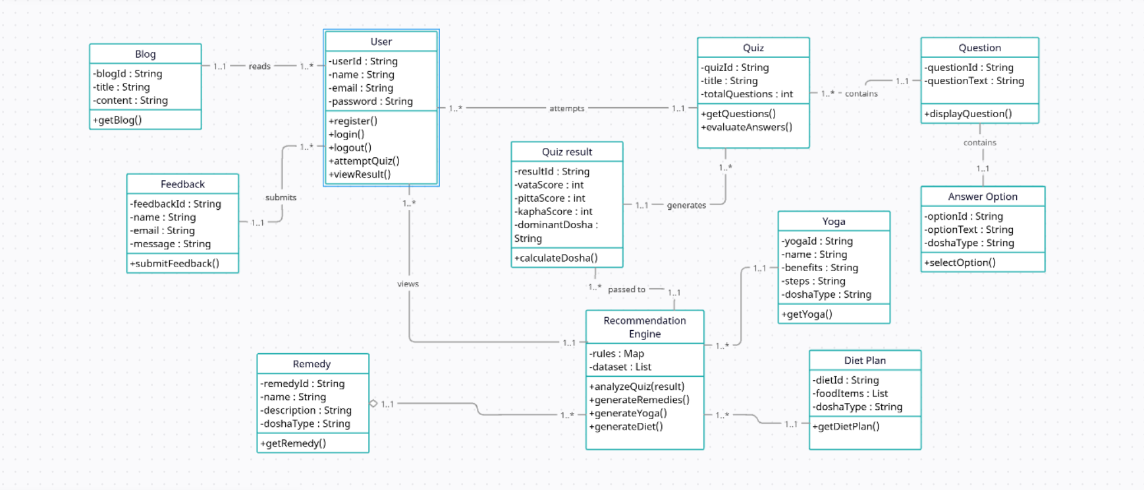
Class Diagram

Slide 10
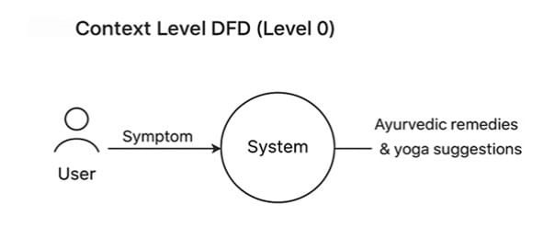
Data Flow Diagram

Slide 11
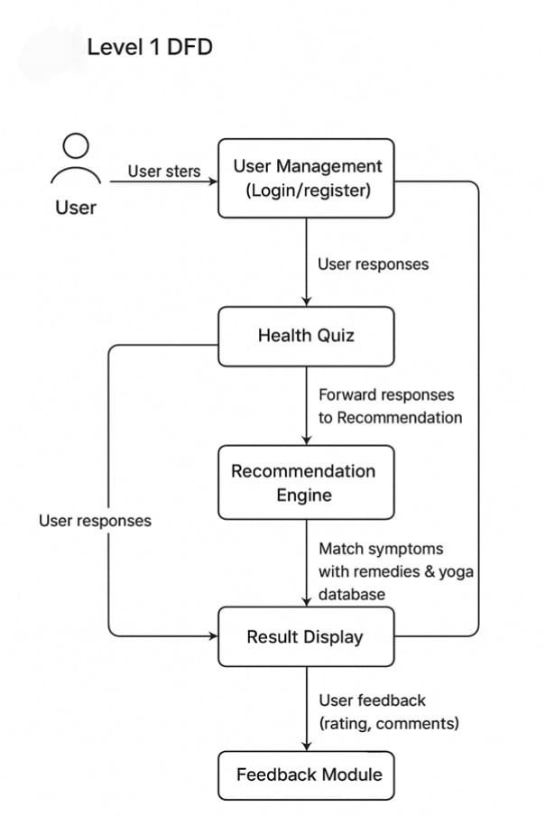

Slide 12
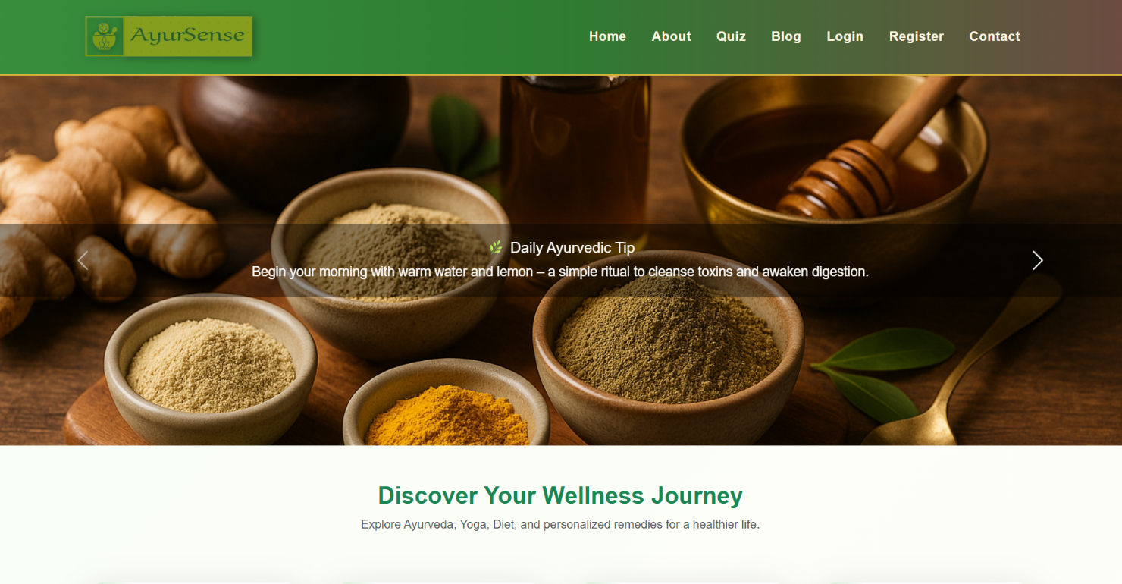


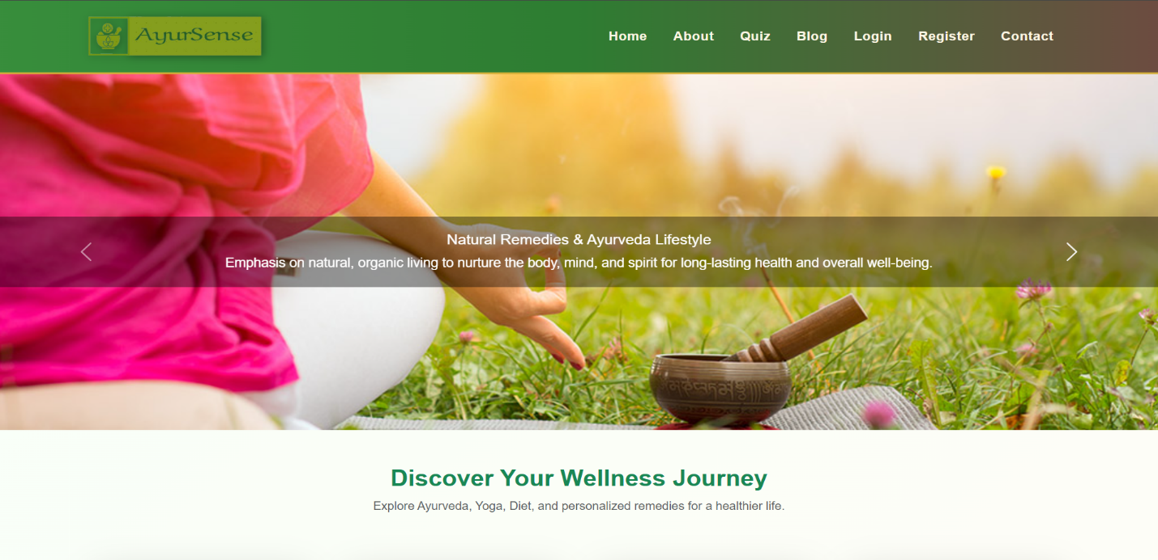

Slide 13
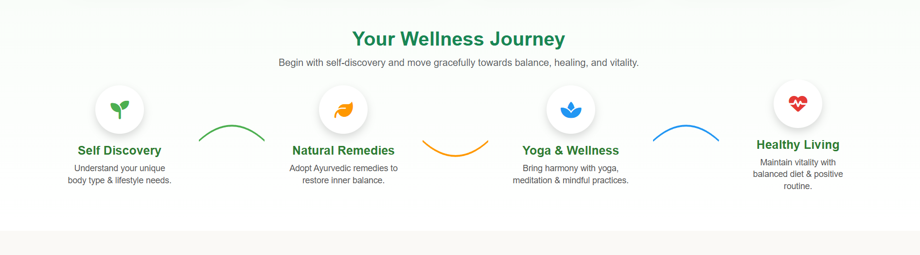
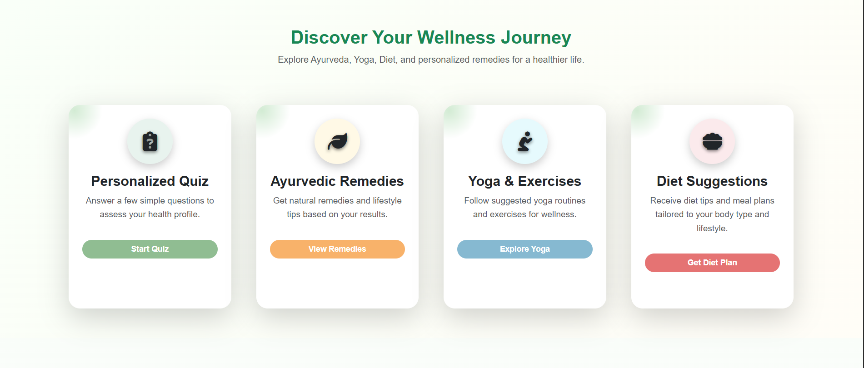
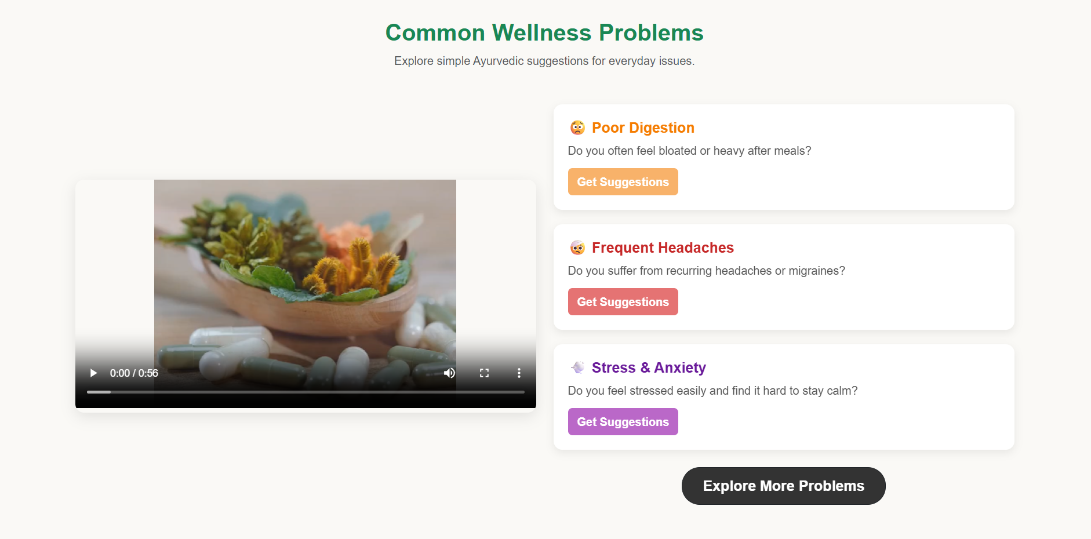

Slide 14
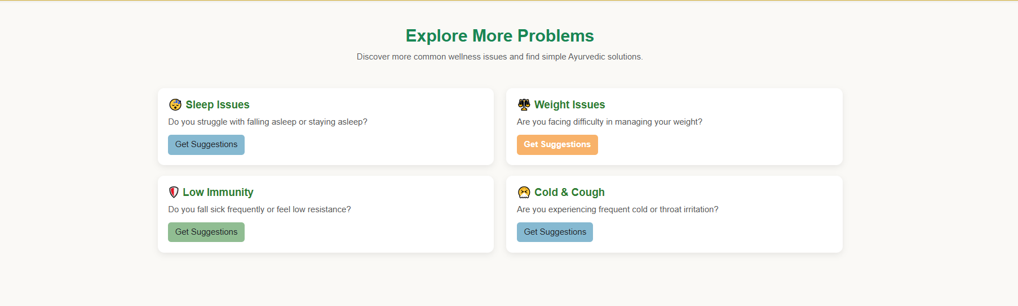

Slide 15
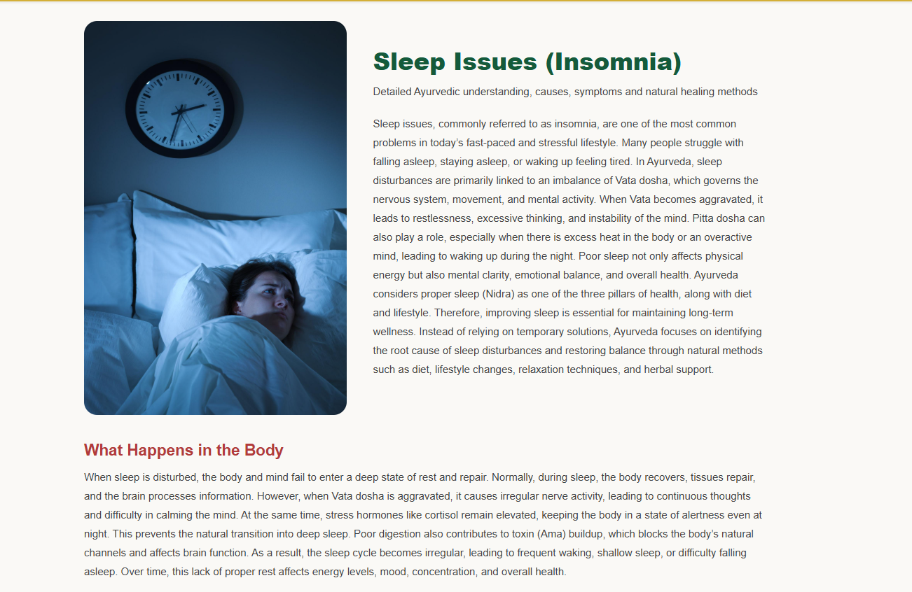

Slide 16
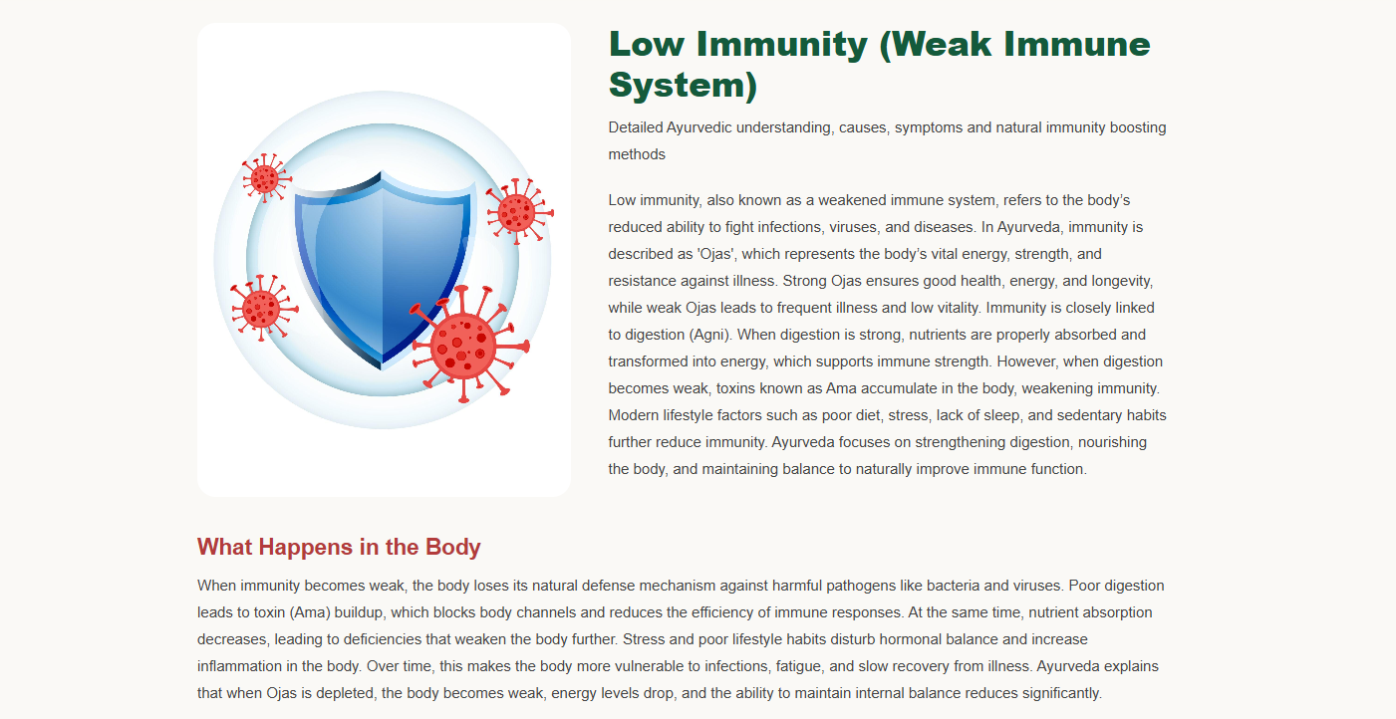

Slide 17
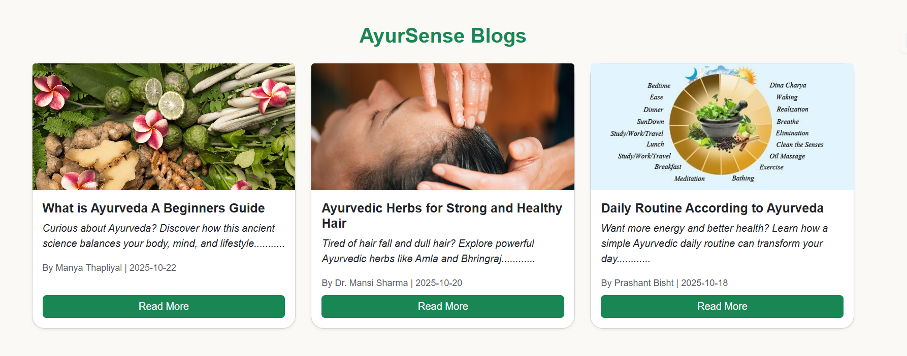
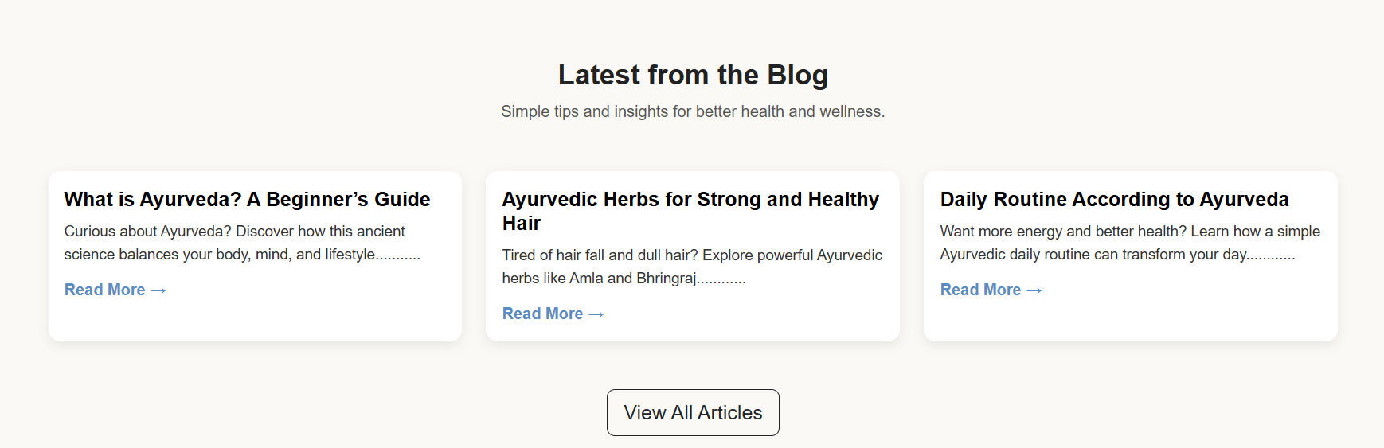

Slide 18
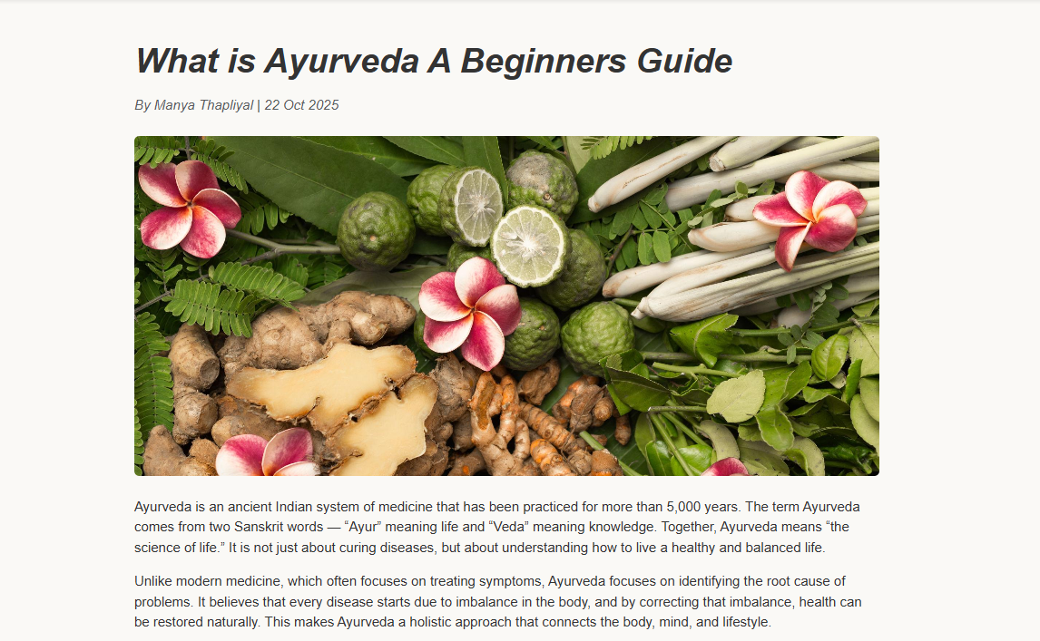

Slide 19


Slide 20
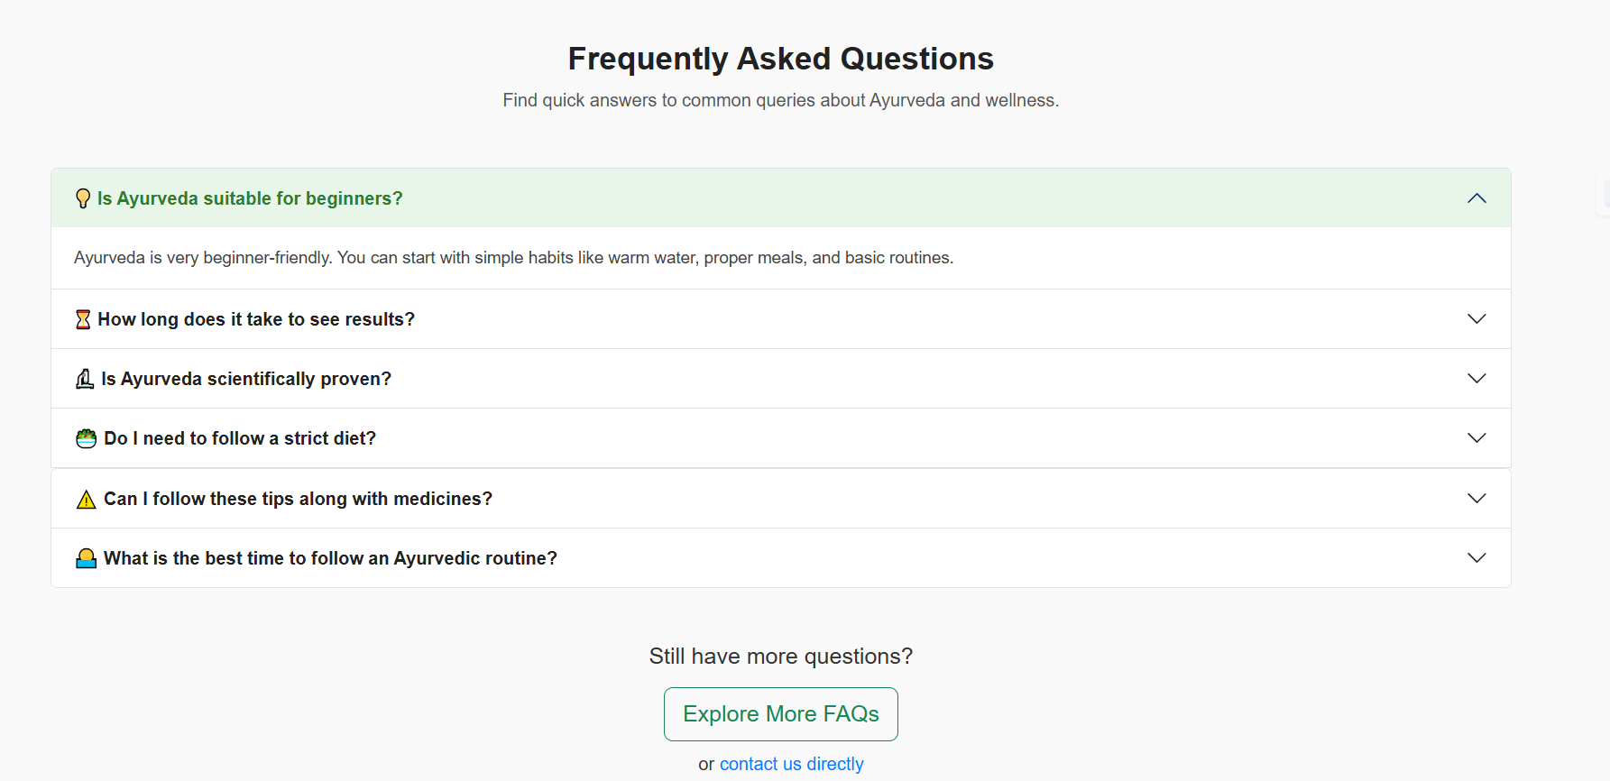


Slide 21
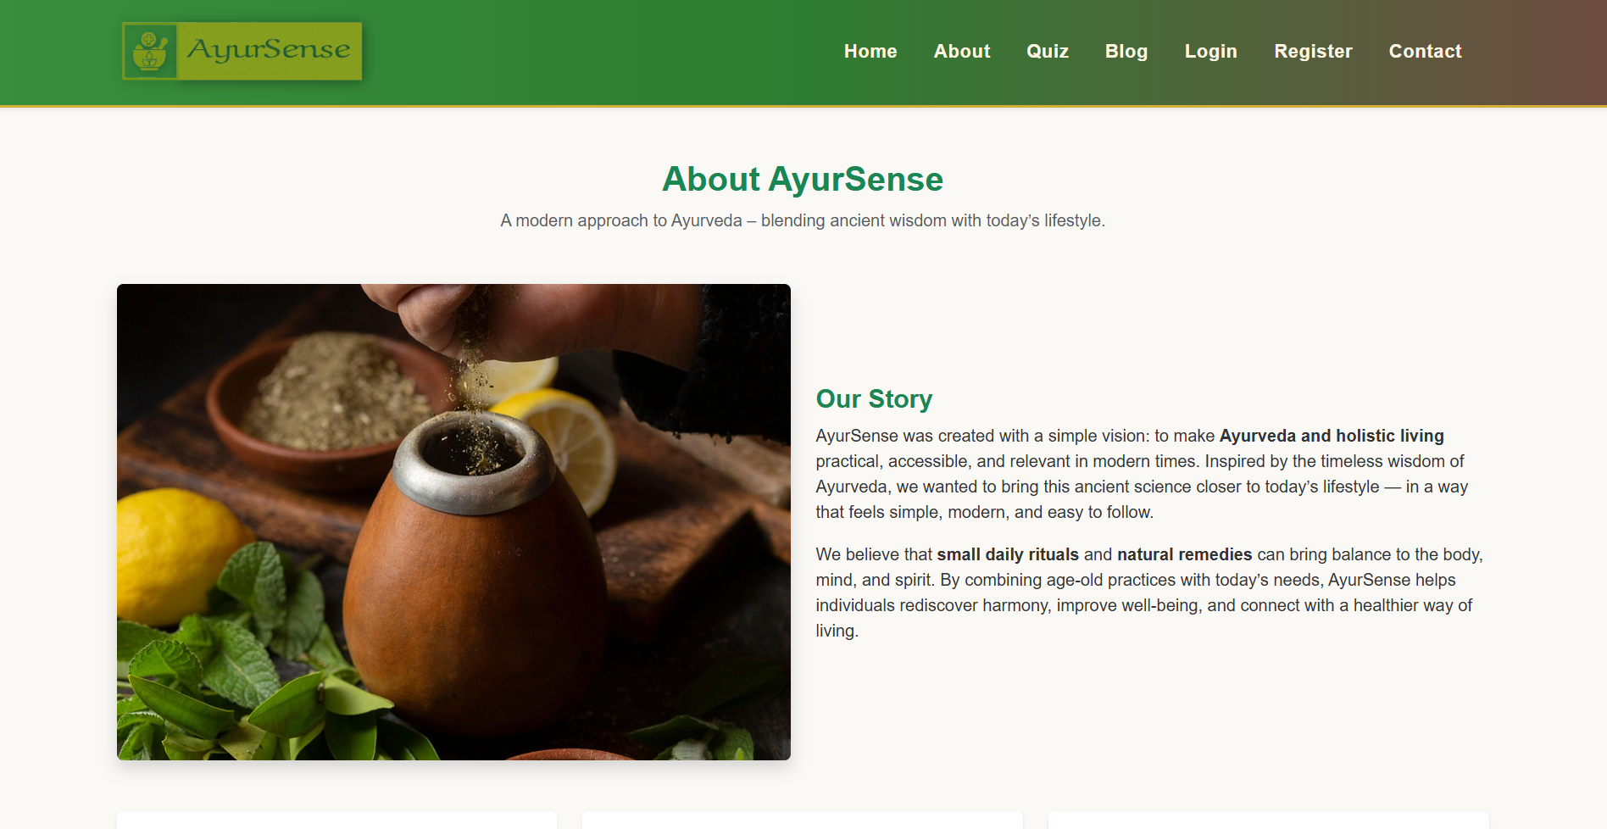

Slide 22
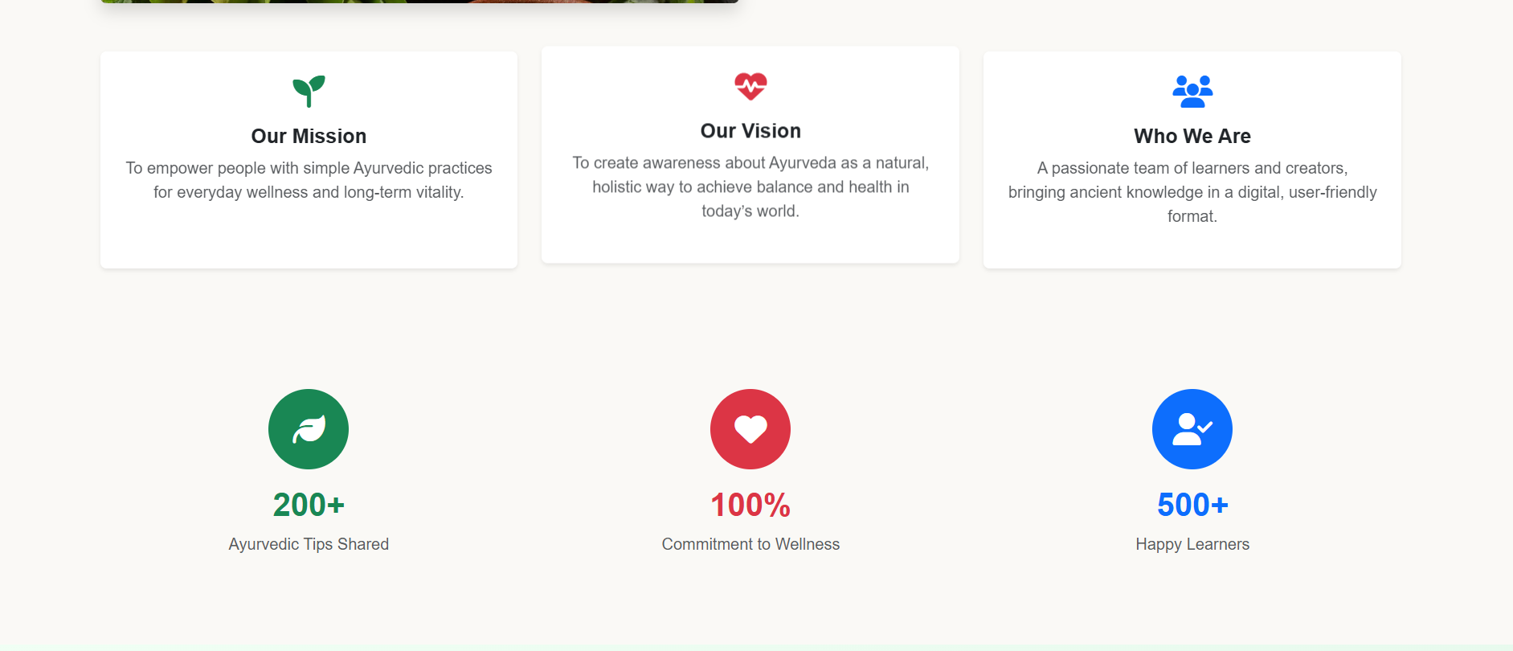

Slide 23
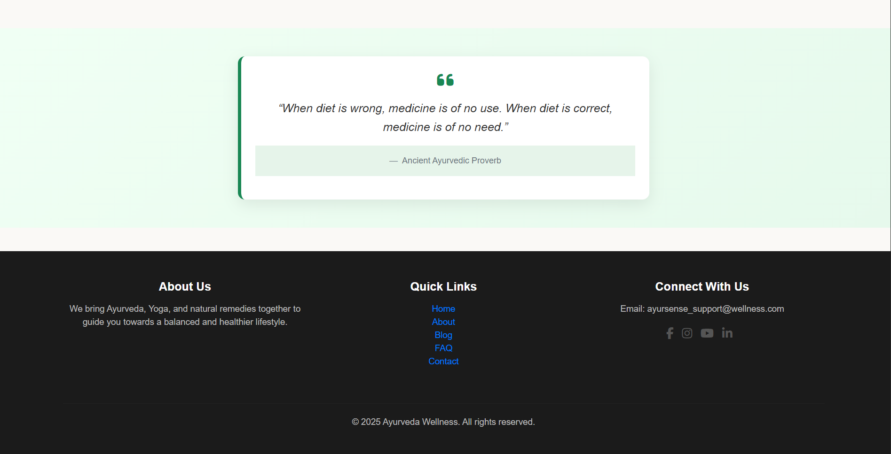

Slide 24
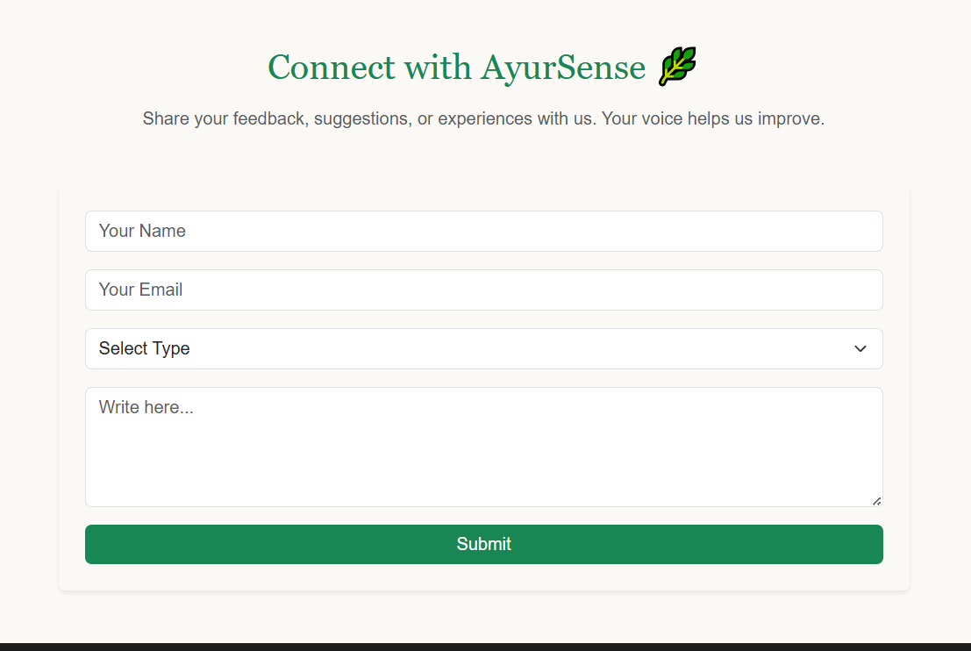

Slide 25
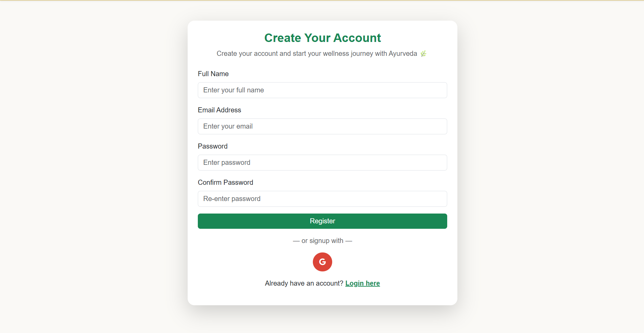

Slide 26
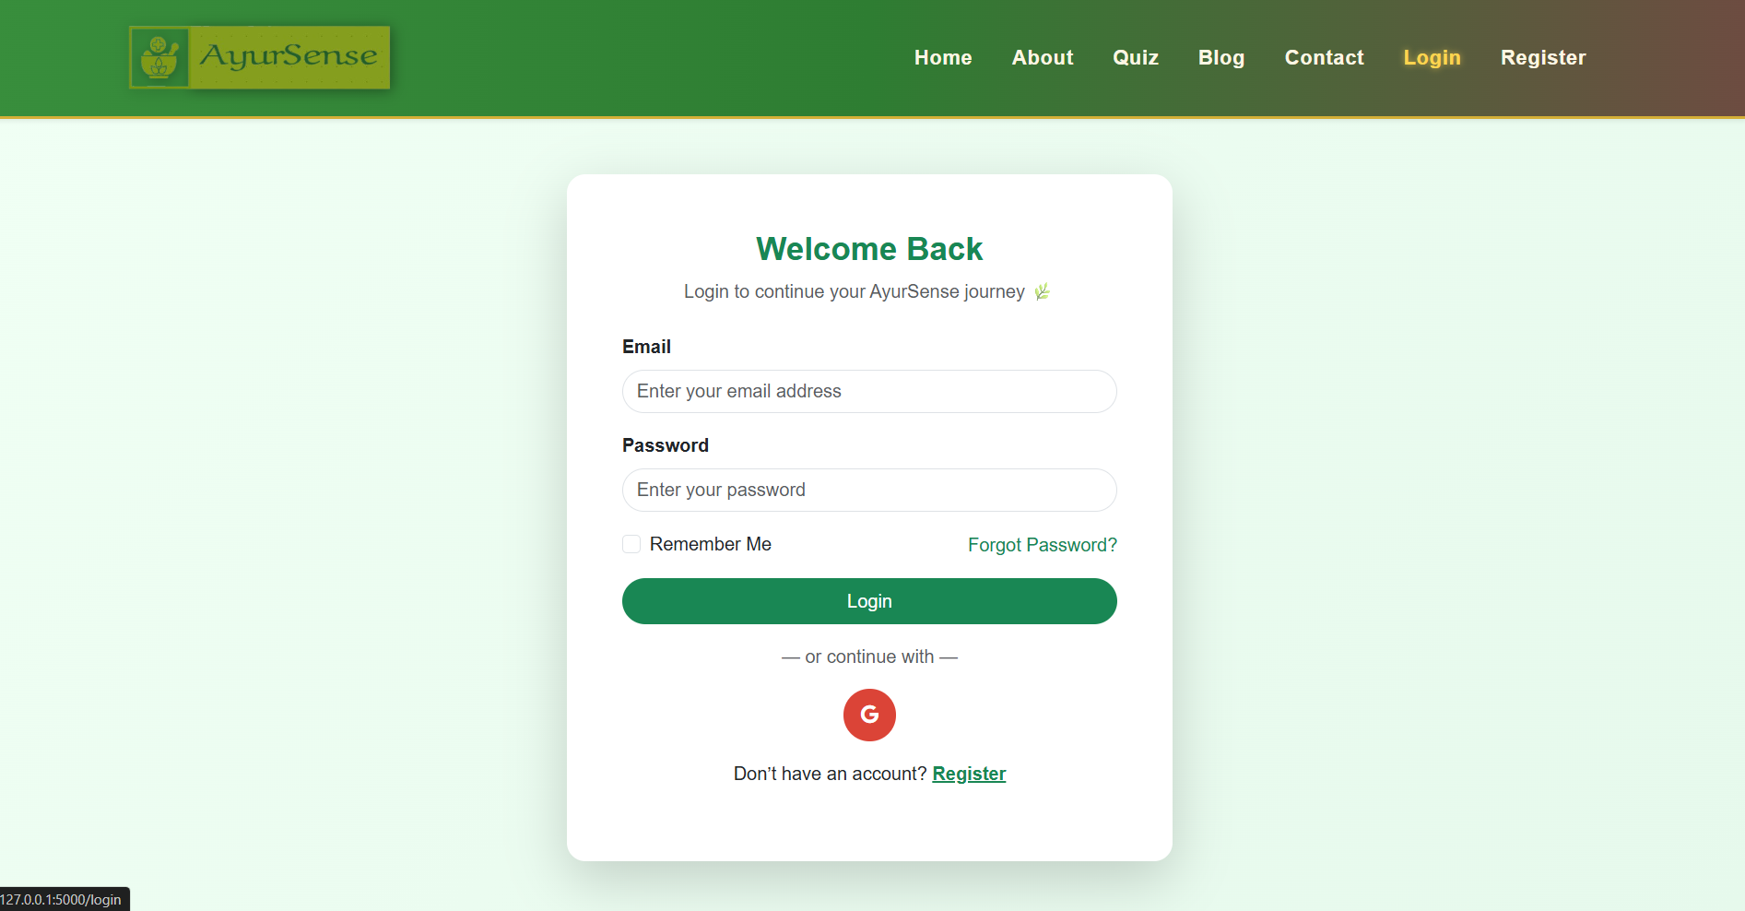

Slide 27


Slide 28
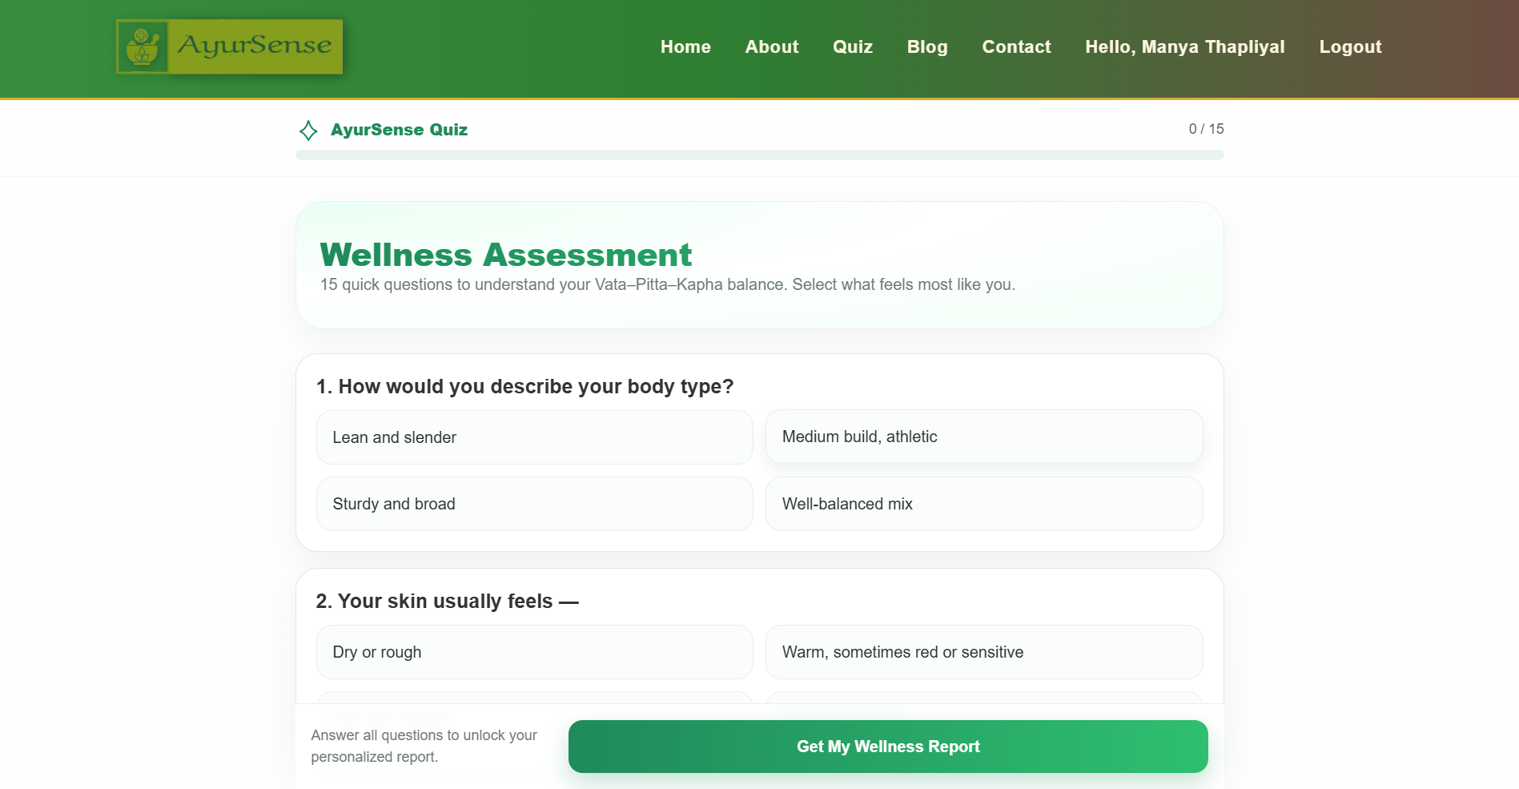
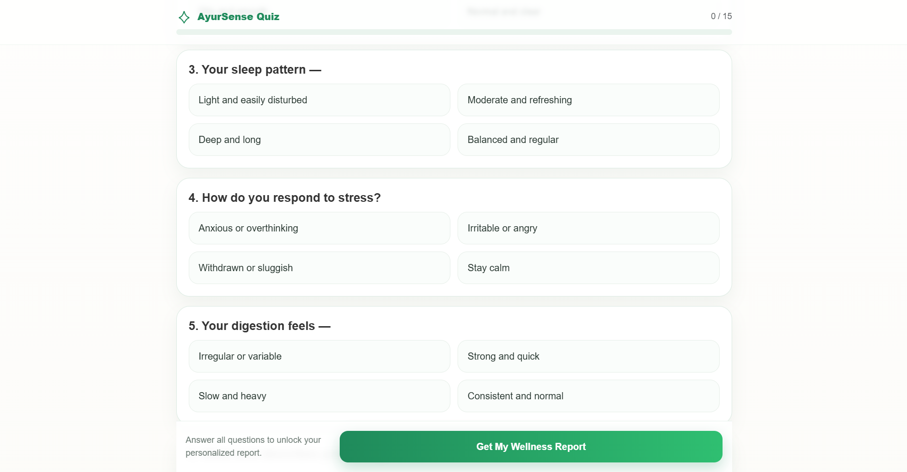

Slide 29
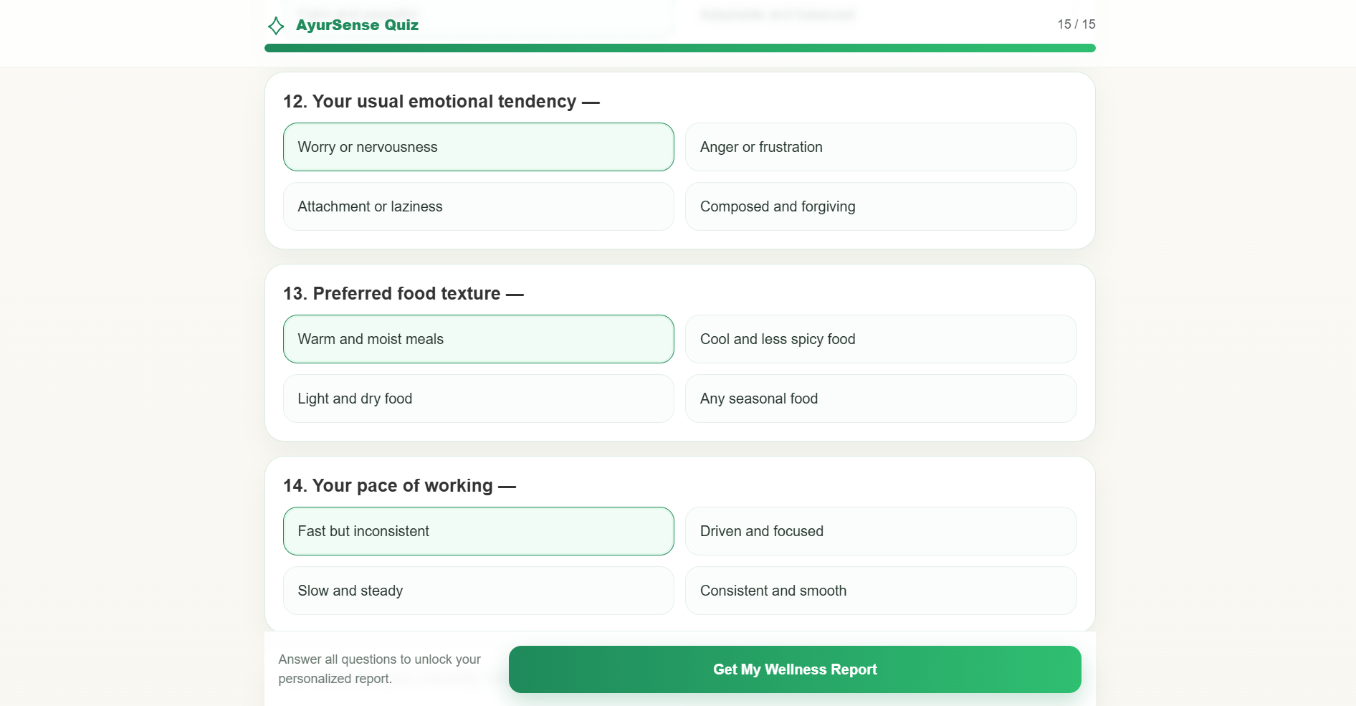
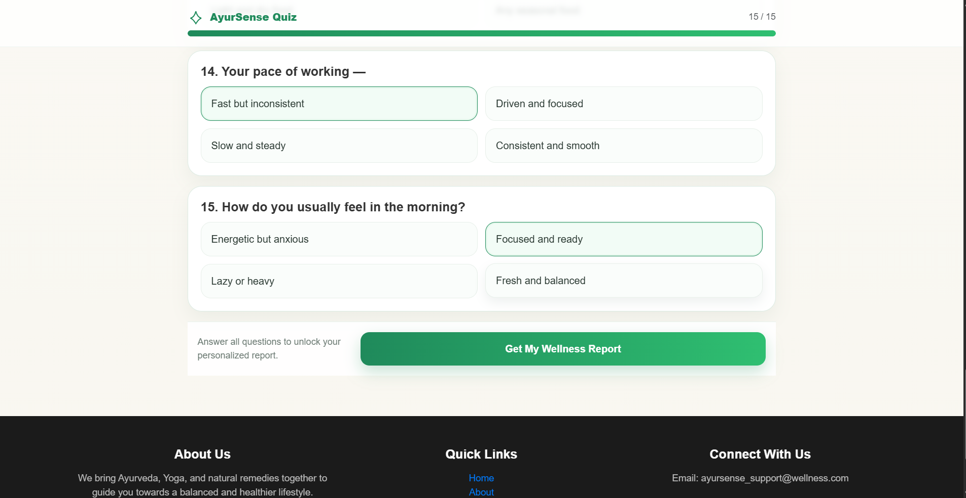

Slide 30
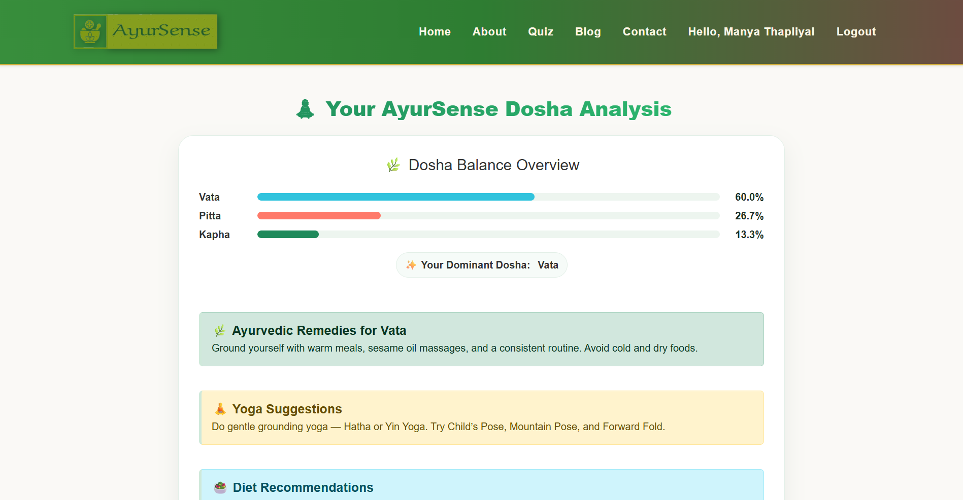
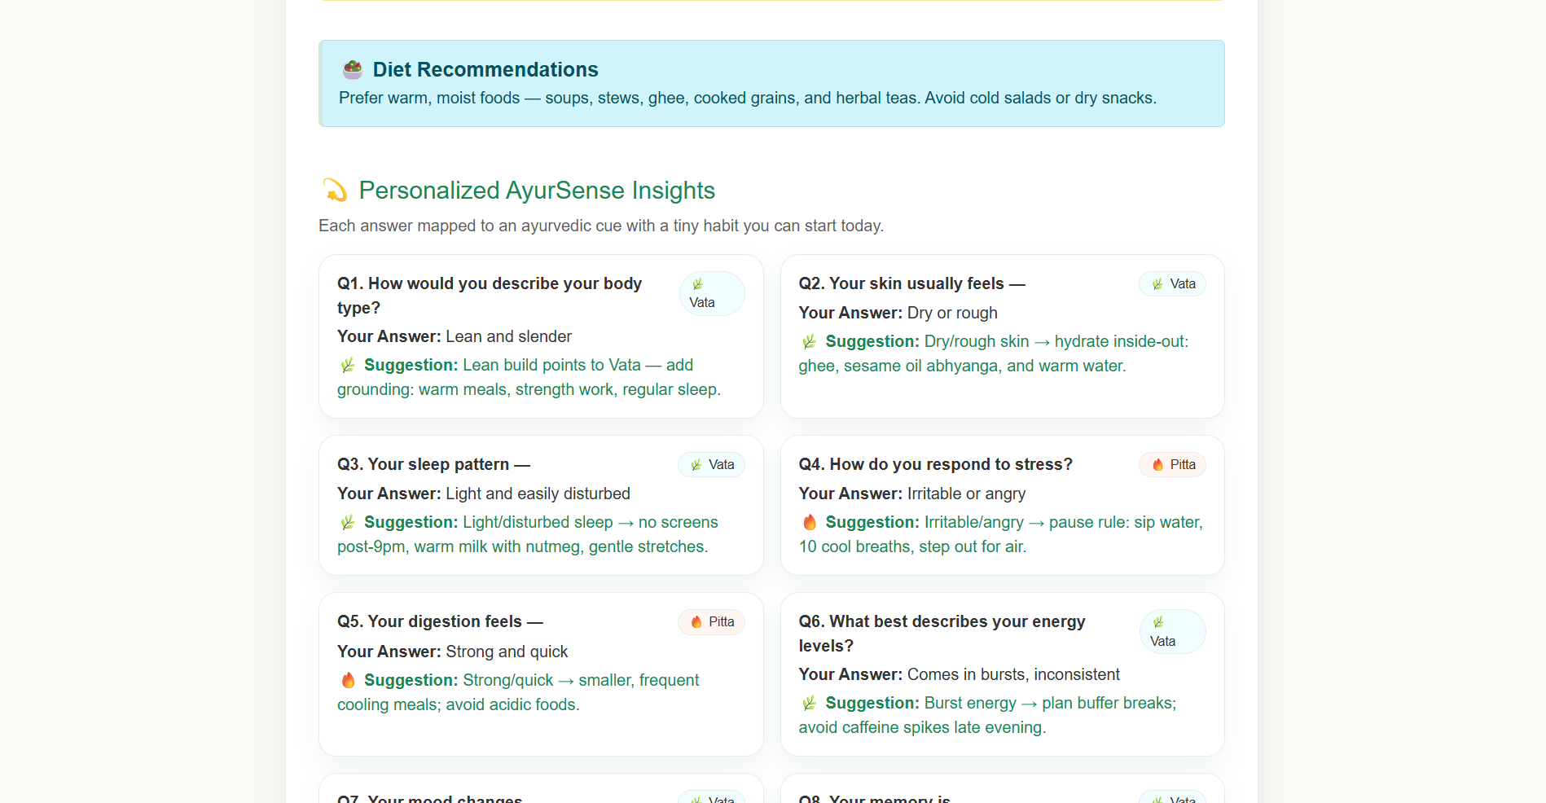

Slide 31
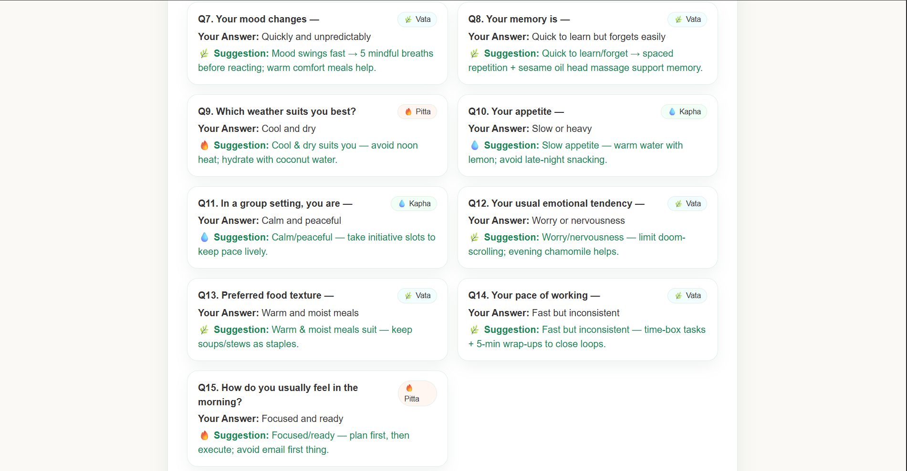

Slide 32
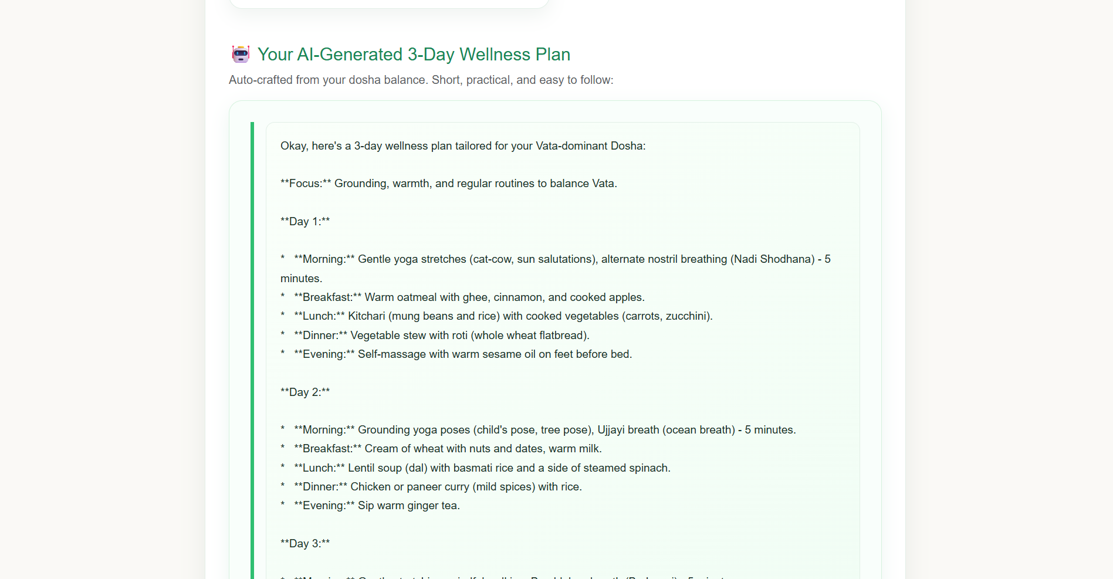

Slide 33
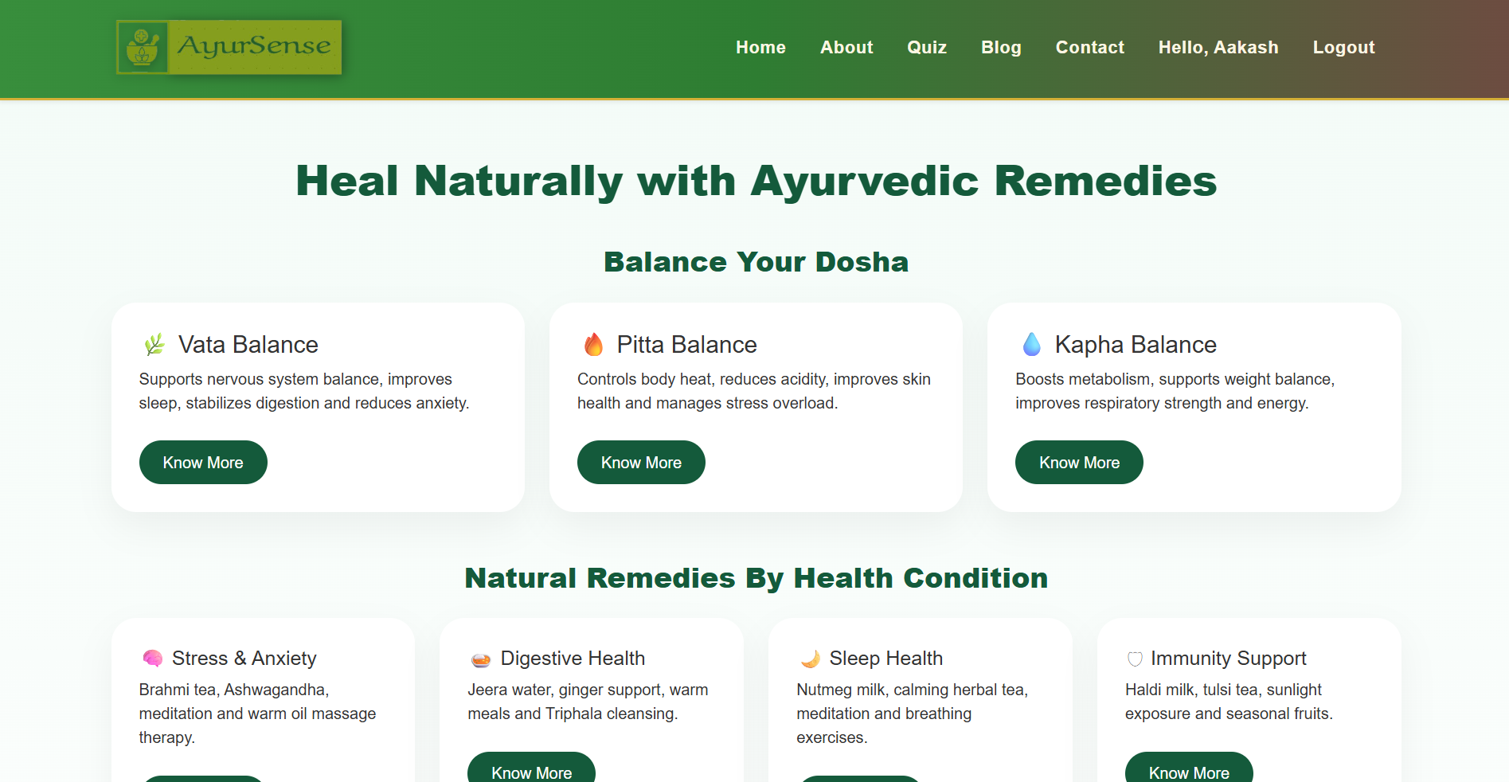
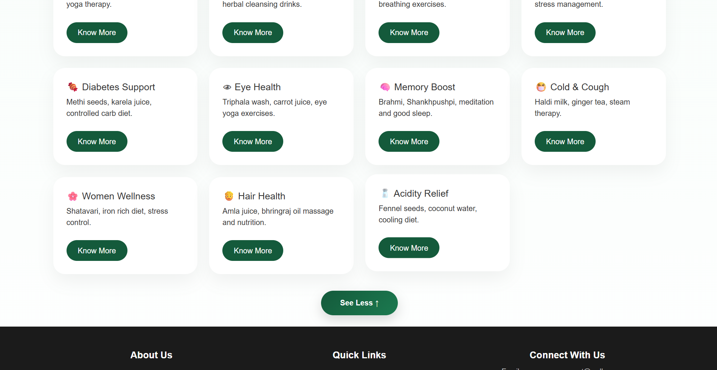

Slide 34

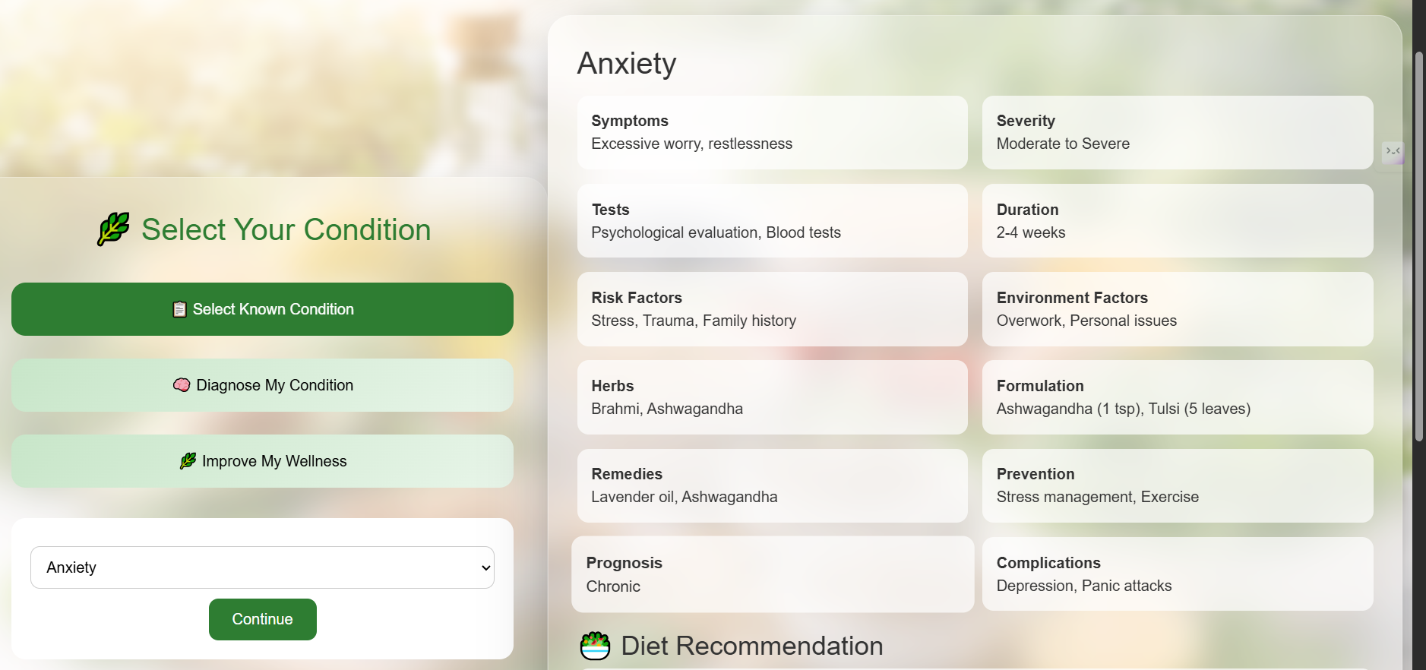

Slide 35
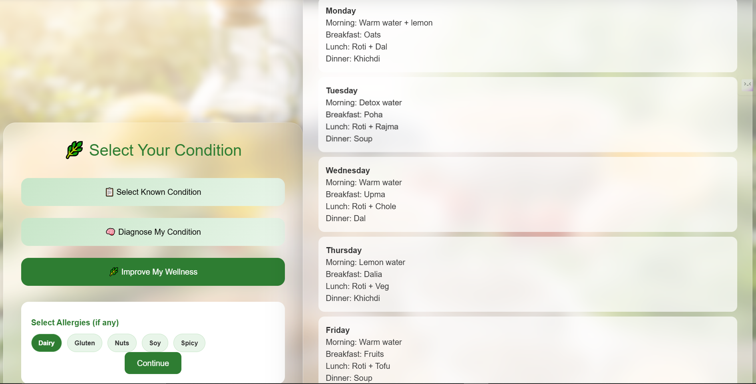

Slide 36
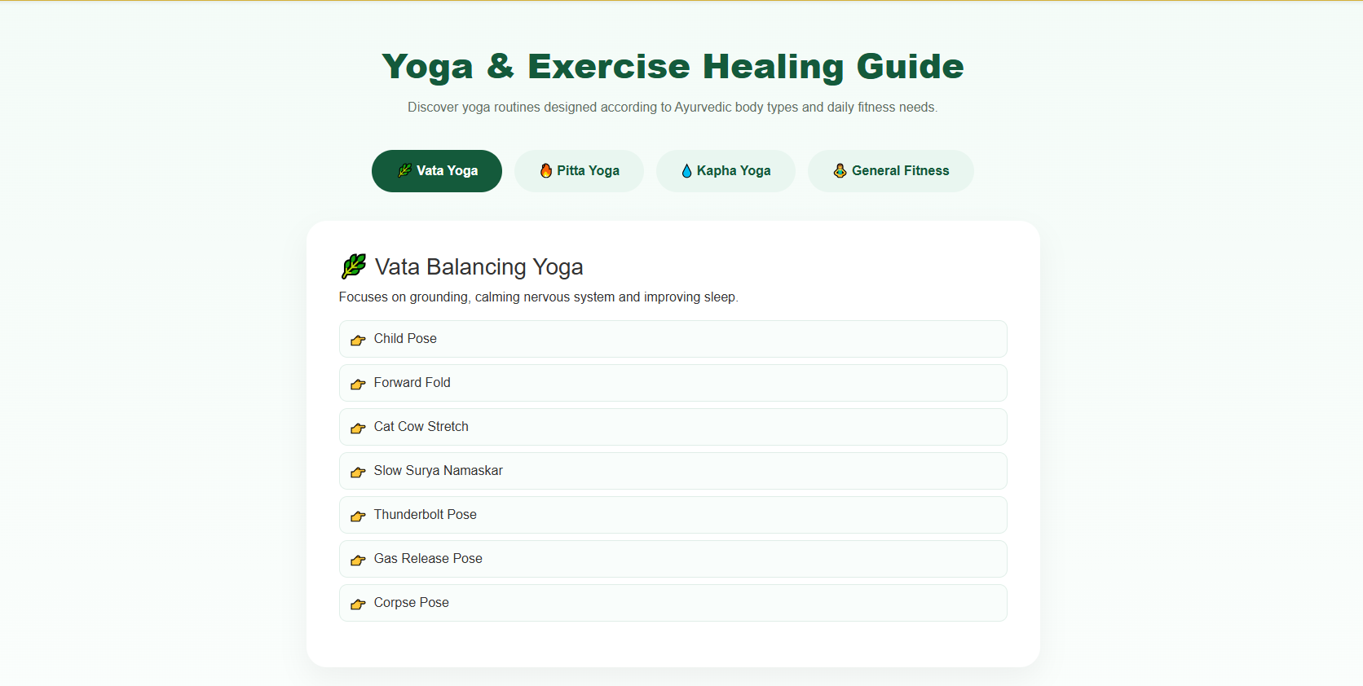
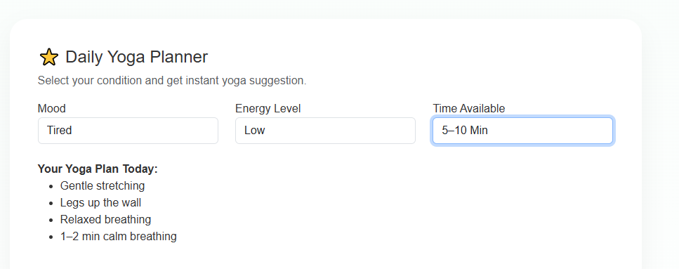

Slide 37
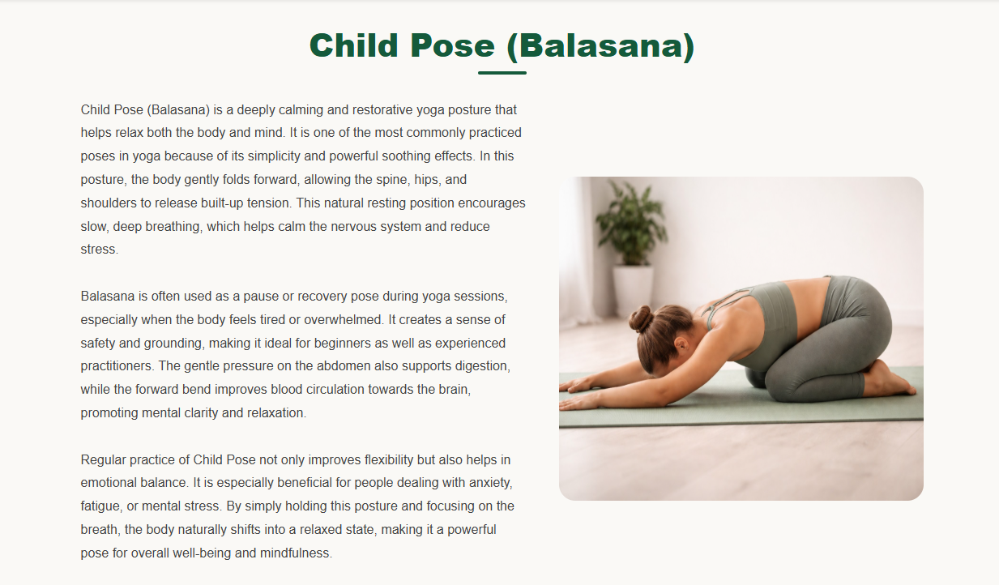

Slide 38
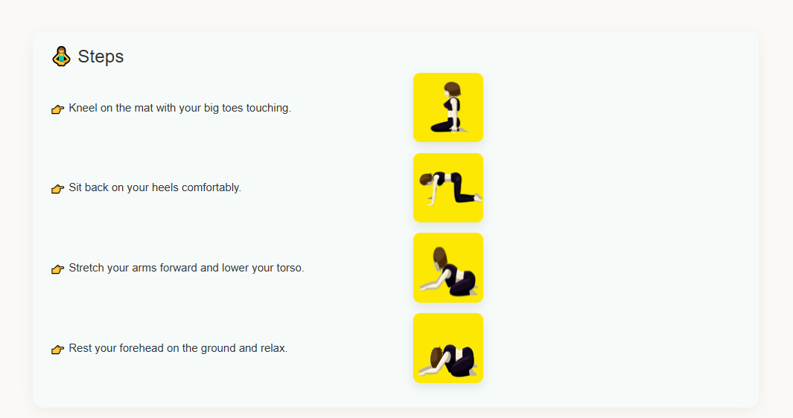

Slide 39
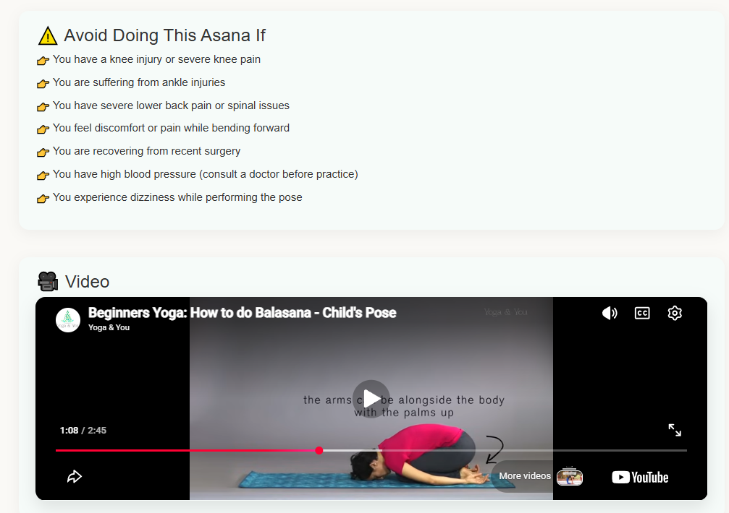

Slide 40
Target Journals/Conferences
Planning to submit in reputed conferences/journals on healthcare, AI, and Ayurveda..
Collaboration & Guidance Working under guidance of faculty mentors for refinement. Exploring collaboration with Ayurveda practitioners for validation.
Future Scope for Publication Potential for case studies based on real user feedback. Expansion into international digital health research platform.
Research Paper Drafting
Preparing manuscript highlighting AyurSense methodology, results, and impact.
Efforts Towards Publication

Slide 41

CONCLUSION
AyurSense provides a personalized Ayurvedic health guidance platform using AI.
It bridges the gap between traditional wisdom and modern digital solutions.
Helps users adopt natural, side-effect free remedies instead of over-dependence on medicines.
Ensures accessibility, awareness, and trust in Ayurveda through a simple web application.
Future enhancements can include mobile app integration, real-time chat with experts, and multilingual support.

Slide 42
REFERENCES
Charaka Samhita, P. V. Sharma, Trans., Varanasi, India: Chaukhambha Orientalia, 2008.
Sushruta Samhita, K. R. Srikantha Murthy, Trans., Varanasi, India: Chaukhambha Orientalia, 2012.
World Health Organization, “Traditional, Complementary and Integrative Medicine,” [Online]. Available: https://www.who.int
Ministry of AYUSH, “Ayurveda Overview,” [Online]. Available: https://www.ayush.gov.in
M. Grinberg, Flask Web Development: Developing Web Applications with Python, 2nd ed. Sebastopol, CA, USA: O’Reilly Media, 2018.
J. Duckett, HTML and CSS: Design and Build Websites. Hoboken, NJ, USA: Wiley, 2011.
D. Flanagan, JavaScript: The Definitive Guide, 7th ed. Sebastopol, CA, USA: O’Reilly Media, 2020.
Bootstrap, “Bootstrap Documentation,” [Online]. Available: https://getbootstrap.com
W3Schools, “Web Development Tutorials,” [Online]. Available: https://www.w3schools.com
V. Lad, Ayurveda: The Science of Self-Healing. Twin Lakes, WI, USA: Lotus Press, 2002.
H. Sharma and H. M. Chandola, “Ayurveda in present scenario,” International Journal of Research in Ayurveda and Pharmacy, vol. 2, no. 3, pp. 1–5, 2011.

Slide 43

Please visit our website
https://ayursense-3.onrender.com/

