Slide 1

DEPARTMENT OF SOFTWARE ENGINEERING
PROJECT TITLE:
Charity management system
GROUP MEMBER :
MANZAR ALI BSE-23F-143
MUHAMMAD SARMAD BSE-23F-115

Slide 2
INTRODUCTION
A Charity Management System helps charities by organizing donations, volunteers, events, and beneficiaries. It makes operations smoother and more transparent, allowing charities to focus on helping more people
PURPOSE Of Charity Management System :
Streamline Operation: Automate and simplify management tasks.
Improve Communication: Enhance interaction with donors, volunteers, and beneficiaries.
Increase Transparency: Provide clear and accurate information
Support Growth: Scale up easily as the charity expands.

Slide 3
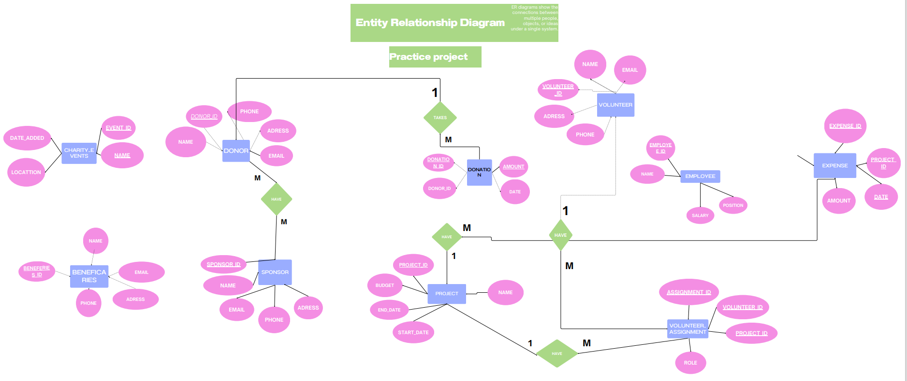
ER MODEL of Charity Management System :

Slide 4
Now Let's review Queries

Slide 5
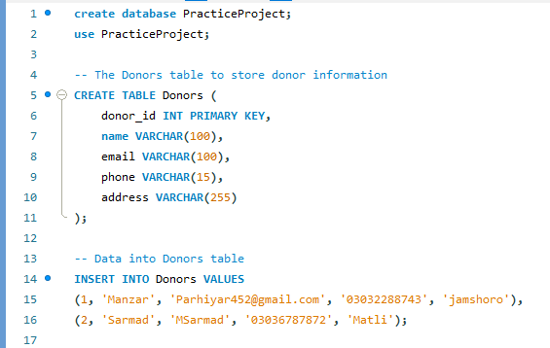
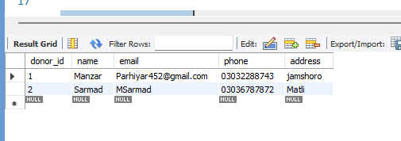
Donors Table

Slide 6
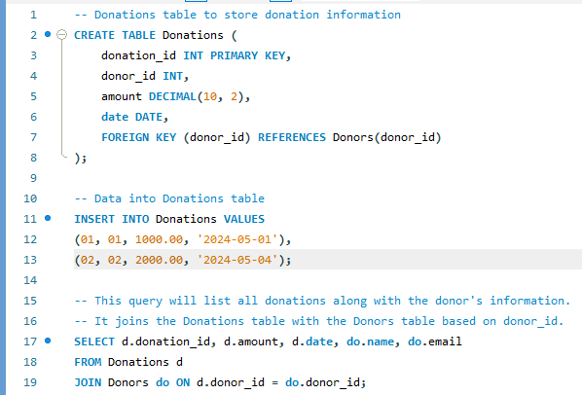
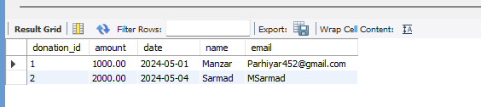
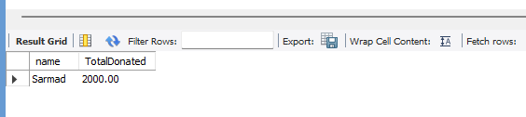
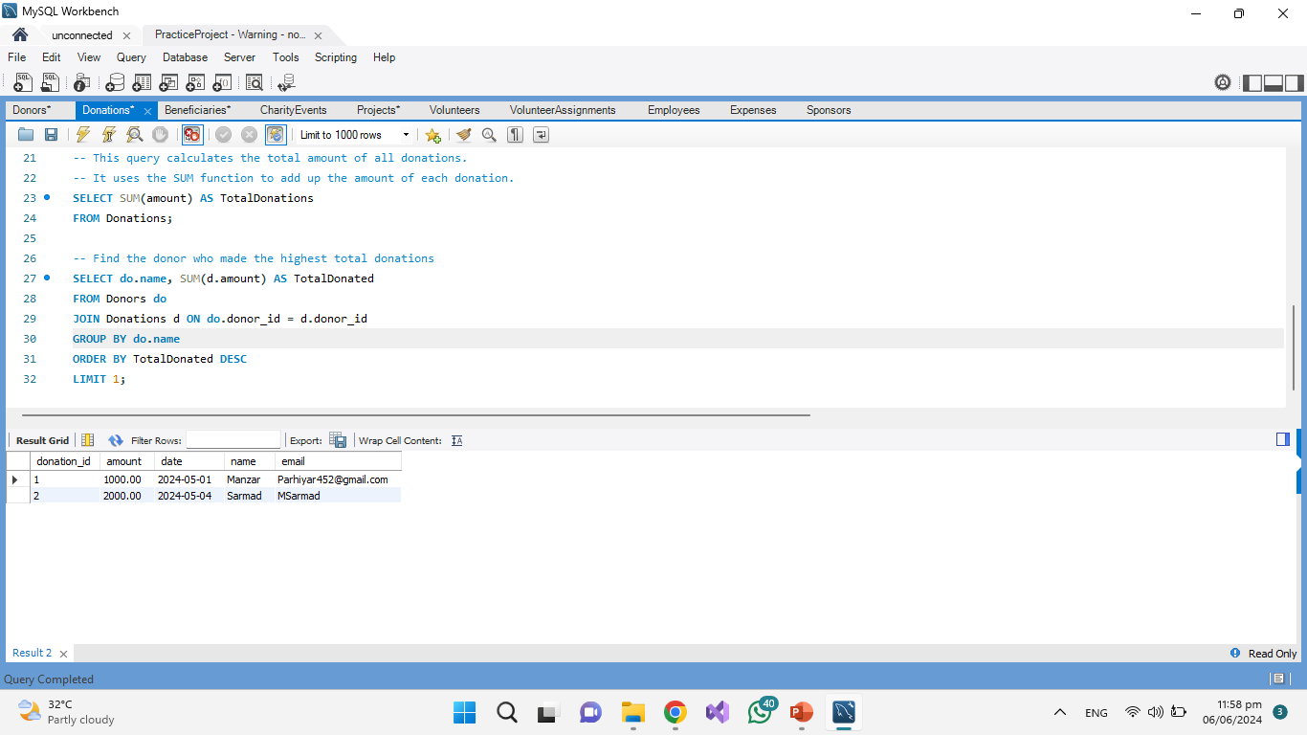
Donations Table

Slide 7
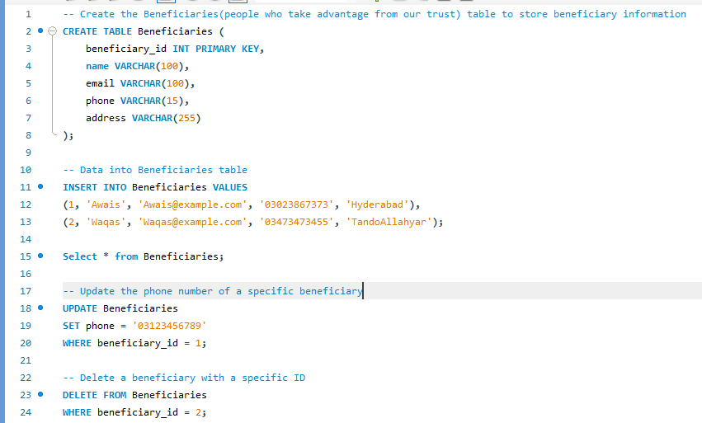
Beneficiaries Table

Slide 8
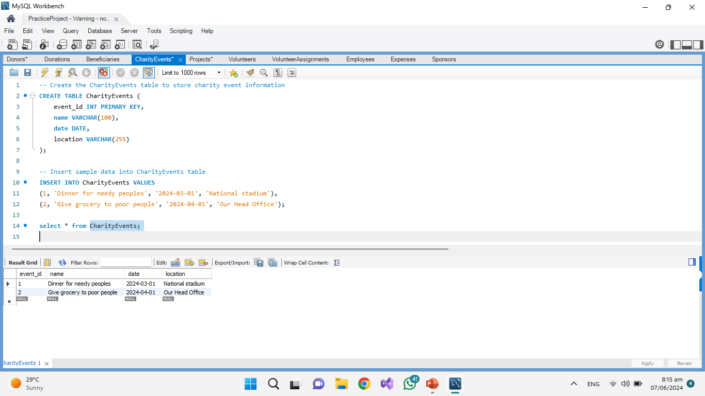
Charity Events

Slide 9
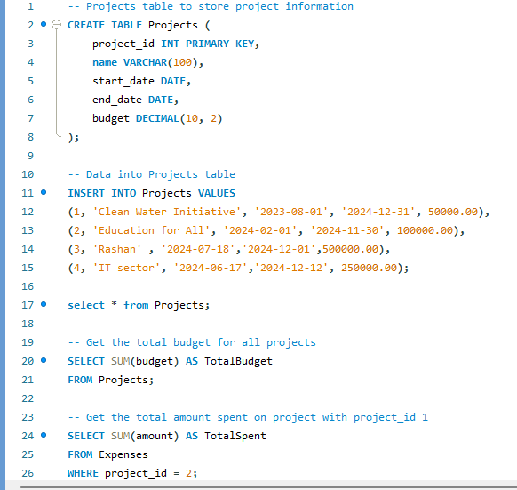
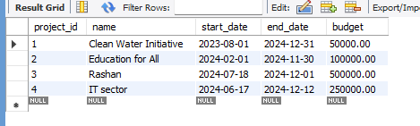
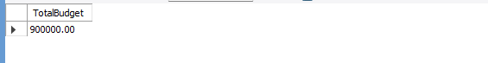
Projects Table

Slide 10
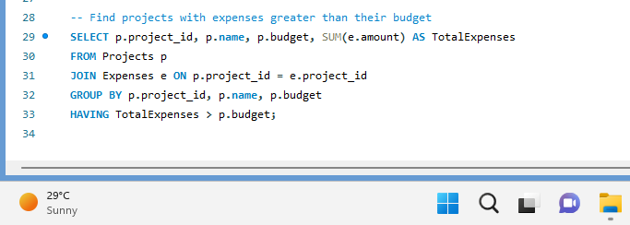
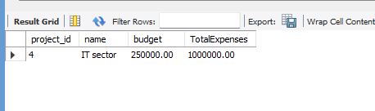
Projects Table

Slide 11
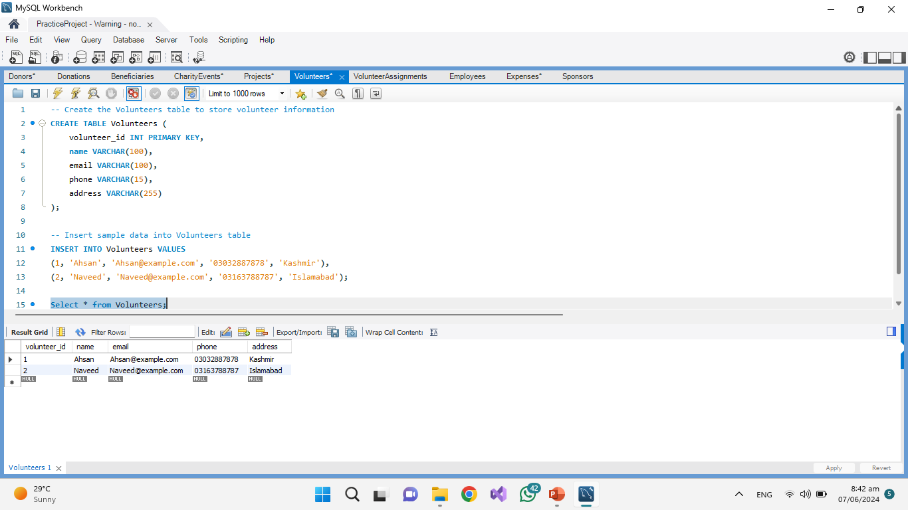
Volunteers Table

Slide 12
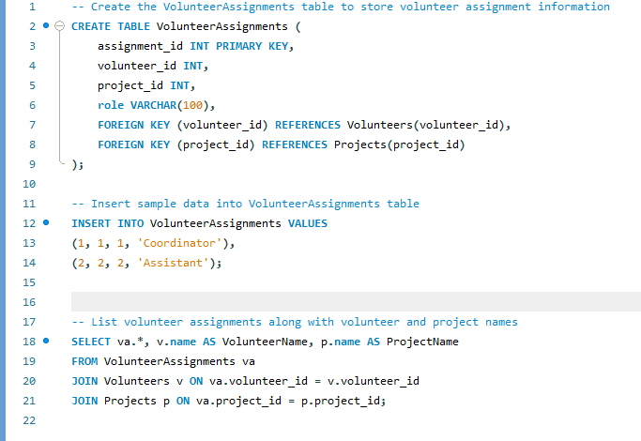
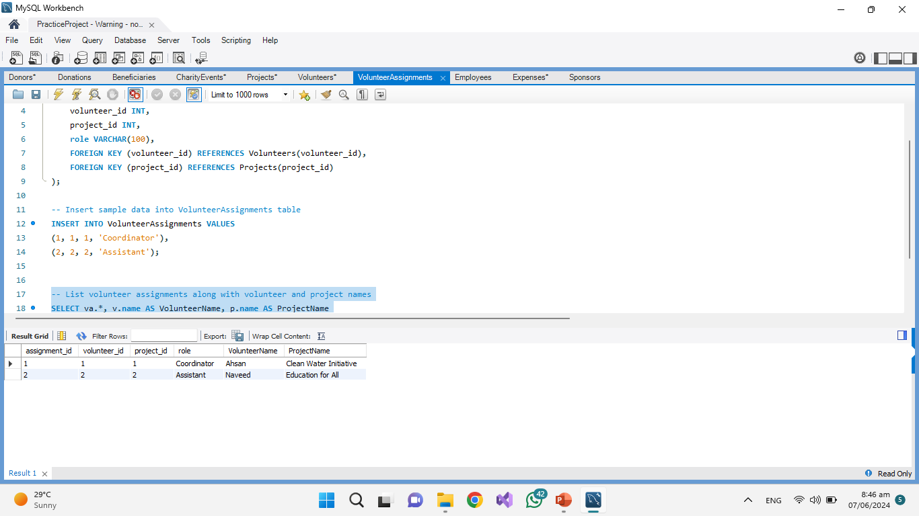
Volunteer Assignments Table

Slide 13
Contribution
Some Queries were made by me and some were by Sarmad
ER diagram was made by Sarmad
PPT was Made by Manzar
All the works was done in group.

Slide 14
Thank You

