Slide 1
WEB DEVELOPMENT
PROJECT TITLE: CRICKET SCORES
DONE BY:
NAME | SRN | SECTION
MANNAV DHAMIJA | PES2UG19CS220 | D
MANASI SWAIN | PES2UG19CS216 | D
MANZOOD NAQVI | PES2UG19CS223 | D

Slide 2
ABSTRACT OF THE PROJECT
Displaying live scores of cricket matches online.
Helpful to those who don’t have televisions , can be seen by viewers while travelling etc.
This system will hold a schedule of all the matches inorder to let the viewer know regarding the IST timings at which the match will start.
Allowing the user to view the scores in real time , thus keeping the cricket fanatics updated at all times.
The system is flexible to use and cost effective.

Slide 3
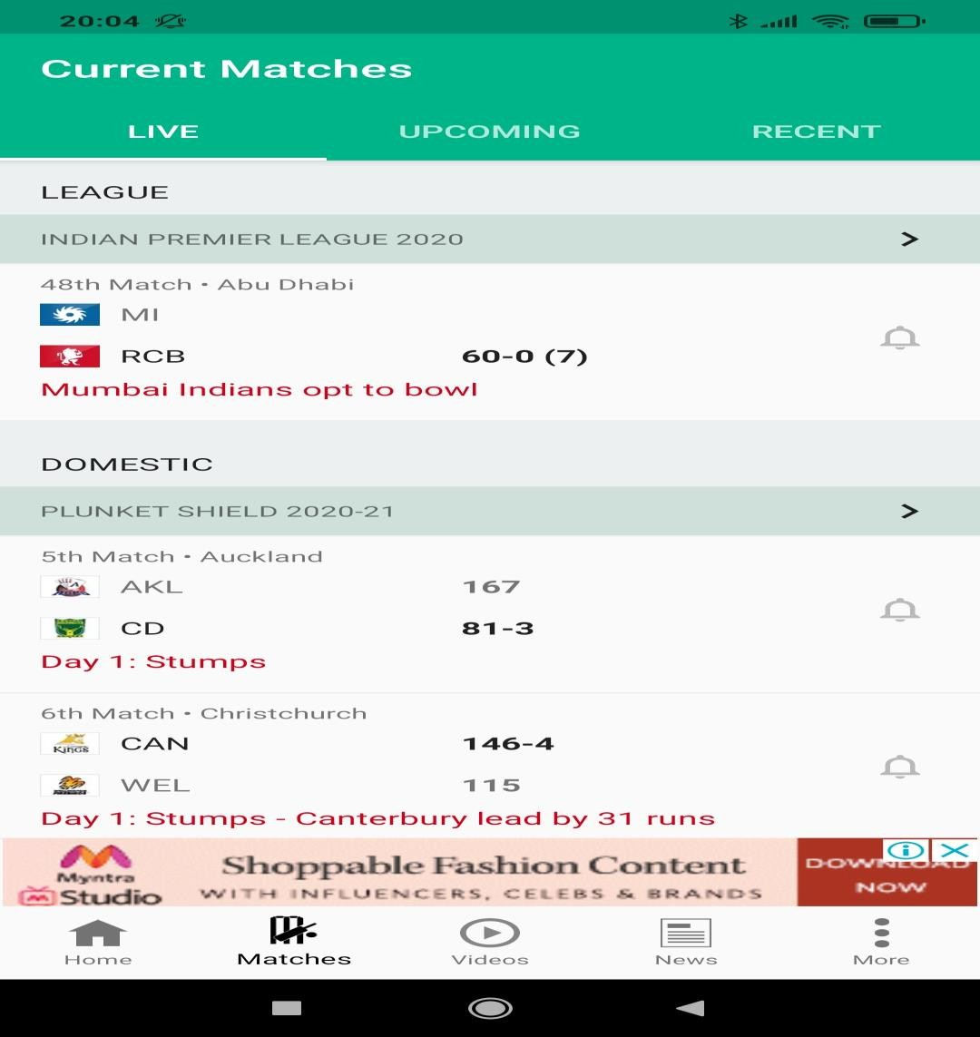
We expect it to look something like this:

Slide 4
INTRODUCTION AND MODULE DESCRIPTION
A home page where general view of all the matches will be available
Each match will have a link to its own page , where more details will be available.
React will used to make these elements seem more interactive and dynamic.
We will be storing data of all the matches using MongoDB and cater to the data requests using Node.js and Express.js frameworks.

Slide 5
THANK YOU

