Slide 1
Transactions in SQL

Slide 2
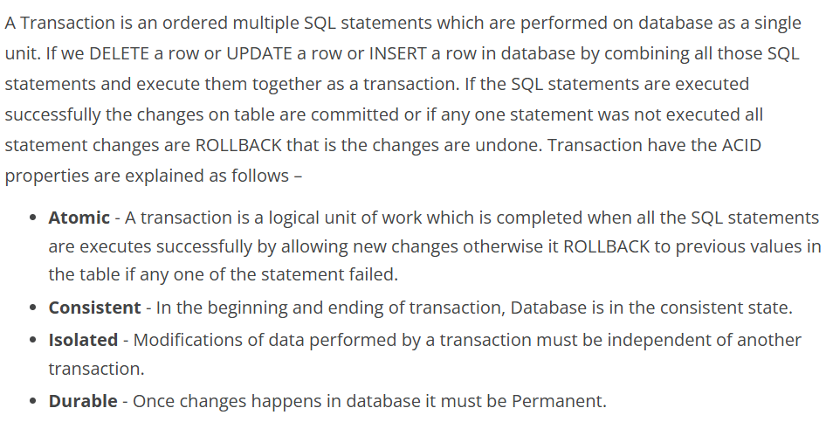
What is a Transaction? What are its properties

Slide 3
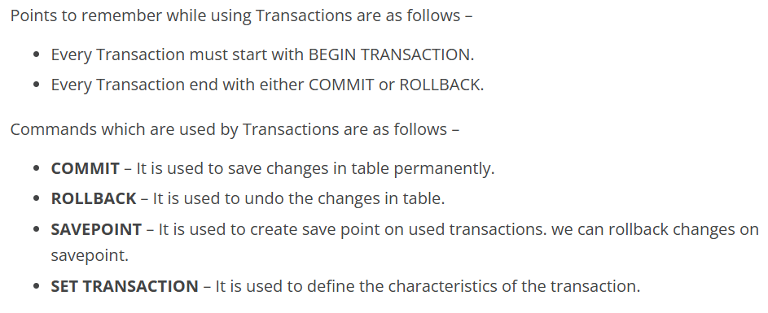
Note that….

Slide 4
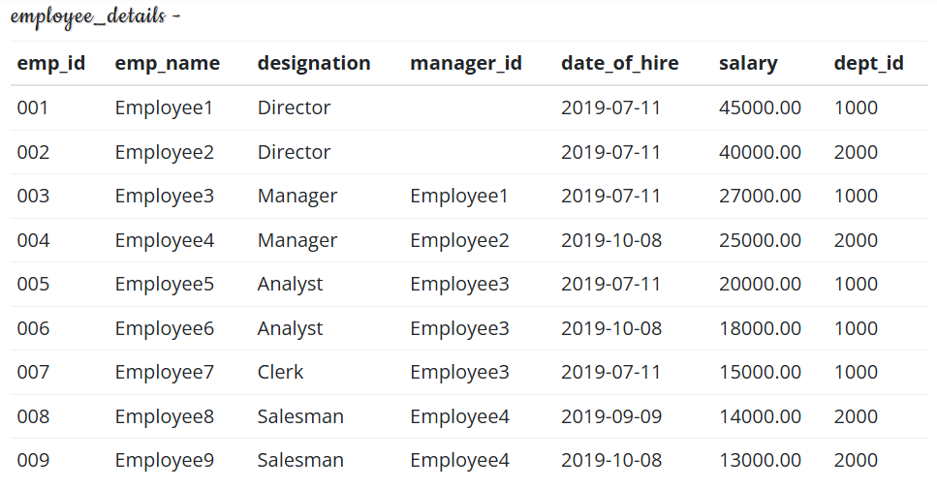

Example…

Slide 5

Example…

Slide 6
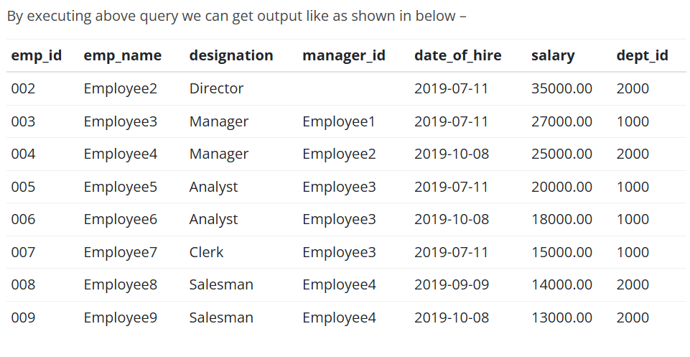
Results….

Slide 7

Scenario: Getting Rows by AUTO ROLLBACK

Slide 8
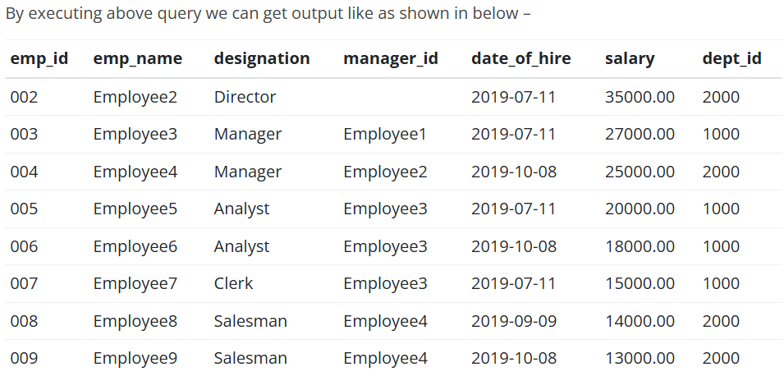
Results…

Slide 9


Slide 10
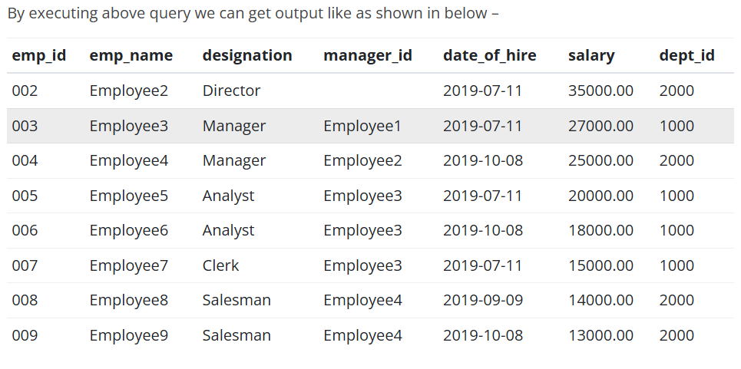
Results…

Slide 11
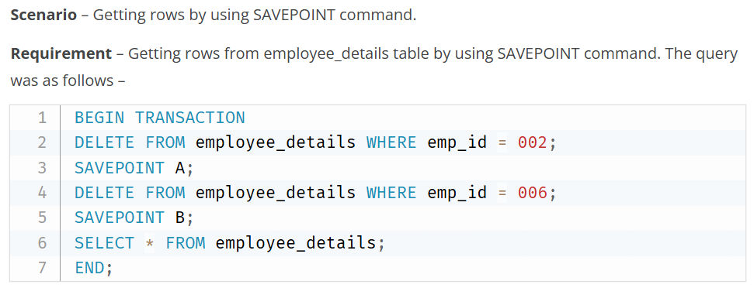

Slide 12
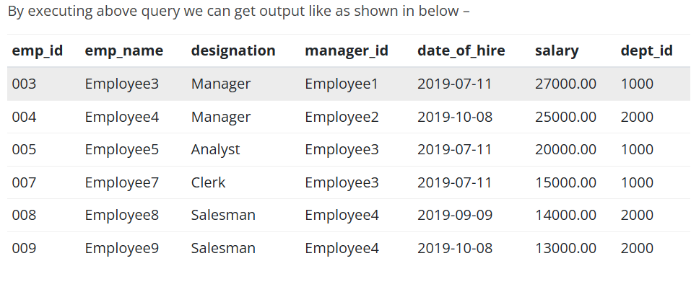
Results…

Slide 13
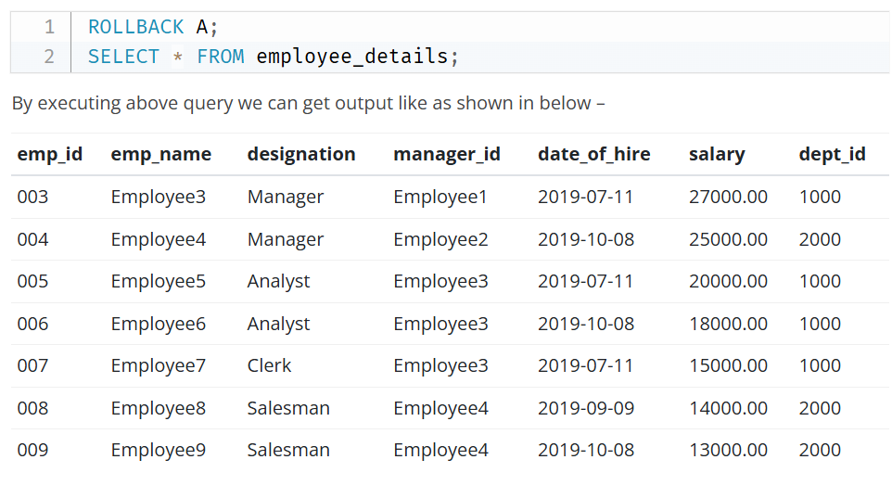

Slide 14
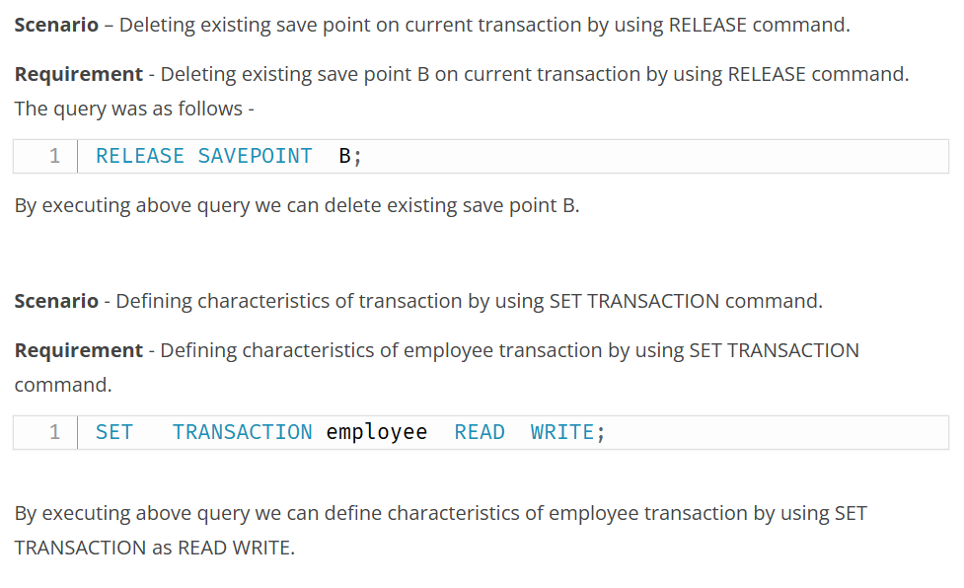

Slide 15


