Slide 1
Stage -03 presetation.
project
2019
REPORT
ML-RandomForest for prediction

Slide 2
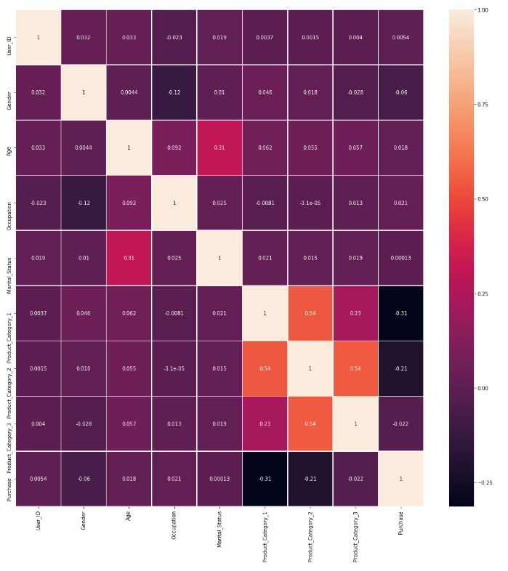
ML-RandomForestRegressor
In this project, the blackfriday dataset has been explored. Correlation revealed some relationships among different features, for the purpose of predicting customer's Purchase, the top three features useful included Product_Category_1, Product_ID and User_ID
Therefore I prepare two cases for the models
Text here
Copy paste fonts. Choose the only option to retain text.….
... ￥ | 27 %

Slide 3

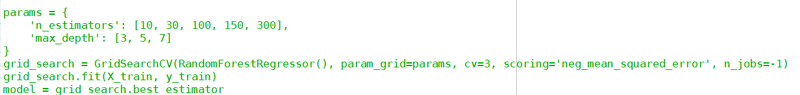
Case 1
While the ordinal categorical features can be simply encoded with integers, the nominal categorical features need to be one-hot-encoded. In this case, however, the number of unique entires for User_ID and Product_ID is too big and one-hot-encoding these features will unnecessarily increase the data dimension and therefore cardinality. thses two features will be simply encoded with integers. Except for Gender and Marital_Status which are binary, all other nominal categorical data will be, however, one-hot-encoded. We will also remove Product_Category_2 and _3 since they have a high rate of null values
Hyperparameter selection through 3-fold cross-validation: RMSE
What we are trying to do here is to predict purchase amount from other features, namely Gender,Age,occupation,city etc. We'll choose number of trees (n_estimators) in our forest and max_depth for each tree by calculating scores for each combination and choosing the best one. Scoring metric we'll use is RMSE.
Screenshot of RMSE is deleted Accidentally，RMSE about 2900+

Slide 4
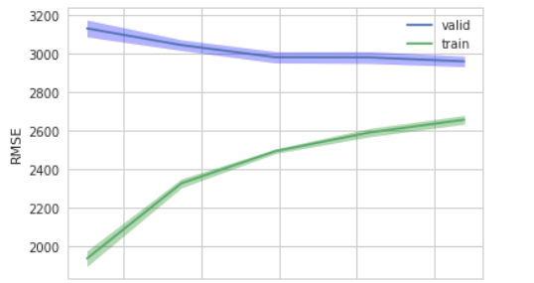
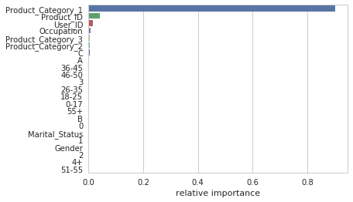
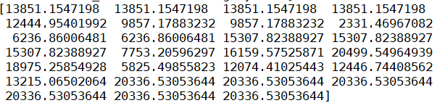
ML-RandomForestRegressor
Unified fonts make reading more fluent.
Theme color makes PPT more convenient to change.
Adjust the spacing to adapt to Chinese typesetting, use the reference line in PPT.
This tells that the current model heavily relies on Product_Category_1 (followed by Product_ID and User_ID) to make prediction on purchase, as they are directly related to the amount of Purchase that the customers make. Therefore in Case 2, these suspicious features will be removed in training the second model.

Slide 5
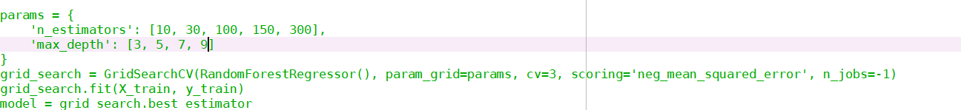
Case 2
Different Data processing compared with Case 1
The Training process are the same as case 1
Supporting text here.
When you copy & paste, choose "keep text only" option.

Slide 6
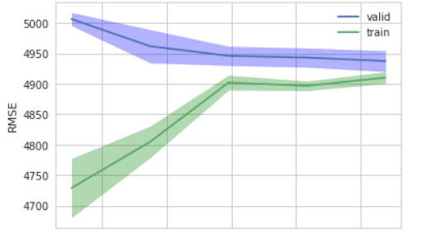
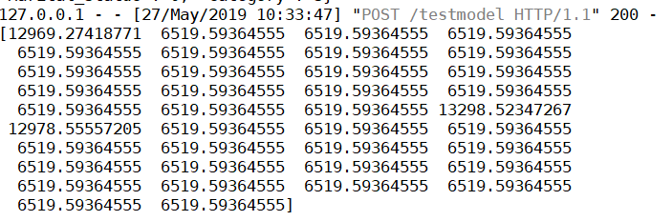
ML-RandomForestRegressor
Unified fonts make reading more fluent.
Theme color makes PPT more convenient to change.
Adjust the spacing to adapt to Chinese typesetting, use the reference line in PPT.
It’s so weird that the different testset result in the same output, and I still try to find out why
However, if the goal is to predict Purchase for the new customer who have never been in the store, those customer-specific and product-specific information cannot be utilized. In this case, only the low-level features can be utilized to train the model. In this case, the model perfornace of the test set was about

Slide 7
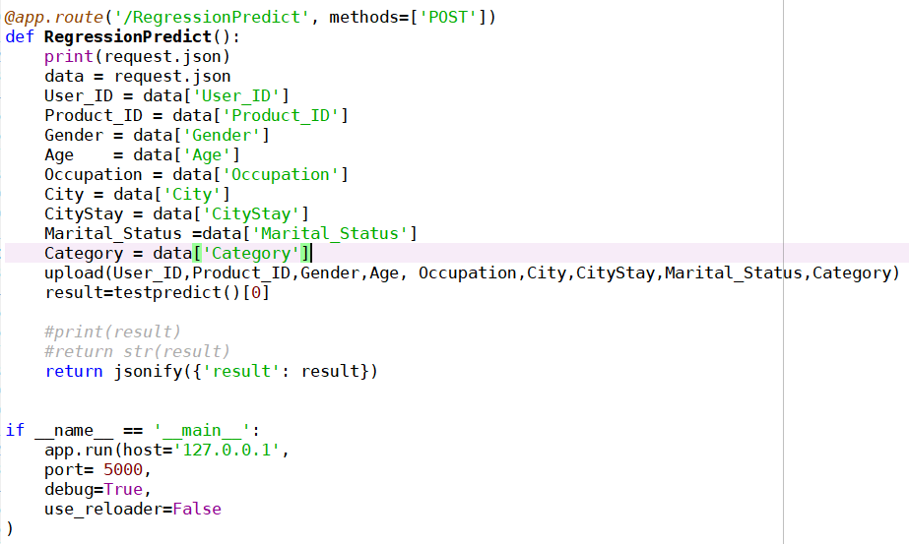
Result
The results are quite dissapointing. However, at the same time, it looks quite reasonable for this synthetically generated dataset where the given low-level features showed to have very weak relationships with the target variable
test the application locally. Have not deploy it to the server

