Slide 1

DataMining&MachineLearning
project
2019
Task allocation
REPORT

Slide 2
01
Analyze
02
Model Training
CONTENTS
03
Classification
04
Visualization
Data analyze presentation & The results of prediction

Slide 3
Analyze
/01

Slide 4
What descriptive information can be obtained from this dataset
Total sales, average sales, median sales.
TOP 10 items of sales.
Consumption of different age, occupation, gender, city, marital status, years of residence.
Use pandas to draw the relevant plot

Slide 5
Set predictive goals
01. Analyze the correlation of data in each column.
Use pandas to do correlation analysis.
Find relation from the Correlation matrix.
02. Set the predictive goals
Use the conclusion of data exploration.
Maybe the analyze can help us get more interesting information.

Slide 6

Data preprocess
1
One-hot Encoding
2
Fill or ignore the missing data
3
Choose appropriate feature

Slide 7
Model Training
/02

Slide 8
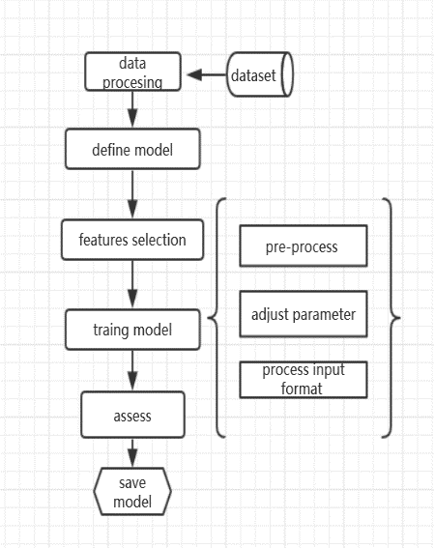
Training Model and Predict the Purchase
Training the Model for predicting the purchase.
Get the front-end request and set as input
Obtain predicted results and send to the front-end

Slide 9
preliminary ideas of Model Training (Regression)
Assessment
Training
Asses the model base on the accuracy and enhanced or retrain the model
this is a regression problem and probably I'll use random forest . I'll choose number of trees (n_estimators) in our forest and max_depth for each tree by calculating scores for each combination and choosing the best one. Scoring metric I'll use is RMSE.
Acceleration Algorithm PCA
Features selection (Correlation Filter etc )
Features encoding (label and one-hot )
Define Model
Regression (RandomForestRegressor,Xgboost,etc )
Pro-process

Slide 10
preliminary ideas of Model Training (Clustering)
Pre-process
Training
Assessment
Choosing random value of k centroids from the values present in dataset(k=2 here)
Calculate Euclidean distance for each point with each centroid
Comparing the distances and assigning clusters
Taking mean and repeat till zero error
.
Generally k-means works best for 2 dimensional numerical data.. So try to figure Whether it can be well divide into K cluster

Slide 11
classification
/03

Slide 12

Decision tree algorithm
The decision tree is built from the top of the root node and involves partitioning the data into subsets containing instances with similar values.
Algorithm Description
The decision tree builds the model in the form of a tree structure. It breaks down the data set into smaller and smaller subsets and gradually develops the relevant decision trees.
achieve：
step1
from sklearn.tree import DecisionTreeRegressor
dtr = DecisionTreeRegressor()
step2
fit2 = dtr.fit(X_train,y_train)
#Here we fit training data to Decision Tree Regressor……

Slide 13
Random forest algorithm
01.import
The random forest algorithm is an estimator that applies to many classification decision trees on each subsample of a dataset and uses averaging to improve prediction accuracy and control overfitting.
The random forest algorithm model is very good at processing tabular data with digital features
from sklearn.ensemble import RandomForestRegressor
02.define model
rfr = RandomForestRegressor()
03.training
fit3 = rfr.fit(X_train,y_train)
#Here we fit training data to Random Forest Regressor

Slide 14

Gradient Boosting algorithm
Algorithm Description
01
from sklearn.ensemble import GradientBoostingRegressor
Gradient Boosting is a machine learning technique for regression and classification problems that produces a predictive model in the form of a set of weak prediction models (usually decision trees).
It builds models in stages like other enhancement methods and promotes them as an optimization algorithm for a suitable cost function
Apr-Jun
02
gbr = GradientBoostingRegressor()
Jul-Sep
03
fit4 = gbr.fit(X_train,y_train)
#Here we fit training data to Gradient Boosting Regressor.….
Oct-Des
04
fit3.score(X_train,y_train)*100.….
#Accuracy Score of Gradient Boostingon train set

Slide 15
Visualization
/04
Notes:
The task of Visualization is to presentation the results of the data we analyze and predict the

Slide 16
Visualization
Data Prediction
Forecast data using trained models.
Data Analyze
Using charts to show the result of data we analyze.
Front-end Style Design
Using LTE template & bootstrap Library to design user-interface.
Using Echarts Library to design the chart.
Dynamically modify the display language based on the browser language.

Slide 17
Thanks
project
2019
REPORT

