Slide 1
BlackFriday - ML(Regression)
TJU
——LI MA
Project
2019
REPORT
2019 06 12

Slide 2
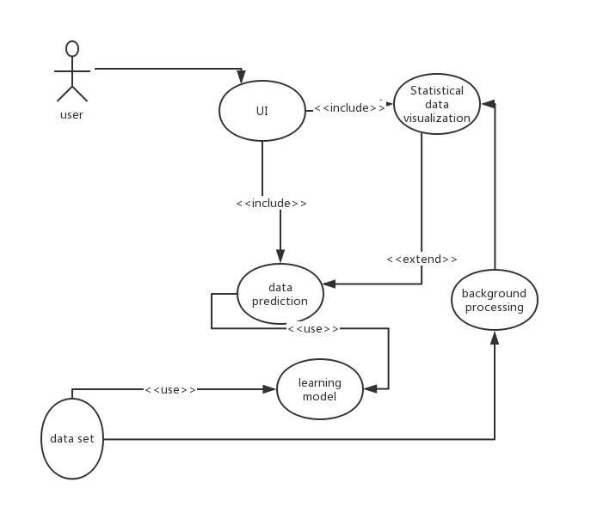
Initialization step (5.5-5.10)
Web browser sends an HTTP request to Nginx
Nginx forwarded to uWSGI
uWSGI processes it according to the WSGI specification
uWSGI will send HTTP requests to the Flask application for processing
Flask application handles HTTP
Get data from an HTTP request and set it as input for the prediction model(trained)
Flask generates an HTTP response (the prediction result), which is given to uWSGI according to the WSGI specification.
uWSGI sends HTTP response to Nginx via TCP
Nginx sends the HTTP response to the web browser via TCP
In the first step, we decided to choose the dataset BlackFriday for our project, then elaborated the use-case diagram and detailed description of the most important cases and defined the global architecture of our project.
Ngnix
Text here
Backend
uWGSI
Python
Flask

Slide 3
Elaboration step (5.11-5.18)
Data columns (total 12 columns):
User_ID 537577 non-null int64
Product_ID 537577 non-null object
Gender 537577 non-null object
Age 537577 non-null object
Occupation 537577 non-null int64
City_Category 537577 non-null object
Stay_In_Current_City_Years 537577 non-null object
Marital_Status 537577 non-null int64
Product_Category_1 537577 non-null int64
Product_Category_2 370591 non-null float64
Product_Category_3 164278 non-null float64
Purchase 537577 non-null int64
dtypes: float64(2), int64(5), object(5)
01
Understand data
02
Data cleaning
03
Data Analysis

Slide 4
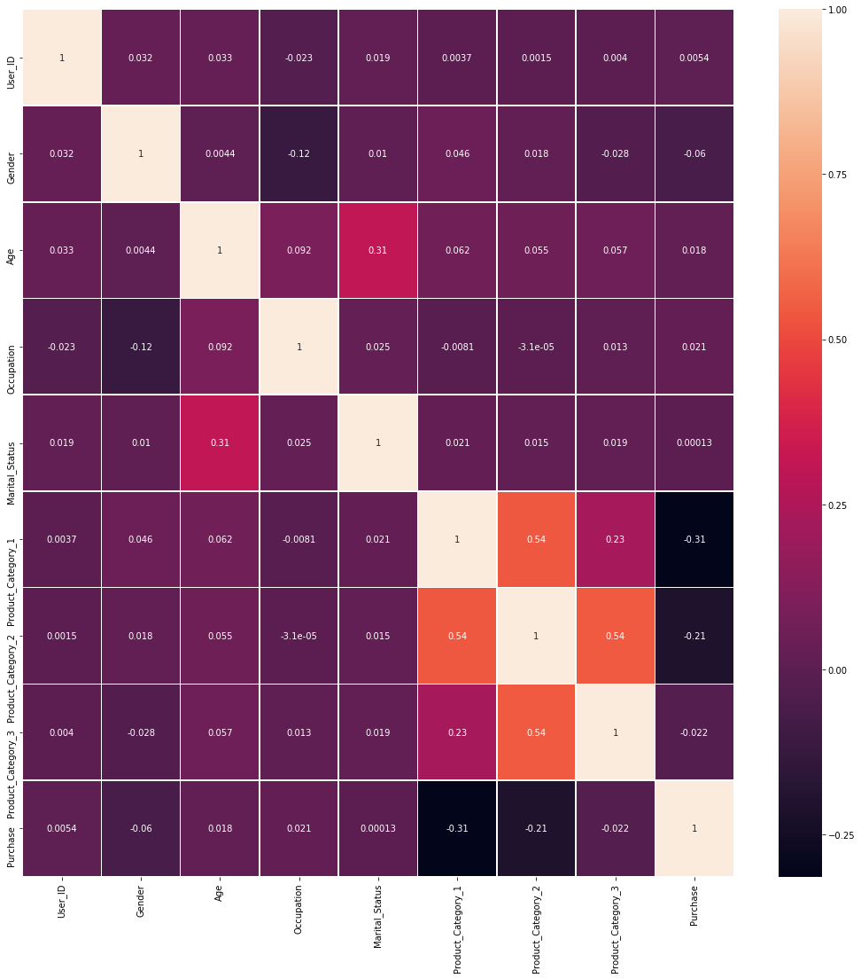
This dataset has 537577 entries with 12 columns (potential features ). The unique User_ID and Product_ID are 5891 and 3623, respectively. They are small compared to the total number of entries, therefore, it can be inferred that a great portion of User_ID and Product_ID repeat many times and they may contain crucial information. However, these information are only available for the target variable Purchase. We want to predict Purchase based on the information Gender, Age, etc so that they can reflect those in their marketing strategies that target new customers. And according to the info, there are 2 columns where data is missing, Product_Category2 and Product_Category_3 is missing more, so they are not considered in this analysis.
The dataset explored through eda (exploratory data analysis) to provide the necessary conclusions for subsequent processing and modeling. And my group partners Xinzhi Huo and Zhelin Liang did the data analysis section and showed the relationship between data.
.

Slide 5
Construction step (5.19-6.10)
RFregressor: RMSE for case1 : 2930; for case2 : 4422
Xgbregressor: RMSE for case1: 3622; for case2: 6917
From the results of the assessment: Although xgb has better speed performance, it does not perform satisfactorily on this data set. So I choose the RF model
RandomForestRegressor
XgboostRegressor
Simple Features selection
Model selection
Model parameters
Training result
Model improvement
According to the step II, I found that User_ID and Product_ID are the most relevant to purchases and other attributes are not so highly. So I considered training two cases:
Case1: Train with all features except
Case2: Train with all features except purchases,User_ID and Product_
GridSearchCV
Features seletion
Parameter adjustment

Slide 6
Simple Features encodeing:
Convert gender strings to binary encoding so that It is better for numerical calculations
Case1: while the ordinal categorical features can be simply encoded with integers, the nominal categorical features need to be one-hot-encoded. In this case, however, the number of unique entires for User_ID and Product_ID is too big and one-hot-encoding these features will unnecessarily increase the data dimension and therefore cardinality. In real case, User_ID and Product_ID tended to be label-encoded. And other features tended to be one-hot-encoded
Case2: all of the features tended to be one-hot-encoded
then split our train and test data and will standardize the data using StandardScaler

Slide 7
Xgboost advantage☹(official document)
High flexibility
Regularization
Shrinkage
Pruning
Parallel operation
.

Slide 8
Max_features: The feature that is divided when the optimal property is selected cannot exceed this value.
When it is an integer, that is, the maximum number of features; when it is a decimal, the training set feature number * decimal;
Max_depth: (default=None) sets the maximum depth of the tree. The default is None. When building a tree, there will be only one category for each leaf node, or min_samples_split.
Min_samples_split: The minimum number of samples per partition when dividing nodes according to attributes.
Min_samples_leaf: The minimum number of samples for the leaf node.
Max_leaf_nodes: (default=None) The maximum number of samples in the leaf tree.
Min_weight_fraction_leaf: (default=0) The minimum weight required for the leaf node
n_estimators:[500](500,600,700,800)
min_child_weight:[2](1,3,5)
max_depth:[6](3-10)
gamma:[0]
subsample:[1](0.5-1)
colsample_bytree:[0.7](0.5-1)
reg_alpha:[0](0.01,0.5,1)
reg_lambda:[1]（0.01-0.1，1）
‍learning_rate:[0.05](0.01-0.3)

Slide 9
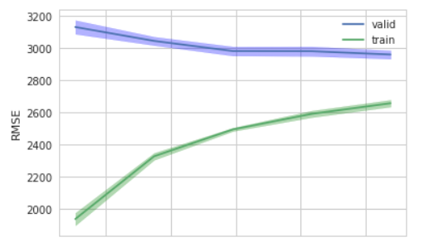
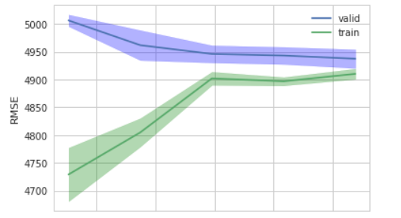
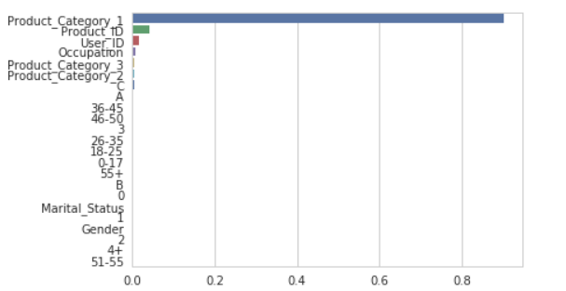
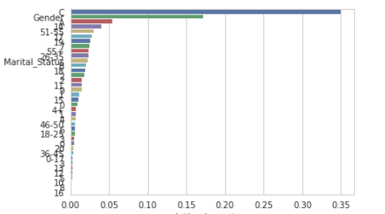

Slide 10
different encoding: one-hot encode only for age, city ,and citystay
Delete feature quantities with low correlation like marital_status, gender
The above steps in order to reduce the number of features
Change parameters group referenced network tutorial and official document
However, these modifications did not improve performance. Rmse have not broken 2930

Slide 11



