Slide 1
Model Refinement - Feature Reduction Methodology
An excessive number of potentially unrelated features can elevate the likelihood of introducing misleading correlations, adversely impacting model performance.
Aim: Identify the minimum number of input features needed to maintain the best model performance
Perform agglomerative hierarchical clustering analysis with Wards Linkage Distance to rank clusters by similarity
Examine model performance (MAE, Pearson, Spearman) following sequential removal of clusters
For each cluster, the feature resulting in the best model performance was preserved
Repeat process for multiple cell lines to analyze trends

Slide 2
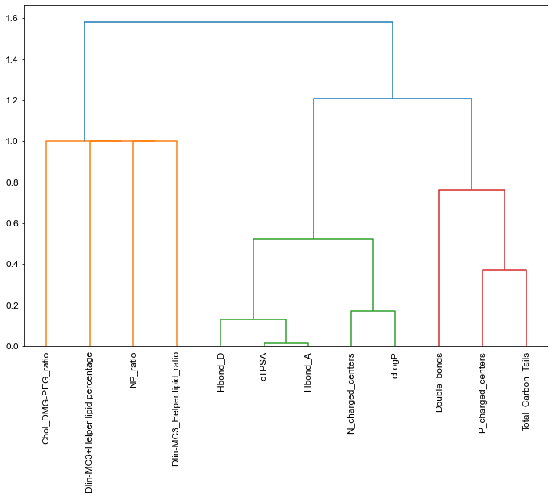
Model Refinement - Feature Reduction Results
Cluster | WLD
['cTPSA','Hbond_A'] | 0.01
['cTPSA','Hbond_A','Hbond_D'] | 0.13
['N_charged_centers', 'cLogP'] | 0.17
['P_charged_centers','Total_Carbon_Tails'] | 0.37
['cTPSA','Hbond_A','Hbond_D','N_charged_centers', 'cLogP'] | 0.52
['P_charged_centers','Total_Carbon_Tails','Double_bonds'] | 0.76
['NP_ratio', 'Dlin-MC3_Helper lipid_ratio'] | 1.00
['NP_ratio', 'Dlin-MC3_Helper lipid_ratio','Dlin-MC3+Helper lipid percentage'] | 1.00
['NP_ratio', 'Dlin-MC3_Helper lipid_ratio','Dlin-MC3+Helper lipid percentage', 'Chol_DMG-PEG_ratio'] | 1.00
['P_charged_centers','Total_Carbon_Tails','Double_bonds','cTPSA','Hbond_A','Hbond_D','N_charged_centers', 'cLogP'] | 1.21
All Features | 1.58
Wards Linkage Distance

Slide 3
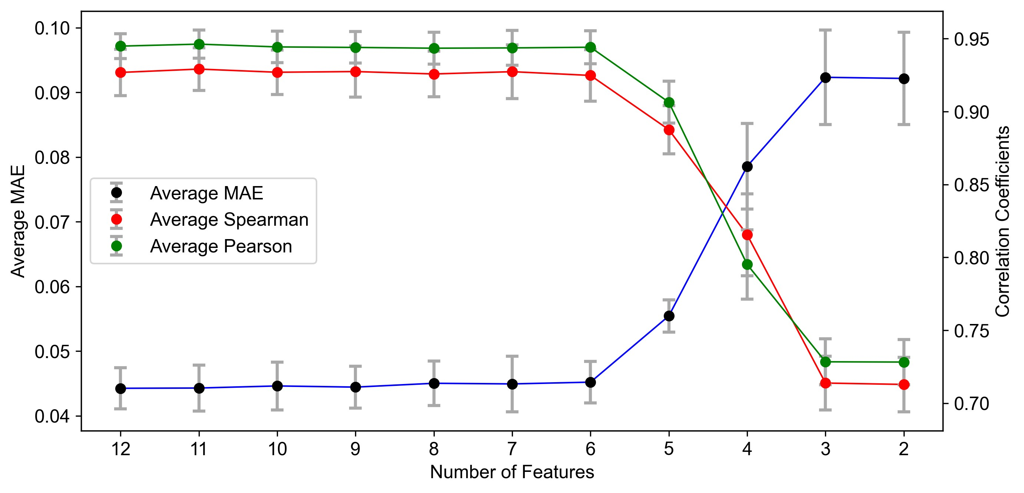
Model Refinement - Feature Reduction Results (B16F10)
LGBM Trained on 6 features (cLogP, P_charged_centers, NP_ratio, Dlin-MC3_Helper lipid_ratio, Dlin-MC3+Helper lipid percentage, Chol_DMG-PEG_ratio) is sufficient to yield model performance comparable to original model

Slide 4
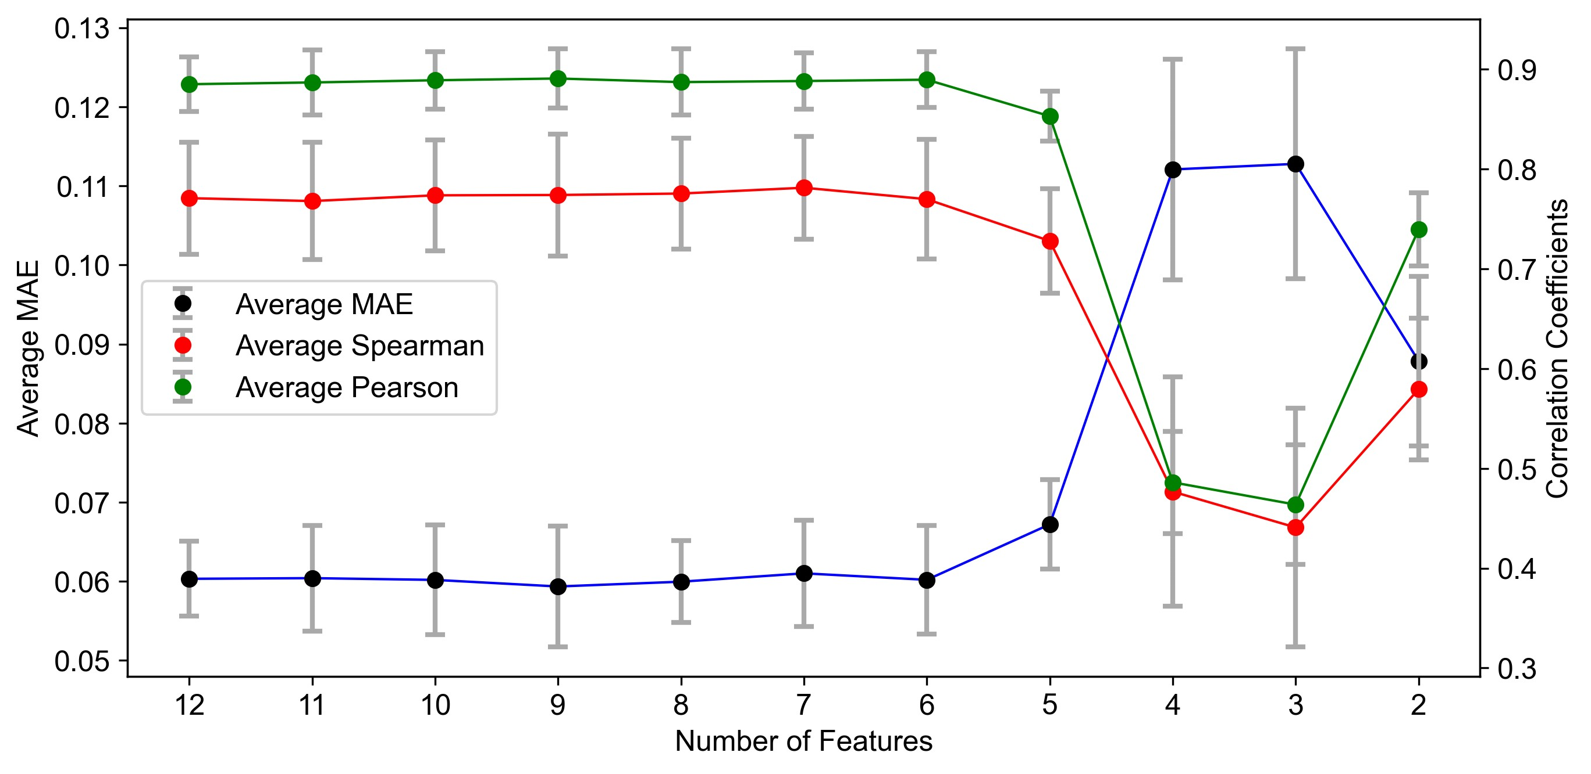
Model Refinement - Feature Reduction Results (HepG2)
LGBM Trained on 6 features (cTPSA, P_Charged_Centers, NP_ratio, Dlin-MC3_Helper lipid_ratio, Dlin-MC3+Helper lipid percentage, Chol_DMG-PEG_ratio) is sufficient to yield model performance comparable to original model

Slide 5
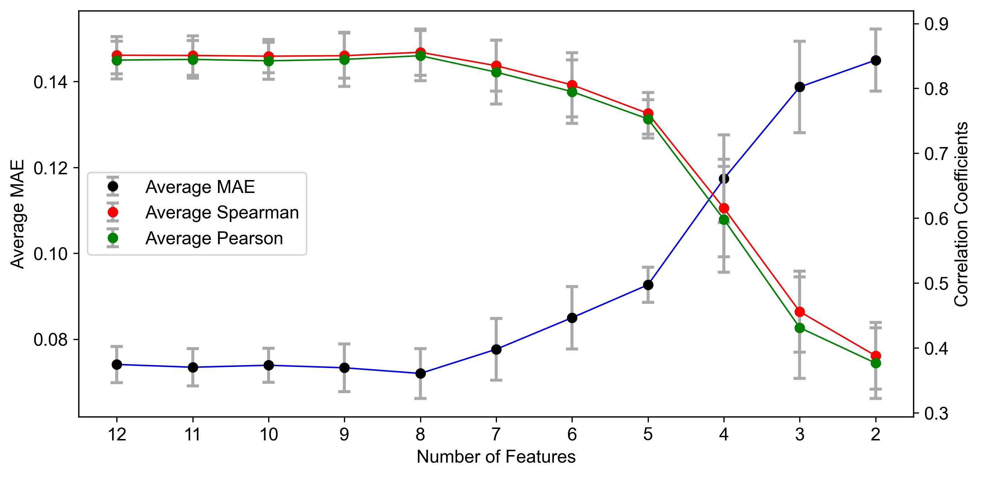
Model Refinement - Feature Reduction Results (HEK 293T)
LGBM Trained on 7 features (Hbond_D, N_Charged_Centers, Double_bonds, Total_Carbon_Tails, NP_ratio, Dlin-MC3_Helper lipid_ratio, Dlin-MC3+Helper lipid percentage, Chol_DMG-PEG_ratio) is sufficient to yield model performance comparable to original model

Slide 6
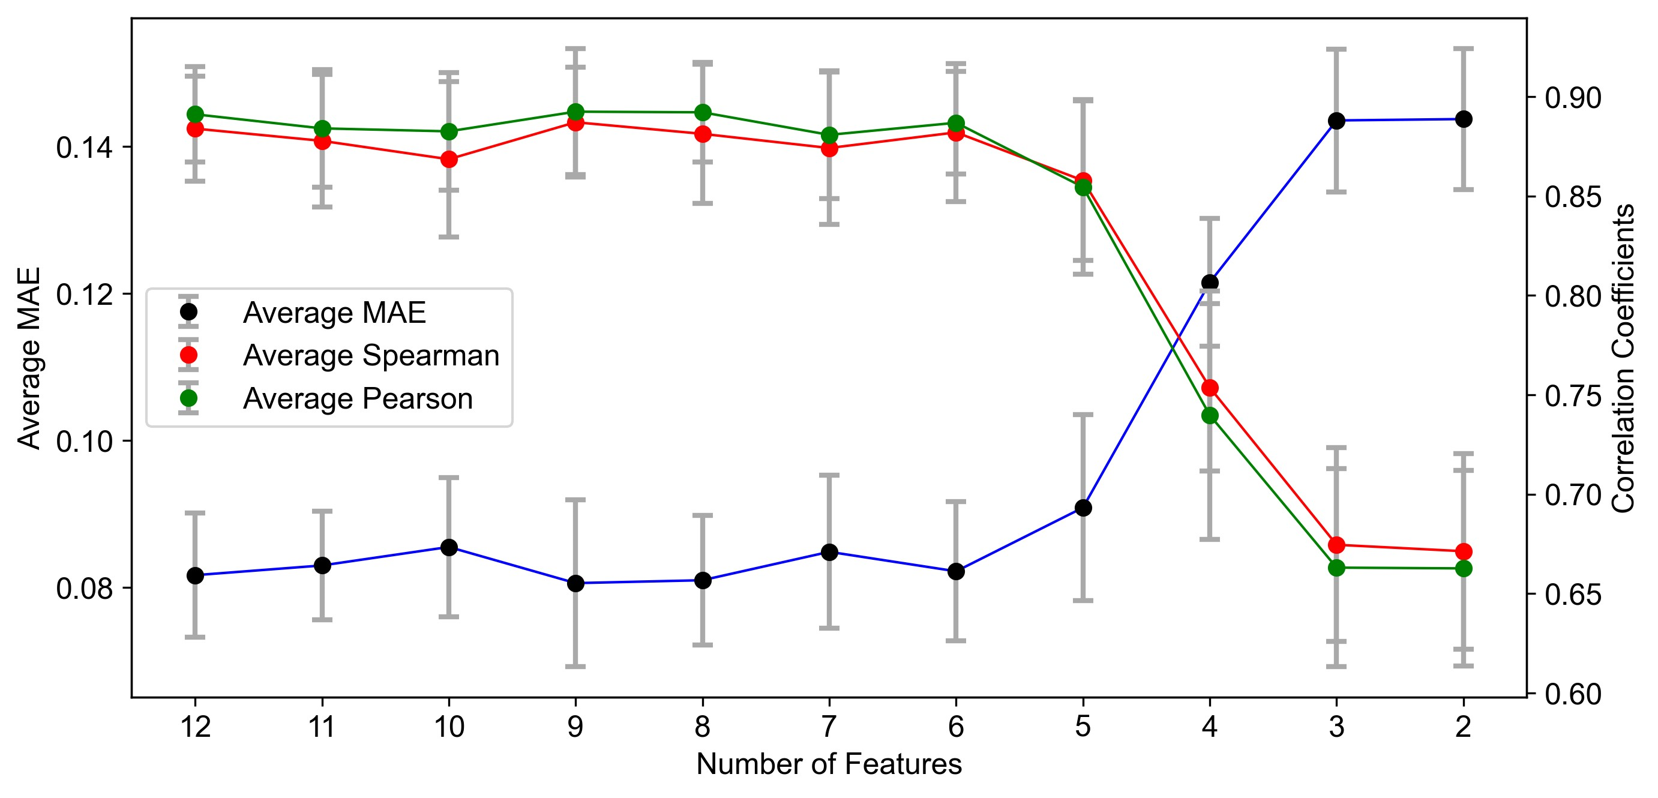
Model Refinement - Feature Reduction Results (ARPE19)
LGBM Trained on 6 features (cTPSA, Double_bonds, NP_ratio, Dlin-MC3_Helper lipid_ratio, Dlin-MC3+Helper lipid percentage, Chol_DMG-PEG_ratio) is sufficient to yield model performance comparable to original model

Slide 7
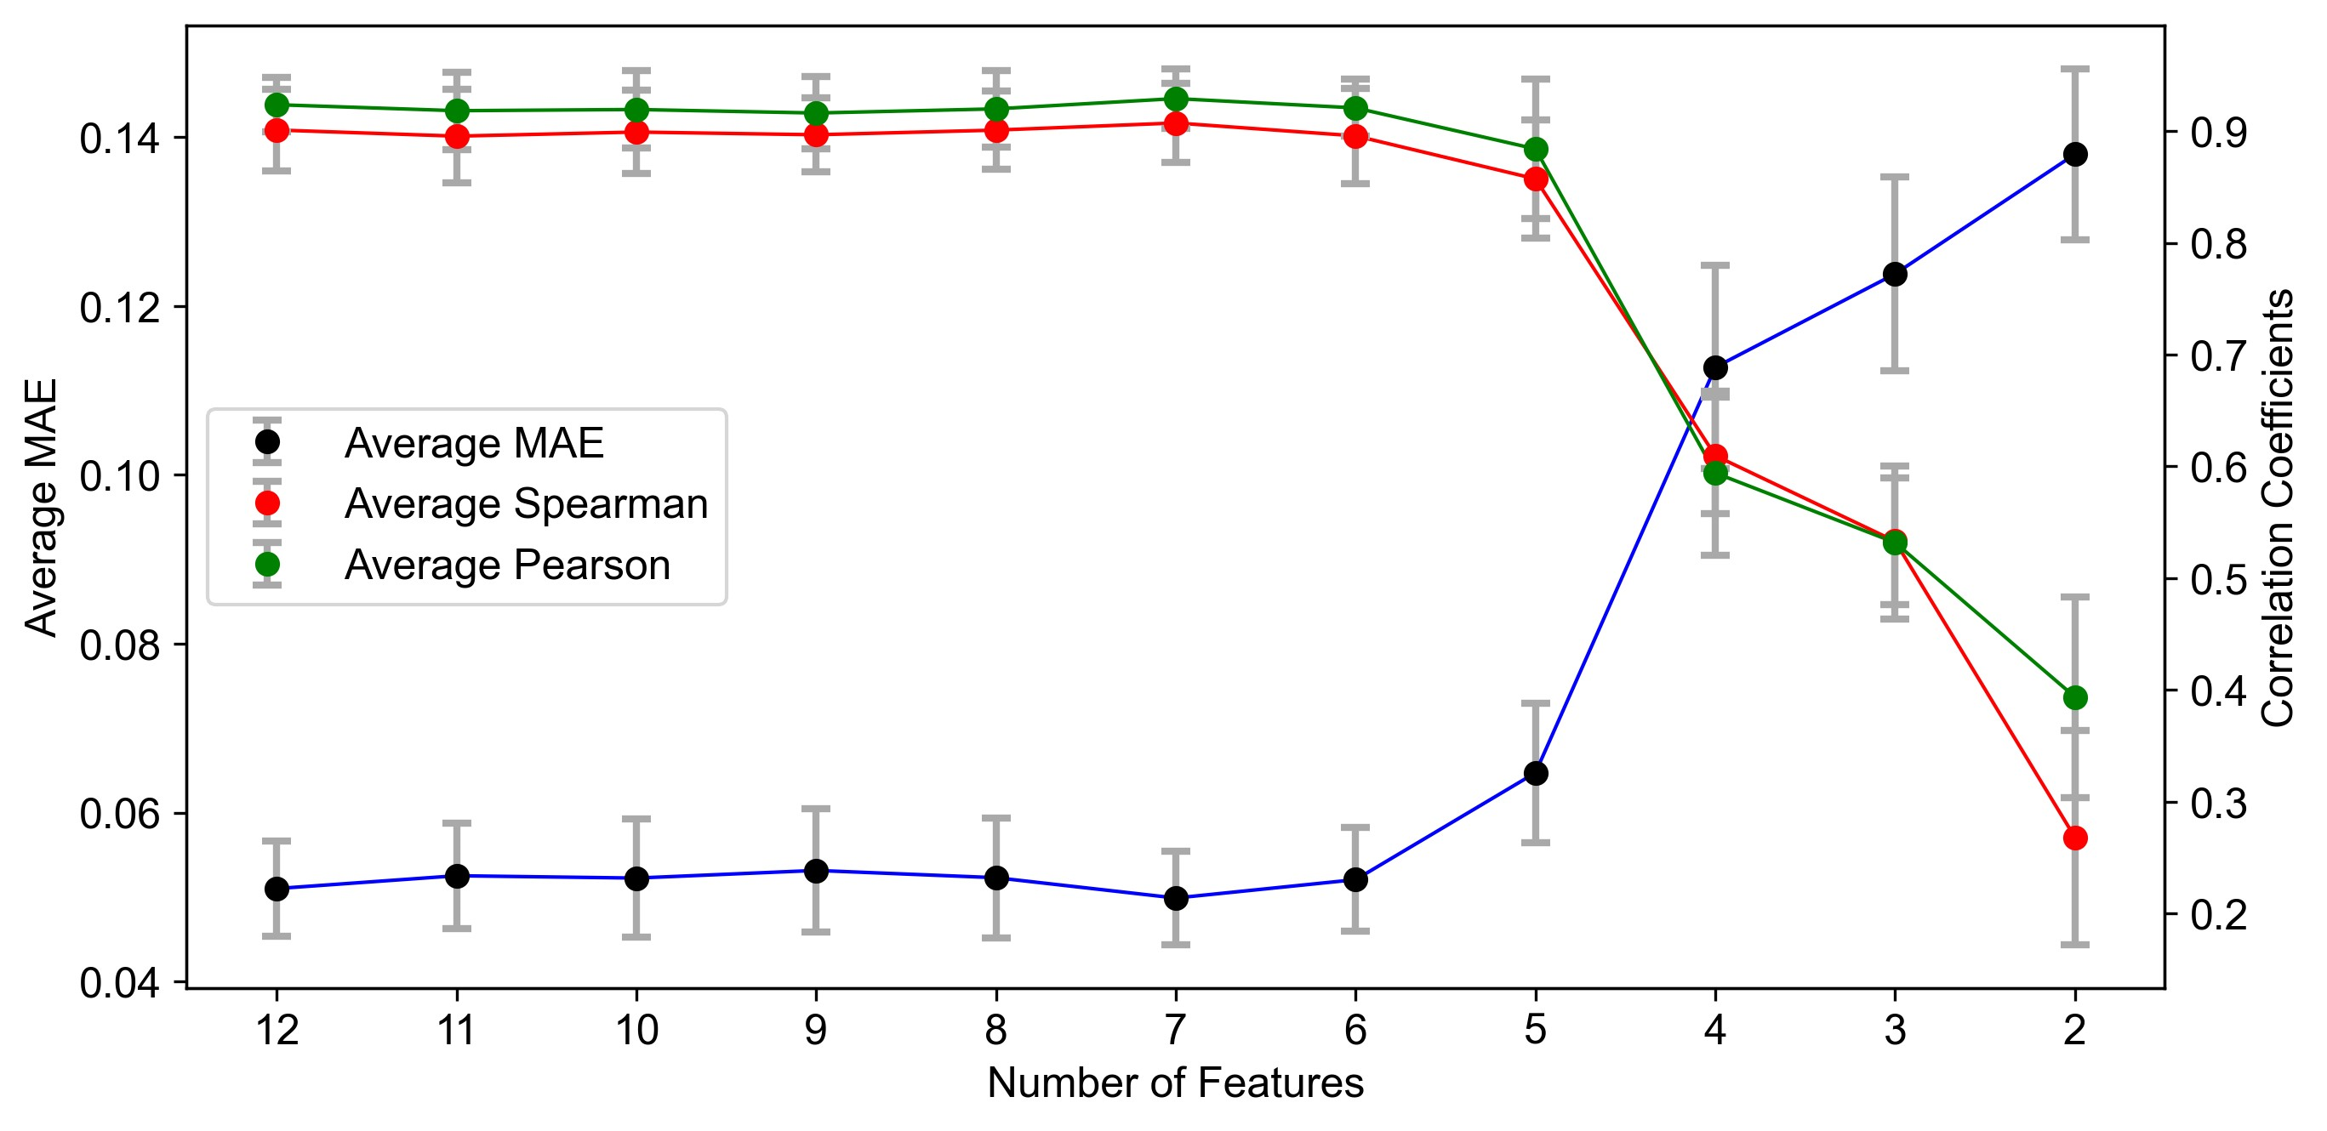
Model Refinement - Feature Reduction Results (N2a)
LGBM Trained on 6 features (N_charged_centers, Double_bonds, NP_ratio, Dlin-MC3_Helper lipid_ratio, Dlin-MC3+Helper lipid percentage, Chol_DMG-PEG_ratio) is sufficient to yield model performance comparable to original model

Slide 8
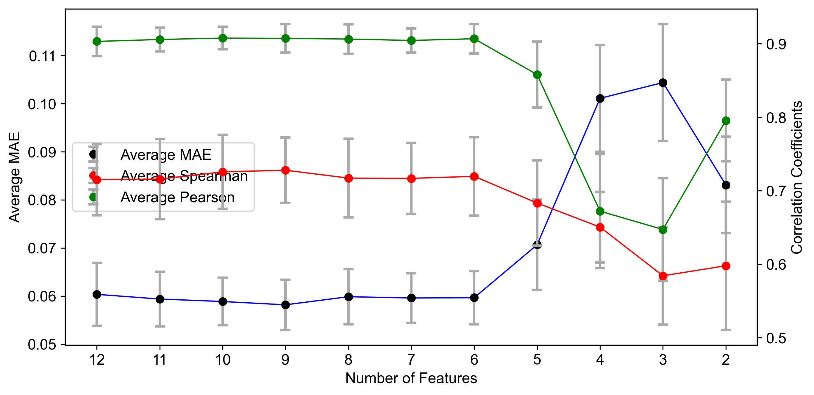
Model Refinement - Feature Reduction Results (PC3)
LGBM Trained on 6 features (P_charged_centers, cLogP, NP_ratio, Dlin-MC3_Helper lipid_ratio, Dlin-MC3+Helper lipid percentage, Chol_DMG-PEG_ratio) is sufficient to yield model performance comparable to original model

Slide 9
Model Refinement - Feature Reduction Results Summary
Cell Type | No. Features Needed | Helper Lipid Features Included *** | MAE Average | Pearson Average | Spearman Average
B16 | 6 | [cLogP, P_charged_centers] | 0.0452 | 0.944 | 0.925
HepG2 | 6 | [cLogP, P_charged_centers] | 0.0602 | 0.889 | 0.770
HEK 293T | 8 | [Hbond_D, N_Charged_Centers. Double_bonds, Total_Carbon_Tails] | 0.0720 | 0.850 | 0.856
ARPE19 | 6 | [cTPSA, Double_bonds] | 0.0822 | 0.889 | 0.882
N2a | 6 | [N_charged_centers, Double_bonds] | 0.0521 | 0.921 | 0.896
PC3 | 6 | [cLogP, P_Charged_Centers] | 0.0596 | 0.904 | 0.717
*** Note. – In all cell types, inclusion of formulation parameter input features was necessary to retain model performance. Inclusion of other input features may still maintain model performance, but the listed features maximize the performance.

