Slide 1

AI-Native Transceiver Design for Next-Generation Wireless Networks
Yuxing Mao and Haikun Xu
Supervisor: Dr Huynh Nguyen
LivSURF 436026 · School of Computer Science and Informatics
Notes:
A, 0:00-0:10. Introduce both of us and the project in one sentence: using deep learning to redesign a wireless transceiver.

Slide 2
The problem, and what we asked
A conventional transceiver design treats coding, modulation, channel estimation and detection as separate blocks.
Each block is optimal for its own task, but not for the system as a whole. Consequently, the end-to-end performance is limited.
Instead, the transmitter and receiver blocks can be replaced by deep neural networks, jointly optimised as an autoencoder.
Research questions
1
How much is learning worth?
Measured against a classical receiver that is already doing its best.
2
Can the end-to-end system train with no channel model?
Training needs a differentiable channel model. In practice the channel is a black box: only its inputs and outputs can be observed.
The channel is sampled, never differentiated.
Gains are usually shown on AWGN, where the classical receiver is already optimal.
Notes:
A, 0:10-0:40. The two objections lead to the two questions. Do not read the cards out; say them in your own words.

Slide 3
Making the comparison fair
LDPC encoder
Mapper
Channel
Demapper
LDPC decoder
Only the two shaded blocks differ. Same LDPC code, same channel, same random seeds, and both systems evaluated on the same terms.
Pilots are not free
1.76 dB
They occupy symbol slots, so the effective code rate falls to R(L-P)/L.
The channel estimate is imperfect, which adds noise: a factor of (1+1/P).
what that factor is worth at two pilots. Before we added it, we were understating our own noise.
64,000
codewords per SNR point. Points with fewer than 30 block errors are dropped, not plotted.
Notes:
A, 0:40-2:00. The heart of your section. Land 1.76 dB and say the sentence about understating our own noise - it sets up your skill at 3:20.

Slide 4
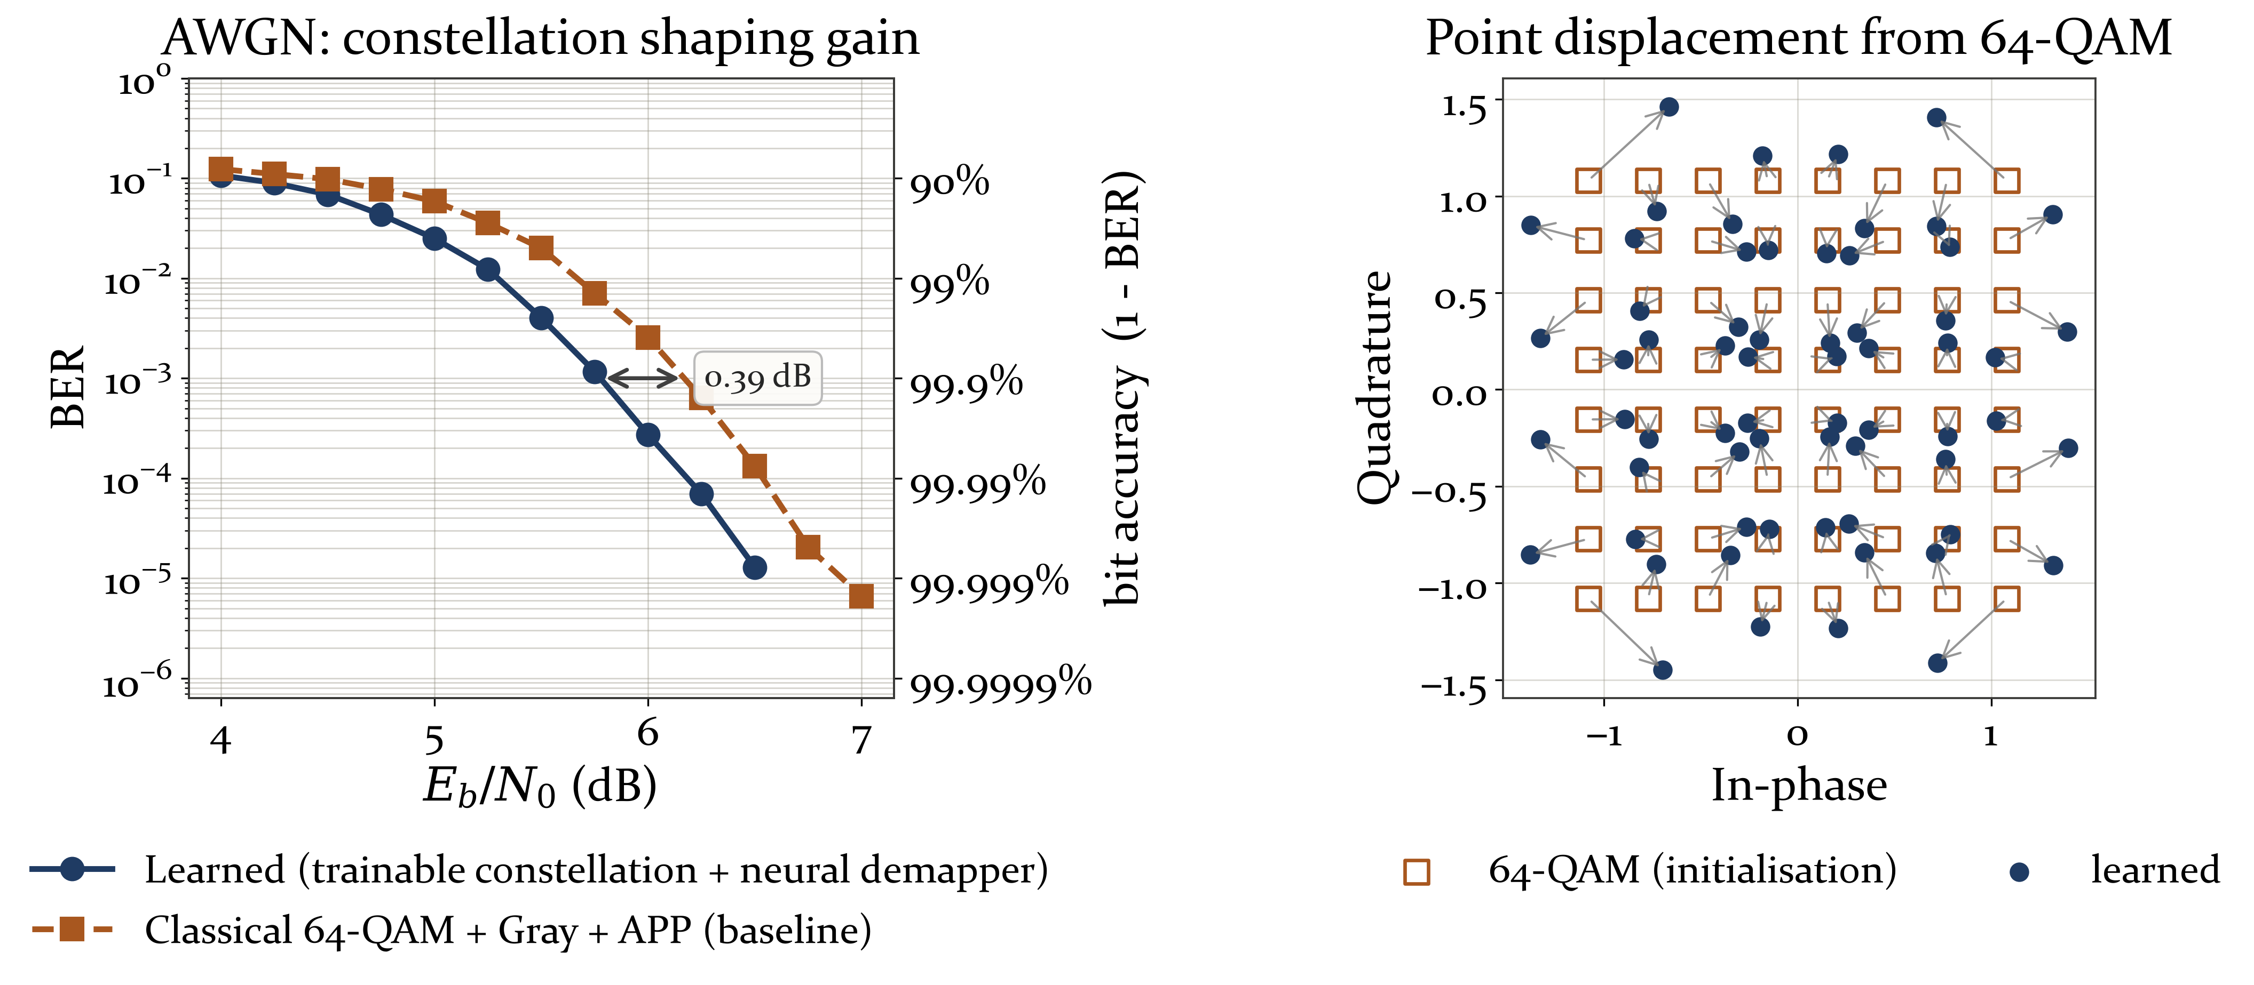
On AWGN, learning wins, and the transmitter is why
A posteriori probability (APP) demapping is already optimal here, so the receiver cannot be the source of the gain.
It comes from the transmitter. The learned constellation leaves the regular lattice and spends more power on the symbols that are most often confused.
0.37 dB
gain over classical 64-QAM at BER 1e-2
Notes:
B, 2:00-2:30.

Slide 5
Under fading, the gain is small
System | 1e-2 | 1e-3 | 1e-4
AWGN, classical 64-QAM + APP | 5.67 | 6.17 | 6.54
AWGN, learned (channel gradient) | 5.30 | 5.78 | 6.18
AWGN, learned (RL, no channel model) | 5.42 | 5.92 | 6.31
Rayleigh, classical 64-QAM + APP | 11.26 | 13.30 | 14.79
Rayleigh, learned | 11.25 | 13.19 | 14.94
5.9 to 8.8 dB
the cost of fading
under 0.4 dB
what changing the receiver is worth
Under Rayleigh with estimated CSI there is a small gain at 1e-2 and 1e-3, of 0.01 and 0.11 dB, and a loss of 0.15 dB at 1e-4.
Eb/N0 needed to reach a given bit error rate, in dB. Lower is better.
Notes:
B, 2:30-3:00. The point is the vertical gap between the AWGN block and the Rayleigh block, not the differences inside either one.

Slide 6
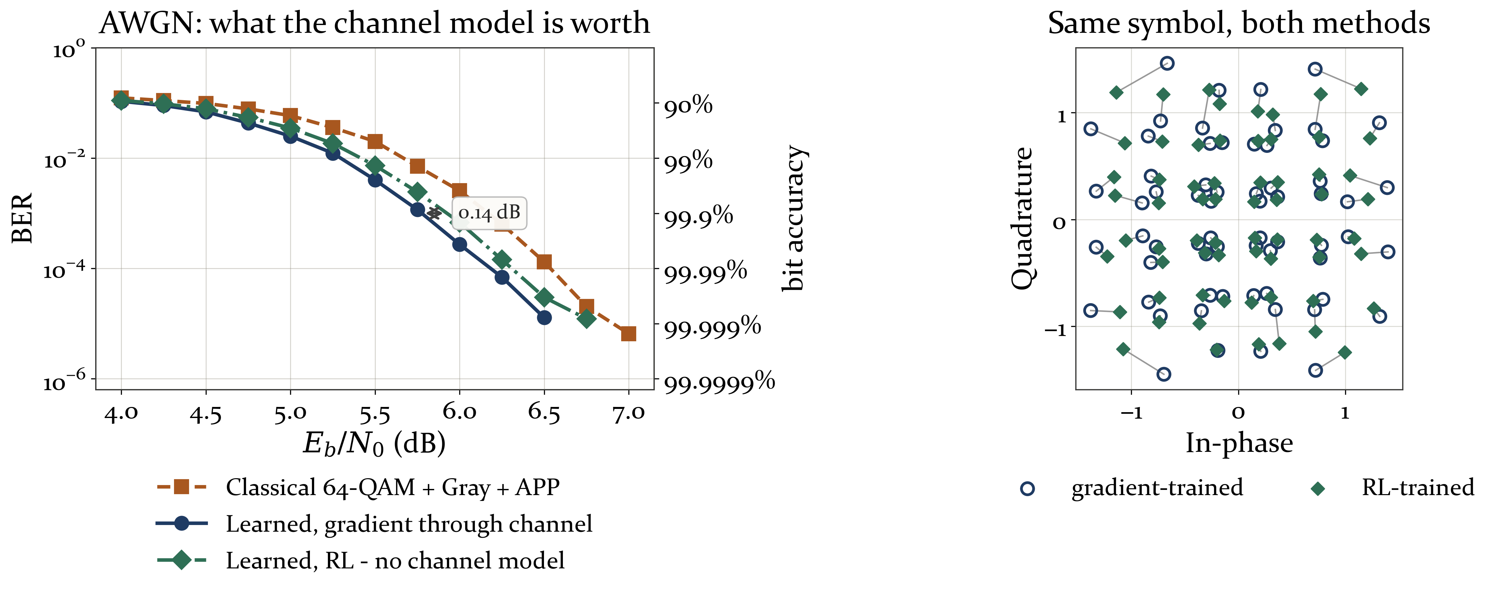
Training with no channel model at all
There is no channel layer connecting the two neural networks, because the channel is not differentiable.
We feed the training loss from the receiver back to the transmitter, which is then trained by reinforcement learning. The two networks are still jointly optimised, without a channel model.
0.12 to 0.14 dB
what dropping the channel model costs
0.23 to 0.25 dB
still ahead of classical 64-QAM
Notes:
B, 3:00-3:20. This is the result the project turns on. Say both numbers.

Slide 7
Skill 1 · Research rigour
Checking the thing that would embarrass you
1
What happened
Beyond LivSURF
Our effective-noise model was missing the (1+1/P) term. Adding it made our own numbers worse.
In research and in industry you will get results that favour you.
What makes a result trustworthy is whether you were willing to test the thing that would embarrass you.
Directly useful for postgraduate study, and for any role that works with data.
2
It inverted our own conclusion
Two pilots went from apparently best to measurably worst. We changed it anyway, and wrote a validation cell that tests the model against the simulator.
Notes:
A, 3:20-4:20. Tell it as a story. The "Beyond LivSURF" panel is the half the marking scheme asks for, so do not skip it.

Slide 8
Skill 2 · Problem solving under uncertainty
Diagnose by intervention, not by argument
1
A curve that could not be real
Beyond LivSURF
Reused on a fading channel, the BER rose as the SNR rose. Our first explanation blamed deep fades.
The first explanation for a bug is usually the most familiar one, not the right one.
Designing an experiment that can prove yourself wrong is faster than arguing about it.
That habit transfers to any engineering or analysis work.
2
We tested instead of arguing
Weights held fixed, one thing changed at a time. Erasing deep fades made it worse. The real cause was the quiet tail: at 18 dB, 89% of symbols were quieter than anything seen in training.
Notes:
B, 4:20-5:20. Same shape as slide 7.

Slide 9
What we take away
Under fading the measured gain is small, and at 1e-4 it goes the other way.
That looks like a disappointing result, until you notice the interesting finding was somewhere else entirely.
A measurement that shows little is worth as much as one that shows a lot, provided it is clean enough to trust.
The end-to-end system can be trained with no channel model, and we can now say what that costs.
Notebook, figures and measured data: github.com/MaoYuxingy
Notes:
A and B, 5:20-6:00. A takes the left, B takes the right, then thank the audience.

