Slide 1

COMP 208
PLANNING
Notes:
aims of these slides
make you aware of the importance of planning
discuss the different activities related to planning

Slide 2
INTRO
Planning, important, often neglected
Crucial to project success.

Slide 3
(PRESENTATION) PLAN
What is planning in general?
Planning in the group project
How to plan

Slide 4
WHAT IS PLANNING?

Slide 5
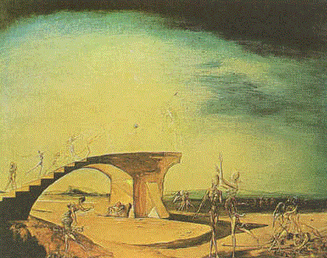
PLANNING
Planning is key to a successful project
It is doubly important when multiple people are involved
Plans are needed to:
  Identify what must be done (WHAT)
  Allocate work across the team (WHO)
  Co-ordinate the activities of the team (WHEN)
Notes:
Planning is needed because we are not working on a tiny Java assignment. The task at hand is very large, and complicate.
PLAN AIMS:
WHAT?
WHO?
WHEN?

Slide 6
EXAMPLE 1:
LIFECYCLE OF THIS PROJECT
Although, within each team you are free to work using any methodology you like¹, the module assessment follows the traditional waterfall model:
Define your requirements
Produce a design of the sought system
Implement the proposed design
Test and evaluate your product
Document your solution
Notes:
1. The way in which each team organizes its work between assessment events is mostly left to the team’s initiative.

Slide 7
EXAMPLE 1:
LIFECYCLE OF THIS PROJECT
Notice that the initial stages are quite important!
Requirement Analysis (Review worth 12%)
Design (worth 15%)
Implementation (demo worth 15%)
Final documentation (assessment worth 30%)
Notes:
A WORD OF WARNING!
Reqs + Design may not look worthy that much …. So … YEAH Planning is important.

Slide 8
EXAMPLE 1:
LIFECYCLE OF THIS PROJECT
WARNING!
Requirement Analysis (TIME: 3 WEEKS – 150 hours)
Design (TIME: advised, 3 WEEKS – 150 hours)
Implementation (TIME: 4 WEEKS – 200 HOURS)
Final documentation (TIME: throughout the term)
Notes:
… time wise, they are significant activities!

Slide 9
EXAMPLE 1:
LIFECYCLE OF THIS PROJECT
WARNING!
Requirement Analysis (TIME: 3 WEEKS – 150 hours)
Design (TIME: 4 WEEKS – 200 hours)
Implementation (TIME: 3 WEEKS – 150 HOURS)
Final Documentation (TIME: Throughout term + 1 WEEK)
THE INITIAL PART OF TERM IS USUALLY MORE FREE FROM WORK AND DEADLINES.
Notes:
… time wise, they are significant activities!

Slide 10

EXAMPLE 2: PROJECT
Organizing a Party?
Notes:
Example:
tasks (organizing, venue, music, food, participants, activities)
time frame (invitations cannot be sent before deciding participants, etc)
budget

Slide 11
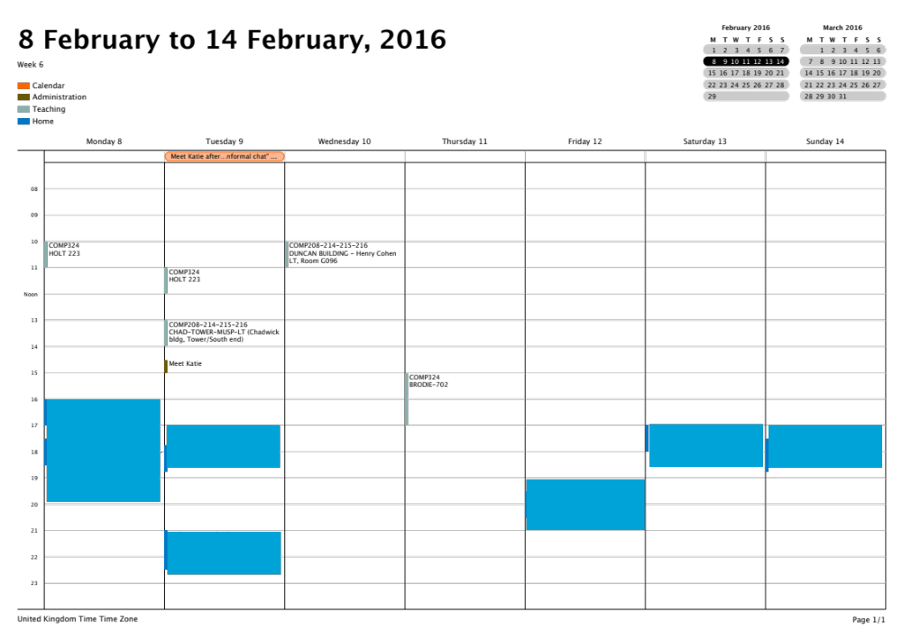
Notes:
Third example: planning my week!

Slide 12
TASKS
(excluding contingencies & long term jobs!)
Prepare 5 lectures (2 hours each)
Prepare 1 tutorial (3 hours)
Write reference letters (1 hour)
Meeting Preparation (2 hour)
Work on a scientific paper (10 hours)
Review conference papers (5 hours)
Return reports on a bunch of conference submissions (1 hour)

Slide 13

… AND MANY MORE …
Build a house
Business activity
Organize a trip

Slide 14
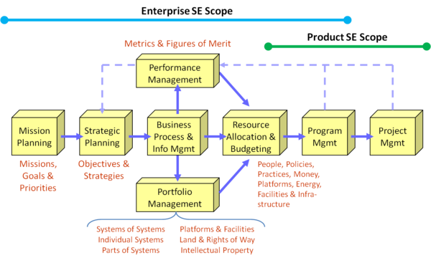
… AND MANY MORE …
Build a house
Business activity
Organize a trip
Martin, J.N. 2010. "An Enterprise Systems Engineering Framework." Presented at 20th Anniversary International Council on Systems Engineering (INCOSE) International Symposium, July 12-15, 2010, Chicago, IL, USA.

Slide 15
… AND MANY MORE …
Build a house
Business activity
Organize a trip

Slide 16
… AND MANY MORE …
Few years ago we had a nice talk by a guy from DELOITTE that gave us their view on the importance of planning (details can be found here and on CANVAS)

Slide 17
IN COMP208
Honestly, don’t leave it to single individuals enthusiasm, or even chance
Make planning part of your project work
You will reap at the end

Slide 18
HOW TO PLAN

Slide 19
MAIN ACTIVITIES IN A S/E PROJECT
Managing project scope
Defining & scheduling tasks
Acquiring & allocating resources
Assessing & managing quality
Managing risk
Managing procurement
Execution (this could be the actual waterfall process)
Control and closure

Slide 20
MAIN ACTIVITIES IN A S/E PROJECT
Managing project scope
Defining & scheduling tasks
Acquiring & allocating resources
Assessing & managing quality
Managing risk
Managing procurement
Execution (this could be the actual waterfall process)
Control and closure
One/Two people devoting half of their time planning and controlling!!
Notes:
My advice is apparently suicidal, but in fact quite appropriate.
Although most of the team members should have technical responsibilities (e.g. look at the data model, work on the UI//UX) one or two people should focus regularly, if not constantly, on the plan, to make sure that the interna team clock keeps turning.

Slide 21

STEPS IN PLANNING
Work breakdown
Time estimates
Milestone identification
Activity sequencing
Scheduling and allocation of people
Re-planning

Slide 22
(1) WORK BREAKDOWN
It is important to think about tasks at the right level of detail
“Do project” is clearly too abstract:
  It doesn’t tell you what you need to do
  You can’t estimate how long it will take
  You can’t tell what progress you have made
  It gives no basis for splitting the work.

Slide 23
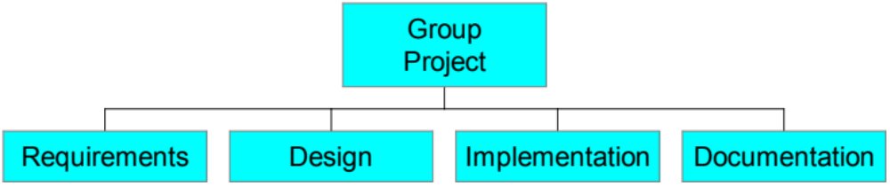
REFINE THE TASKS STEP BY STEP
Notes:
EXAMPLE

Slide 24
REFINEMENT OF REQUIREMENTS
Requirements
Database
System
Requirements
Planning
Definition
Collection
Mission
Mission
User
For each
Statement
Objectives
Views
User View
Administrator
Enquirer
Data to be
How data
Used
will be used
Sub-tasks taken from Connolly and Begg: “Database Solutions”
Notes:
To save time, ask what is REALLY needed. Check that you are not actually duplicating efforts.

Slide 25

HOW FAR SHOULD WE REFINE?
Break the task down until you are sure what the task involves
If the task is likely to take more than a week, probably it should be broken down
If the task is likely to take less than a day, you’ve probably gone too far
Later tasks can be left with less detail until they are reached
Too much detail makes re-planning difficult, too little makes planning impossible.
Notes:
Guidelines, useful within the group project context

Slide 26
(2) TIME AND PERSON ESTIMATES
Examine the tasks at the lowest level of detail
For each estimate how long it will take, and how many people are needed and desirable to do it
Other resources that may be needed.
These estimates MAY BE wrong.
  Don’t worry about this, but make sure your plan can cope (leave slack in the Plan).
  Plan gives you structure nevertheless

Slide 27
(3) MILESTONE IDENTIFICATION
Milestones are significant events before project completion.
External milestones (usually with fixed date):
  The requirements review
  The demonstration
  The final report.
Internal milestones:
  e.g. project meetings, Completion of significant tasks (optional).
Notes:
milestones drive the process

Slide 28
(4) ACTIVITY SEQUENCING
For each task, decide which milestone it must be completed before
For each task, see which (other) tasks must be completed before it can start, and which cannot start until it is completed
Draw a chart showing these relationships.

Slide 29
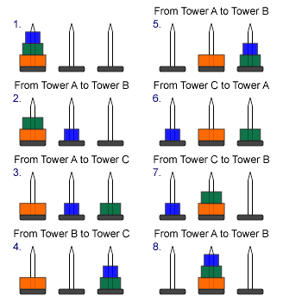
EXAMPLE
Notes:
Move the top 2 to C FIRST!
Then the red disk can be moved to positiion
Move the 2 from C to B.

Slide 30
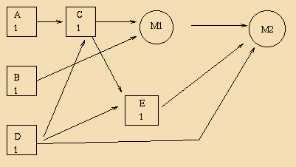

EXAMPLE ACTIVITY NETWORK
Tasks A,B,C are required by milestone 1
Tasks D,E, are required by milestone 2
Task C requires tasks A and D
Task E requires tasks C and D
All tasks take 1 week

Slide 31
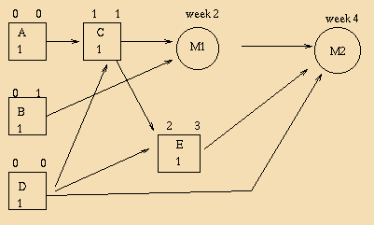

NOW ADD SOME DATES
Fixed Dates for Milestones
Earliest Start dates (from required tasks)
Latest start dates (from deadlines)
In the example:
  A and D must start in week 0, and be done in parallel
  C must start in week 1

Slide 32
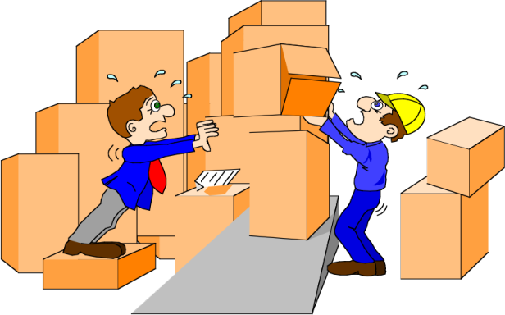
AT THIS POINT:
We can identify:
  What CAN (or MUST) be done in parallel
  When tasks must start, and which have flexibility
  Potential problems: latest start date is before earliest start date
In the last case re-planning is needed:
  Split the task
  Change the time estimate
  Reconsider dependencies
  Reduce the task.

Slide 33
(5) SCHEDULING
We now decide which task will start when
Gantt Charts are commonly used
They show explicitly how long tasks will take, what must be done in parallel, and what slack there is in the plan
  The more slack you have the better.

Slide 34
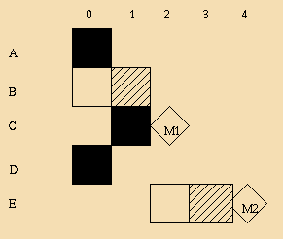
GANTT CHART FOR EXAMPLE
Horizontal axis shows time steps/Vertical axis shows tasks
Black shows no float
Shaded shows float
White shows earliest possible scheduling
Milestones shown as diamonds at end of last task.
Notes:
If the charts ends up being VERY wide you may prefer to rotate it, and show time on the vertical axis.

Slide 35

SCHEDULING IMPLICATIONS
We must start A and D in parallel at the earliest time
C must start immediately when A and D are complete
B can start after A and D are complete, or straight away.
  Do we need the resources from A or D to do it?
We can take a week off after M1, but why not do it after E is complete??

Slide 36
ALLOCATION OF PEOPLE - I
What is desirable?
Some tasks naturally require different numbers of people;
  The whole group (e.g. deciding on the application area):
    Everyone needs to agree and be involved
  Pairs (e.g. requirements collection for a use case)
    2 heads are better than 1: It helps to talk
  Individuals - (e.g. drawing a diagram, implementing a piece of code) - but someone else reviewing the work may be helpful.
    It is easier for a fresh eye to spot any problems.

Slide 37

ALLOCATION OF PEOPLE -II
What is possible?
If tasks need to be done in parallel, it may be essential to split your resources across them
Different people may have different skills and interests.

Slide 38
ALLOCATION OF PEOPLE - III
Better if everyone has something to do all the time
  There are on-going background tasks, such as data acquisition which can be done at “any” time
Try to avoid too much waiting for other people to finish
Spread the work evenly over people and time
Try to keep slack in your plan.

Slide 39
ALL DONE??

Slide 40

(6) RE-PLANNING
Plans are never perfect: things will go wrong or well.
  Modify the plan - don’t throw it away
  General Colin Powell: “No plan survives first contact with the enemy.”
A task finishes late and there was no slack: other tasks must be completed more quickly
  Use more people; reduce the task;
Tasks are finished early
  Move an activity forward; always try to create slack
New tasks are identified in the course of the project
  Add them to the plan
Tasks are no longer needed
  Remove them from the plan.

Slide 41
IF YOU HAVE A GOOD PLAN
Everyone knows what to do, when they need to do it, and why they are doing it
Potential difficulties will be anticipated
Things will be completed on time
Work will be divided fairly
Everyone will be happy.

Slide 42
