Slide 1

COMP 208
DESIGN

Slide 2

Design??
Reality
Notes:
DESIGN PROCESS
You all started from an idea to add a software system in a particular scenario

Slide 3

Design??
Reality
HOW?
Notes:
DESIGN PROCESS
You all started from an idea to add a software system in a particular scenario
The big question we should be dealing with now is HOW? How are we going to do that.

Slide 4

I know it! NO Design!

Slide 5
NO Design
Task: Write a Java program that prints the sentence
Hello YOUR_NAME! Today it’s date. Good morning!
(with the obvious substitution for the placeholders YOUR_NAME and date)

Slide 6
Design??
Reality
HOW?
Notes:
DESIGN PROCESS
You all started from an idea to add a software system in a particular scenario
The big question we should be dealing with now is HOW? How are we going to do that.

Slide 7
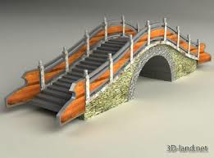
Design??
Reality
Model
HOW?
Notes:
DESIGN PROCESS
You all started from an idea to add a software system in a particular scenario
The big question we should be dealing with now is HOW? How are we going to do that.
The output of that is a model, a model of your final system (not the initial reality we want to model!).

Slide 8
Design??
HOW?
Notes:
Design, for a software system typically involves modelling DATA and PROCESSES

Slide 9
Design??
HOW?
Processes
Notes:
Design, for a software system typically involves modelling DATA and PROCESSES

Slide 10
Design??
HOW?
Data
Processes
Notes:
Design, for a software system typically involves modelling DATA and PROCESSES

Slide 11
Design??
HOW?
Data
Processes
Interface
Notes:
Design, for a software system typically involves modelling DATA and PROCESSES and INTERFACE

Slide 12



Database Design
Connolly and Begg give a very
detailed step by step guide to design
  See Chapters 9-10 & 12-16 (Chapters 6-17 in 1st edition), summarised in Appendix B.
Following this method produces a number of documents
We review the most
important of these.
Notes:
DATA(BASE) design, a good source is Connolly and Begg.

Slide 13
Data(base) Design Method
Logical DB design
  Create and check the ER model
  (usually) Map the ER model to tables
Physical DB design
  Translate Logical DB design for target DBMS
  Choose file organization and indexes
  Design user views
  Design security mechanisms
  Design controlled redundancy
  Monitor and tune operational system
Notes:
The logical DB design has two main aims: the design of the conceptual model and the mapping of such model to a collection of tables (IF YOU CHOOSE A RELATIONAL DATABASE FOR YOUR IMPLEMENTATION)
You will always need a conceptual model of your data, even if you do not use a data base. This could be described as an ER diagram, or a Class Diagram (say)
The physical design MAY include the elements listed here

Slide 14
Design Documentation
( for a typical DB project )
Global Logical Data Model (ER Diagram)
Data Dictionary
Logical Table Structures
Physical Table Structures
Business Rules
Transaction/Table Matrix
Project Gantt Chart.
DATA
PROCESSES
PLAN
Notes:
This is the way the Data Design would fit into the design documentation of a typical DB project.
More algorithmic projects might have a chunkier process design part

Slide 15
Design Documentation
(Disclaimer)
NONE OF THEM ACTUALLY REQUIRED
USE YOUR JUDGEMENT!
ADD MORE IF YOU THINK IT’S NECESSARY
EXAMPLE: Transaction Matrix is only one way to specify transactions. If you are not familiar with the technique, use a different one. You are in charge.

Slide 16
Data Model
Logical model
Dictionary
Logical data structure organization
Physical data structure organization
Constraints
Transactions

Slide 17
(1) (Global) Logical Data Model
During design you may produce local data models for different user views
These are brought together into a global data model. The global data model will be reviewed
The global data model should be described in a diagram showing:
  entities and their primary keys,
  relationships between entities and their direction and multiplicities
An example is given in:
  Figure C.4 p 439 (Figure 10.4 in 1st edition).

Slide 18
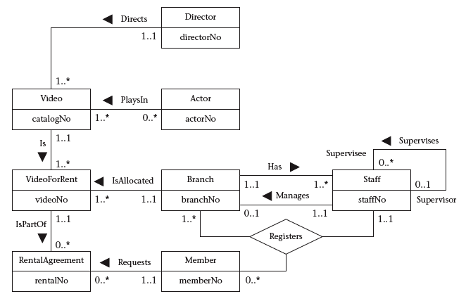
Global ER diagram

Slide 19
Global ER diagram
1. KEEP IT SIMPLE,
KEEP IT CLEAR.
EXPLAIN IT!!!

Slide 20

KEYS?

Slide 21
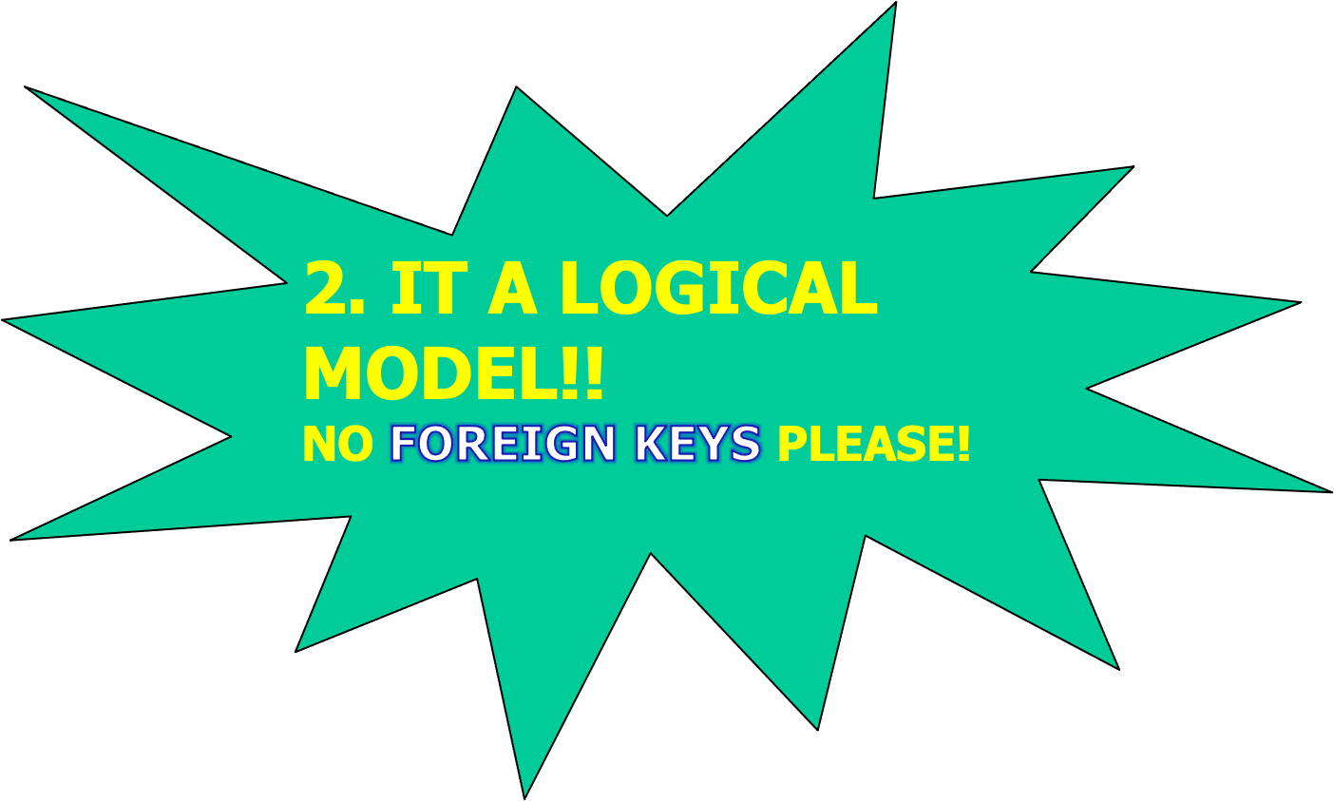
Global ER diagram
Notes:
NO FOREIGN KEY IN THE ER DIAGRAM!!! (BY FAR THE MOST COMMON ERROR!)

Slide 22
(2) Data Dictionary
The Data Dictionary is built up throughout the logical design phase
It should contain all information about the data to be used by the system
Entities require a description, any aliases used, and occurrence
  See Fig 9.2 (Fig 8.1 in 1st edition)
For each relationship in which an entity participates we need the multiplicity, the related entities and their multiplicity
  See Fig 9.7 (Fig 8.6 in 1st edition)

Slide 23
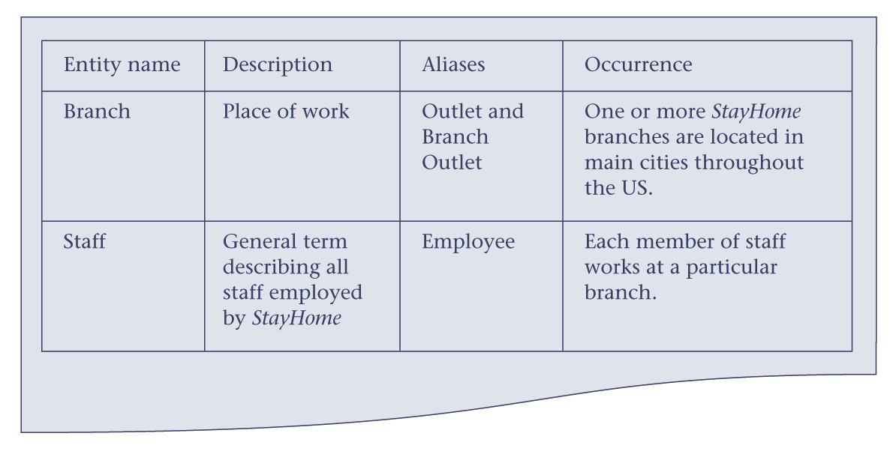
Extract from data dictionary

Slide 24
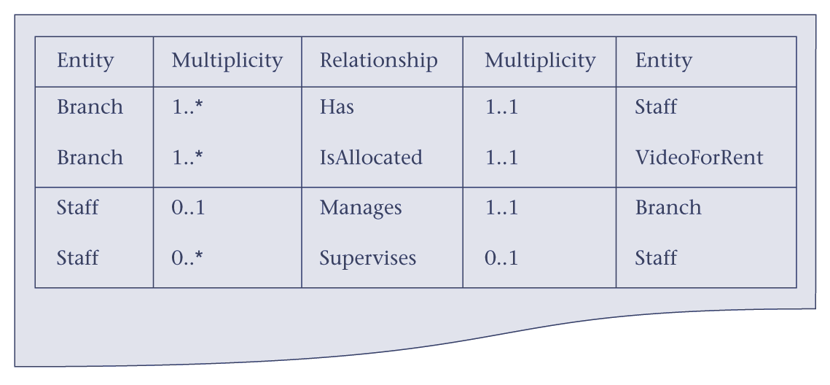
Extract from the data dictionary showing descriptions of relationships

Slide 25
(2) Data Dictionary
For each attribute of an entity, a description, data type and length, whether nulls are allowed and whether it can be multi valued
  See Fig 9.8 (Fig 8.7 in 1st edition)
For each entity its primary and alternate keys
  Fig 9.10 (Fig 8.9 in 1st edition)
Any integrity constraints on attributes resulting from referential integrity and business rule considerations
Indication of derived data items, and how they are computed
  See p. 205 (p. 139 in 1st edition).

Slide 26
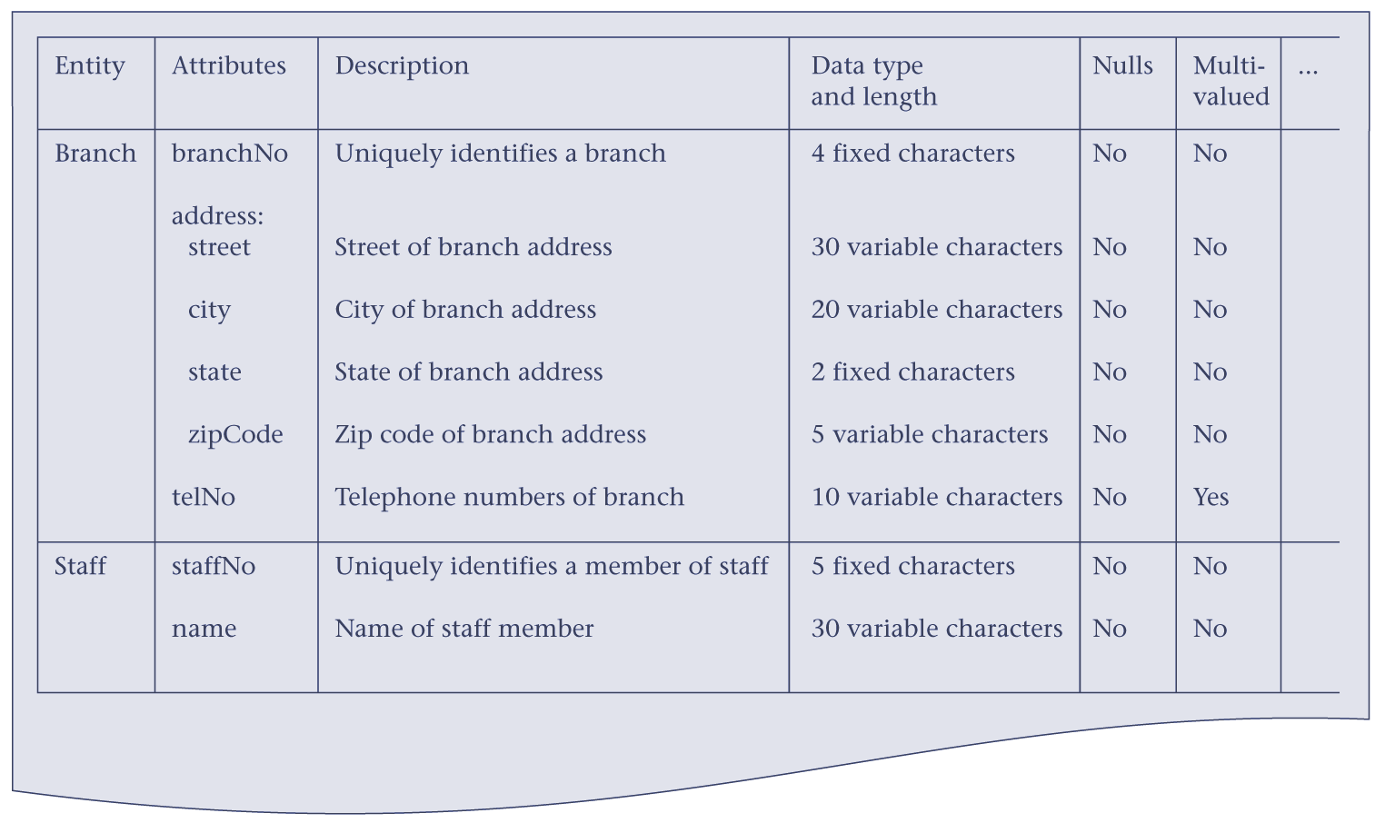
Sample of data dictionary showing descriptions of attributes

Slide 27
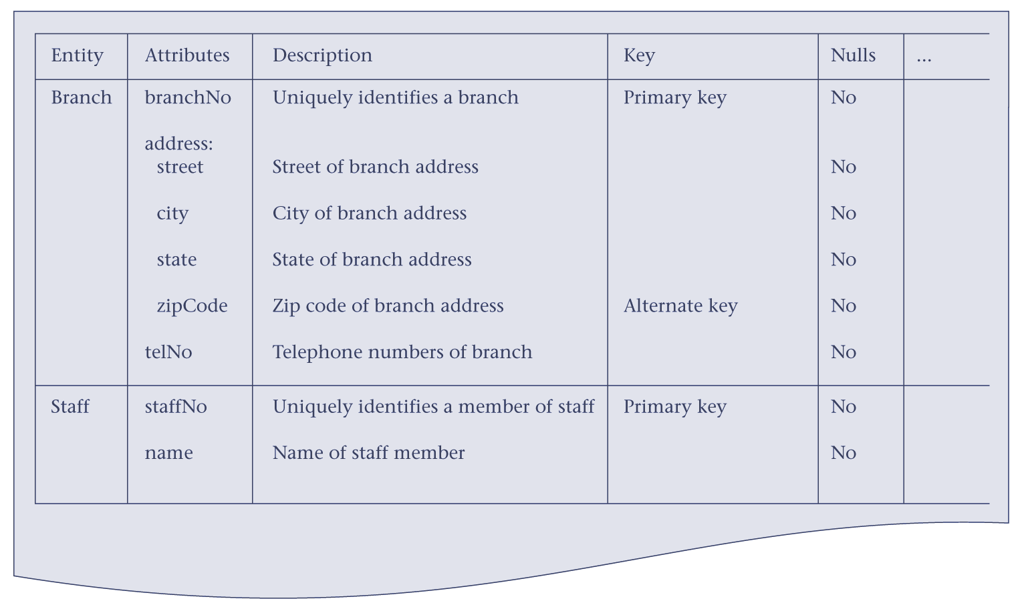
Sample of data dictionary showing attributes with primary and alternate keys

Slide 28
(3) Logical Table Structure
The Logical Table structures comprise, for each proposed table:
  The name of the table
  The columns for that table
  the primary key for that table
  any alternate keys for that table
  any foreign keys for that table, and the tables they reference
An example is given
  Figure C.3 p. 438 (Figure 10.5 in 1st edition).

Slide 29
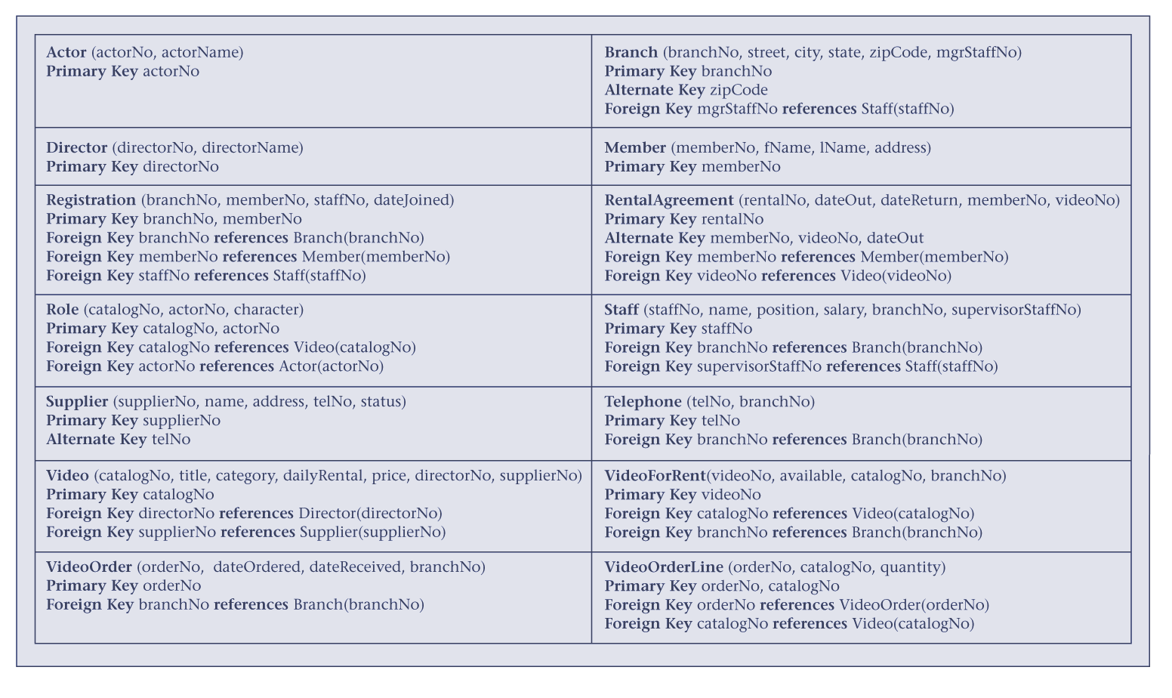
Tables for the global logical data model

Slide 30
(4) Physical Table Structure
The physical table structures comprise, for each table to be implemented,
  the name of the table,
  the domains of the columns
  the column names, their domains, and whether they may be null
  the primary and any alternate keys
  any foreign keys and their associated integrity constraints
An example for one physical table is given at Figure 12.2 (both editions).
Notes:
The RELATIONAL one is one possible Physical Database model

Slide 31
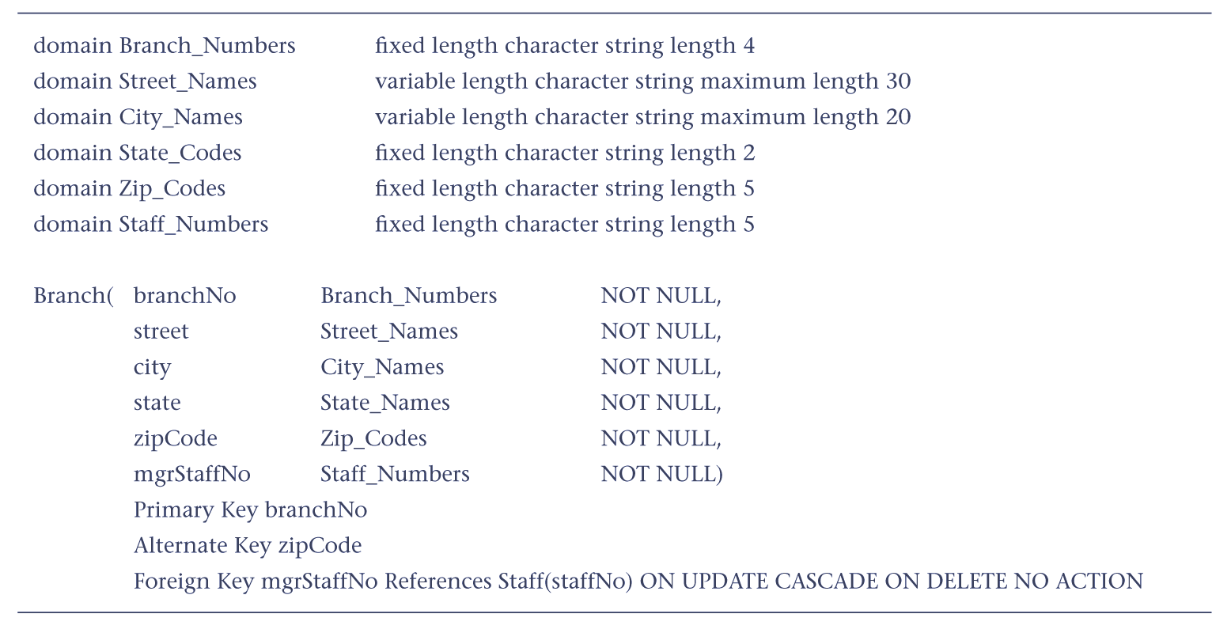
Example of Physical Table

Slide 32
(5) Business Rules
Business Rules express constraints on data that can be entered
  e.g. 10 books for students, 30 books for staff may be borrowed from a library
They are instantiated policies of the client company or organization expressed in the form of rules over the data
  Note that Business Rules are more precise than company policies
Documentation should show any such rules and how they will be implemented
  validation rules on fields
  validation rules for records.
Notes:
BE REALISTIC! DON’T MAKE UP RULES THAT DO NOT EXIST. Add constraints that you will actually enforce in your implementation.

Slide 33
Example of Policies and Rules
Business Policies
  Only registered students may use the University Library.
  Students may only borrow a limited number of books at any one time.
Business Rules
  Each student may only borrow 10 books at any one time.
Business Rules force constraints on the data in the database
  eg, the number of books linked to each student name in the library database is not more than 10.
Not all Business Policies are translated into Business Rules.

Slide 34
(6) Transaction Table/Matrix
The transaction table/matrix shows, for each transaction, what tables are used, and how they are used
Each table forms a row
Each transaction has four columns
  insert
  read
  update
  delete
An example is given as Table 13.1 (both editions).

Slide 35
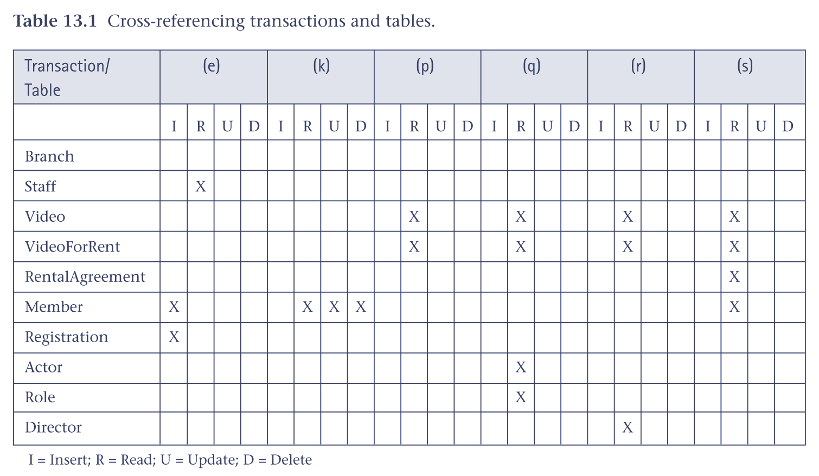
Transactions and tables matrix
Transaction (e): Enter details of new member registering at a branch
Transaction (k): Update/delete the details of a given member
Transaction (p): List the title, category and availability of all videos at a specific branch.
etc.

Slide 36



Process Design
Notes:
PROCESS Design

Slide 37
Process Design
Some possible design tools:
  Use-cases
    Descriptions of typical usage situations
  Data flow diagrams
    Showing which data items are transferred between which components, in which scenarios
  Navigation path diagrams
  Storyboards
  Functional descriptions of components
  Pseudo-code, flow charts, sequence/activity diagrams
Notes:
PROCESS Design

Slide 38
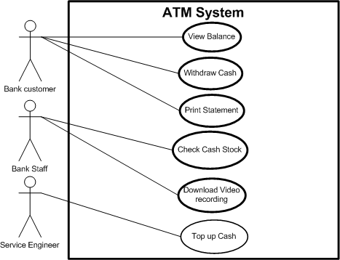
Use Cases and
Sequence Diagrams
Use Cases show what happens when each type of user interacts with the system
  By recording all the ways the system is used (“cases of use”) we accumulate all the goals or requirements of the system
The Use Case is a collection of sequences of actions or events relating to a particular goal
We would typically develop use cases for all the main processes in normal operation, and for many of the processes in abnormal operation.

Slide 39
Functional Descriptions
A Functional description provides details about the function of a component, along with actions, pre-conditions and post-conditions associated with that component.
Example:
Stock manager function in Book Inventory system
  Description: The function manages the stock of books available as books enter and leave the book database, ordering new stock as needed. It maintains information as to when stock is expected to arrive.
  Goals: Re-order books, log books arriving, log books outgoing.
  Actions: Send e-mail to order new stock.
  Triggers: Stock arrival, stock order delay, failed stock arrival.
  Information used: Stock database, Customer order, Stock order.
  Information produced: Stock database, Delayed orders, Arrived orders.

Slide 40



Interface Design
Notes:
Briefly. Many of the techniques mentioned when we talked about processes can be used to design the system’s interfaces:
Storyboards
Navigation charts
State charts (State Transition Diagrams) or even Flow Charts

Slide 41
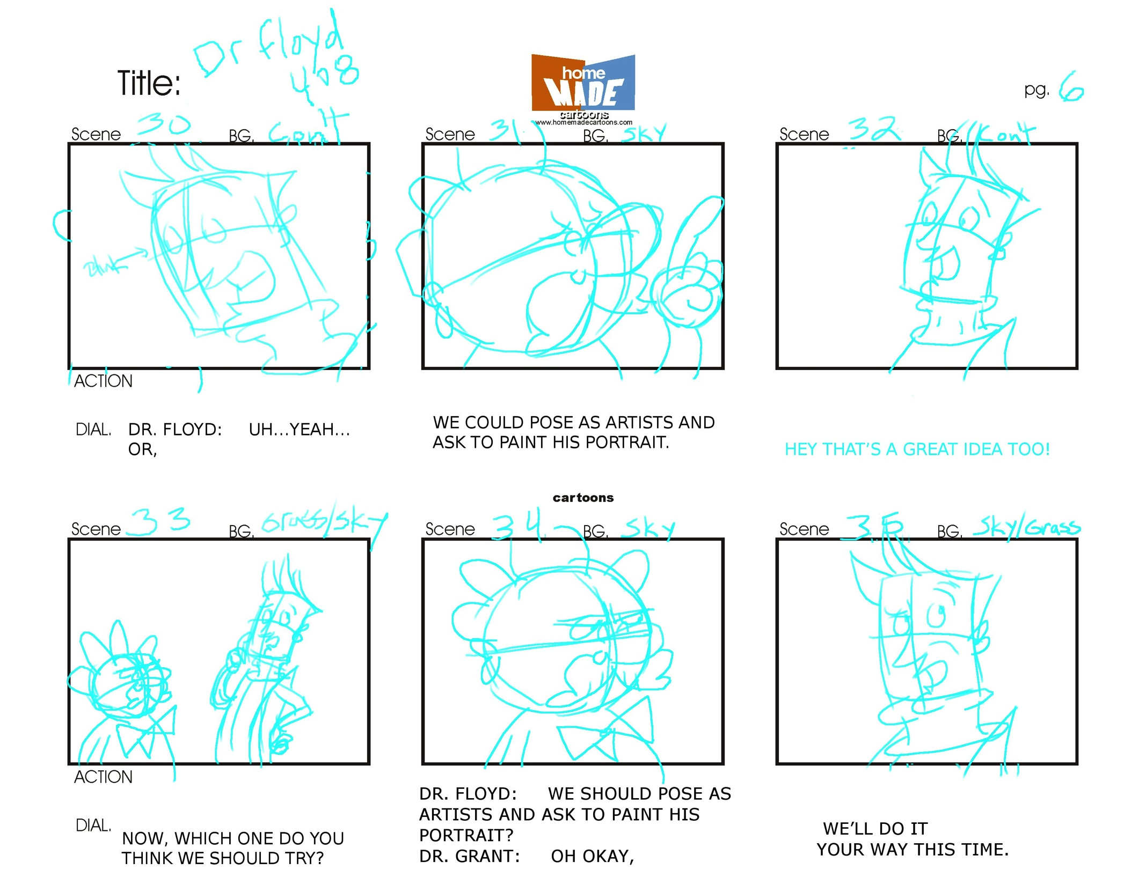
Storyboards

Slide 42
Storyboards
Page Heading
Links:
Link1
Link2
Link3
These give an outline of each web-site, showing:
  The structure of each web-page
    Where the text is
    Where the graphics are, and what these will consist of
    Where the links are
  The flow of control between pages
The term comes from the movie industry (check Wiki page)
  Before a movie is made, each scene is mapped onto story boards to enable
    Planning of rehearsals and shooting
    Obtaining props and costumes
    Planning of lighting, sound, camera angles, etc.
Photo of
book
cover
Advertisement

Slide 43
A Process Map
Browse
catalog
Home page
Register as
customer
Browse
catalog
Customer
Login
Put item in
cart
Make
purchase
Customer
Logout
Give payment
details

Slide 44
A Process Map
Browse
catalog
Should not be just boxes and arrows
The chart describes possible system states
Details of possible transitions should be given too
State charts provide an alternative
Home page
Register as
customer
Browse
catalog
Customer
Login
Put item in
cart
Make
purchase
Customer
Logout
Give payment
details

Slide 45
Navigation structure charts
Page 1
Page 1.1
Page 2.1
Home page
Page 2
Page 2.2
Page 3

Slide 46
Navigation structure charts
Page 1
Page 1.1
Page 2.1
Home page
Page 2
Page 2.2
Same as before consider using
State charts instead.
Page 3

Slide 47
Summary
Design specifies
HOW?
Process design
Data design
Interface design
Output: Design documents

Slide 48
Summary (references)
Design specifies
HOW?
Process design (SE, Algorithms, Data Structure)
Data design (DB courses)
Interface design (Human Centric Computing)
Output: Design documents

Slide 49
Further Issues
Class Diagrams
  For non-DB applications, they replace the ER model
  For DB applications, the could complement the conceptual data model
Lots of diagrams/tools, writing well is hard.
Description of general system dynamics
  Often missing …

