Slide 1

For user’s owned SNP dataset.
2. Create dataset
3. Build and train model
1. Introduction
4. Prediction & discovery
For SoyNAM SNP dataset.
(Skip steps 2 & 3)

Slide 2
For user’s owned SNP dataset.
2. Create dataset
3. Build and train model
1. Introduction
4. Prediction & discovery
For SoyNAM SNP dataset.
(Skip steps 2 & 3)

Slide 3
For user’s owned SNP dataset.
2. Create dataset
3. Build and train model
1. Introduction
4. Prediction & discovery
For SoyNAM SNP dataset.
(Skip steps 2 & 3)

Slide 4
For user’s owned SNP dataset.
2. Create dataset
3. Build and train model
1. Introduction
4. Prediction & discovery
For SoyNAM SNP dataset.
(Skip steps 2 & 3)

Slide 5
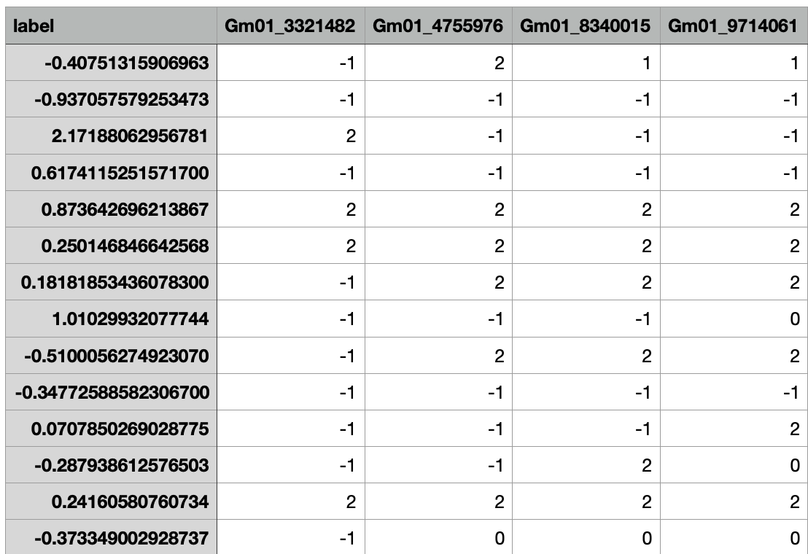
Features
Label
Samples
https://de.cyverse.org/dl/d/2FFA3458-2DDF-4FCB-B1FE-DF5C08A0BD28/protein.train.csv

