Slide 1










Controle
Sensor
Modelo
Controle

Slide 2



Control
Sensors
Model
Controle

Slide 3


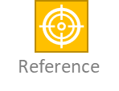



RUN
. . .
r(s)
u(s)
y(s)
+
-
Reference

Slide 4


