Slide 1
CHAPTER 8: INDEX STRUCTURES AND INDEX CREATION
Outline:
Understand the storage structure for database systems.
Understand I/O cost of database access.
Understand the basic index structures for reducing the I/O cost.

Slide 2
Storage Hierarchy (1)
Main memory (primary storage): storage media that can be operated on directly by CPU.
Characteristics of main memory:
fast access to data
small storage capacity (typically several GB)
Volatile
Expensive
Memory
Disk

Slide 3
Storage Hierarchy (2)
Secondary storage (e.g., disk): cannot be directly processed by the CPU; it must be brought to the main memory first.
Characteristics of secondary storage:
Slow access to data
Large storage capacity
Non-volatile
Cheap

Slide 4
Disk Device (1)
actuator
read/
write
heads
spindle

Slide 5
Disk Device (2)
Track: an information storing circle on the surface of a disk.
- A few hundred tracks per surface
- Between 4KB and 50KB of data per track
Cylinder: the tracks with the same diameter on all surfaces of a disk pack
Sector: a part of a track with fixed size; also known as blocks and pages
Typical page size: 1KB, 2KB, 4KB, 8KB

Slide 6
Page I/O (1)
Page is the smallest unit for transferring data between the main memory and disk.
Address of a page:
(cylinder#, track#, block#)
Page I/O – one page I/O is the cost (or time needed) to transfer one page of data between the memory and the disk.

Slide 7
Page I/O (2)
A (random) page I/O = seek time + rotational delay + block transfer time
Seek time: time needed to position read/write head on the correct track (10 msec)
Rotational delay: time needed to rotate the beginning of page under read/write head (4 msec)
Block transfer time: time needed to transfer data in the page (1 msec)

Slide 8
Page I/O (3)
Approximate time for reading/writing n consecutive pages:
seek time + rotational delay
+ n*block transfer time

Slide 9
Alternative Storage Hierarchies
Cache-memory-disk
Memory
Cache-memory
Memory-Disk-Tape/Optical Disk
Cache-memory-Disk-Tape/Optical Disk

Slide 10
Access Methods: Sequential Access
Consider query:
select * from Employees where name = ‘Bill’;
Sequential access: (tuples are scanned one at a time) to evaluate the condition on name.
This is reasonable if
Relation Employees is small, or
High percentage of the tuples in the relation satisfy the condition.
Too slow for most other cases.

Slide 11
Access Methods: Hash Table (1)
Using a hash table:
Create a hash table based on the values of A in advance. Suppose h( ) is the hash function used.
To process a query with condition “A = v”, first use h(v) to find the bucket in the hash table and then compare v with the A-values in the bucket to identify qualified tuples.

Slide 12
Access Methods: Hash Table (2)
Example: Suppose Employees has 9 tuples.
Build a hash table based on Name.
Suppose we have 3 buckets and each can hold 3 entries and an overflow pointer.
Hash function: h(x) = seq(x) mod 3
seq(x) returns the serial number of the first letter in x in the English alphabet.

Slide 13
Access Methods: Hash Table (3)
Hash Table
Stored Employees Table
SSN Name Salary
123456789 Bill 35k
234567891 Amy 28k
345678912 Bob 30k
456789123 Mike 27k
567891234 Liz 43k
678912345 Bill 30k
789123456 Ann 31k
891234567 Beth 25k
912345678 Roy 36k
Liz
Roy
0
Amy
1
Mike
Ann
Bill
2
Bob
Bill
Beth

Slide 14
Access Methods: Hash Table (4)
Evaluate query using the hash table:
select * from Employees where Name = ‘Bill’;
1. Apply hash function to obtain a bucket#:
hash(‘Bill’) = seq(‘Bill’) mod 3 = 2 mod 3 = 2
2. Search the identified bucket (and related overflow bucket(s)) for ‘Bill’ and follow proper pointer(s) to obtain the tuple(s).

Slide 15
Access Methods: Hash Table (5)
Using hash table can reduce search time substantially.
Example: Suppose Employees table has 1000 pages. The hash table on SSN has 50 pages and can be kept in memory.
Finding a tuple using sequential scan needs about 500 page I/Os on average.
Finding a tuple using the hash table needs 1 or 2 page I/Os.

Slide 16
Access Methods: Hash Table (6)
Hash tables are effective only when the operator is = but not effective for the other comparators
Best for primary keys where order is meaningless (e.g., SSN)
Complications of implementing hash tables: hash function selection, collision resolution, bucket overflow, hash table overflow.

Slide 17
Access Methods: B⁺ Tree
A B⁺ tree is a balanced search tree
Each node (internal or external) is stored as a page
Format of an internal node:
p1 a1 … ai-1 pi ai … ak pk
a < a1
. . .
ai-1 <= a < ai
. . .
ak =< a
https://www.cs.usfca.edu/~galles/visualization/BPlusTree.html

Slide 18
Access Methods: B⁺Tree
Format of a leaf node:
a1 p1 … ai pi … ak pk p
All leaf nodes form a linked list in non-decreasing A-values.
Every non-root node must be at least half full.

Slide 19
B+ Tree
Balanced tree
Every path from the root to a leaf is of the same length
Each non-leaf node of the tree has between ⌐K/2¬ and K data where K is fixed for a particular tree
Exception: Root can have less than ⌐K/2¬ data items
A non-leaf node contains data and indexes
A leaf should have between ⌐L/2¬ and L data, where L is fixed for a particular tree
Let K = L in the following slides

Slide 20
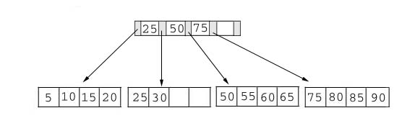
Example B+ Tree (K=L=4)

Slide 21
Searching
Example: find the value 15 and 45 in the tree below.
Search time: O(log _{K/2} N) where N is the total number of data
Fast search time for a flat B+ tree with large K
Good for range queries

Slide 22
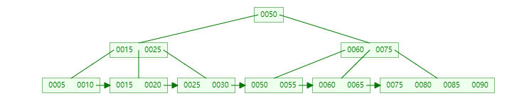
Insertion
Rearrange the B+ tree, if necessary, to keep it balanced
Example 1: insert 28

Slide 23
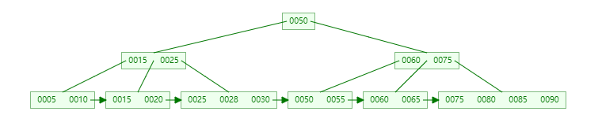
Insertion
Result:

Slide 24
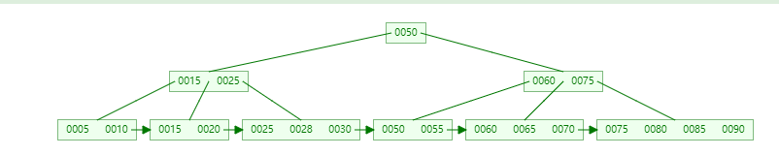
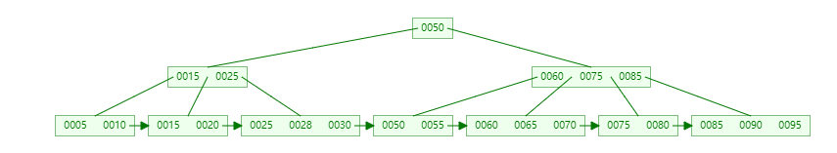

Slide 25
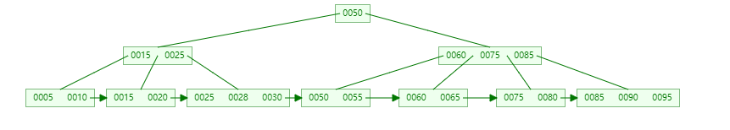
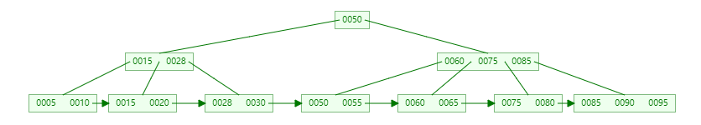
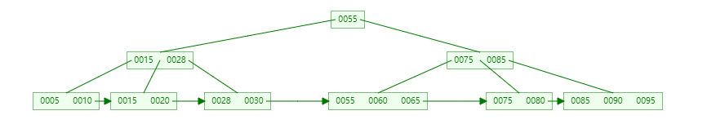
Example 1: Delete 70,25,50

Slide 26
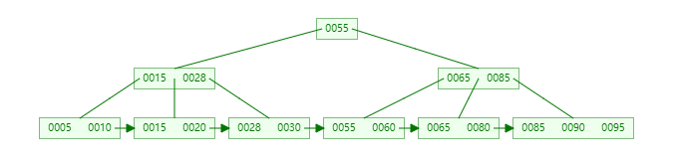


Slide 27
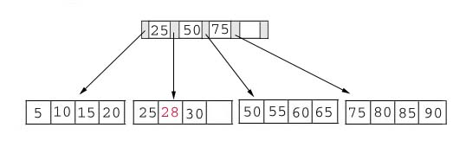
Insertion
Example 2: insert 70

Slide 28
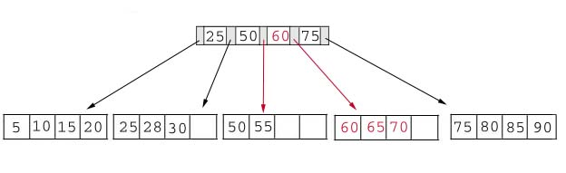
Insertion
Choose the middle key 60 and place it in the index page between 50 and 75. (Minimal changes to the tree.)

Slide 29
Insertion
Exercise: Insert 95

Slide 30
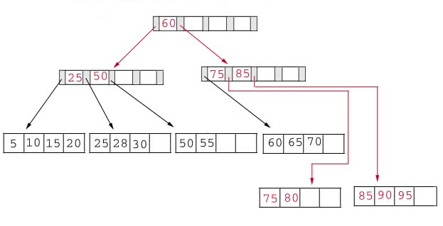
Insertion
Result:

Slide 31
Deletion
Example 1: Delete 70

Slide 32
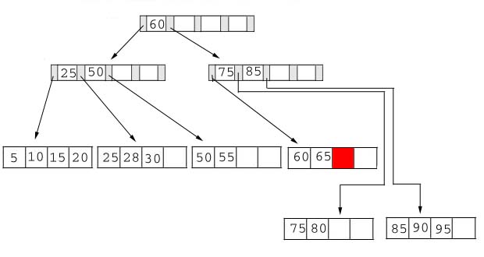
Deletion
Result:

Slide 33
Deletion
Example 2: delete 25

Slide 34
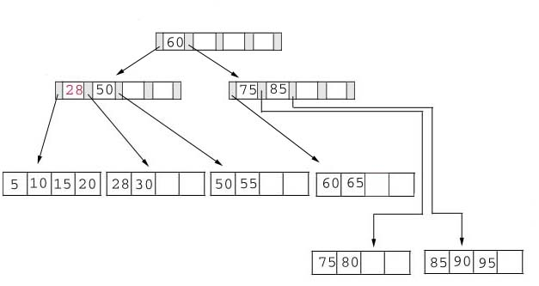
Deletion
Result: replace 25 with 28 in the index page.

Slide 35
Deletion
Example 3: Delete 60

Slide 36
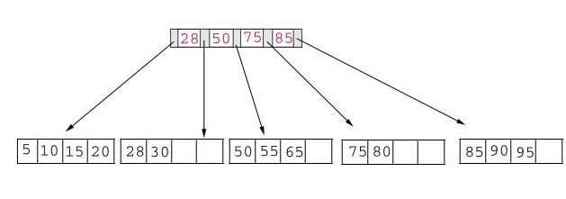
Deletion
Result:

Slide 37
Access Methods: B⁺ Tree
Indexes in databases are usually implemented as a B⁺ tree.
Definition: If the tuples of a relation R are stored in ascending (or descending) A-values, then the B⁺ tree index on A is a primary index (clustered index).
Note: Primary index is not directly associated with the primary key. (i.e., there may not be a primary index on the primary key)

Slide 38
Access Methods: B⁺ Tree
Definition: A secondary index (non-clustered index) is an index on an attribute whose values are not sorted.
Several possible pointer implementations:
1. Each p_{i} in the leaf node points to one tuple.
This is suitable for attributes that are candidate keys or have low-degree of repeating values.

Slide 39
Access Methods: B⁺ Tree
Build an index based on R.A:
(1) Sort R based on A and store the sorted R.
(2) Create a pair (a, p) for each tuple t, where a is t[A] and p is the address of t. Sort all pairs based on a.
(3) Build the leaf nodes, starting with pairs with the smallest a’s. Each leaf node has a pointer to the next leaf node.
(4) Build the upper level nodes, one level at a time.
(5) If insertion and update are expected, leave some free space in each page.

Slide 40
Access Methods: B⁺ Tree
Stored Employees Table
SSN Name Salary
e1: 234567891 Amy 28k
e2: 789123456 Ann 31k
e3: 891234567 Beth 25k
e4: 123456789 Bill 35k
e5: 678912345 Bob 30k
e6: 345678912 Fay 30k
e7: 567891234 Liz 43k
e8: 456789123 Mike 27k
e9: 912345678 Roy 36k
Page k
Page k+1
Page k+2
Page k+3
Page k+4

Slide 41
Access Methods: B⁺ Tree
Fay Roy
Ann Bill Fay
Mike Roy
Amy Ann
Beth Bill
Bob Fay
Liz Mike
Roy
e1
e2
e3
e4
e5
e6
e7
e8
e9

Slide 42
Access Methods: B⁺ Tree
Another pointer implementation:
2. Each p_{i} in the leaf node points to a page that contains pointers to tuple(s) whose index value is a_{i}.
This is suitable for attributes that have high-degree of repeating values.
For each distinct index value, exactly one pointer exists in the leaf node.
An extra indirection is needed to access a tuple.

Slide 43
Access Methods: B⁺ Tree
11 25 36
8 11
14 25
34 36
Redirection layer

Slide 44
Access Methods: B⁺ Tree
Normal height of a B⁺tree is only 2 or 3.
Example: Suppose Employees has 100,000 tuples of length 100 bytes. Each key value is 10 bytes and each pointer is 4 bytes. Each page is 2 KB.
Each cell (a, p) has 14 bytes.
Each page (2048 bytes) can contain 146 cells.
# of cells (a, p): 100000, needs 685 pages at the bottom level.
# of cells at next level: 685, needs 5 pages.
# of cells at next level: 5, needs 1 page.

Slide 45
Access Methods: B⁺ Tree
Some questions:
Can we create multiple primary indexes for the same relation?
Answer: No. A table can only be physically sorted once.
Can we create multiple secondary indexes for the same relation?
Answer: Yes.
Which is faster: primary index or secondary index?
Answer:
If just retrieve one tuple, no difference.
If multiple tuples are retrieved, primary index is usually faster as these tuples are likely clustered.

Slide 46
B⁺ Tree: Common Operations (1)
Let a, b – search key values
T – the pointer to the root of the tree
search(a, T): find all tuples whose A-values are a.
search(a, b, T): find all tuples whose A-values are between a and b.
insert((a,p), T): insert cell (a, p).
Delete(a, T): delete all cells whose A-values are a.

Slide 47
B⁺ Tree: Common Operations (2)
Search(a, T) /* with index on primary key */
case 1: T is an internal node. Compare a with the A-values in T.
(a) If a < a1, call search(a, p1).
(b) If ai-1 ≤ a < ai, call search(a, pi).
(c) If a > ak, call search(a, pk).
case 2: T is a leaf node. Compare a with A-values in T.
(a) If no A-value in T equals a, report not found.
(b) If ai in T = a, follow pointer pi to fetch the tuple.

Slide 48
Guidelines on Index Creation (1)
Information that guides the creation of indexes is the transactional analysis of the requirements document.
The following are the main factors on whether or not to create an index on an attribute A:
Search frequency: How frequently A is searched, including for evaluating conditions and joins?
Update frequency: How frequently A is updated, including insertion and deletion?
Candidate key: Must the values of A be unique?
Size: How large is the relation containing A?
Notes:
Oracle’s recommendation: An index should be created if all of the following conditions are satisfied:
* The table contains a large number of tuples (large means over 100,000)
* The attribute contains a wide range of values
The attribute contains a large number of null values
Application queries frequently use the attribute in search/join conditions
Most queries retrieve a small percentage of the tuples (say 4%)

Slide 49
Guidelines on Index Creation (2)
Oracle Corporation’s recommendation: An index should be created if all of the following conditions are satisfied:
The table contains a large number of tuples (large means over 100,000)
The attribute contains a wide range of values
The attribute contains mostly non-null values
Application queries frequently use the attribute in search/join conditions
Most queries retrieve a small percentage of the tuples (say 4%)

Slide 50
Guidelines on Index Creation (3)
Oracle Corporation’s recommendation: An index should not be created if one of the following conditions is true:
The table does not contain a large number of tuples
Application queries rarely use the attribute in search/join conditions
Most queries retrieve more than 4% of the tuples
Applications frequently changes the table contents.
Maintenance cost: Maintaining an index can be costly if frequent changes are needed.

Slide 51
Guidelines on Index Creation (4)
Among all the attributes of a relation that should have an index, only one attribute can have a primary index, and all others will have secondary indexes.
Attribute A should be favored to have a primary index if:
Searches on A are more likely to return multiple tuples (due to repeating values and range queries).
A is the primary key of the relation (more joins are likely involve primary key).

Slide 52
An example (1)
Consider table R(A, B, C, D) with the following information:
A is the primary key and no other candidate key exists.
Approximately, the number of distinct values under B is two times of that under C and this ratio does not change.
Out of every 100 operations against R, 10 will be insertions; 10 will be deletions with 5 based on conditions on A and 5 based on conditions on B; 70 will be selection queries with 30 based on conditions on A, and 20 based on conditions on B and 20 based on conditions on C; and 10 will be updates with 5 based on conditions on B and 5 based on conditions on C. All conditions are equality conditions.
Discuss which attribute should be used to build the primary index and which attribute(s) should be used to build secondary index(es).

Slide 53
An example (2)
From the given information, the following can be derived:
Out of every 100 operations:
45 need to search based on A (10 insertions, 5 deletions, 30 selections)
30 need to search based on B (5 deletions, 20 selections, 5 updates)
25 need to search based on C (20 selections, 5 updates)
0 need to search based on D

Slide 54
An example (3)
A should have a secondary index (having a primary index on A does not improve efficiency because at most one tuple will satisfy each condition).
D should not have any index because it is not used to search in any operation.
B should have a secondary index and C should have a primary index. Even though a slightly larger percentage of all conditions involves B than C, the number of tuples satisfying each condition involving C is two times of that involving B because B has two times the number of distinct values than C. This implies that if both B and C had secondary indexes, each search based on C would cost twice as much as each search based on B. Therefore, having a primary index on C would reduce more cost than having a primary index on B.

Slide 55
Types of Indexes in MySQL
MySQL supports the following types of indexes:
Single-column index: An index on a single attribute.
Composite index (multi-column index): An index on a combination of attributes.
Column prefix index: An index on the first n characters/bytes of a column’s values.
Unique index: Non-null values under the column or a combination of columns must be unique.
Regular index: Duplicate values are allowed.
Full-text index: Used to support full text search. Only supported for tables in MyISAM storage engine.
Hash index: Only for tables in Memory storage engine.
Spatial index: For data of spatial type in MyISAM tables.

Slide 56
Creating Indexes in MySQL (1)
Some indexes are automatically created by MySQL
For each primary key and unique key, a unique index will be created for it automatically by the system.
MySQL requires each auto_increment attribute to have some kind of index – this is satisfied when the attribute is used as the primary key or a unique key.
MySQL recommends that each foreign key attribute either has an index or be the first attribute of a composite index.

Slide 57
Creating Indexes in MySQL (2)
Indexes can be created when a table is being created.
Example:
create table Enrollments
(B_number varchar(10) not null,
course_no varchar(8) not null,
section_no int(2) unsigned not null,
grade varchar(2),
primary key (B_number, course_no, section_no),
Foreign key (B_number) references Students (B_number),
Foreign key (course_no) references Courses (course_no),
index (course_no)); -- a regular index

Slide 58
Creating Indexes in MySQL (3)
Create indexes when a table is being created.
Syntax:
create table table_name
( <column definitions>
index index_name (column_names),
unique index_name (column_names),
primary key index_name (column_names),
fulltext index_name (column_names),
spatial index_name (column_names));

Slide 59
Creating Indexes in MySQL (4)
Indexes can be added to an existing table using the alter table statement.
Syntax:
alter table table_name add index index_name (column_names);
alter table table_name add unique index_name (column_names);
alter table table_name add primary key (column_names);
alter table table_name add fulltext index_name (column_names);
alter table table_name add spatial index_name (column_names);
Example:
alter table Students add index gpa_index (GPA);

Slide 60
Creating Indexes in MySQL (5)
Indexes can be created directly using the create index statement.
Syntax:
create index index_name on table_name (column_names);
create unique index index_name on table_name (column_names);
create fulltext index index_name on table_name (column_names);
create spatial index index_name on table_name (column_names);

Slide 61
Creating Indexes in MySQL (6)
For all storage engines except for the Memory engine, indexes are implemented using B⁺ tree.
The default index type for tables in the Memory storage engine is hash.
You can change the default index type for a Memory table as follows:
create table table_name
( <column definitions>
index using btree (column_name),
) engine memory;

Slide 62
Creating Indexes in MySQL (7)
To index a prefix of a column of a string type, just replace column_name by column(n) for some integer n.
Example:
create table Students
( <column definitions>
index (name(10)));

Slide 63
Creating Indexes in MySQL (8)
When an index is no longer needed, you can drop it as follows:
drop index index_name on table_name;
drop ‘primary’ on table_name;
alter table table_name drop index index_name;
alter table table_name drop primary key;

