Slide 1
Clustering-enhanced stock price prediction using deep learning
姓名 叶茂林 学号 2021155015 学院 计算机与软件学院
同组其他成员：无
组长：叶茂林

Slide 2
Significance
fundamental and important
for the accuracy of stock price prediction
high concern.
financial time series prediction

Slide 3
Problems
a very difficult task
complex and challenging
influenced by immense factors
Outbreak of unexpected events
COVID-19
War
Catastrophe
interest rates
inflation rates
political events

Slide 4
Introductions
existing stock price prediction studies
LSTM, RNN and GRU models
k-means clustering
density-based spatial clustering
clustering-enhanced prediction framework
enhanced with new clustering similarity measure and deep learning models
contributions of this study
cluster the similar stocks effectively
integrates LWDTW clustering with three widely-used deep learning models, LSTM, RNN, and GRU

Slide 5
Contributions
Proposals
a clustering-enhanced prediction framework with deep learning models for stock price time series
incorporate stock clustering into price prediction framework
novel weighted DTW similarity measure with logistic distribution probability density function
Experiments
lowest averages of MAPE (0.1278), MAE (0.0536), MSE (0.0059), RMSE (0.0745) and highest average of R² 0.9517

Slide 6
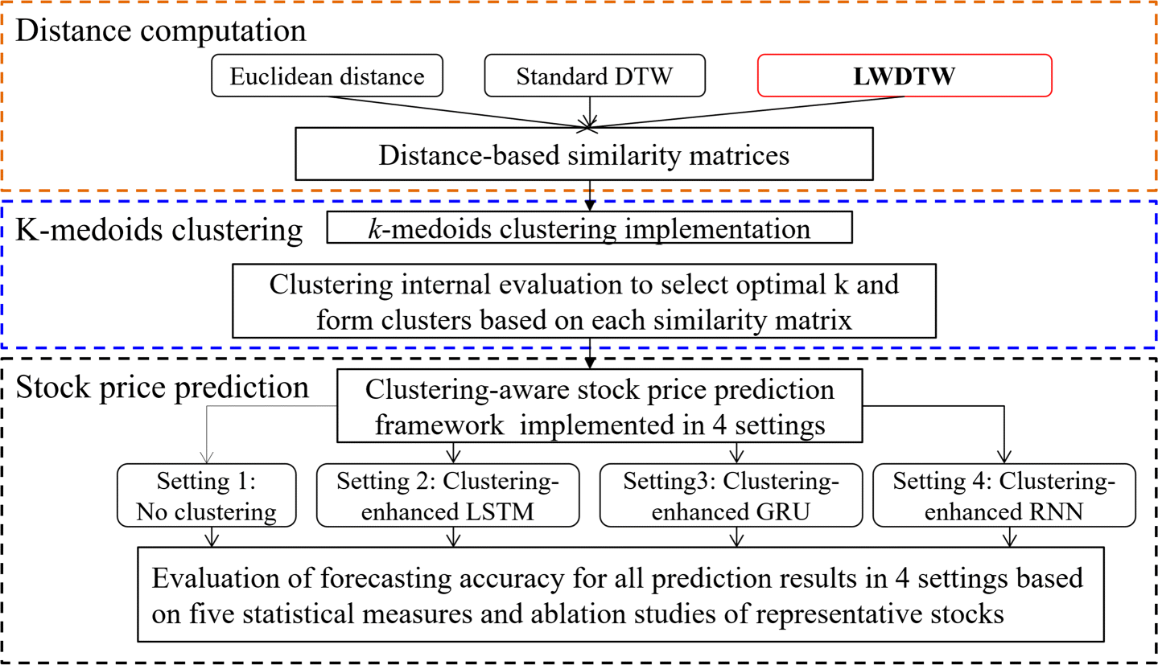
Solution

Slide 7
Solution
Step 1: Similarity computation
Step 2: k-medoids clustering
Step 3: Stock price prediction

Slide 8
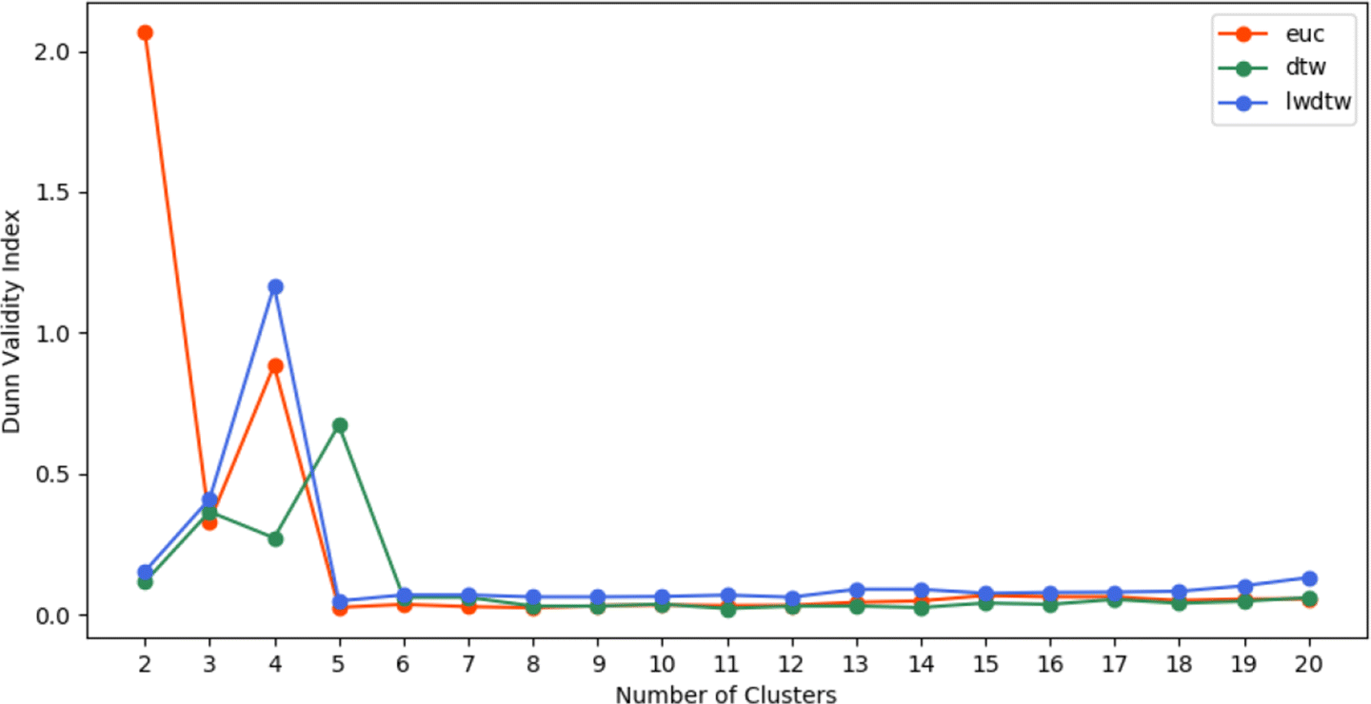
Experiments and Discussion
Dunn Index values for clusters when k is varying from 2 to 20 based on Euclidean distance (orange line), standard DTW (green line) and new proposed Logistic WDTW method (blue line), respectively.

Slide 9
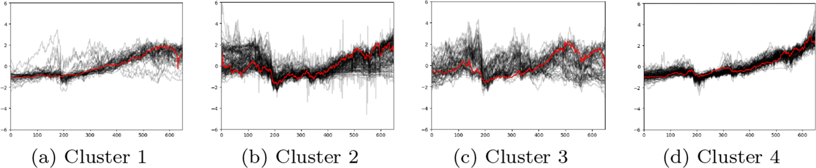
Experiments and Discussion
Visualisation of 4 stock clusters based on LWDTW when k is 4. X-axis and y-axis represent the number of weeks during the whole time period and z-score standardised prices of individual stocks within each cluster, respectively.

Slide 10
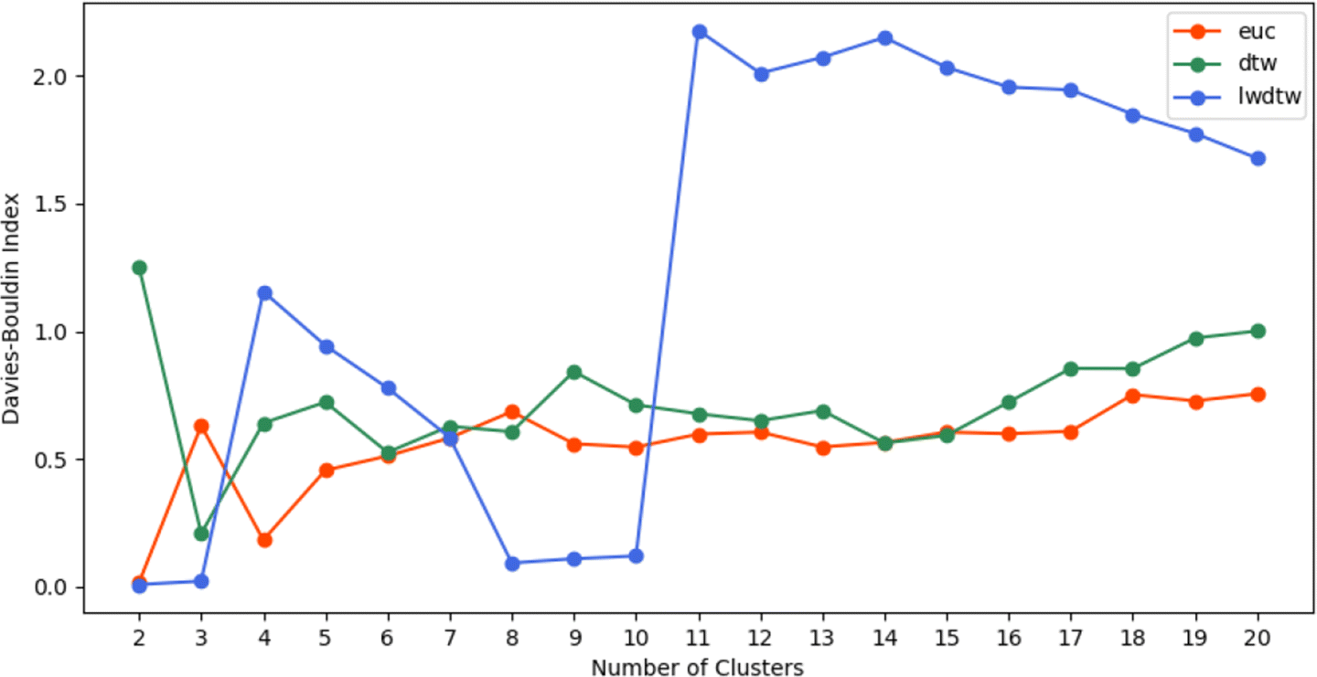
Experiments and Discussion
Davies-Bouldin Index values for clusters based on Euclidean distance(orange line), standard DTW (green line) and new LWDTW (blue line), respectively, when k is varying from 2 to 20.

Slide 11
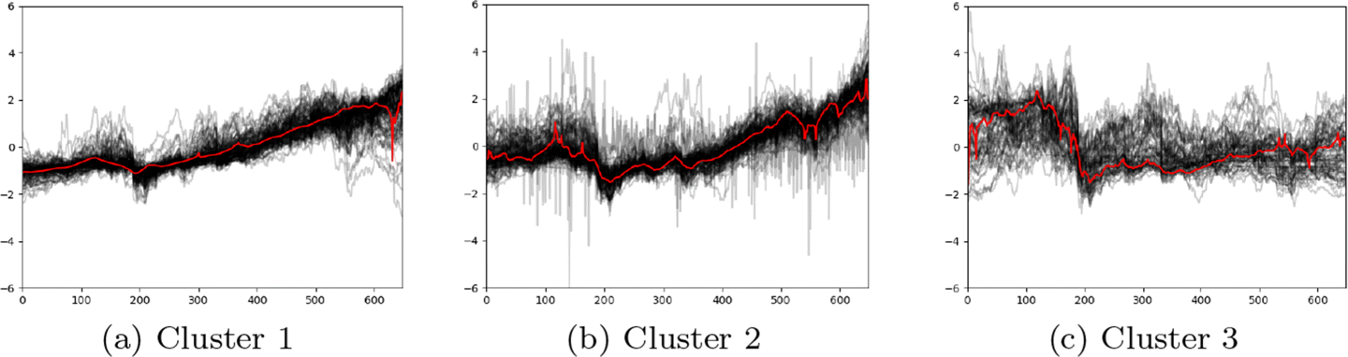
Experiments and Discussion
Visualisation of 3 clusters of stocks based on LWDTW when k is 3. X-axis and y-axis represent the number of weeks during the whole time period and z-score standardised prices of individual stocks within each cluster, respectively.

Slide 12
Conclusions
Presented a clustering-enhanced prediction framework
with deep learning models
propose a novel weighted DTW similarity measure
with logistic distribution probability density function
Experiments
successfully identified similar stocks within one cluster and achieved the best clustering results
recognized the relative importance of price observations
achieved the best estimates of stock prices with the lowest averages of MAPE, MAE, MSE, RMSE and highest average of R²

