Slide 1
Risk Management via Anomaly Circumvent: Mnemonic Deep Learning for Midterm Stock Prediction
姓名 xxx 学号 xxxx 学院
同组其他成员：
组长：

Slide 2
Significance
fundamental and important
for investment companies
for quantitative analysts.
high concern.
midterm investment than short term

Slide 3
Problems
a very difficult task
noisy and contain many anomalies
highly nonlinear dynamic system
influenced by immense factors
interest rates, inflation rates, trader’s expectation, catastrophe, political events and economic environments

Slide 4
Introductions
RNN
long-term sequence dependency problem
unable to remember early anomalies
LSTM
combined with emotional analysis
limited ability to predict short-term stocks
stock prices are noisy and unstable
Problem for mid-term prediction
prediction errors will accumulate

Slide 5
Contributions
Proposals
Mid-LSTM for midterm stock prediction
market trend as hidden states
midterm ARMA
LSTM, hidden Markov model and linear regression networks
Experiments
2-4% improvement in prediction accuracy
up to 120.16% annual return
2.99 average Sharpe ratio

Slide 6
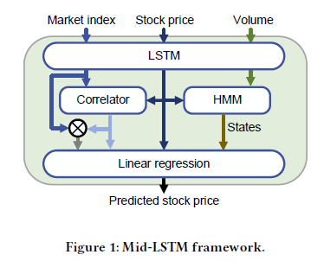
Solution
Correlator:
HMM:

Slide 7
Solution
Mid-LSTM Network Training
Normalization Process
Rolling Window Based Data Preprocessing

Slide 8
Experiments and Discussion

Slide 9
Experiments and Discussion

Slide 10
Experiments and Discussion

Slide 11
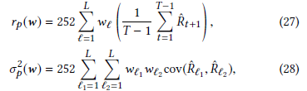
Experiments and Discussion

Slide 12
Conclusions
Proposed deep neural netowrks based on
CAPM and ARMA
Market index, Volume
Mid-LSTM
LSTM, hidden Markov model and linear regression
Experiments
predict S&P 500 accurately even in the event of anomalies.
higher portfilio return

