Slide 1
Bayesian Decision Theory
Introduction
Bayesian Decision Theory–Continuous Features
Minimum-Error-Rate Classification
Classifiers, Discriminant Functions and Decision Surfaces
The Normal Density
Discriminant Functions for the Normal Density
Bayes Decision Theory – Discrete Features

Slide 2
Introduction
The sea bass/salmon example
  State of nature, prior
    State of nature is a random variable
    The catch of salmon and sea bass is equiprobable
      P(ω₁) = P(ω₂) (uniform priors)
      P(ω₁) + P( ω₂) = 1 (exclusivity and exhaustivity)
Bayesian Decision Theory

Slide 3
Decision rule with only the prior information
  Decide ω₁ if P(ω₁) > P(ω₂) otherwise decide ω₂
Use of the class –conditional information
P(x | ω₁) and P(x | ω₂) describe the difference in lightness between populations of sea and salmon
Bayesian Decision Theory

Slide 4
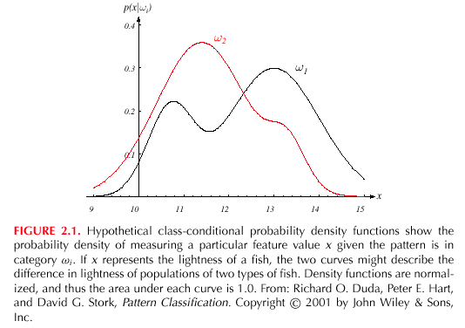
Bayesian Decision Theory

Slide 5
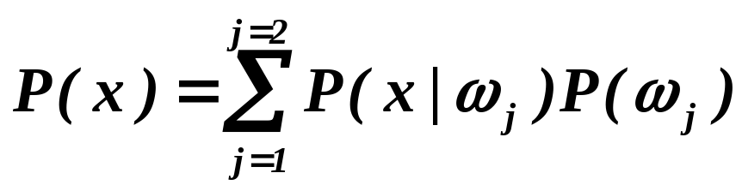
Posterior, likelihood, evidence
  P(ω_{j} | x) = P(x | ω_{j}) . P (ω_{j}) / P(x)
  Where in case of two categories
  Posterior = (Likelihood. Prior) / Evidence
Bayesian Decision Theory

Slide 6
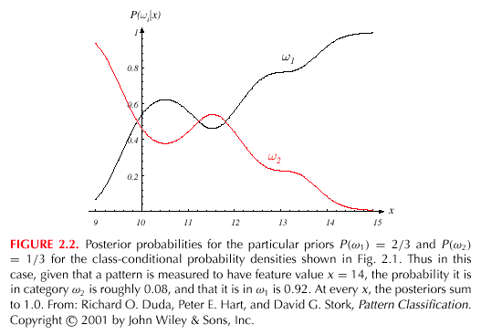
Bayesian Decision Theory

Slide 7
Decision given the posterior probabilities
X is an observation for which:
if P(ω₁ | x) > P(ω₂ | x) True state of nature = ω₁
if P(ω₁ | x) < P(ω₂ | x) True state of nature = ω₂
Therefore:
whenever we observe a particular x, the probability of error is :
P(error | x) = P(ω₁ | x) if we decide ω₂
P(error | x) = P(ω₂ | x) if we decide ω₁
Bayesian Decision Theory

Slide 8
Minimizing the probability of error
Decide ω₁ if P(ω₁ | x) > P(ω₂ | x);
otherwise decide ω₂
Therefore:
P(error | x) = min [P(ω₁ | x), P(ω₂ | x)]
(Bayes decision)
Bayesian Decision Theory

Slide 9
Two-category classification
    α₁ : deciding ω₁
    α₂ : deciding ω₂
    λ_{ij} = λ(α_{i} | ω_{j})
loss incurred for deciding ω_{i} when the true state of nature is ω_{j}
Conditional risk:
R(α₁ | x) = λ₁₁P(ω₁ | x) + λ₁₂P(ω₂ | x)
R(α₂ | x) = λ₂₁P(ω₁ | x) + λ₂₂P(ω₂ | x)
Bayesian Decision Theory

Slide 10
Our rule is the following:
if R(α₁ | x) < R(α₂ | x)
action α₁: “decide ω₁” is taken
This results in the equivalent rule :
decide ω₁ if:
(λ₂₁- λ₁₁) P(x | ω₁) P(ω₁) >
(λ₁₂- λ₂₂) P(x | ω₂) P(ω₂)
and decide ω₂ otherwise
Bayesian Decision Theory

Slide 11
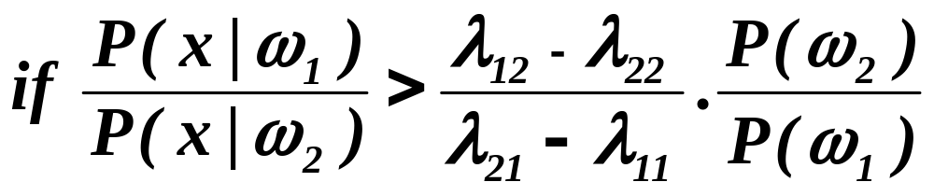
Likelihood ratio:
The preceding rule is equivalent to the following rule:
Then take action α₁ (decide ω₁)
Otherwise take action α₂ (decide ω₂)
Bayesian Decision Theory

Slide 12
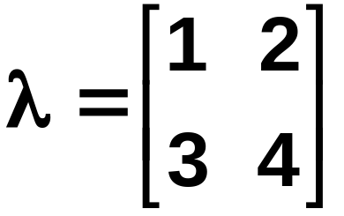
Exercise
Select the optimal decision where:
= {ω₁, ω₂}
P(x | ω₁) N(2, 0.5) (Normal distribution)
P(x | ω₂) N(1.5, 0.2)
P(ω₁) = 2/3
P(ω₂) = 1/3
Bayesian Decision Theory

Slide 13
Minimum-Error-Rate Classification
Actions are decisions on classes
If action α_{i} is taken and the true state of nature is ω_{j} then:
the decision is correct if i = j and in error if i ≠ j
Seek a decision rule that minimizes the probability of error which is the error rate
Bayesian Decision Theory

Slide 14
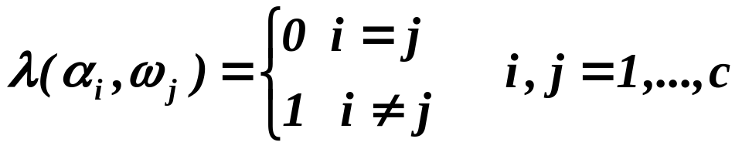
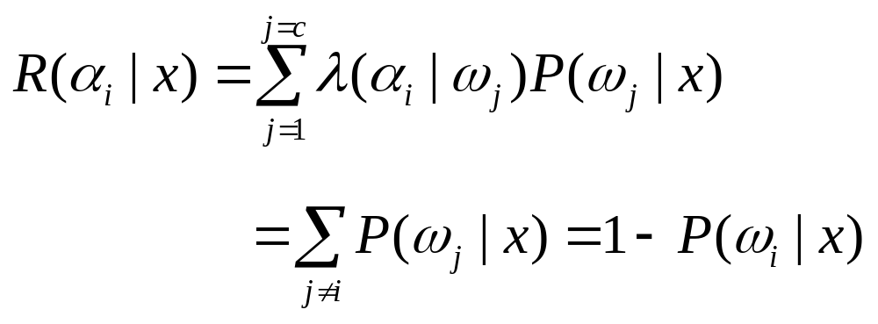
Introduction of the zero-one loss function:
Therefore, the conditional risk is:
Bayesian Decision Theory

Slide 15
Minimize the risk requires maximize P(ω_{i} | x)
(since R(α_{i} | x) = 1 – P(ω_{i} | x))
For Minimum error rate
  Decide ω_{i} if P (ω_{i} | x) > P(ω_{j} | x) ∀j ≠ i
Bayesian Decision Theory

Slide 16
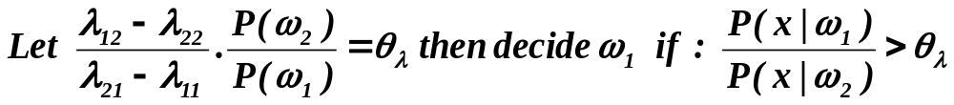
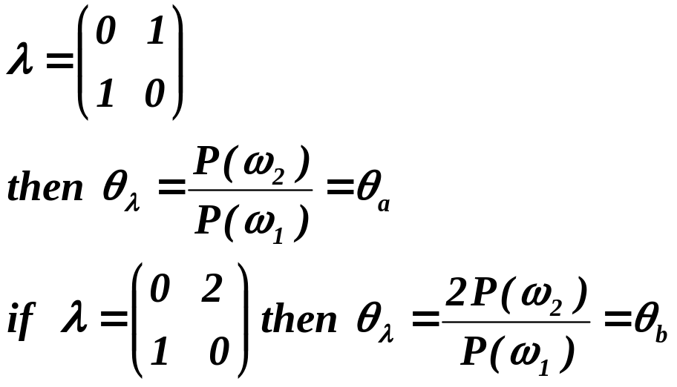
Regions of decision and zero-one loss function, therefore:
If λ is the zero-one loss function which means:
Bayesian Decision Theory

Slide 17
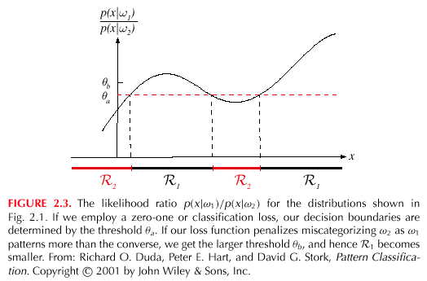
Bayesian Decision Theory

Slide 18
某医院确诊患者中疾病A和疾病B的概率分别为P(A)=0.7和P(B)=0.3，两种疾病发生都有症状x，其概率分别为P(x|A)=0.45和P(x|B)=0.5，同时两种疾病的误诊代价λ_{AB}=1和λ_{BA}=2。现有患者出现了症状x，请帮助医生做出疾病决策。
Bayesian Decision Theory

