Slide 1
switchup
Scrape
MAOMAO YI

Slide 2

WEBSITE

Slide 3
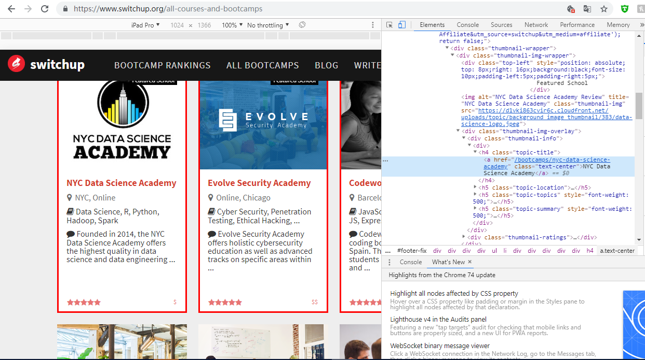

Slide 4
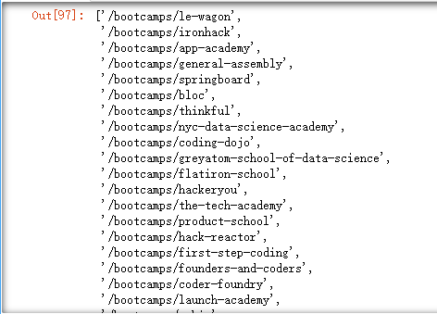



SCRAPY
SELENIUM

Slide 5


Slide 6
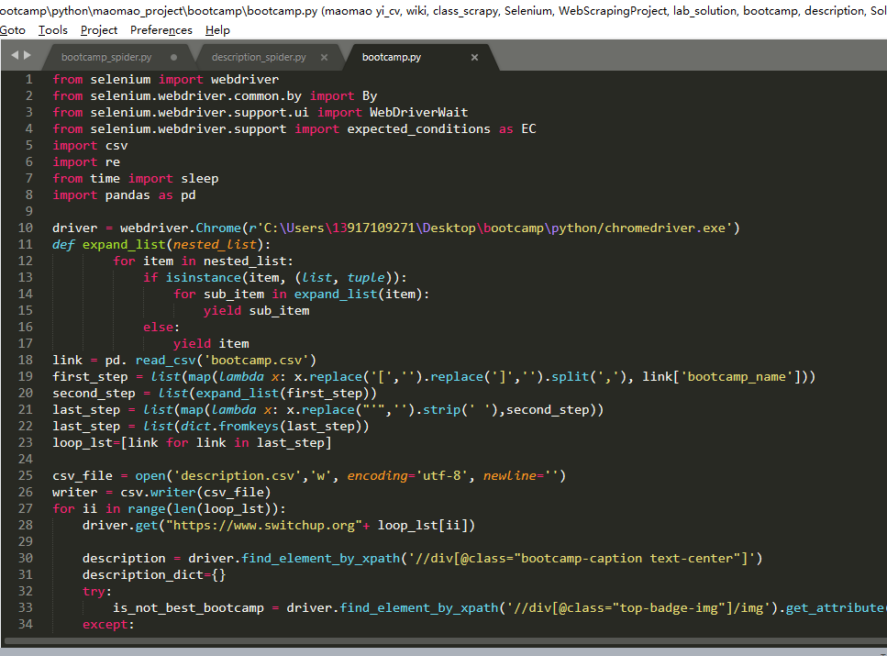
SELENIUM
CODE

Slide 7
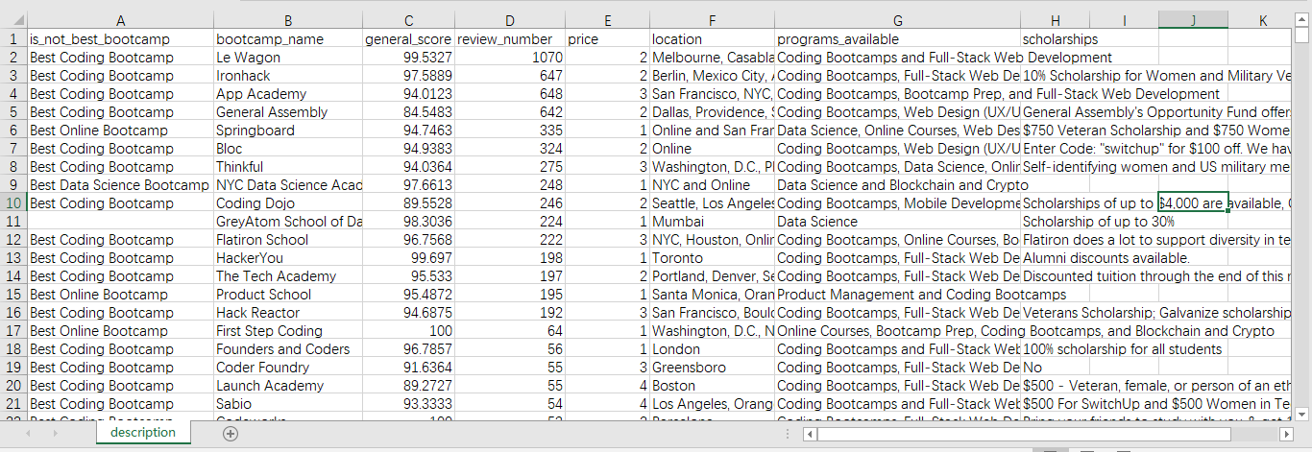

821 rows

Slide 8
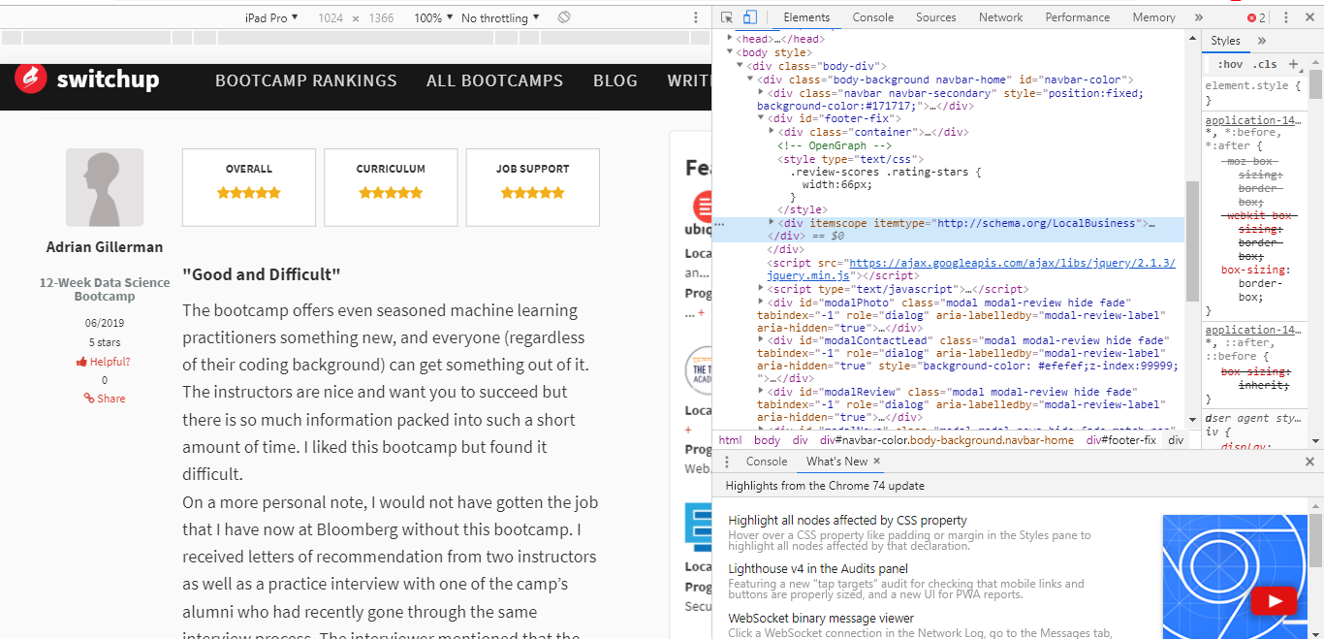

Slide 9
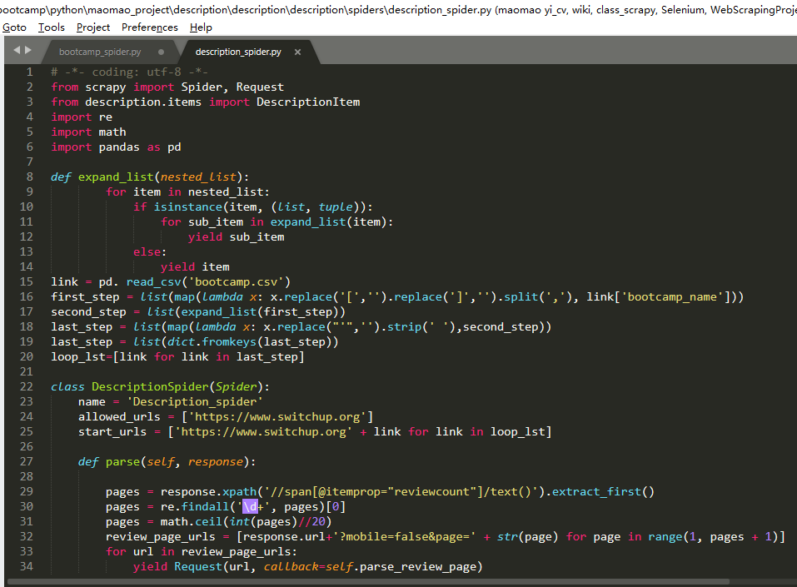
SCRAPY
AGAIN

Slide 10
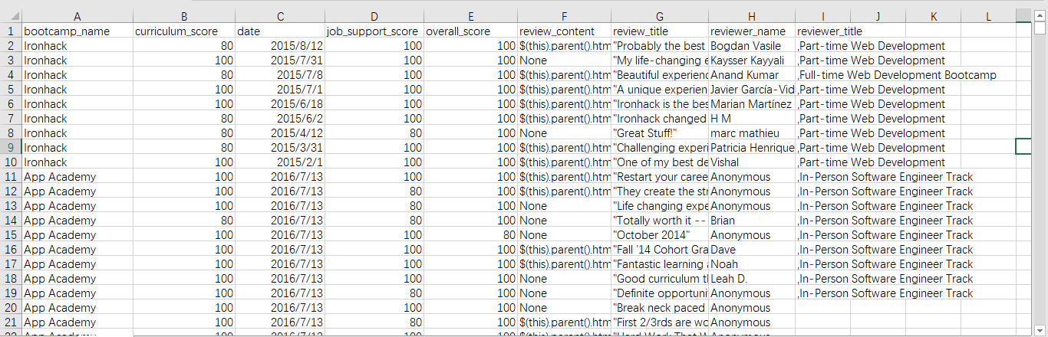
9038 rows

Slide 11
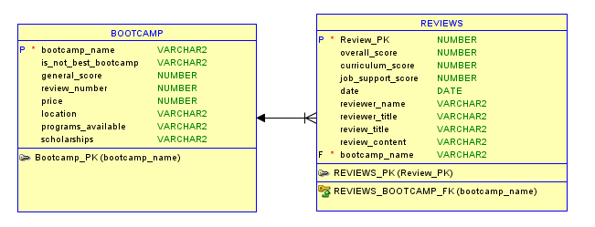

Slide 12
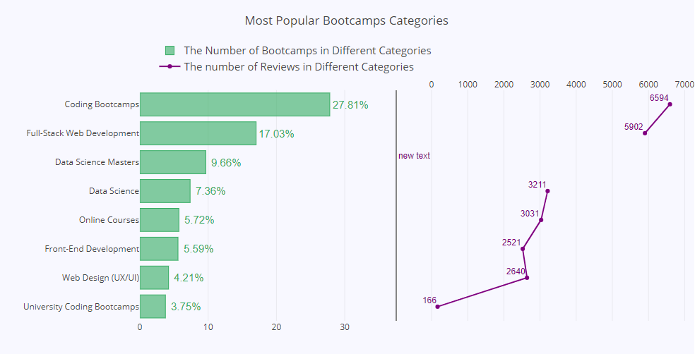

Slide 13
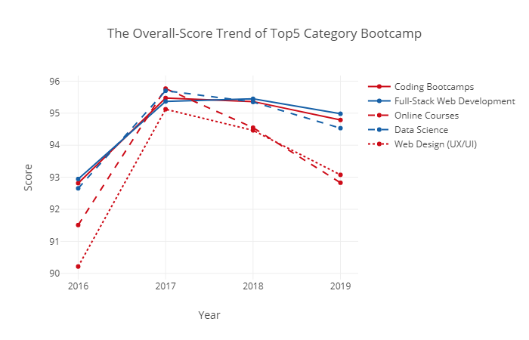

Slide 14
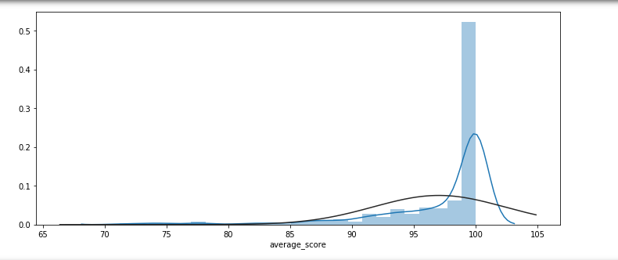

Slide 15
Satisfactory Analysis
Overall score <90
‘neg’> ‘ pos’in
review content

Slide 16
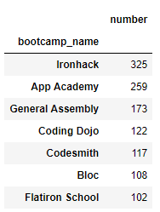
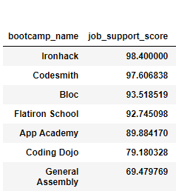

Slide 17


Slide 18


Slide 19


Slide 20
THANK YOU

