Slide 1
Final Presentation for Android Application: Approaching
Feifei GU & Qingyuan LI

Slide 2
outline
Application demo
Project demonstration
Project management

Slide 3
What/Why/How
Product statement
FOR college students
WHO want to track their assignments due time
THE application named APPROACHING
IS an remainder
THAT helps students arrange their time
UNLIKE other reminder apps, this app will show exactly how many hours left for each assignment

Slide 4
What/Why/How
Questions:
How many deadlines did you have last semester?
36 dues = 4 classes * 3 assigns/class *3 (check point) !
When we say we still have one day to hand in, how many hours do you exactly have?
24 H?
12 H?
4 H?

Slide 5
What/Why/How
HOW?

Slide 6
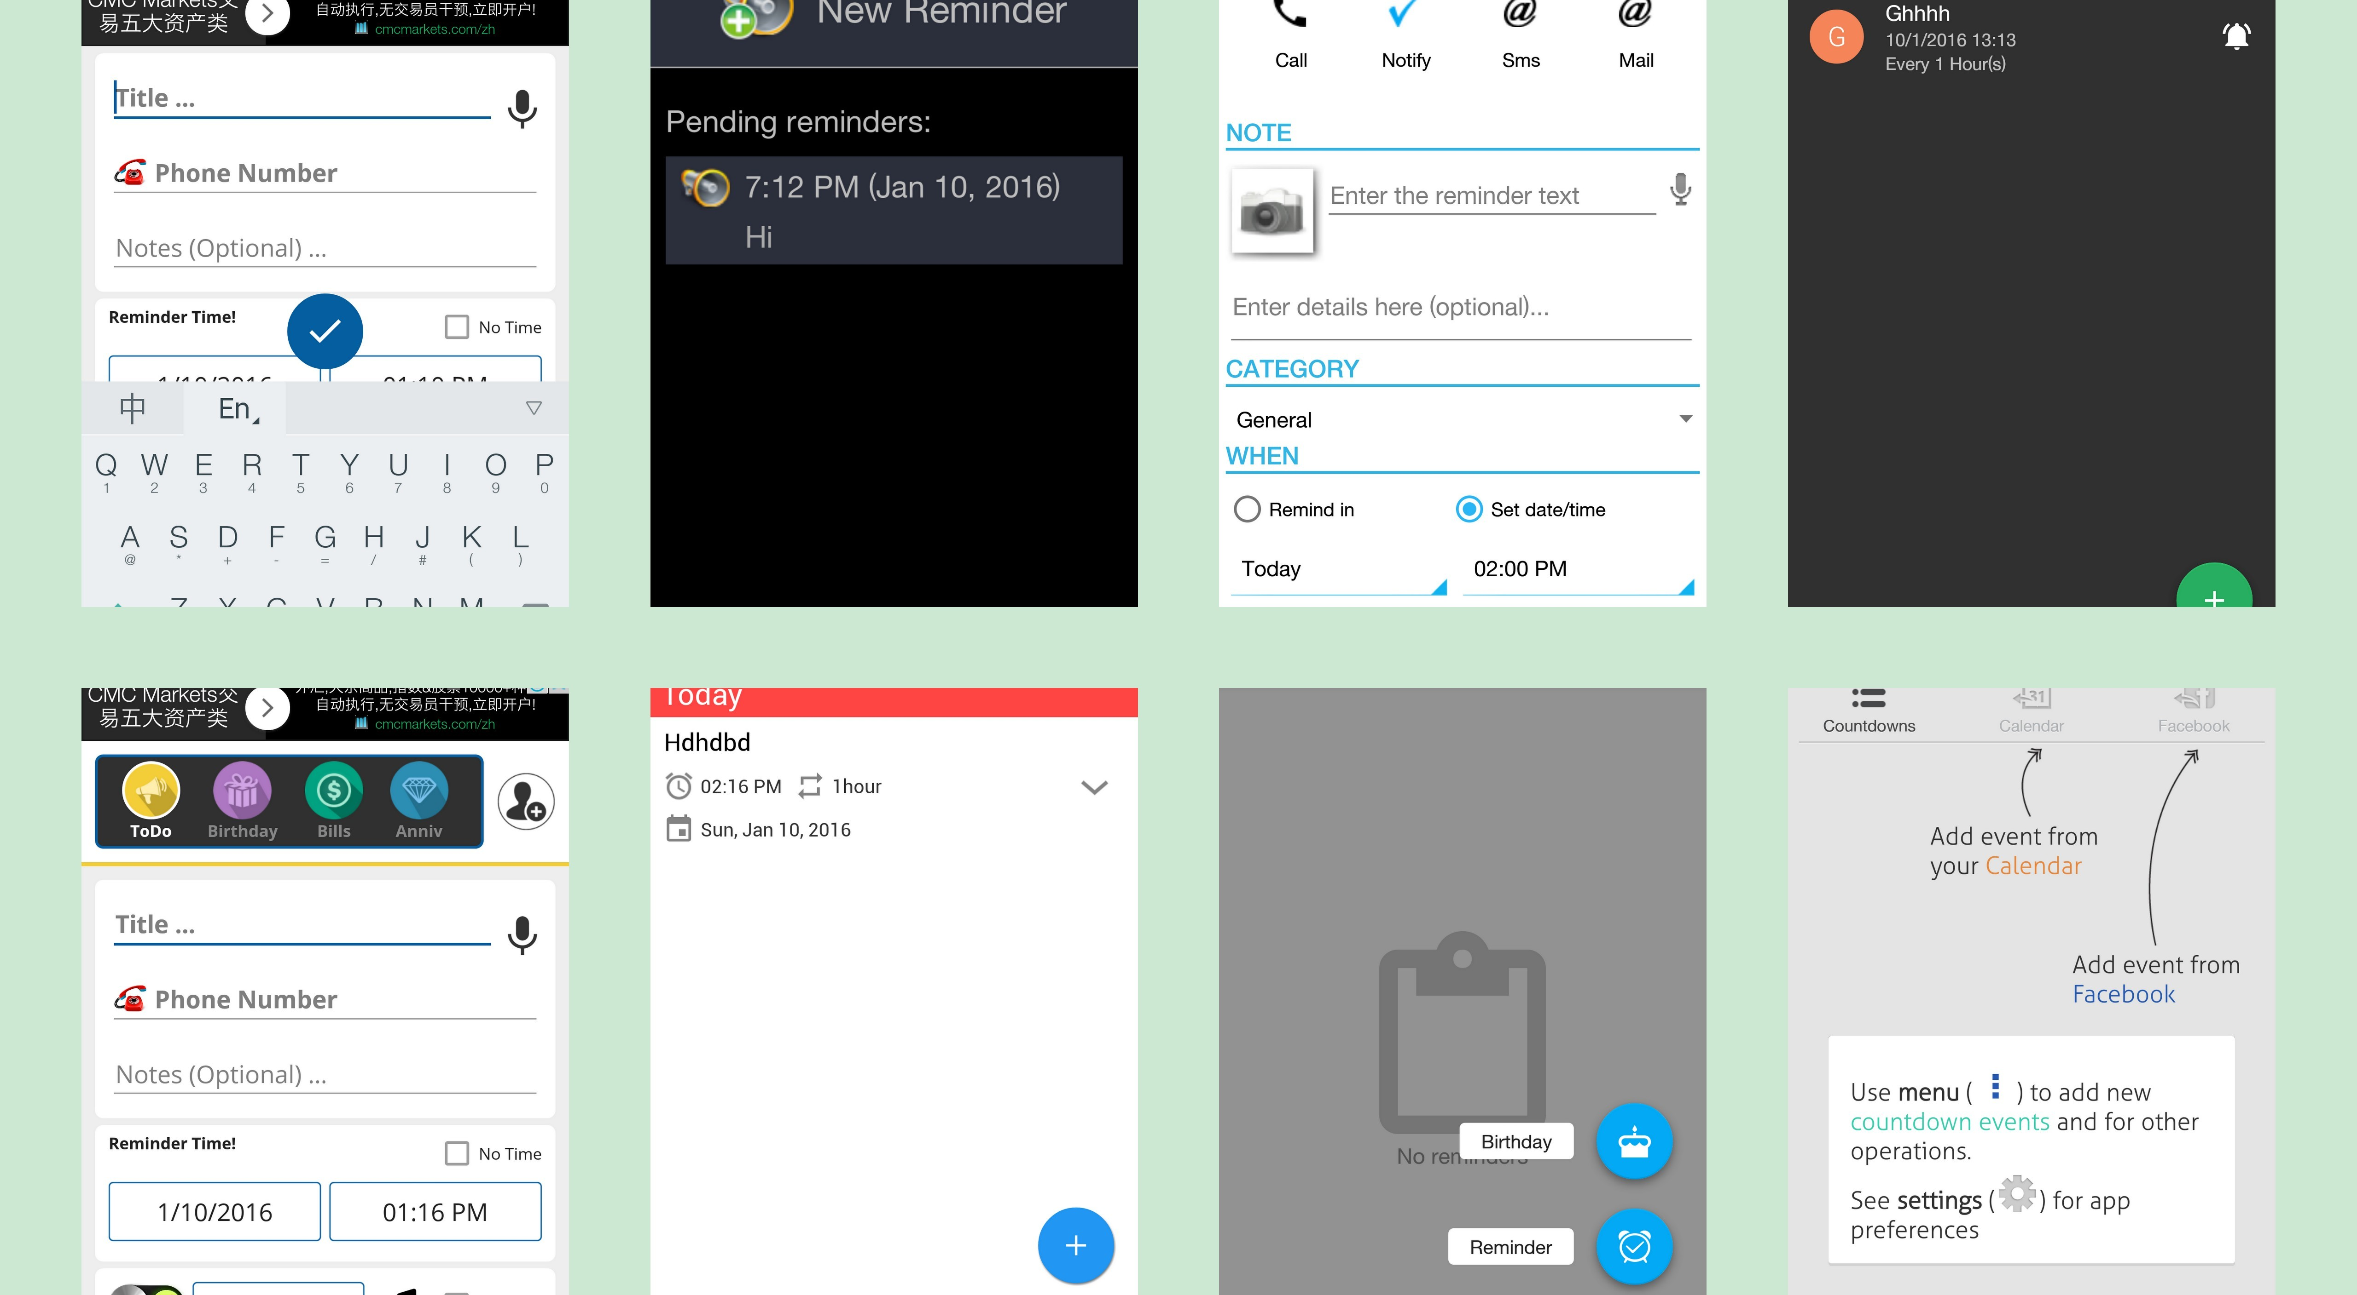
You definitely don’t want to use these apps complicated, ugly, cannot track hours

Slide 7
demo

Slide 8
Final Presentation for Android Application: Approaching
Application demo
Project demonstration
Project management

Slide 9
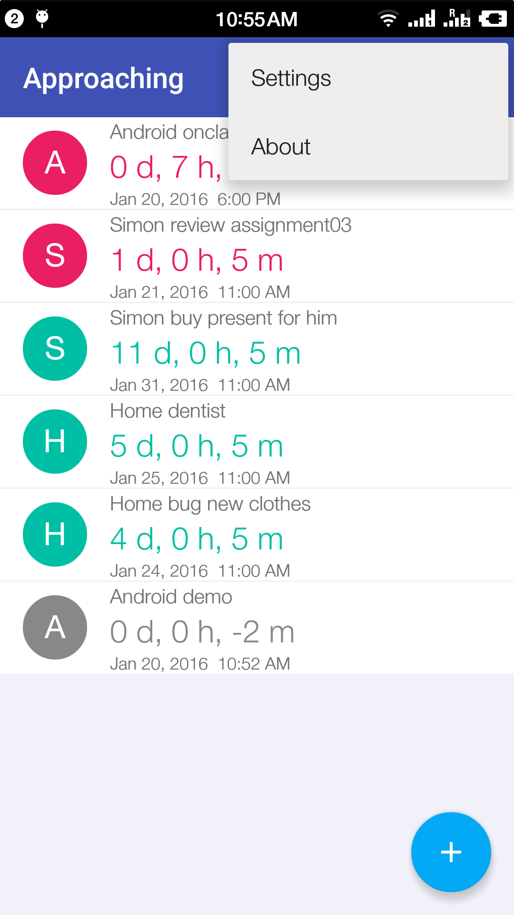
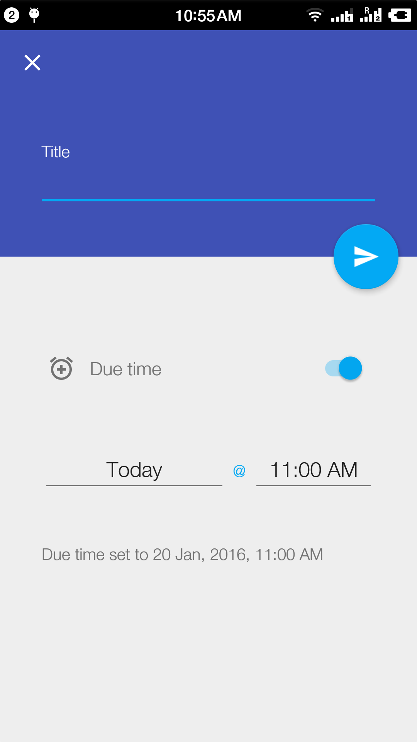
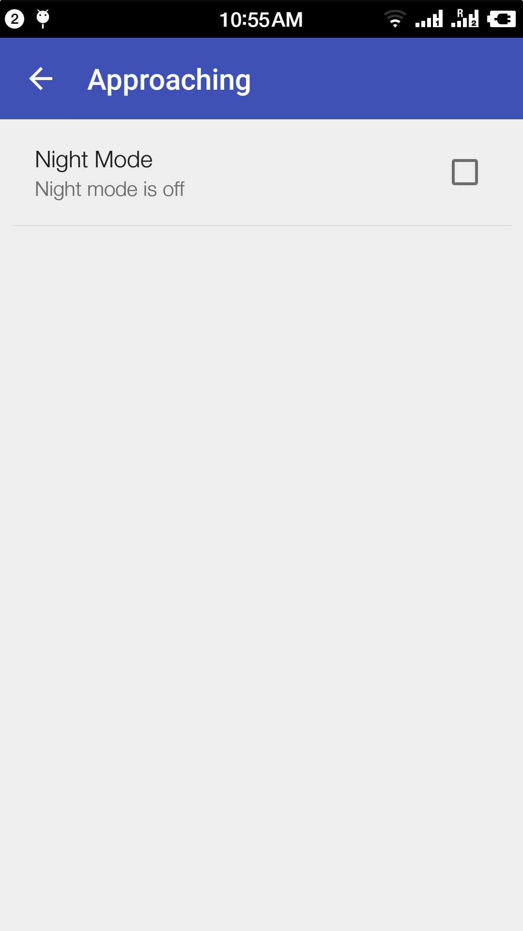
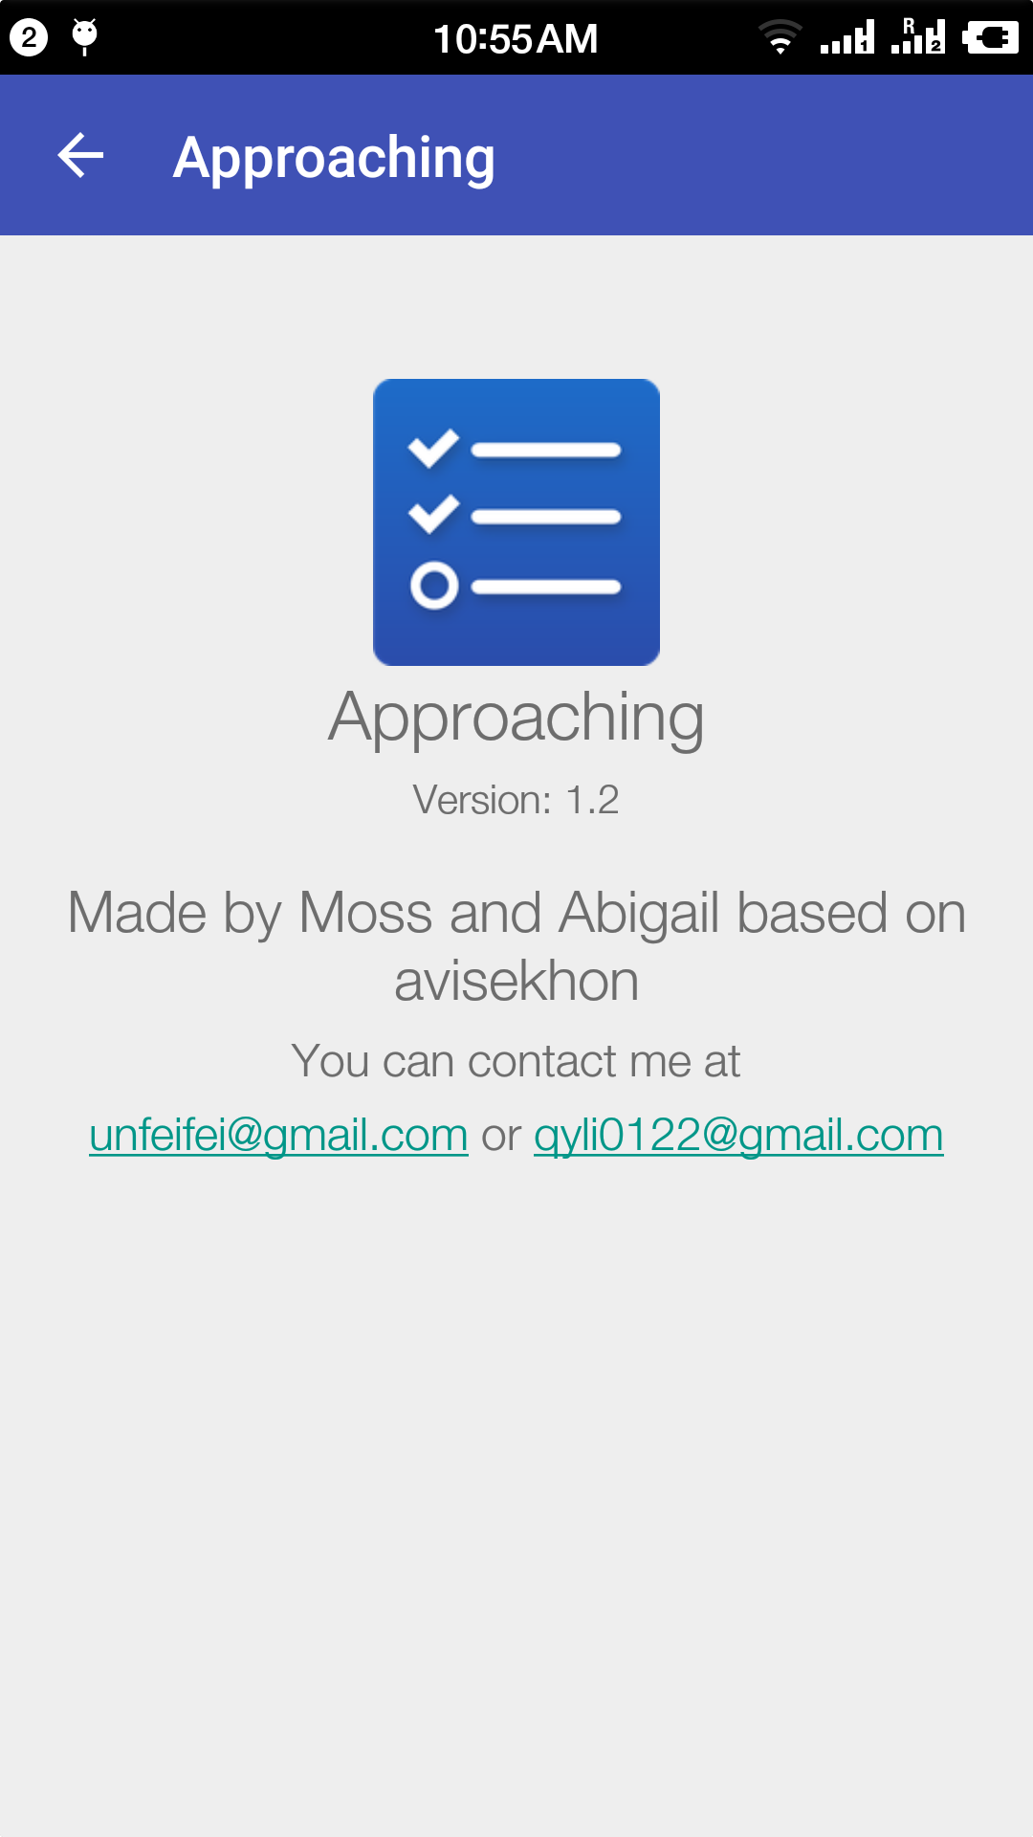
MainActivity
AddToDoActivity
SettingActivity
AboutActivity
GOOGLE material design (Video)
LinearLayout
CoordinatorLayout -> FAB
RecyclerView -> Swipe, move an item, insert to the list

Slide 10
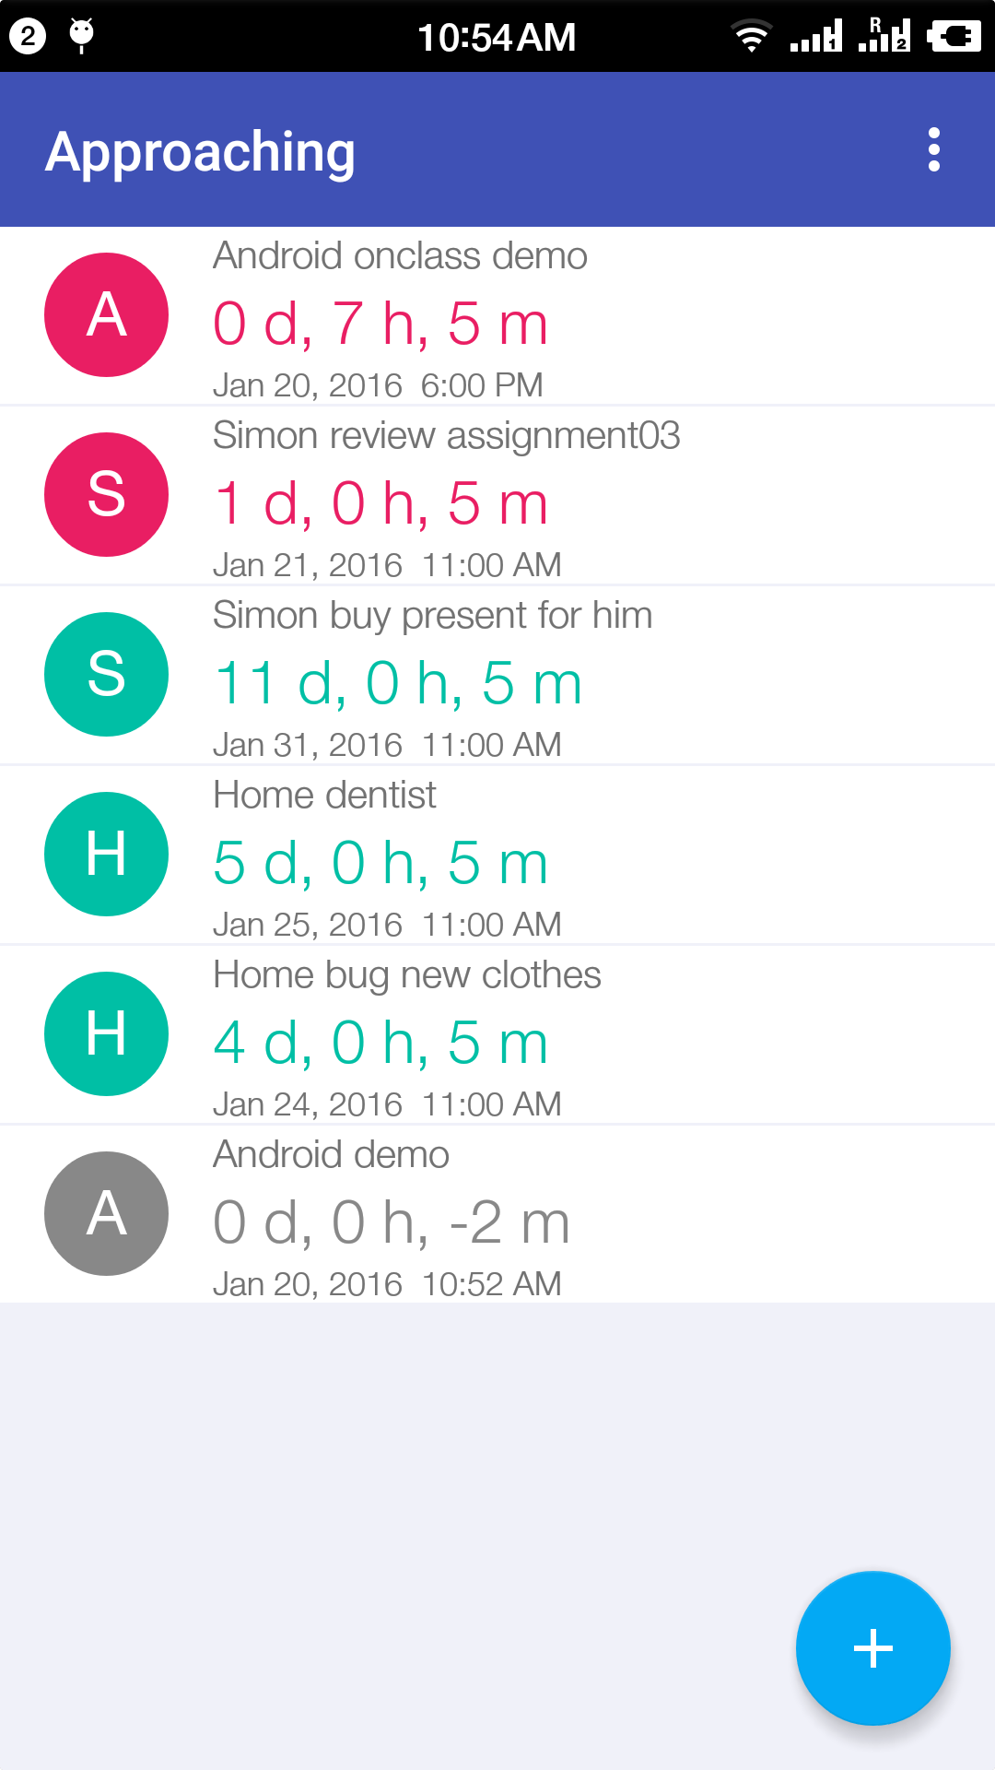
Data Structure
ToDoItem.class
arguments
String mToDoText
Int mToDoColor
Date mToDoDate
Methods
toJSON() //save as a Json object
getToDoColor()
Other setters and getters for other activity to use

Slide 11
Life Cycle of AddToDoActiviy
onCreate
Set preference, load layout and res
onClickListner on date and time
Set todoText // will write to JSON file
On back/FAB button Clicked
Go to MainActivity

Slide 12
SettingActivity, set themes
If we changed the theme, in this Activity
First, get a SharedPreferences object
SharedPreferences settings = getSharedPreferences(“setting”, 0);
Second, get the SharedPreferences.Editor object
SharedPreferences.Editor editor = settings.edit();
Third, write data
editor.putString(“currTheme”,”vampires are Coming ”);
In the end, set the mainActiviy to re_Create itselft
themeEditor.putBoolean(MainActivity.RECREATE_ACTIVITY, true);
In MainActivity
Check the theme
Set the background color and TODOTextViewColor

Slide 13
AboutActivity
Based on com.avisekhon (The MIT licences)

Slide 14
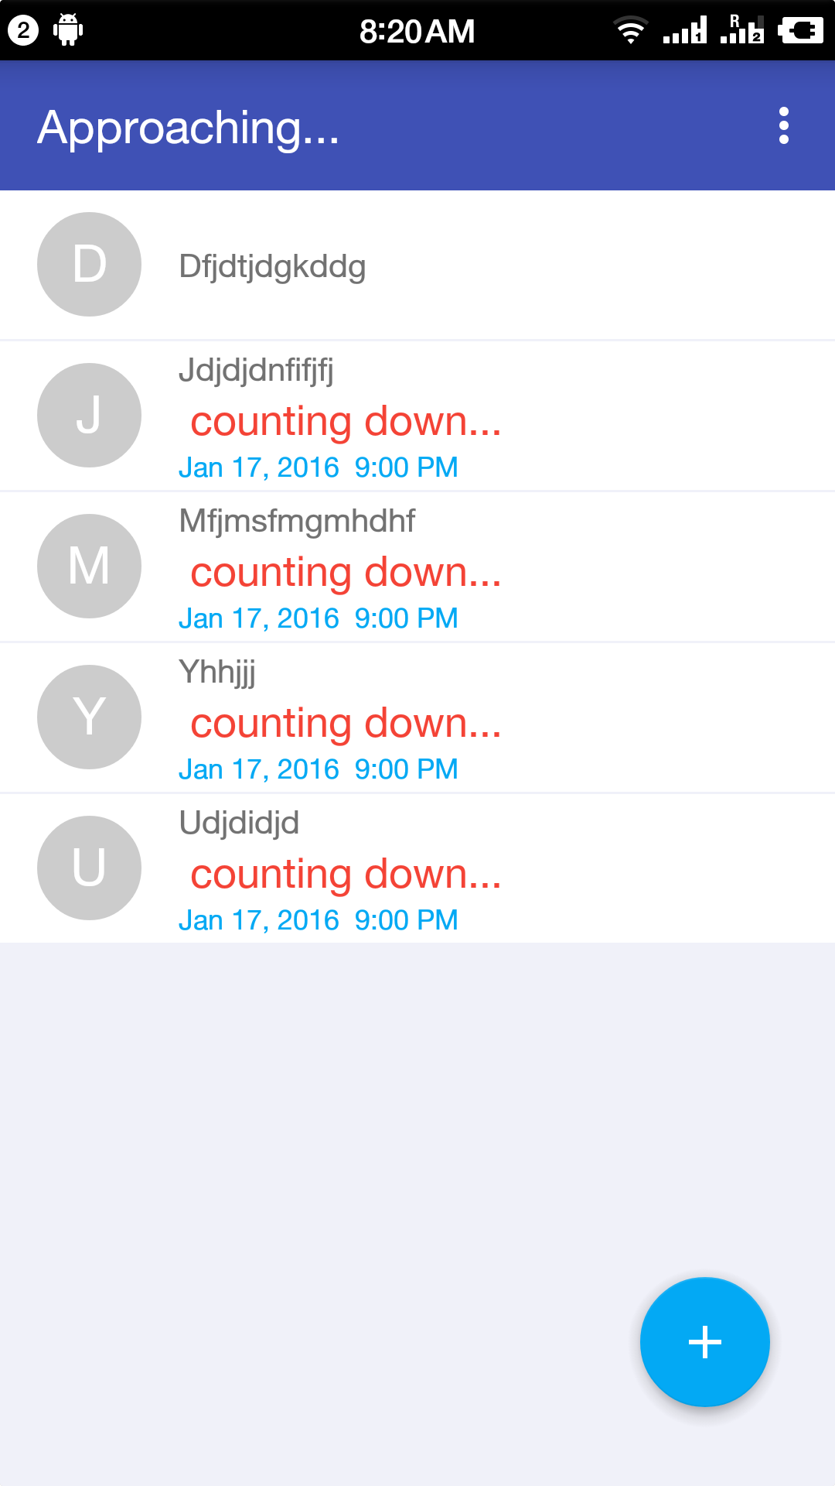
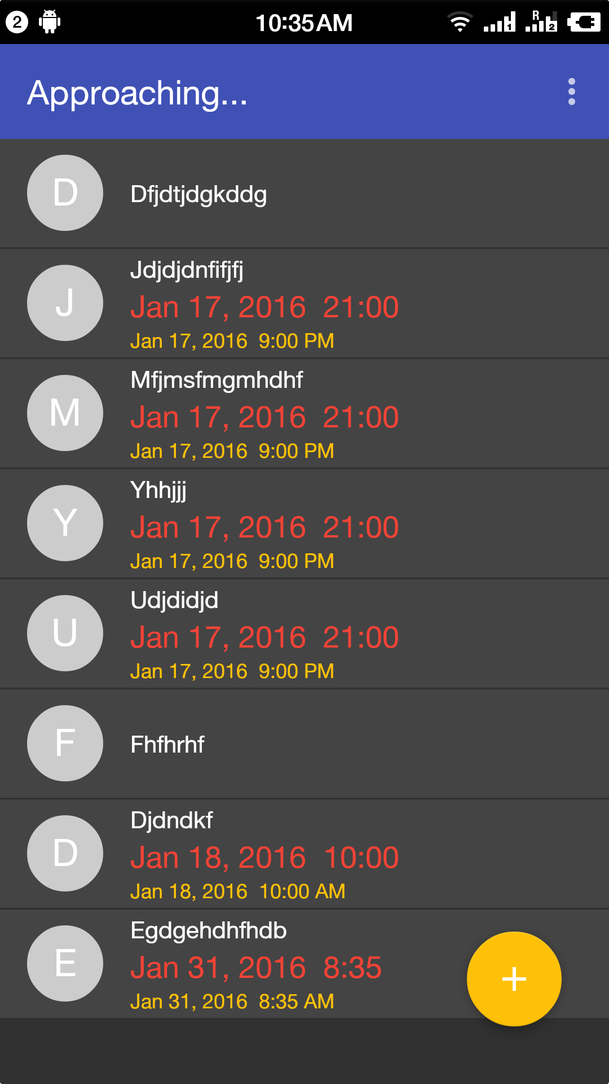
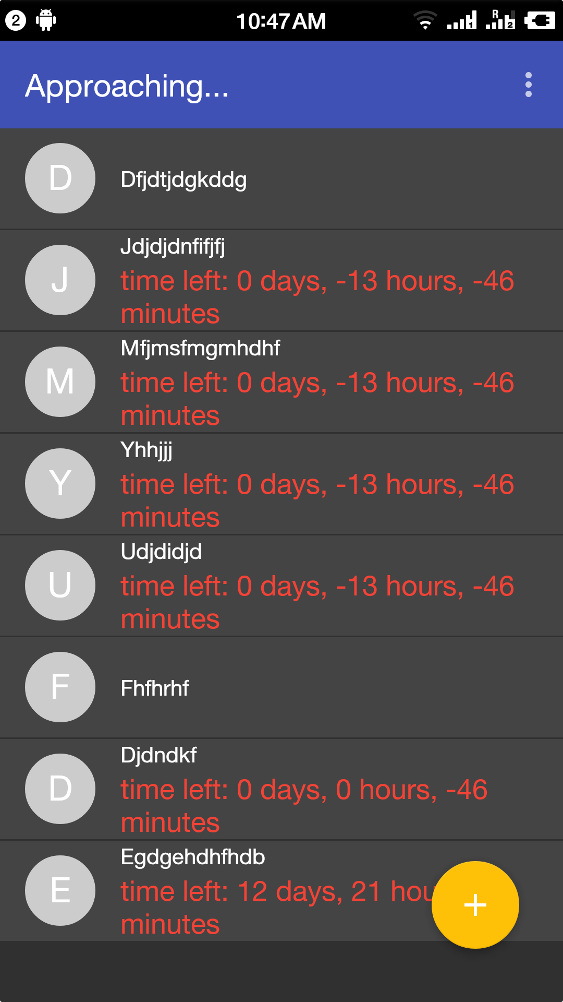
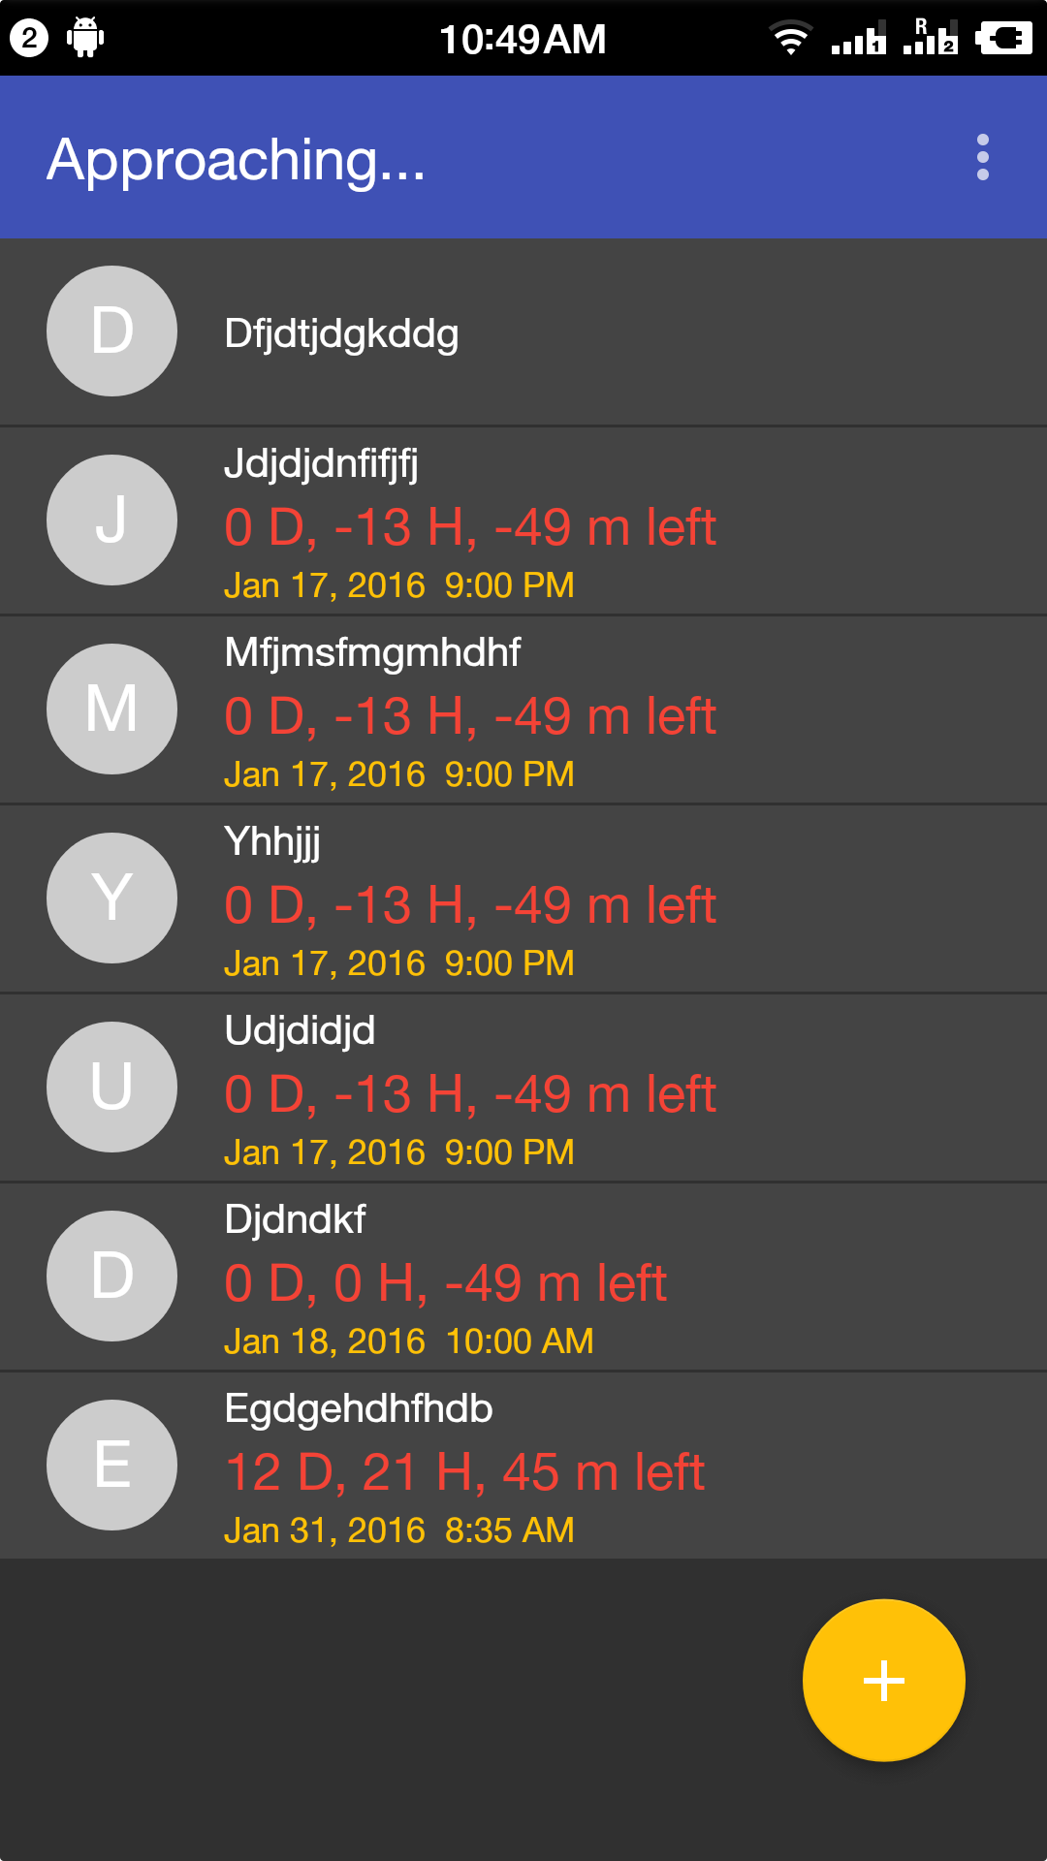
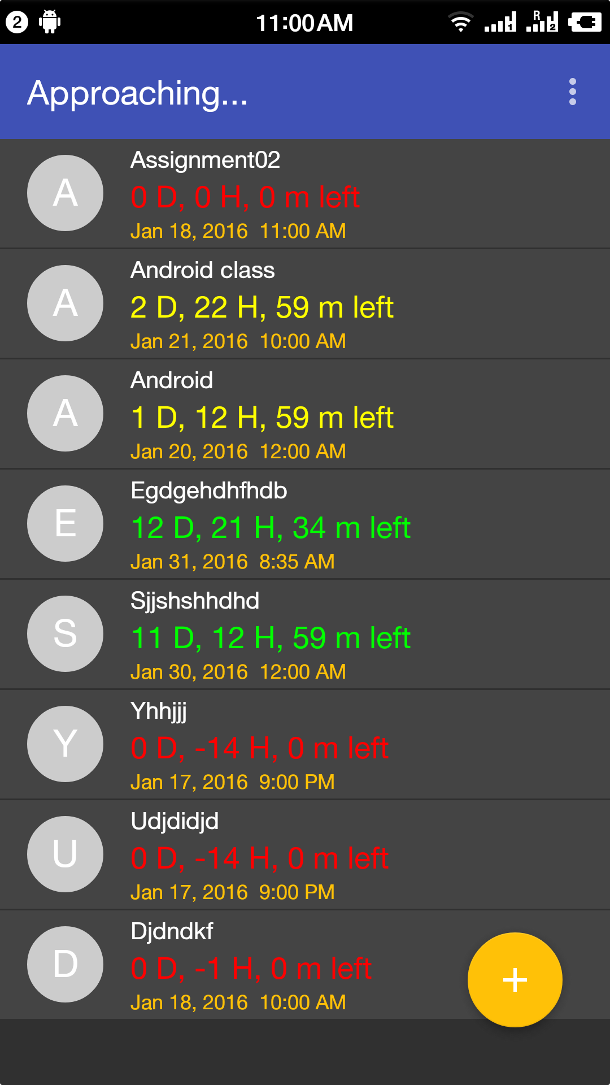
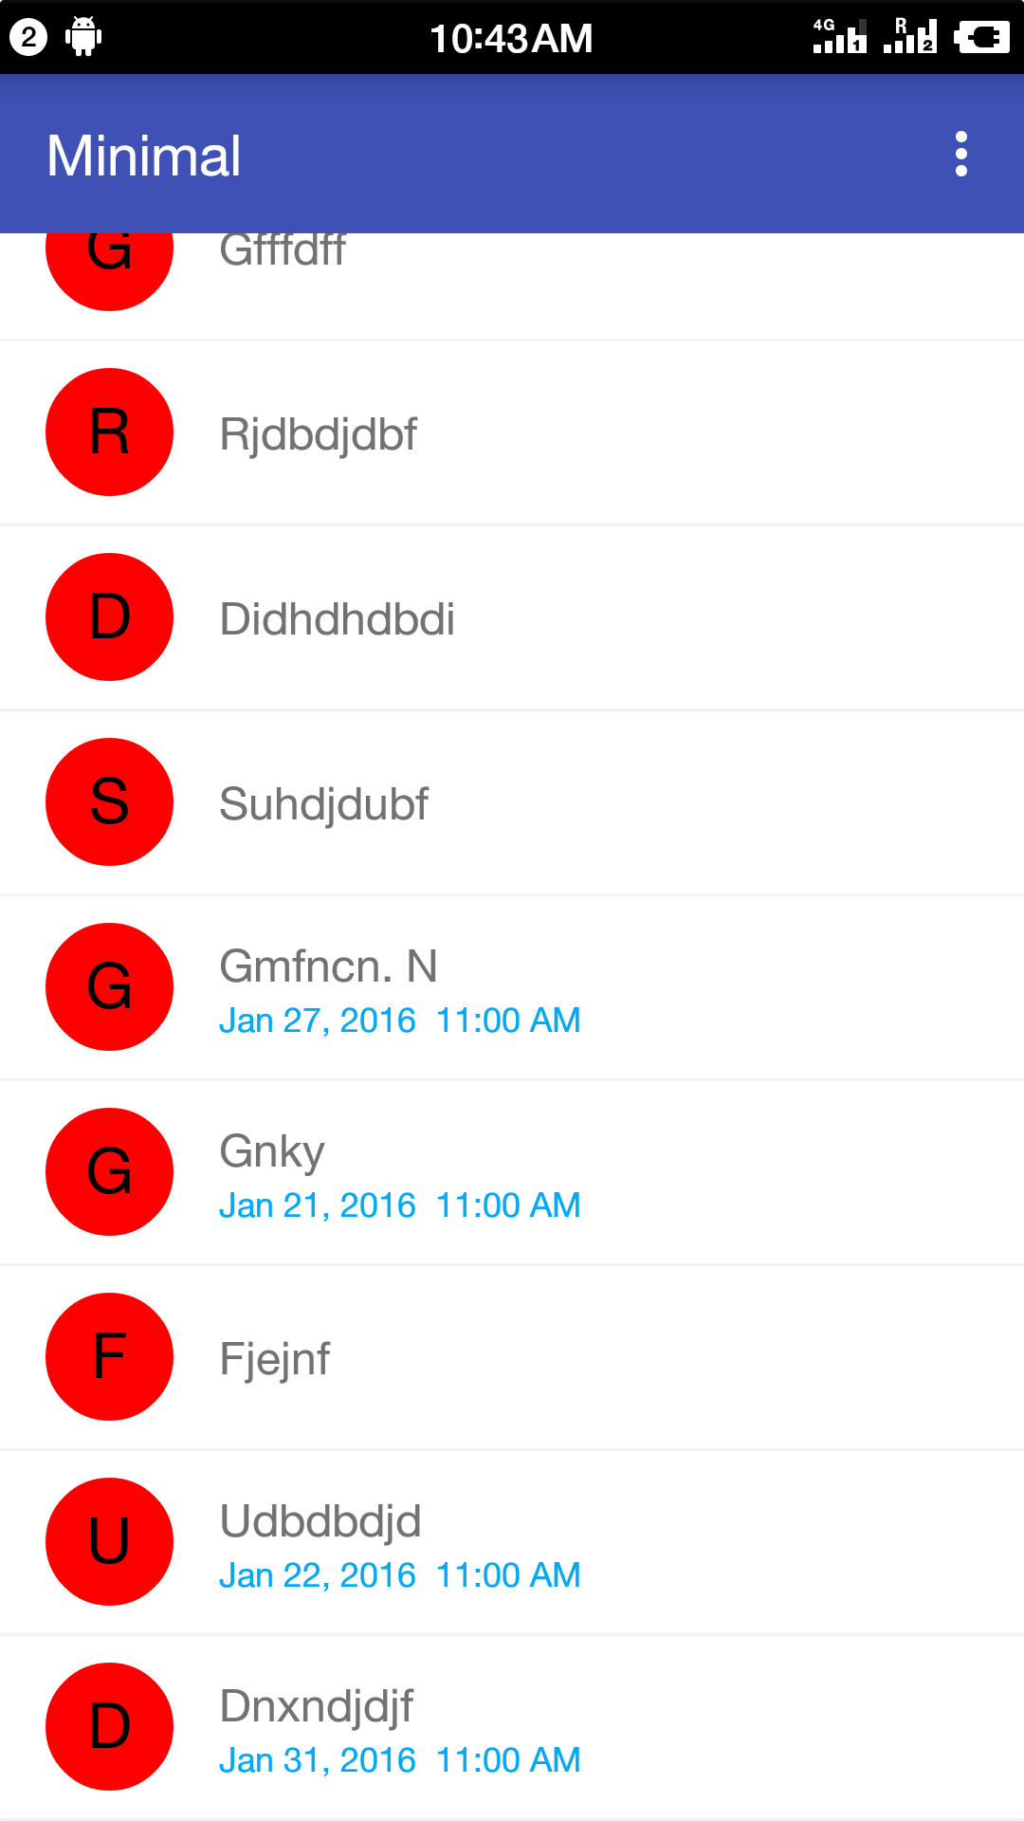
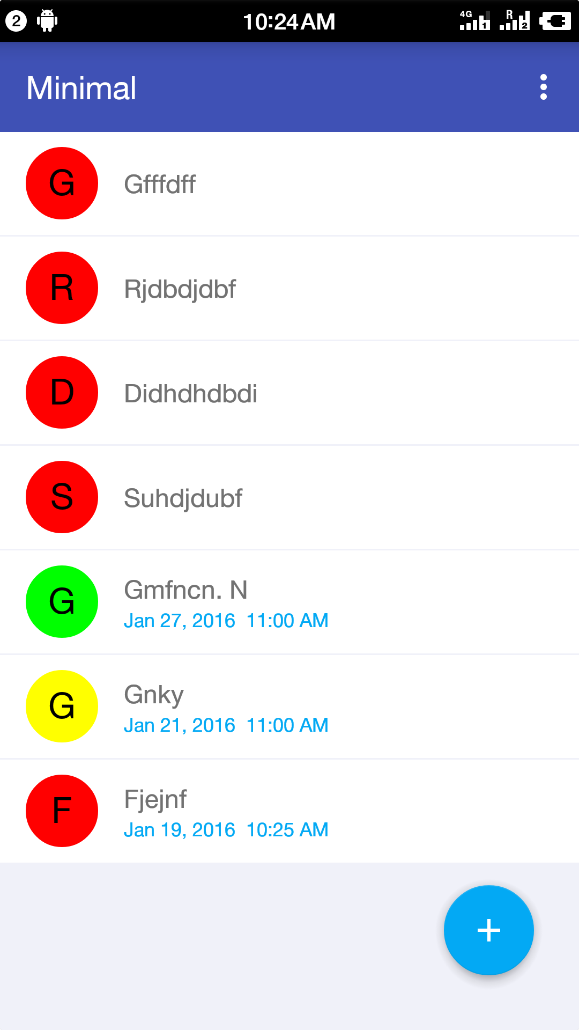
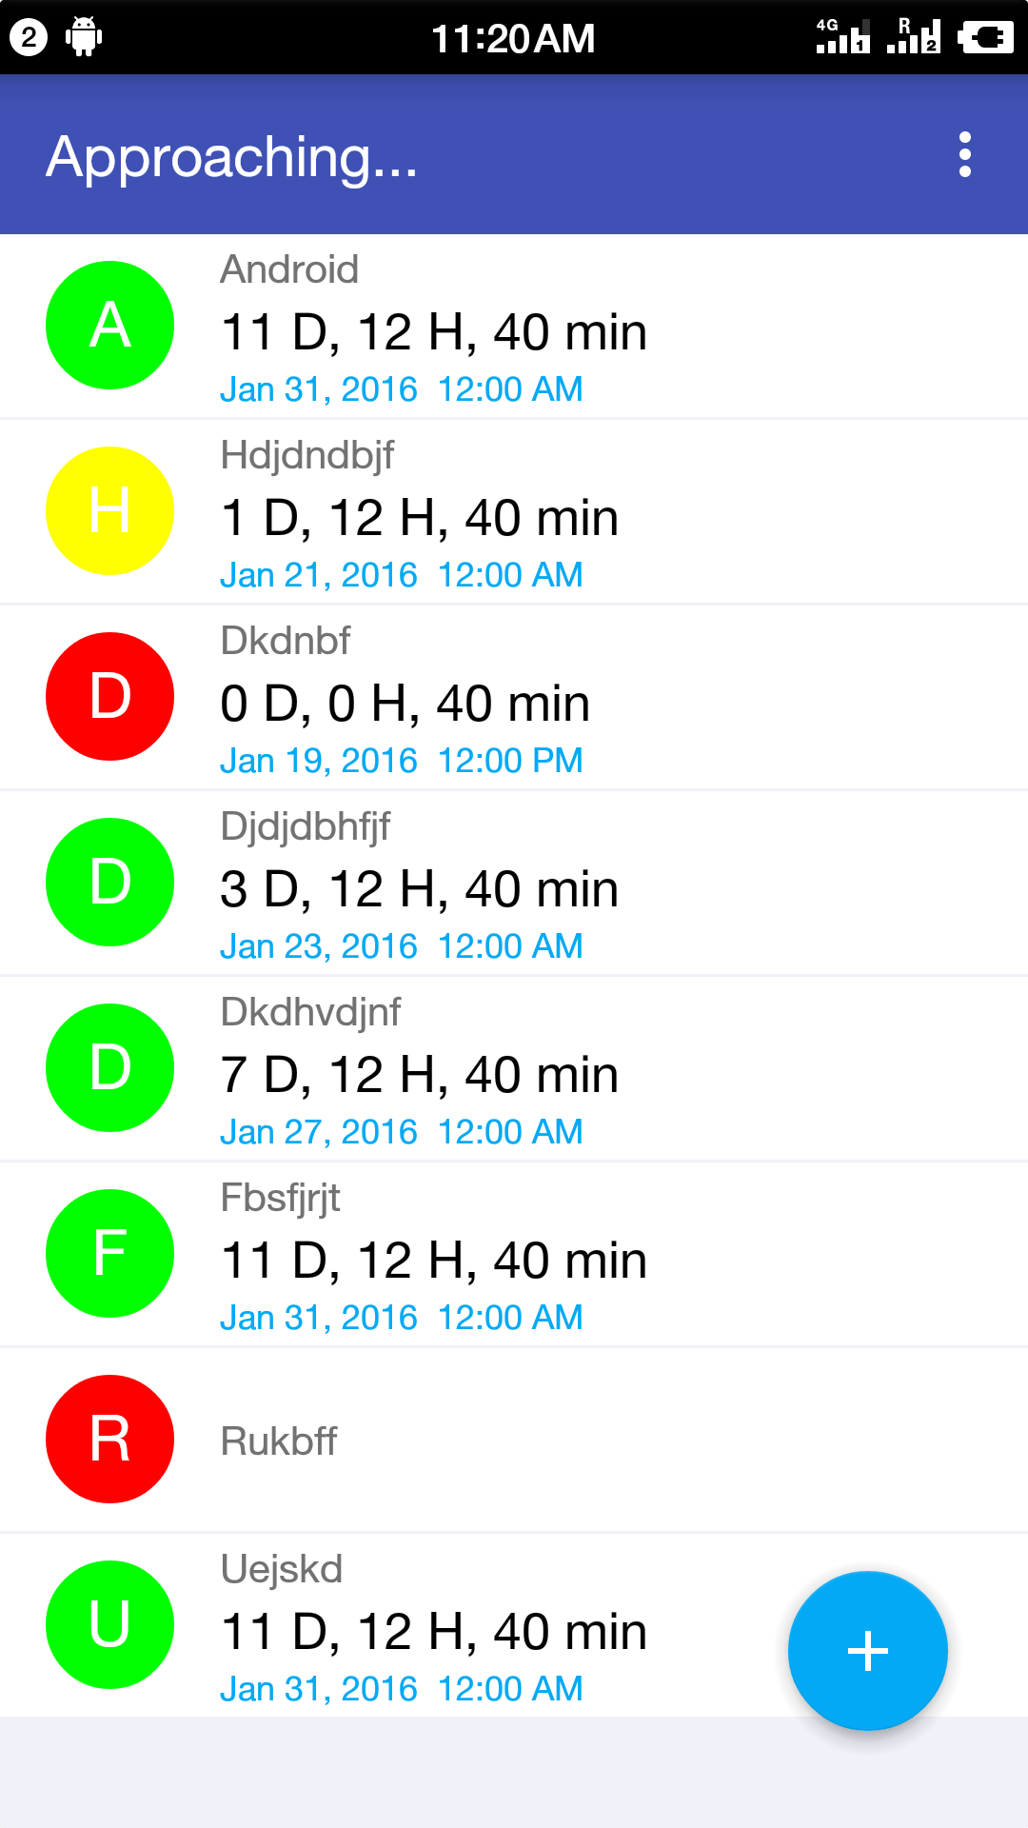
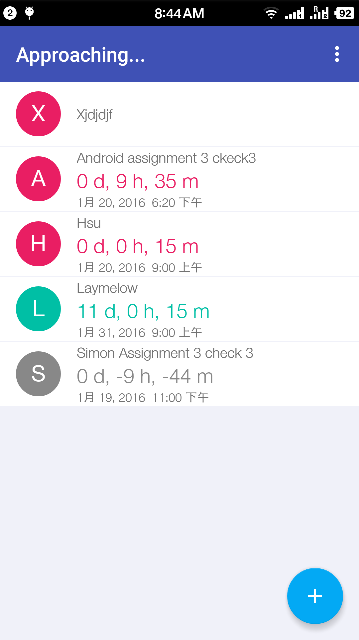
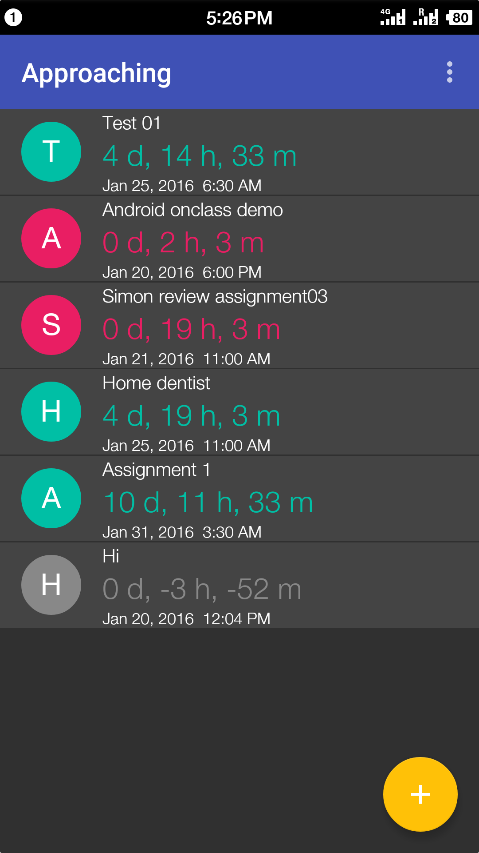

Slide 15
Final Presentation for Android Application: Approaching
Application demo
Project demonstration
Project management

Slide 16
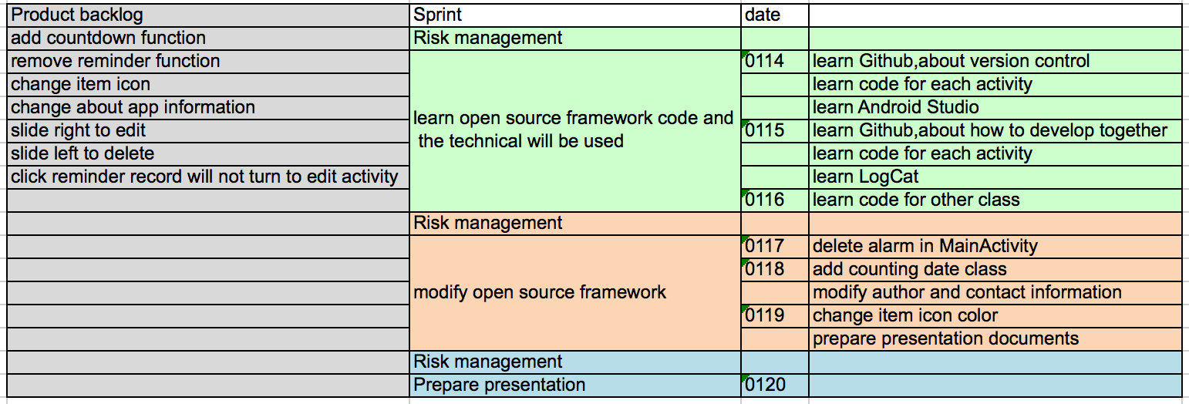
Agile Process
Roles:
Product Owner: Qingyuan LI
Scrum Master: Feifei GU
Process:
Product back
Sprint planning
Sprint
Stand up meeting
Sitting on the chair
Do daily risk evaluation

Slide 17
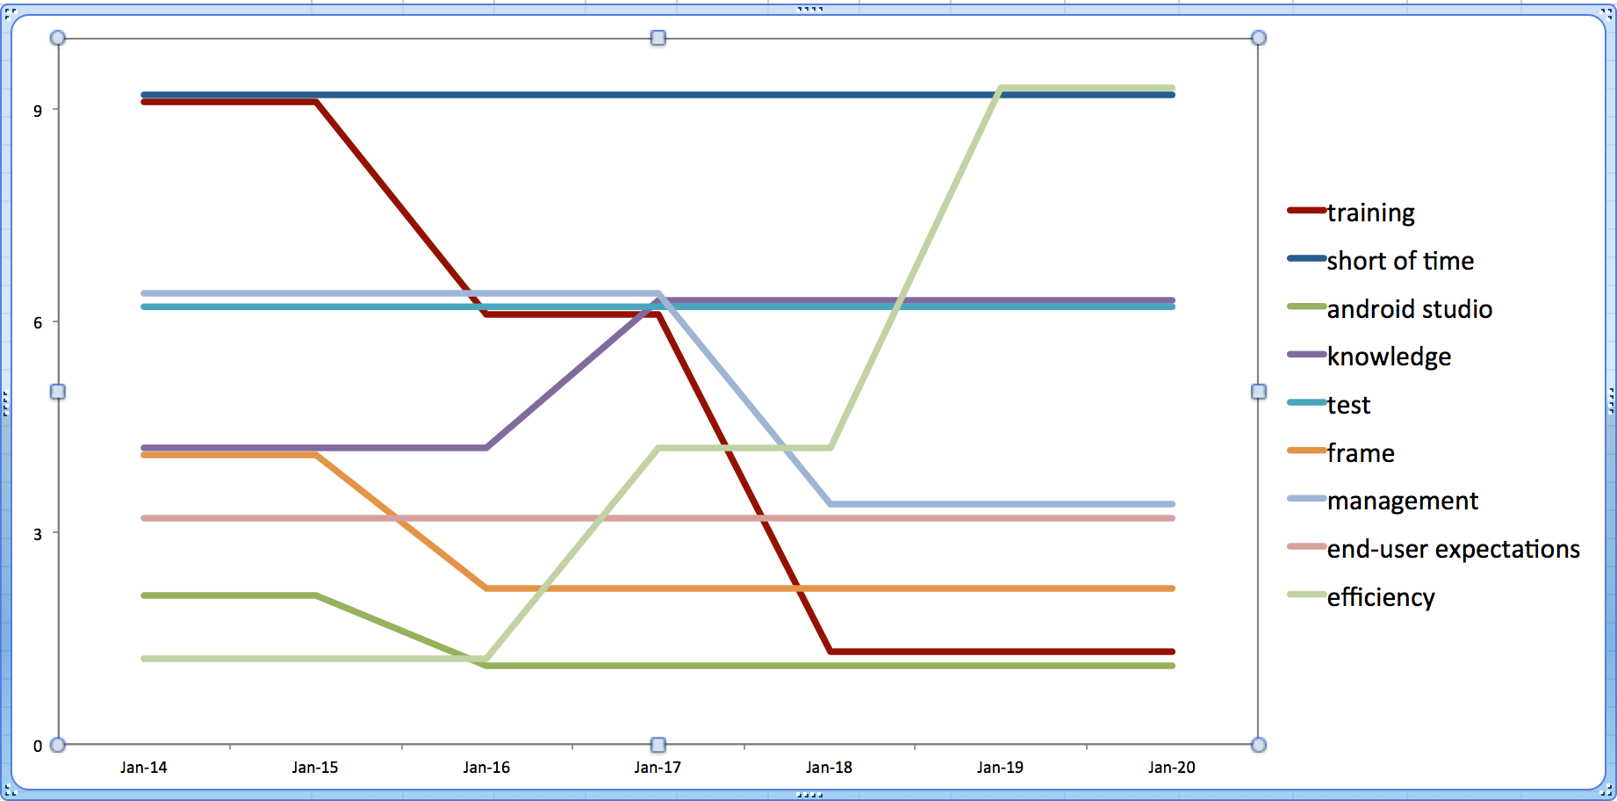
Risk management
Conclusions:
Risks changes all the time and has it’s trends, should check it regularly
Some risks die during the life cycle of developing
Thanks Sean XIE, teach us using Github
New risks come out
Feifei got some healthy problem during the developing, efficiency risk went up

Slide 18
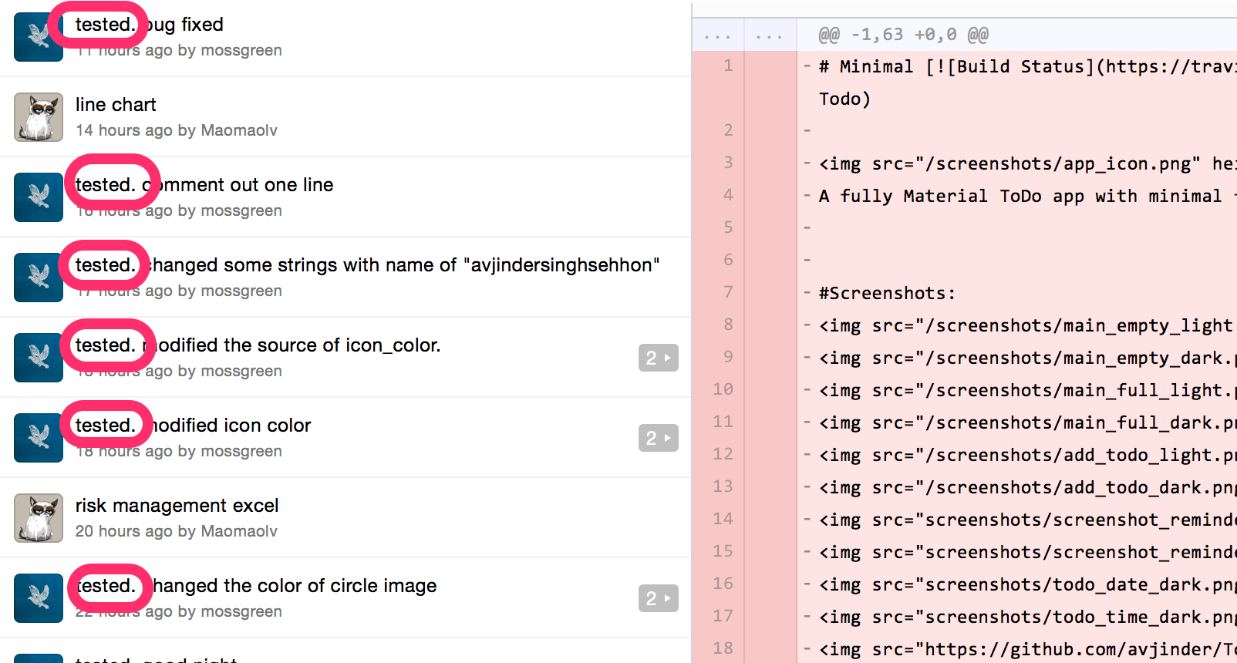
Team collaboration
Roles:
Conclusions:
Github boosts the efficiency, however, before pushing it, test again and again.
Communicate face to face: we meet everyday in the lab of Unitec
Use cloud tools, like GOOGLE sheet to collaborate and share data

Slide 19
Future plan
Add Features:
Swipe left to edit
Swipe right to delete
Tip on item won’t trigger editing
Add tutorial
Bug fix
I don’t want to tell you currently, sorry
Upload it to android market

Slide 20
Thanks
First, Google and open source community
Second, Smartisan phone
Beloved Diana
Sean XIE
Sean XIE’s study group

