Slide 1
Generating and Removing Anomalies in a Frozen Representation Space
Representation Autoencoders (RAE) for unsupervised industrial anomaly detection
Momo · Okatani Lab, Tohoku University · Lab seminar, October 2026
Notes:
Progress report on a new direction: using Representation Autoencoders, a 2025 generative-modelling idea, for reconstruction-based industrial anomaly detection. Plan: what RAE is, the idea, why it should work, and two finished experiments plus one in progress.

Slide 2
Today's talk
From a generative-modelling tool to an anomaly detector
1
RAE architecture
What a Representation Autoencoder is and why its latent space matters
2
The idea
Synthesize anomalies and learn to remove them inside the frozen RAE latent
3
Why it should work
Arguments, novelty check, and the controls built in
4
Results so far
Exp 1 fidelity · Exp 2 latent DRAEM pilot · Exp 3 in progress
Notes:
Four parts. Part 3 is where I want pushback; I also have backup slides with answers to the questions I expect.

Slide 3
Representation Autoencoders
Part 1
Notes:
First, the tool.

Slide 4
Two kinds of latent space
Latent diffusion has used reconstruction-only autoencoders; RAE swaps in a pretrained encoder
SD-VAE (standard latent diffusion)
RAE (Zheng et al., ICLR 2026)
image
256×256
VAE
encoder
32×32
×4
image
256×256
frozen
DINOv2-B
16×16
×768
Encoder trained only to reconstruct pixels
Few channels, weak semantics
Used by DiAD-style diffusion anomaly detectors
Encoder is a pretrained representation model (DINOv2, SigLIP2, MAE), never trained
High-dimensional, semantic tokens
Only the pixel decoder is learned
Notes:
Standard latent diffusion compresses images with a VAE trained only for reconstruction: 32x32x4 for Stable Diffusion at 256 px. RAE replaces that encoder with a frozen representation model. For DINOv2-B a 224-px input gives 16x16 patch tokens of 768 dims. Same spatial grid idea, but each token carries semantics.

Slide 5
RAE: frozen encoder, trained ViT decoder
Diffusion runs on the normalized encoder tokens; the decoder maps tokens back to pixels
image x
Encoder E
(frozen)
tokens z
16×16×768
ViT-XL
decoder D
x̂
DiT + wide DDT head
(generates z)
How the decoder is trained
1.51
1.13
Semantic latents are diffusable
Reconstruction + perceptual + adversarial losses
Gaussian noise on z during training, so it decodes imperfect generated latents
ImageNet 256 FID,
no guidance
256 and 512 FID,
with guidance
Notes:
The encoder never changes. The decoder is trained on ImageNet with reconstruction, perceptual and GAN losses, and with noise added to the latents so that it can decode imperfect diffusion outputs. That noise robustness matters for us later: it makes the decoder generalize, including to defects. A DiT with a wide DDT head generates in this space and reaches FID 1.51 without guidance and 1.13 with guidance. The takeaway: high-dimensional semantic latents can be generated, which is the property our idea relies on.

Slide 6
Synthesize and remove anomalies in RAE space
Part 2
Notes:
Now the idea.

Slide 7
Synthesize, then learn to remove
Prior work does this in pixels or in a latent space it trains itself
Method | Where anomalies are made | What removes / scores them
DRAEM (ICCV 2021) | Pixels: DTD texture in a Perlin mask | Pixel AE → clean image; discriminator predicts mask
DSR (ECCV 2022) | Self-trained VQ latent codes | Object-specific decoder + segmentation
RealNet (CVPR 2024) | Pixels, sampled from a diffusion model of normals | Feature reconstruction + residual selection
DiffusionAD (2023) | Pixels, DRAEM-style | Pixel diffusion denoising to normal
This work | Frozen foundation latent (RAE tokens) | Token restorer + learned discriminator
Common recipe: anomalies are created without real defects, so training stays unsupervised.
Notes:
The family I build on: make fake anomalies from normal images only, then train a network to remove or segment them. DRAEM pastes textures in pixels. DSR perturbs codes in a VQ latent it trains per category. RealNet samples off-distribution images from a diffusion model trained on normals. Nobody has done it in a frozen foundation-model latent such as RAE's. Also checked: about 297 papers cite RAE and none is about anomaly detection (next part).

Slide 8
Proposed pipeline (v1)
Everything happens on the 16×16 token grid; the pixel decoder is not used for scoring
image x
frozen RAE
encoder
z
synthesize
anomaly → z_a
restorer R
z_a → r ≈ z
discriminator D
→ token map
training only
Restorer R
Discriminator D
Test time
8-layer transformer over 256 tokens; residual output, so normal tokens pass through. Loss: cosine + MSE, anomalous tokens weighted 5×.
Sees [z_a, r, z_a − r, cos-dist]; predicts the token mask (focal loss). Learns which differences matter — DRAEM's key idea.
No synthesis. Maps: D's probability (disc), 1 − cos(z, R(z)) (resid). Upsample 16×16 → 256×256 and blur.
Notes:
Encode with the frozen RAE encoder, damage a region of the token grid, train a token restorer to recover the clean tokens and a discriminator to segment the damage. At test time there is no synthesis: encode, restore, read the discriminator map. The pixel decoder never enters scoring, which turns out to matter (Exp 1).

Slide 9
How anomalies are synthesized
v1 uses hand-made perturbations; v2 replaces them with a learned generator in the same space
v1 · hand-made (tested)
v2 · learned generator (next)
pixel
DRAEM recipe in pixels, then encoded (reference)
Train a small DiT on normal tokens of each category: the "second RAE"
Sample slightly off the normal distribution: inflated variance (RealNet-style) or partial noise-and-denoise of a region
Anomalies stay realistic and close to normal, without hand-crafted rules
latent_tex
DTD texture tokens blended in: z + β·m·(z_tex − z)
latent_self
Shifted tokens from another normal image (latent CutPaste)
latent_noise
Gaussian noise on masked tokens
mix
One of the above per sample
Masks: Perlin blobs at 256 px, pooled to per-token coverage; 20% of samples left clean.
Notes:
Exp 2 tested five hand-made modes. pixel is DRAEM's recipe, run in pixels and then encoded; it is the reference. The three latent modes edit tokens directly. latent_self moves real content to the wrong place, which mimics structural defects. The plan is to replace these with a generator trained on normal tokens; that is the second RAE from the original idea.

Slide 10
Why the RAE latent, and why it is new
Part 3
Notes:
This is the part to challenge.

Slide 11
Four reasons to work in RAE space
Each one is testable, and the experiments are designed around them
1
Semantic edits
2
A generative prior
A token edit is a semantic edit. Misplaced, missing or deformed parts can be synthesized, not only texture blobs.
RAE showed diffusion works in this space, so the anomaly generator can be learned rather than hand-designed.
Exp 2: latent_self wins on transistor
Exp 4 (planned)
3
Frozen and cheap
4
Decoder-free scoring
No encoder training. The restorer is a small transformer over 256 tokens; normal training sets of ~200 images suffice.
Detection and localization use tokens only, so the decoder's pixel errors cannot cause false positives.
~8 min per category on one GPU
Exp 1: why this matters
Notes:
1: in pixel space you can only paste things; in token space you can move semantic content. 2: diffusion works here, so the generator can be learned. 3: frozen encoder, small restorer, fast. 4: scoring stays in token space, so decoder quality is irrelevant to detection. Each point is tied to an experiment.

Slide 12
Novel, and guarded against fooling ourselves
Literature check plus the controls built into every experiment
kNN on the same frozen tokens
0 / 297
Training-free PatchCore-style control. If the learned pipeline does not beat it, the method adds nothing.
papers citing RAE that address anomaly detection (Semantic Scholar, Oct 2026)
Pixel-synthesis reference
DRAEM's own recipe, run through the same encoder, so latent synthesis is compared like-for-like.
Closest: Q-Former AE (2025): frozen DINOv2 + pixel decoder, medical only, no anomaly synthesis, no generative prior.
Two latents
DINOv2-B (semantic) vs MAE (faithful) separates 'semantics help' from 'any latent helps'.
Seeds + held-out normals (Exp 3)
3 seeds; score scales set on held-out normal images only, never on test labels.
Notes:
Novelty: I went through all ~297 papers citing RAE; none is about anomaly detection. The closest work, the Q-Former autoencoder, is medical-only with a frozen DINOv2 and a pixel decoder, with no synthesis and no generative prior. Controls: a kNN baseline on the same tokens, the pixel-synthesis reference, two latents, and from Exp 3 seeds and label-free score normalization.

Slide 13
Results so far
Part 4
Notes:
Two finished experiments, one running.

Slide 14
Exp 1: can a frozen RAE copy industrial images?
MVTec AD normal images, 256 px; released decoders vs the SD-VAE
Mean PSNR (dB)
MAE
33.3
SD-VAE
30.9
SigLIP2
23.8
DINOv2-B 512
20.8
DINOv2-B
19.9
Semantic RAEs have ~5× the error floor of MAE (p99 error 0.18 vs 0.04).
Notes:
Exp 1 asked whether the frozen decoders can reproduce normal industrial images. MAE is the most faithful, better than the SD-VAE. DINOv2 and SigLIP2 lose most of the texture structure: carpet SSIM is 0.05 for DINOv2-B. Their error floor would bury real defects if we scored on pixels. The 512 decoder was fed 256 px, so its number is not a fair comparison.

Slide 15
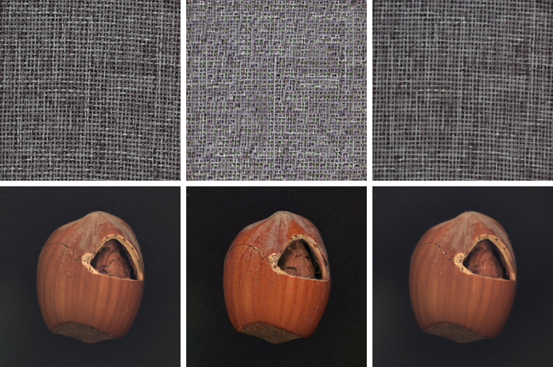
Semantic RAEs redraw instead of copying
Right content, wrong pixels: tone shifts and regenerated textures
input
DINOv2-B recon
MAE recon
Consequences
Pixel residuals from DINOv2/SigLIP RAEs are unusable for scoring
So v1 scores on tokens only
Every decoder reproduces defects (hazelnut crack): a plain RAE does not remove anomalies
Trade-off: most faithful latent (MAE) vs most generative latent (DINOv2)
Notes:
Top row: carpet. DINOv2's reconstruction is plausible carpet with a different weave, so SSIM collapses. Bottom: hazelnut. DINOv2 shifts the colour and saturation, MAE is near pixel-exact, and both reproduce the crack. These results decided two things: score in token space, and expect removal to come from training, not from the RAE itself.

Slide 16
Exp 2: latent DRAEM pilot
5 MVTec categories × 5 synthesis modes × 2 latents; 3000 steps; single seed
Categories
carpet, grid (texture) · hazelnut, screw, transistor (object)
Latents
DINOv2-B and MAE RAE encoders, frozen
Modes
pixel · latent_tex · latent_self · latent_noise · mix
Scores
disc (discriminator) · resid (restorer) · knn (control)
Metrics
image AUROC · pixel AUROC · pixel AP · AUPRO@30% FPR
Three questions: does training beat frozen kNN? Can anomalies be made directly in token space? Which latent?
Notes:
Five categories chosen to cover textures, objects, small defects and structural defects. About 8 minutes per run, 50 runs in total. One seed, so differences of a point or two are within noise; Exp 3 fixes that.

Slide 17
On average, frozen kNN is still hard to beat
DINOv2-B, mean over 5 categories; amber = best in column
Score | Image AUROC | Pixel AUROC | Pixel AP | AUPRO
kNN on frozen tokens (control) | 0.969 | 0.956 | 0.413 | 0.861
pixel · disc | 0.943 | 0.942 | 0.520 | 0.876
mix · disc | 0.921 | 0.947 | 0.533 | 0.867
mix · resid | 0.962 | 0.971 | 0.419 | 0.817
latent_noise · resid | 0.972 | 0.965 | 0.365 | 0.842
latent_self · disc | 0.905 | 0.923 | 0.355 | 0.799
Reading
Learned scores beat kNN on AP (0.41 → 0.53), not on AUROC
The disc image score is weak: it is the max of a map calibrated on fake anomalies
MAE: kNN even stronger (AUPRO 0.884); nothing learned beats it
Notes:
The honest headline: averaged over five categories, a training-free kNN on the same tokens is competitive. The learned discriminator clearly improves AP and slightly improves AUPRO, but loses on image AUROC. The image score is the max of the map; Exp 3 tests a top-1% score and fusion with kNN.

Slide 18
Wins where fake anomalies match the defects
AUPRO per category, DINOv2-B
+0.14
transistor (bent / misplaced / missing parts): mix vs kNN, 0.885 vs 0.746
+0.13
screw (small defects): pixel vs kNN, 0.891 vs 0.757; pixel AUROC 0.982 vs 0.902
Notes:
The per-category view is the encouraging part. Transistor defects are structural, and the modes that include latent_self win clearly. Screw defects are small, and pixel synthesis wins. Texture modes hurt transistor and latent_self hurts screw. So it works when the synthetic anomalies resemble the real ones; making them realistic is what v2 is for.

Slide 19
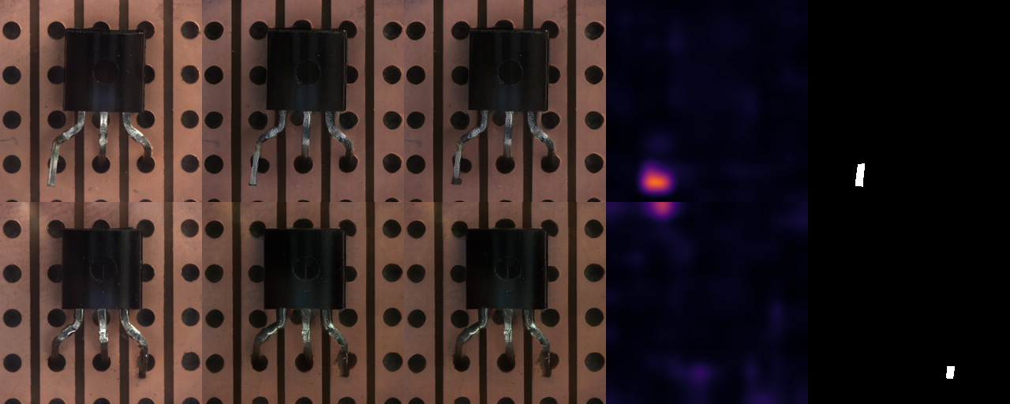
Transistor: the discriminator finds bent leads
But the restored image still contains the defect
input
decode(z)
decode(R(z))
disc map
ground truth
Notes:
Columns: input, the RAE reconstruction, the restored tokens decoded, the discriminator map and ground truth. The map lands on the bent leads. But decode(R(z)) still shows the bent lead, so the restorer does not remove real defects; detection comes from the discriminator ranking the right tokens highest. That points to the realism of the synthetic anomalies as the bottleneck.

Slide 20
What Exp 2 tells us
Three findings that set the next experiments
DINOv2-B is the latent to keep
1
Best learned scores; MAE only helps the training-free kNN.
Token-space synthesis works where matched
2
latent_self beats pixel synthesis on structural defects; pixel wins on small ones.
Realism of fake anomalies is the bottleneck
3
The restorer leaves real defects in place; the learned generator (v2) targets this directly.
Notes:
Summary of Exp 2. Caveat for everything: one seed and five categories.

Slide 21
Exp 3 (running): seeds and score fusion
DINOv2-B · pixel, latent_self, mix · 3 seeds · 20 normals held out for score scaling
What it adds
Smoke test: screw | kNN | pixel·disc | disc+kNN
Image AUROC (top 1%) | 0.889 | 0.722 | 0.908
Pixel AUROC | 0.901 | 0.970 | 0.960
Pixel AP | 0.233 | 0.284 | 0.344
AUPRO | 0.755 | 0.854 | 0.849
3 seeds: report mean ± std; differences marked only beyond 2× seed std
Scores z-normalized on held-out normal images (no test labels)
Fusion: disc + kNN, resid + kNN, all three
Image score: top-1% mean vs max
Preliminary: 1 category, 1 seed, 300 steps. Fusion keeps kNN-level image detection while keeping the localization gain.
Full run: 45 trainings, ~6 h
Notes:
Exp 3 checks whether the Exp 2 wins survive seeds, and whether fusion fixes the weak image score. The smoke test on screw is only a pipeline check, but it already shows the pattern I hope for: fusion recovers image AUROC while keeping better localization. The full run is about six hours.

Slide 22
Next steps
Each step is gated by the one before it
Exp 3
Exp 4
Exp 5
Scale
Seeds + fusion
Learned generator
Resolution
Full benchmarks
Does the learned part add signal beyond kNN, reliably?
DiT on normal tokens; inflated-variance or partial-denoise anomalies
448–518 px input (32–37 token grid) for small defects
All of MVTec AD, then MVTec AD 2 and VisA
Decision rule: if Exp 3 shows no gain beyond seed variance, the learned generator becomes the whole contribution rather than an add-on.
Notes:
Exp 3 decides how much weight the current pipeline carries. Either way, the learned generator is next.

Slide 23
Synthesize and remove anomalies where the representation lives
RAE tokens are semantic and generative · scoring stays in token space · wins where synthetic anomalies match real ones · next: learned generator
Notes:
Closing message. Then questions; backup slides follow.

Slide 24
Anticipated questions
Backup
Notes:
Backup slides for Q&A.

Slide 25
Q1
"Isn't this just DRAEM in another space?"
The space decides what can be synthesized. Pixels allow pasted textures; tokens allow moved or missing semantic parts.
Evidence: latent_self beats pixel synthesis on transistor (AUPRO 0.885 vs 0.651).
DSR showed latent synthesis helps, but with a codebook trained per category. Ours uses a frozen foundation latent, which a generator can then model (v2).
Contribution claim: synthesis and removal in a frozen representation space, plus a learned generator there. Not the DRAEM training loop itself.
Notes:
Backup answer. Key numbers are on the slide.

Slide 26
Q2
"Why not just use kNN / PatchCore on the tokens?"
kNN is our control, and it is strong; we report it everywhere.
It has no notion of structure: misplaced parts that look locally normal score low. Learned scores win on transistor and screw AUPRO (+0.14, +0.13).
Exp 3 tests fusion: keep kNN's image-level strength, add the learned localization.
If the gains don't exceed seed variance, we will say so.
Notes:
Backup answer. Key numbers are on the slide.

Slide 27
Q3
"Fake anomalies won't look like real defects"
Agreed; it is the main risk, and Exp 2 shows it: the restorer leaves real defects in place.
The discriminator still ranks real defects highly, so the learned comparison transfers partly.
Mitigations: mixtures of modes; a generator learned on normal tokens (v2); evaluation on MVTec AD 2 and LOCO, where defects differ most.
Notes:
Backup answer. Key numbers are on the slide.

Slide 28
Q4
"16×16 tokens cannot localize small defects"
Partly true: one token covers 16×16 px at 256 px input.
Yet pixel synthesis reaches pixel AUROC 0.982 on screw: the blurred map still ranks defect pixels highly.
AUPRO is where resolution hurts; planned fix: 448–518 px input (32–37 token grid).
Notes:
Backup answer. Key numbers are on the slide.

Slide 29
Q5
"Single seed, five categories: is anything significant?"
Correct, Exp 2 is a pilot.
Exp 3: 3 seeds; differences flagged only beyond 2× seed std; score scaling from held-out normals.
After that: all 15 MVTec categories, then MVTec AD 2 and VisA.
Notes:
Backup answer. Key numbers are on the slide.

Slide 30
Q6
"Why keep the encoder frozen?"
Fine-tuning on ~200 normal images risks collapsing the features and breaks the link to RAE's generative prior.
Frozen means one encoder for all categories and cheap training.
Fine-tuning only the decoder stays an option for better visualizations (Exp 1 fidelity gap).
Notes:
Backup answer. Key numbers are on the slide.

Slide 31
Q7
"Why have a restorer if it doesn't remove defects?"
It gives the discriminator a reference: D compares z_a with R(z_a), as in DRAEM.
resid alone gives the best image AUROC in Exp 2 (latent_noise: 0.972).
With realistic generated anomalies (v2), removal should improve. Exp 4 measures it directly with decode(R(z)).
Notes:
Backup answer. Key numbers are on the slide.

