Slide 1
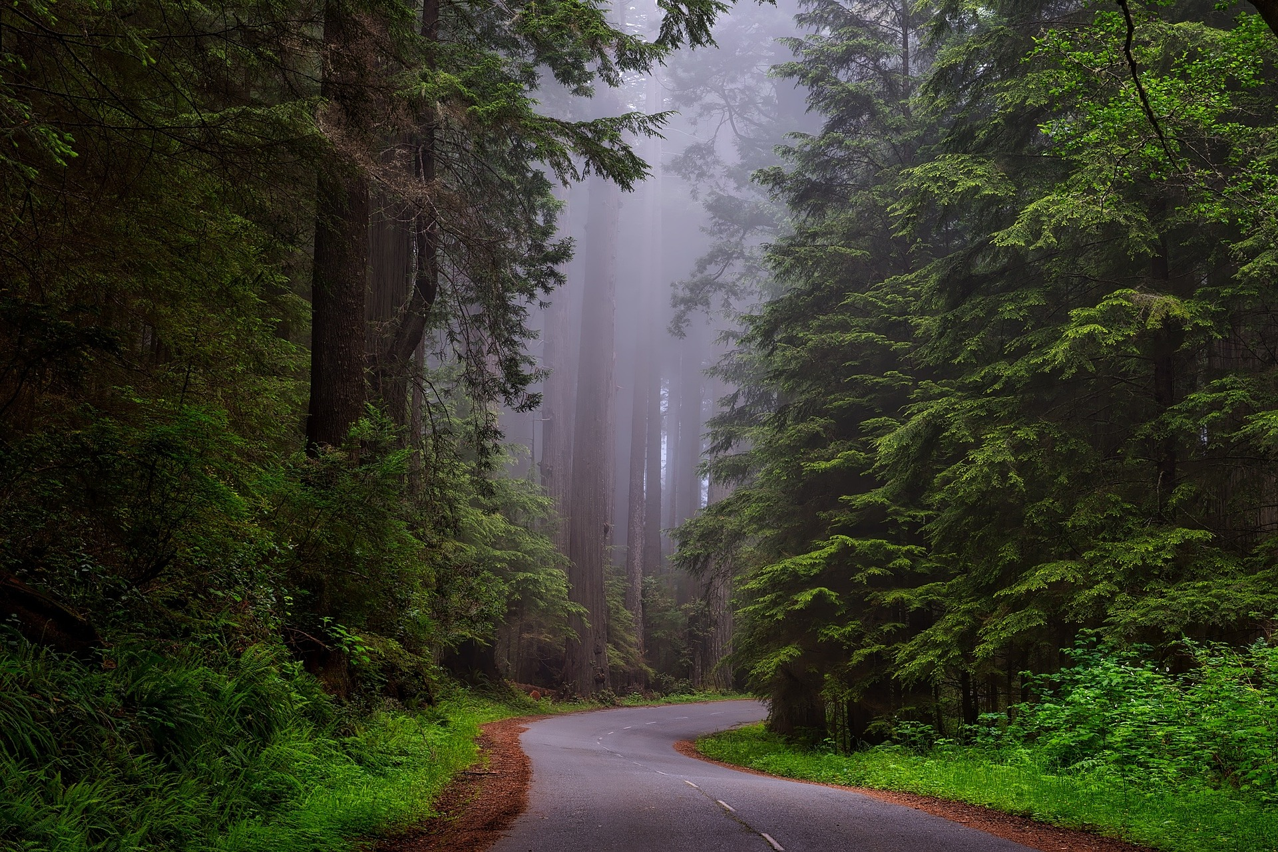
CAMBODIA IN 2010

Slide 2
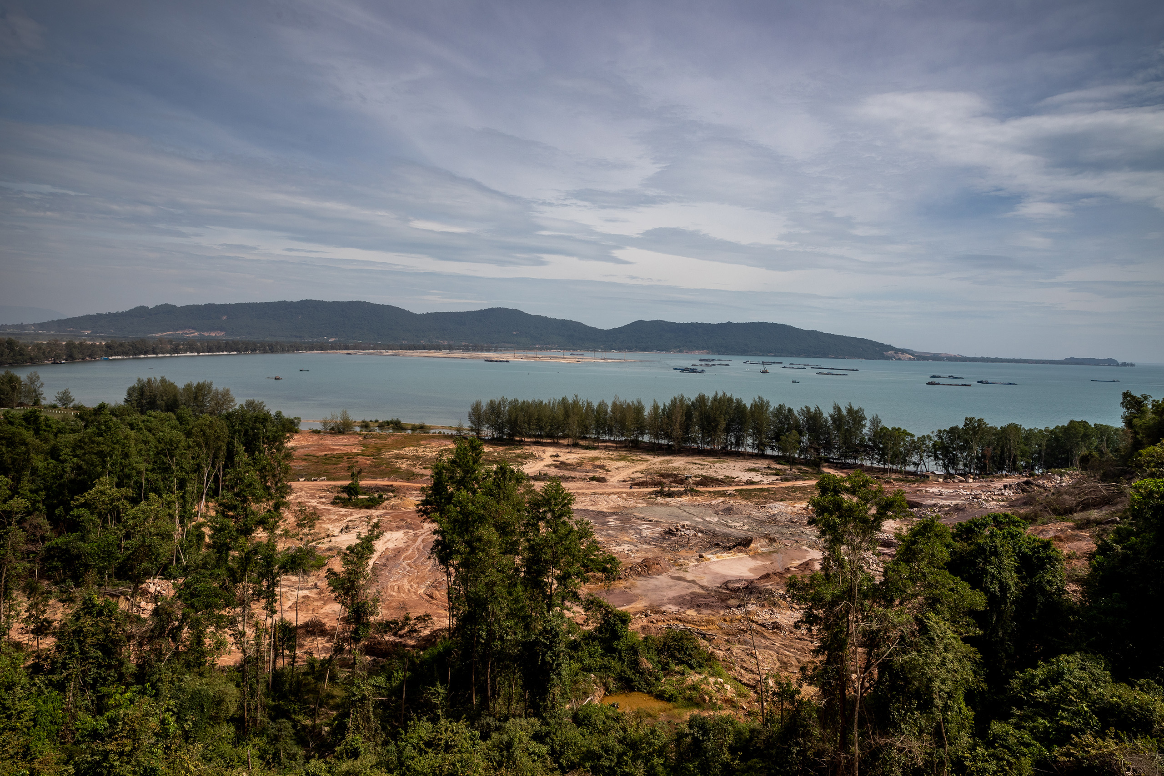
CAMBODIA IN 2021

