Slide 1


Functional programming in concurrent and distributed systems
381-1-0112 | SM B 2018| Tutorial 5
David Leon

Slide 2
Outline
Concurrency vs. Parallelism
Concepts of Concurrency
Scaling of Problems
Concurrency in Practice
Creating processes
Sending messages
Receiving messages
Example
Submission procedures

Slide 3
#1 Concurrency vs. Parallelism
Concurrency
Many actors running independently
Not necessarily all at the same time
Concurrency contain the parallelism.
Parallelism
Actors running exactly at the same time.
The same program is shared between actors.

Slide 4
Parallelism
Threads brought with them many issues of parallel programming such as sharing resources. Typically this is done by semaphores which simply lock a token. In case the programmer doesn’t take in count that there are shared resources you may end with program that works only by chance.
The alternative to threads is, processes.
Code and data are maintained by the OS.
Processes by default operate in an independent memory area.
Usually process is unable to affect data of other processes.

Slide 5

Parallelism
Threading model sits well with OpenMP while the process model with MPI (MPICH library for example).
In terms of GPUs – combining both approaches. CUDA (Compute Unified Device Architecture, by nvidia) or OpenCL uses a grid of blocks of threads.
This can be thought of as a queue (grid) of processes (block) with no inter-porcess communication. Within each block there are many threads which operate cooperatively in groups called warps.
Unlike concurrency the parallelism model treat processes/threads that run at the same time.

Slide 6
#2 Concepts of Concurrency
Scalability
Processes are started and destroyed very quickly
Switching contexts of processes is fast
Possible due to lightweight processes
Fault-tolerance
Supervisors
Hardware failures
Implementation
Erlang is a VM-based language
OS is not trusted to handle processes in manner of optimization and reliability

Slide 7
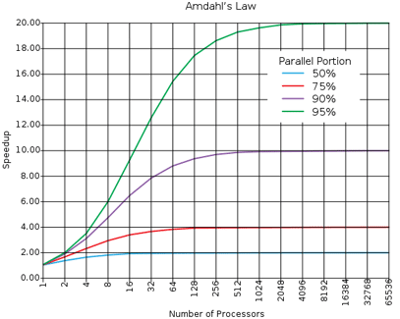
#3 Scaling of Problems
Most of the problems cannot be scaled very well
Examples of problems that scale well: ray-tracing, brute-force searches in cryptography, weather prediction, etc.
Your parallel program only goes as fast as its slowest sequential part
Follow Amdahl's law →
Is 100% parallel is practical?

Slide 8
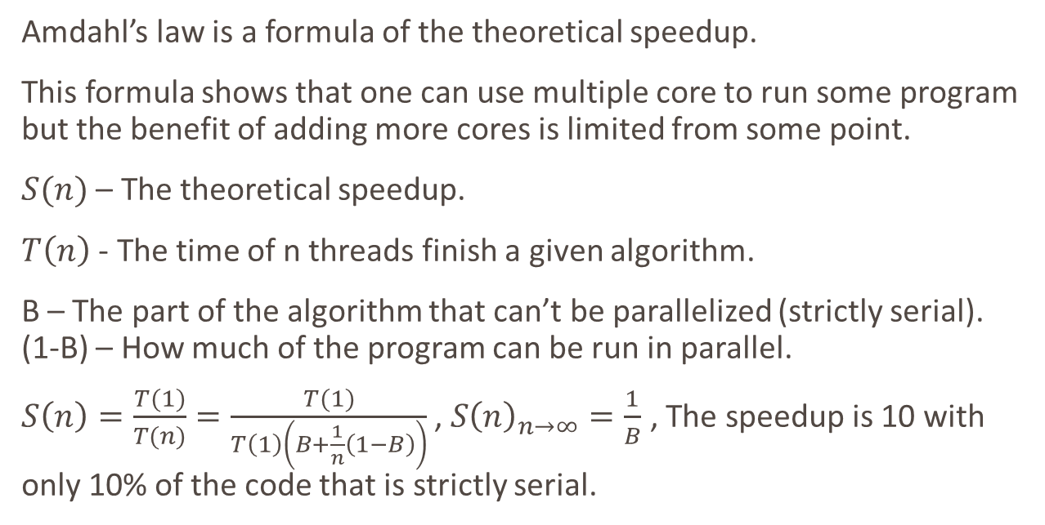
Amdahl’s Law
Amdahl’s law is a formula of the theoretical speedup.
This formula shows that one can use multiple core to run some program but the benefit of adding more cores is limited from some point.
$S(n)$ – The theoretical speedup.
$T\left(n\right)$ - The time of n threads finish a given algorithm.
B – The part of the algorithm that can’t be parallelized (strictly serial). (1-B) – How much of the program can be run in parallel.
$S\left(n\right)=\frac{T(1)}{T(n)}=\frac{T(1)}{T\left(1\right)\left(B+\frac{1}{n}\left(1−B\right)\right)}$ , $S{\left(n\right)}_{n→∞}=\frac{1}{B}$ , The speedup is 10 with only 10% of the code that is strictly serial.

Slide 9
Amdahl's Law Limitations
Not every action done in a program will have the same amount of parallelization.
Amdahl's Law only applies if the CPU is the bottleneck.
Many programs are hard-coded to use a certain number of cores.
Estimating the performance of a CPU will only be accurate for CPUs based similar architecture.

Slide 10
#4 Concurrency in Practice
The three primitives required for concurrency in Erlang
Spawning new processes
Sending messages
Receiving messages

Slide 11
#4.1 Creating Processes
We create a new process by calling function spawn/1, where the argument is a function that contains the code for the created process
What the output of the second command means?
A Process Identifier (PID)
It is used as an address to communicate with the process
One can use the BIF self/0 to obtain the PID of the current process

Slide 12
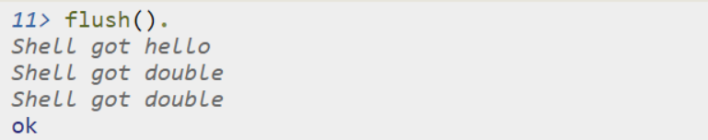
#4.2 Sending Messages
A process can send messages (message passing) using the operator !
To see the contents of the current mailbox, you can use the BIF flush()

Slide 13
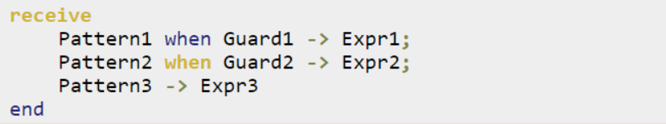
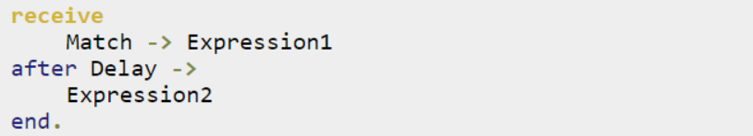
#4.3 Receiving Messages
We can read incoming messages using the receive statement
When using after, Expression2 will be triggered if as much time as Delay has been spent without receiving a message that matches the Match pattern (in ms)

Slide 14
#4.3 Receiving Messages
Each process holds queue of messages.
Inside the “receive block”: only messages that have a match with pattern will be pulled out from the queue, the rest won’t be wiped out.
Clean the queue by using flush() command or implementing receive block that matches any pattern (using “_” in order to capture any pattern).
The following case may result in queue overflow: Sender code: RxPID ! {time,1200} Receiver code: rx_loop()-> receive {A,B} when erlang:is_atom(B) -> not_ok end.

Slide 15
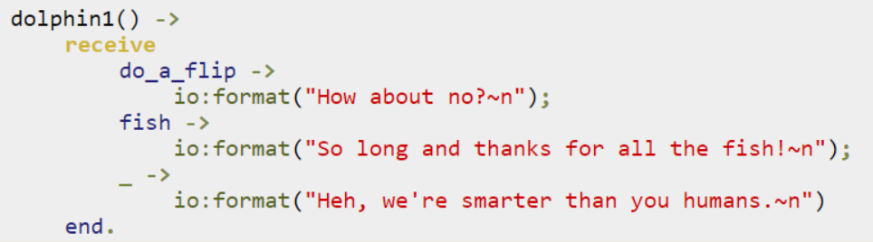
#4.3 Receiving Messages
Example 1

Slide 16
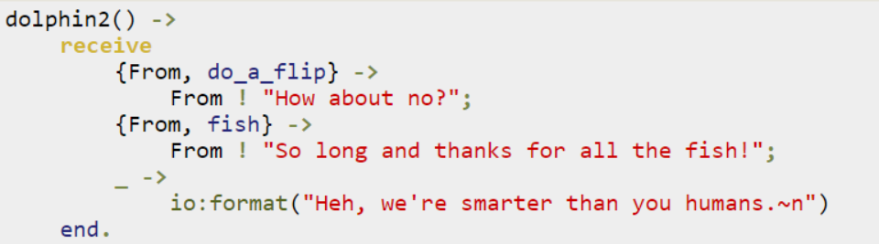
#4.3 Receiving Messages
Example 2

Slide 17
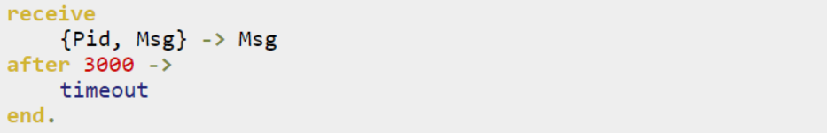
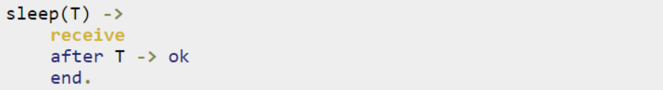
#4.3 Receiving Messages
Example 3.1
Example 3.2

Slide 18
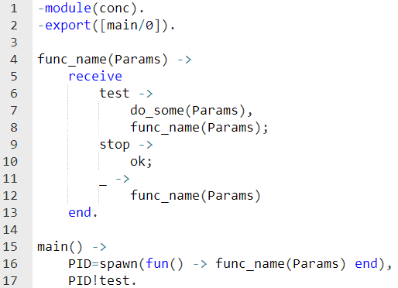
#5 Example
Example

Slide 19
#6 Submission Procedures
Filename format: ex5_<ID>.<type>
Where <ID> needs to be replaced with your ID number
Where <type> needs to be replaced with file type – erl/pdf/doc/docx
Your code MUST be well documented
Functions’ names must be identical to the ones defined in exercise
Same as for the arity
Same as for the output format
Only the tested functions needs to be exported
Internal functions MUST NOT be exported
Assignments will be tested automatically in using Erlang shell in Linux
No excuses

Slide 20
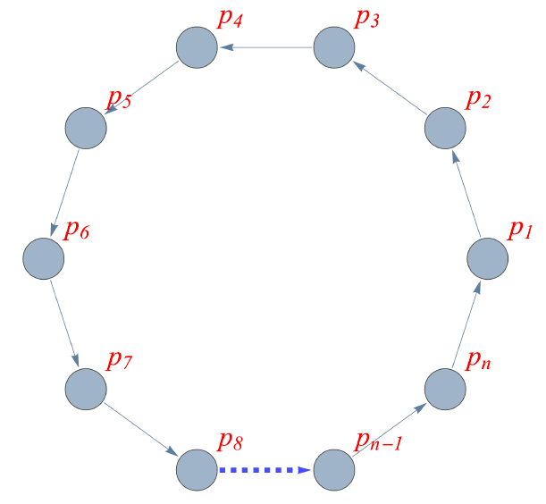
Exercise 5
Write a function ring(N,M) that creates a circle of N processes as shown in the following example:
Example: ring(N,M)

Slide 21
Exercise 5
When the construction of the circle is completed, M messages need to be transmitted by process number 1 (P1)
The next message can be sent only when the previous message has arrived to P1
When P1 receives the Mth message, it should print the total time it took all of the M messages to pass through the circle (try to understand the differences when including the construction time)
Implement the above in two different ways:
ringA/2 – every process creates its next neighbor, one after another
ringB/2 – all processes are created by a central process
Compare the results you receive, and add your conclusions

Slide 22
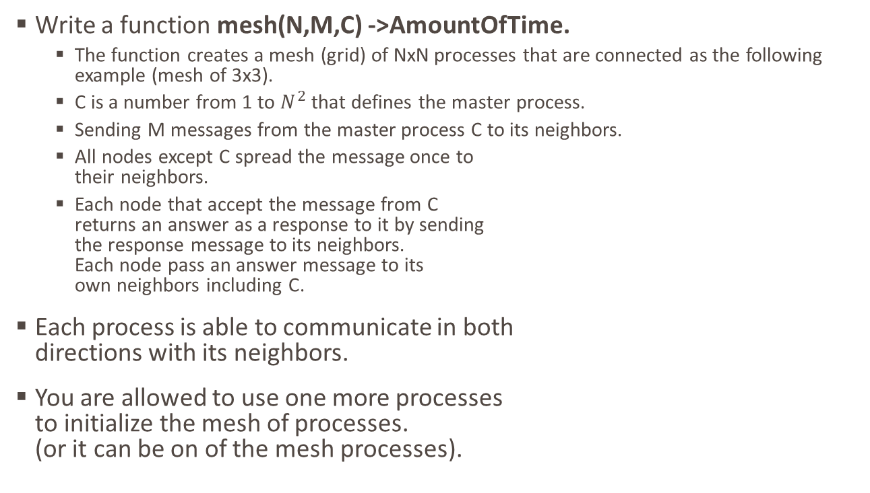
Exercise 5
Write a function mesh(N,M,C) ->AmountOfTime.
The function creates a mesh (grid) of NxN processes that are connected as the following example (mesh of 3x3).
C is a number from 1 to $N^{2}$ that defines the master process.
Sending M messages from the master process C to its neighbors.
All nodes except C spread the message once to their neighbors.
Each node that accept the message from C returns an answer as a response to it by sending the response message to its neighbors. Each node pass an answer message to its own neighbors including C.
Each process is able to communicate in both directions with its neighbors.
You are allowed to use one more processes to initialize the mesh of processes. (or it can be on of the mesh processes).
P1
P2
P3
P4
P5
P6
P7
P8
P9

Slide 23
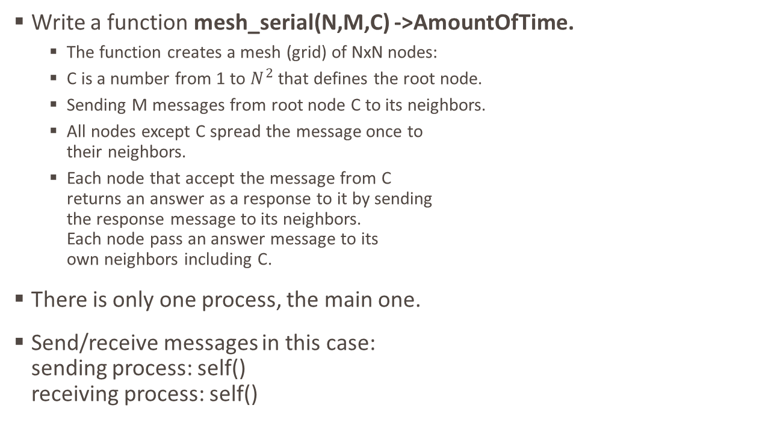
Exercise 5
Write a function mesh_serial(N,M,C) ->AmountOfTime.
The function creates a mesh (grid) of NxN nodes:
C is a number from 1 to $N^{2}$ that defines the root node.
Sending M messages from root node C to its neighbors.
All nodes except C spread the message once to their neighbors.
Each node that accept the message from C returns an answer as a response to it by sending the response message to its neighbors. Each node pass an answer message to its own neighbors including C.
There is only one process, the main one.
Send/receive messages in this case: sending process: self() receiving process: self()
P1
P1
P1
P1
P1
P1
P1
P1
P1

Slide 24
Exercise 5
Process C prints the total time it took to receive answers from the nodes.
Process C prints the amount of messages that were received
Measure times that it took to send/receive the messages with N in range from 2 to 5 and with 3 different centers for each and with 10,100,1000 messages. Write conclusions and plots in the report document for both mesh and mesh_serial.
Compare the theory with the actual result. Determine what is the parallel portion of running mesh and if there is a dependency of the center process location.
Pay attention to freeing resources after mesh function was done. (Which means that can be called multiple time in shell).
Submit the code (one erlang file) and design document.

