Slide 1
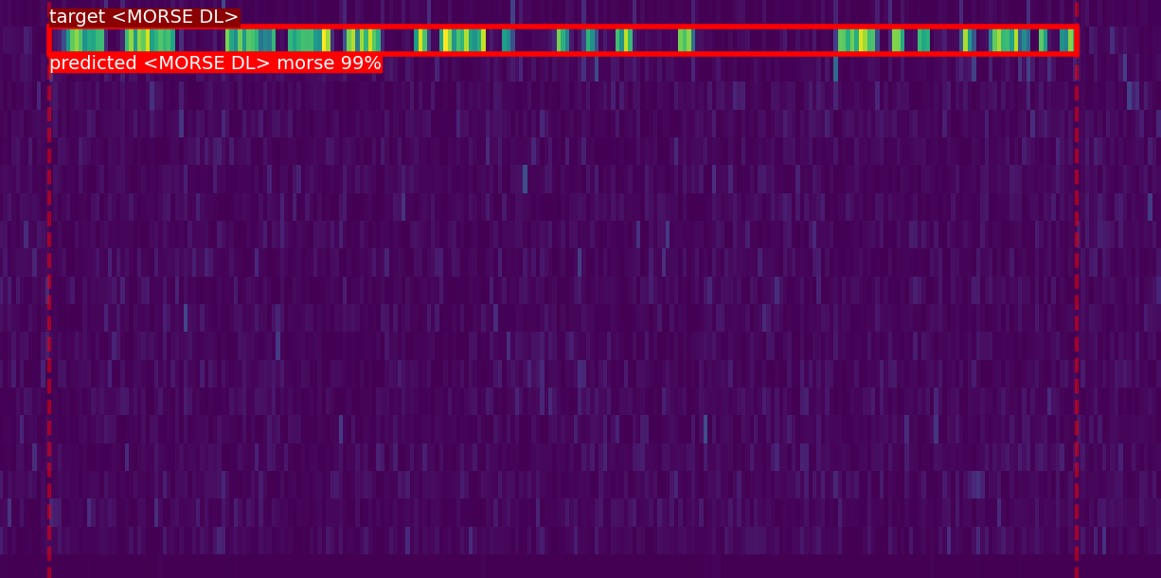
Morse Code Decoder & Detector
w/ Deep Learning
Maor Assayag \ Eliraz Kadosh \ Eliram Amrusi

Slide 2


Outline
Introduction
Objectives
LSTM RNN
Faster RCNN (resnet50)
Demo
Future Work

Slide 3

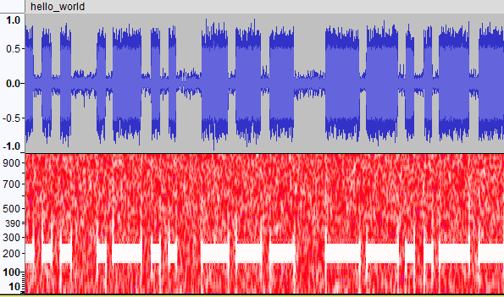
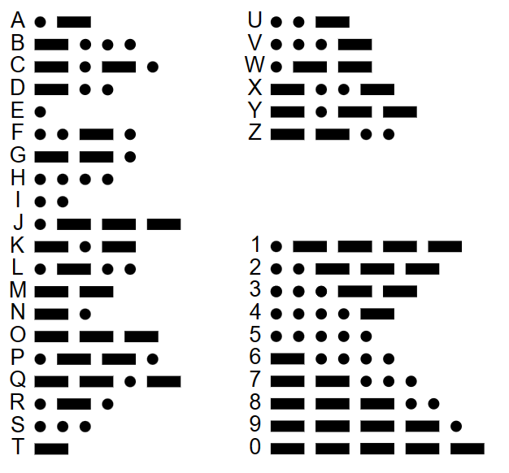
Introduction
Morse Code

Slide 4
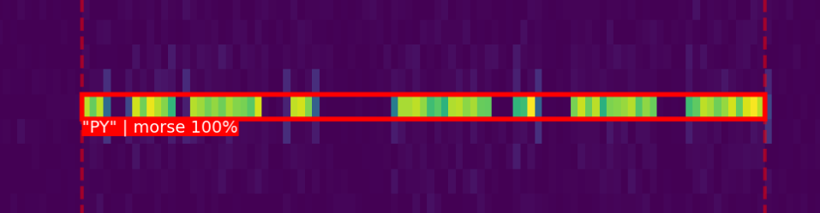
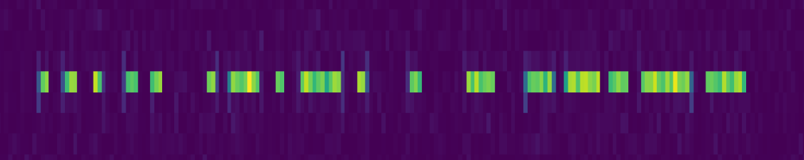
Objectives
Generate labeled data – Pitch \ SNR \ Doppler
Decode Morse from a spectrogram
Detect Morse boundaries in a spectrogram

Slide 5
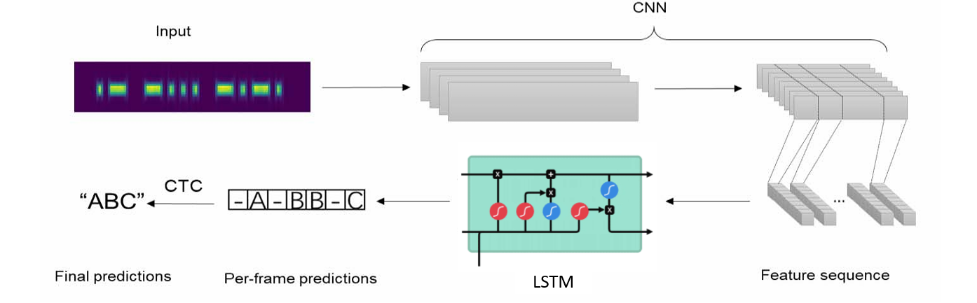
LSTM RNN
(740k params)

Slide 6
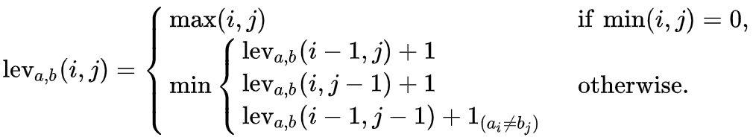
LSTM RNN
CER (Character Error Rate)

Slide 7
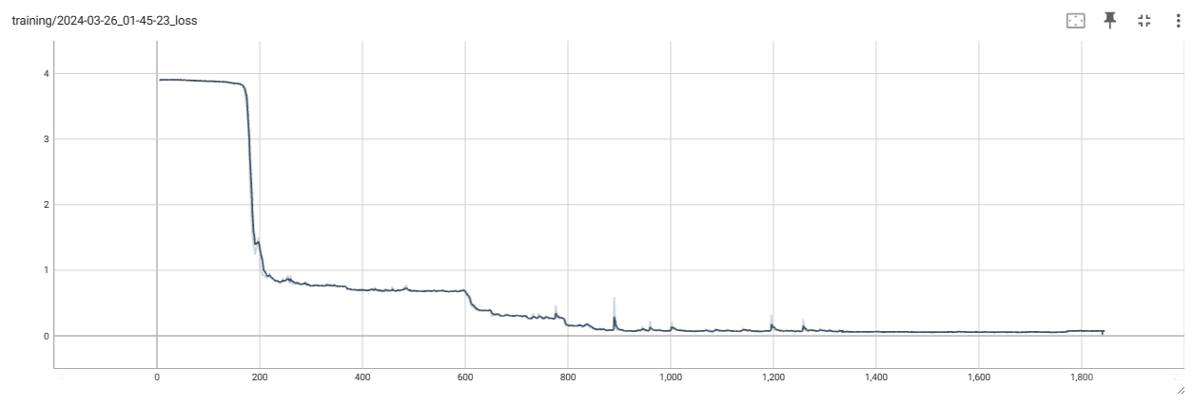
LSTM RNN

Slide 8
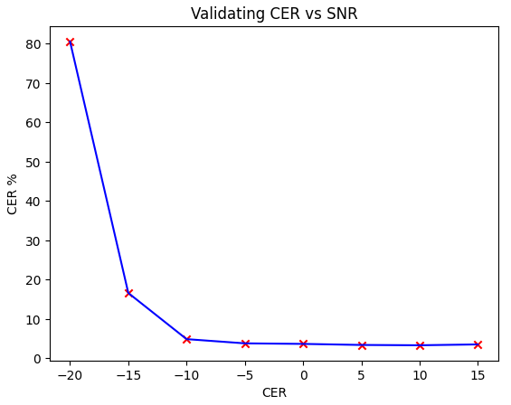
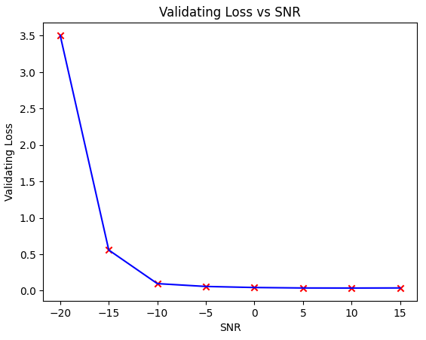
LSTM RNN
SNR
<2% CER

Slide 9
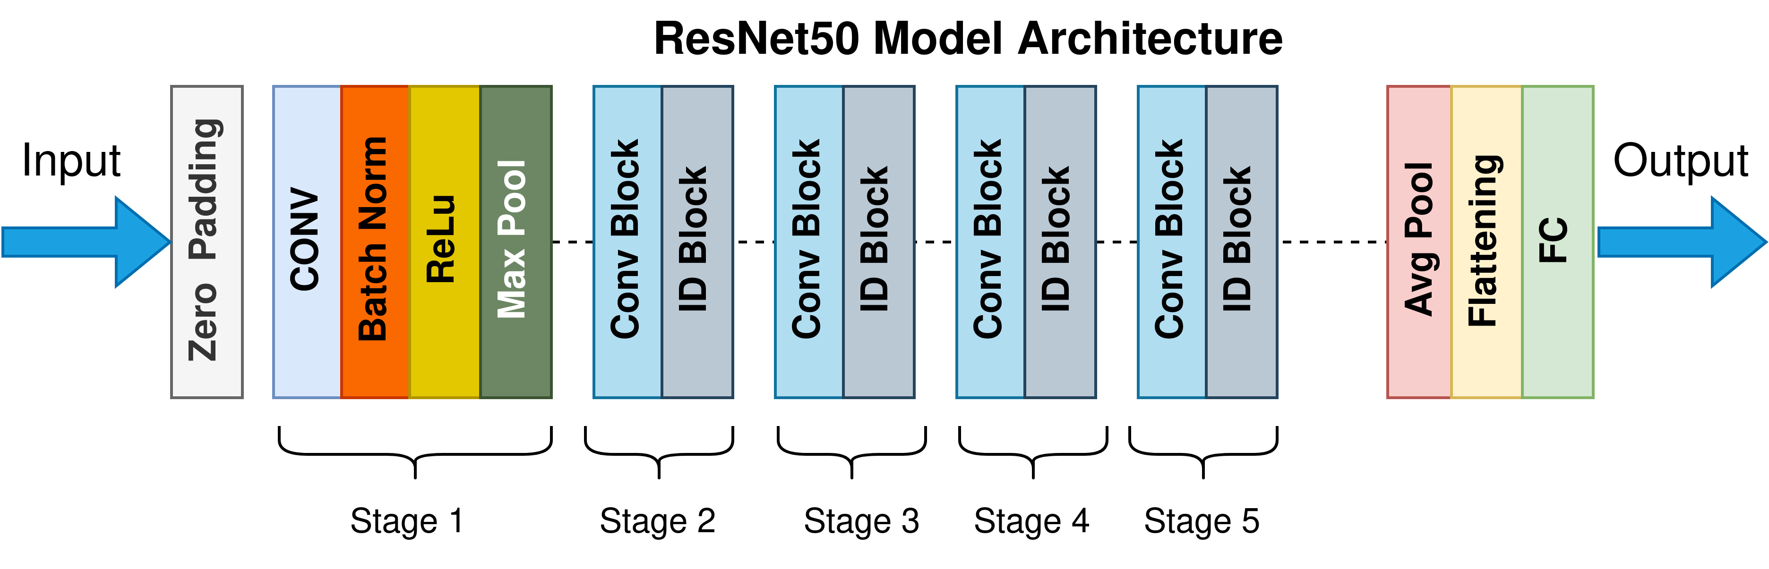
Faster RCNN
Image Object Detection
40M params
RPN Loss Function

Slide 10
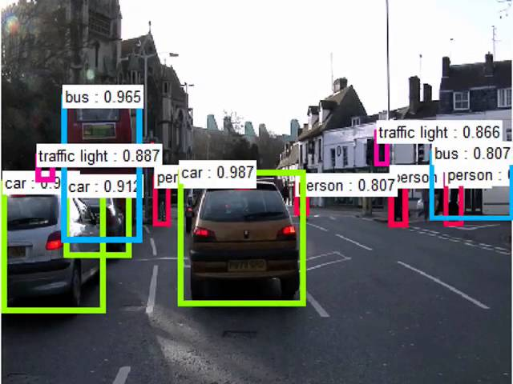
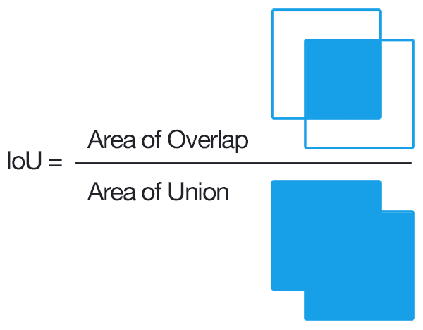
Faster RCNN

Slide 11
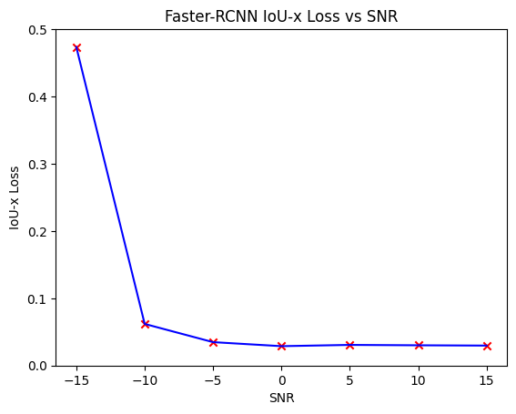
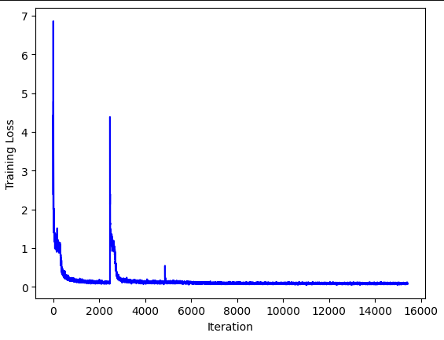
Faster RCNN
Faster-RCNN Training Loss
<3% loss

Slide 12
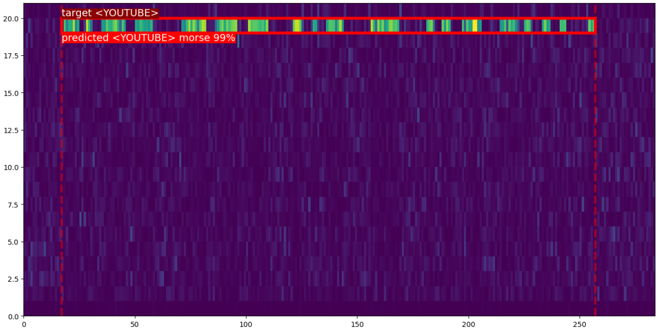
Demo
RESNET50
LSTM-RNN
pitch: 950, wpm: 18, snrDB: 3, amplitude: 164, str: YOUTUBE, bbx: (17, 19, 257, 20)

Slide 13
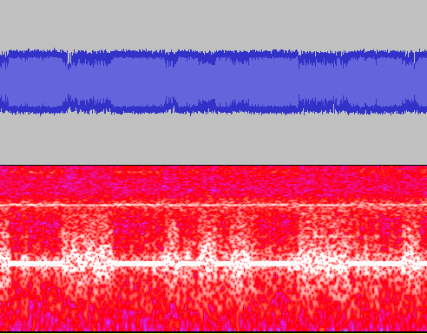
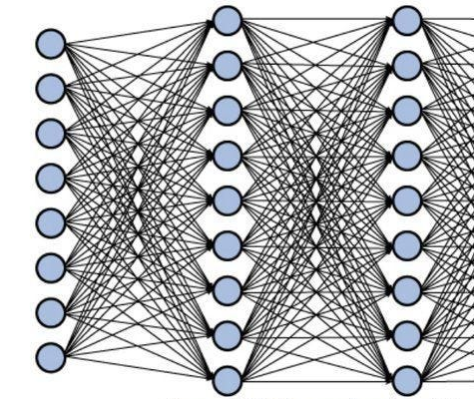
Future work
More complex physical model for morse signal
Harmonies \ Pink Noise \ Spectral Leakage
Deeper Networks !
RESNET152
Bi-directional LSTM, Architecture grid-search

Slide 14
Thank you

