Slide 1

Principles of Programming Languages
Lesson # 1

Slide 2
About lecturer
Dr. Marina Litvak
MSc degree – BGU, CS dept.
PhD degree – BGU, SISE dept.
Research interests (related to final projects):
Information Retrieval: Summarization, Social Networks, Deep Learning

Slide 3
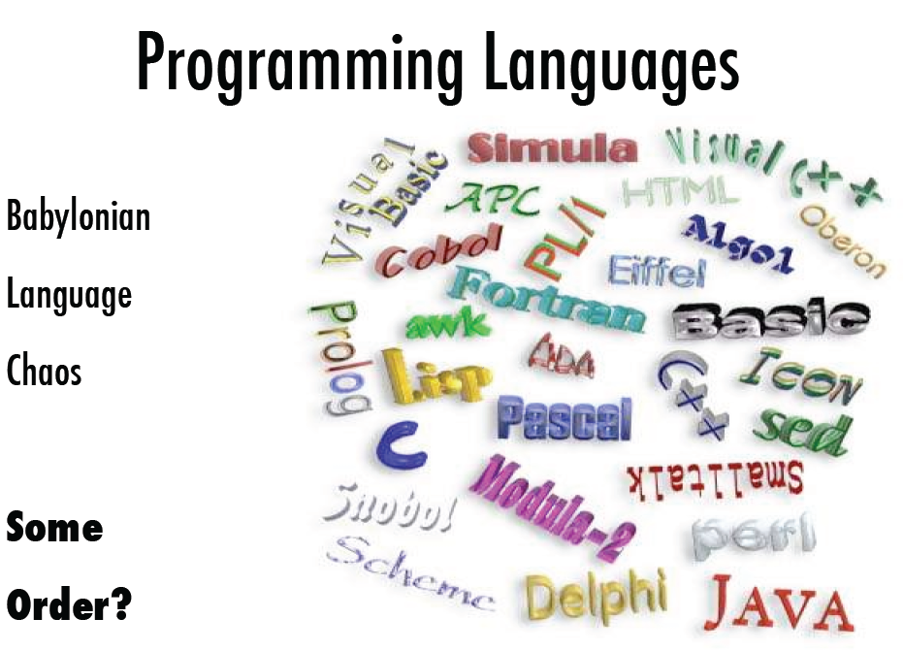

Slide 4
Some recent statistics
https://www.northeastern.edu/graduate/blog/most-popular-programming-languages/
https://towardsdatascience.com/top-10-in-demand-programming-languages-to-learn-in-2020-4462eb7d8d3e
Data Science has a clear preference

Slide 5
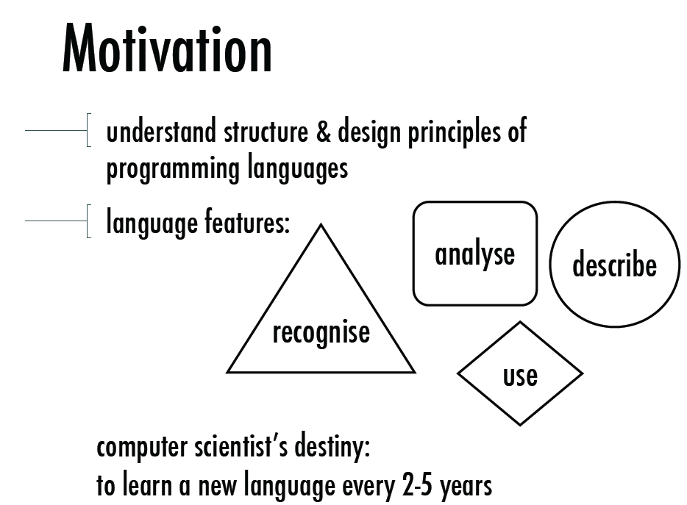

Slide 6
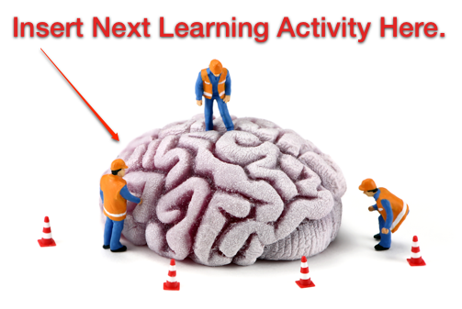
How is programmer’s quality measured?

Slide 7
Syntax - English sentence structure
Subject/predicate:
All sentences are about something or someone – subject
The predicate contains information about the someone or something that is the subject
John often comes late to class.
My friend and I both have a dog named Spot.
?
?
?
?

Slide 8
PLs and NLs are similar but different
Natural Language
Has grammar unit (sentence)
GU has structure (specified by language grammar)
People are smart (?!)
They can understand malformed sentences
Programming Language
Has grammar unit (statement/expression)
GU has structure (specified by language grammar)
Computers are stupid
They must follow unambiguous rules!
https://www.simscale.com/blog/2017/12/nasa-mars-climate-orbiter-metric/

Slide 9
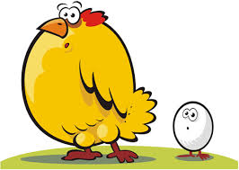
About the course: what is it about?
שפת Python כבסיס להבנה והמחשה של עקרונות שפות תוכנה
Language
Programs
Operations on data
Data
כיצד?
על פי אילו עקרונות?
Language implementation
Translation to executable
Run-time environment

Slide 10
Compiler vs. Interpreter
Compiler
Program that translates the source program to object program in a single run
Object program is used for future use
If the program must be executed again there is no need for retranslation
Interpreter
Program that performs the source program instruction by instruction
Cycle on instructions: translate&execute
No object program is stored for future use
If the program must be executed again it has to retranslate

Slide 11
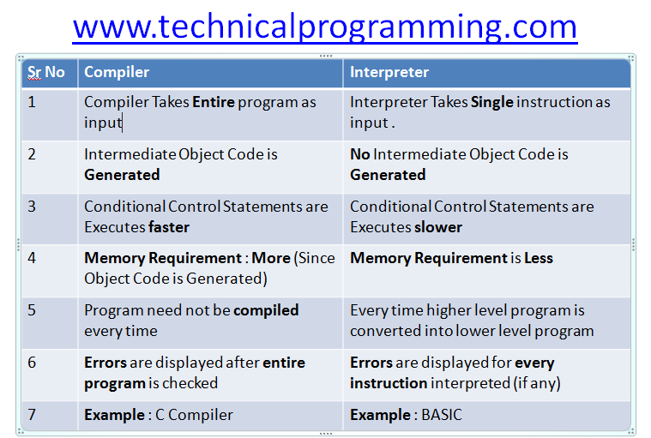

Slide 12
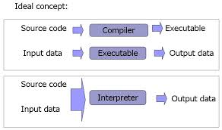
Compiler vs. Interpreter

Slide 13
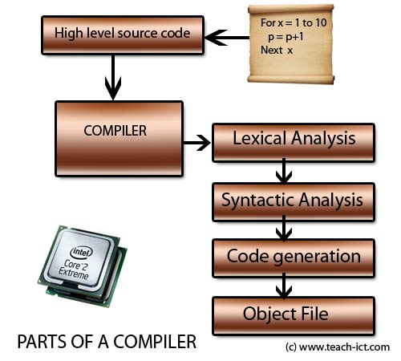
Compiler

Slide 14


From C to Assembler

Slide 15
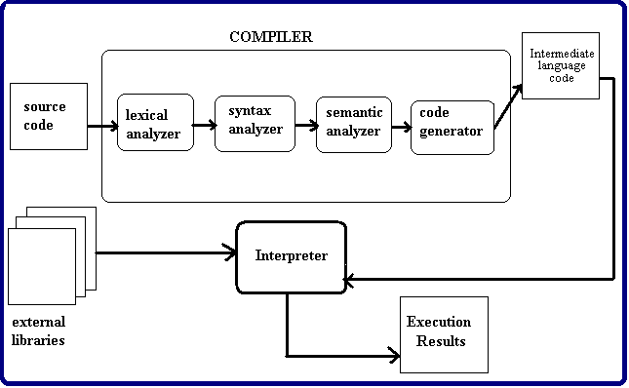
Compiler + Interpreter

Slide 16
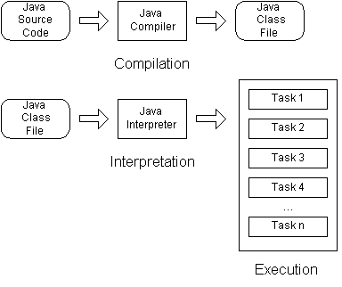

Slide 17
About the course: What we will learn
Principles of programming languages:
The basic elements of programming:
building abstractions with functions and data
How to design your programs sufficiently?
modularity, objects, and state (OOP)
Establishing new languages:
Evaluator/interpreter – is just another program

Slide 18
Interesting facts
What was the first OOP language?
What is the idea behind OOP?
What are generic functions?

Slide 19
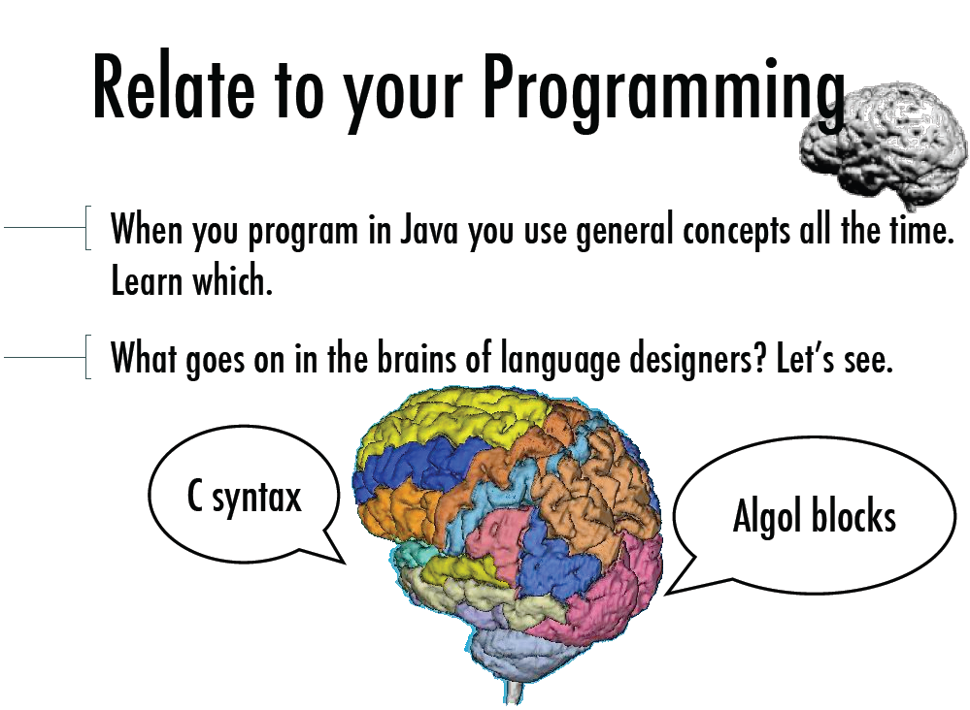

Slide 20
About the course: Main topics
Building Abstractions with Functions (Ch. 1)
The Elements of Programming
Defining Functions
Environment Model
Higher-order functions

Slide 21
About the course: Main topics
Building Abstractions with Objects (Ch. 2)
Data Abstraction
Sequences
Mutable Data
OOP
Goal # 1: Implementing Classes and Objects

Slide 22
About the course: Main topics
The Structure and Interpretation of Computer Programs (Ch. 3)
Memoization and Recursive Data Structures
Exceptions
Goal # 2: Interpreters

Slide 23
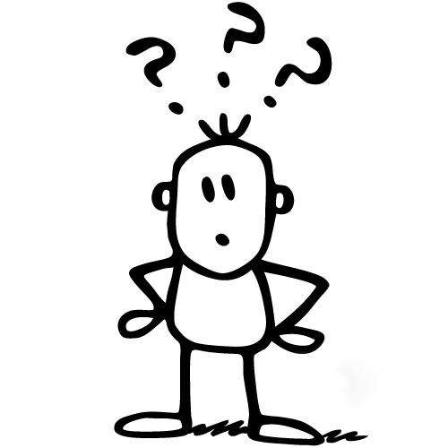
About the course: What it is NOT about
It is NOT about Python!
Python is a TOOL and a MODEL!
We use Python to create a new language which simulates Python

Slide 24
Why Python?
Has simple, unambiguous syntax
Has polymorphic data types (sequences)
Has high-order procedures
Has built-in object system (OO)
Has dynamic memory management
Is efficient and easy to compile
Is useful and very popular

Slide 25
לדוגמה
C++
10% Problem-solving vs 90% Syntax
Python
90% Problem-solving vs 10% Syntax

Slide 26
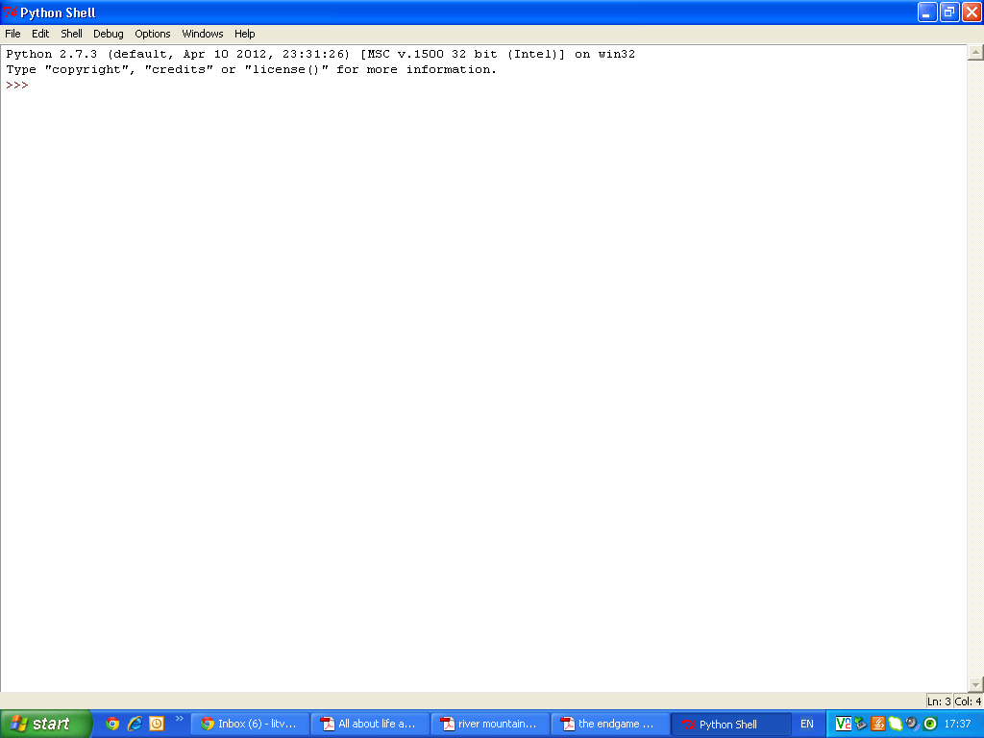
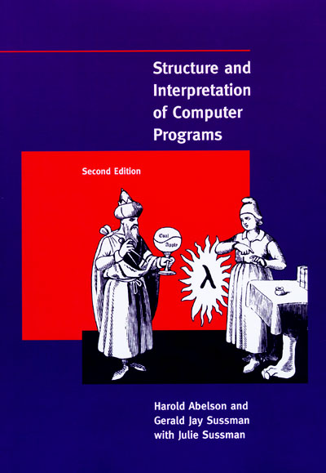
יתרונות נוספים
סביבה נוחה וחופשיה לשימוש
ספר הלימוד באינטרנט - חופשי
http://www.python.org/
http://pydev.org/manual_101_root.html
http://www-inst.eecs.berkeley.edu/~cs61a/sp12/book/
http://getpython3.com/diveintopython3/index.html
Notes:
Turing machine
von Neumann architecture

Slide 27
סיווג שפות תוכנה לפי מודלים (פרדיגמות)
Imperative or Procedural Languages
C, Pascal, Fortran
Applicative or Functional
Scheme, LISP, ML
Object-Oriented
C++, Java, Python, C#
Logical
Prolog
כל שפה מאפשרת לדמות את המודלים תוך יישום עקרונותיהם

Slide 28
שעות קבלה:
יום ב'
12:00-13:00
חדר: קציר G02 ד'
About the course: How will we learn?
הרצאות
3 ש"ש
מבנה הלימודים
מעבדה
2 ש"ש
marinal@ac.sce.ac.il
הערכה
מעבדה - תרגילים
30%
מבחן
70%
IF EXAM >= 56 AND HW >= 56
THEN FINAL = 0.7*EXAM + 0.3*HW
ELSE MIN(EXAM, HW)

Slide 29
שעות קבלה:
יום ה'
13:15-14:15
חדר: קציר G02 ד'
About the course: How will we learn?
הרצאות
3 ש"ש
מבנה הלימודים
מעבדה
2 ש"ש
marinal@ac.sce.ac.il
הערכה
מבחן
40%
מעבדה - תרגילים
30%
בוחן אמצע
25%
נוכחות
5%
IF EXAM >= 56 AND MT >= 56 AND HW >= 56
THEN FINAL = 0.4*EXAM + 0.25*MT + 0.3*HW + 0.05*P
ELSE MIN(EXAM, MT, HW)
; P – presence
(>=80% = 100)

Slide 30
Grading policy
יום איחור בהגשת עבודות בית "עולה" 3% מהציון ☹
שבוע איחור – 20% ☹
אחרי שבוע של איחור עבודה לא תתקבל! ☹
אין ערעורים במקרה של איחור! ☹
מסקנה: יש להגיש עבודות בזמן! ☺

Slide 31
About the course: Why to learn?
Good programmer = Programmer that knows all about the PROGRAMMING and what’s needed about any specific PROGRAMMING LANGUAGE.
You will learn new languages all the time!
You need to be able to adapt your knowledge in programming to a new syntax!
Learn to THINK and APPLY your knowledge

Slide 32
Gantt chart
Introduction, Python, Expressions, etc.
First-Order Functions, Environment
High-Order Functions, Abstractions
Data Abstractions, Pairs, Tuples, Sequences
Conventional Interfaces, Mutable Data
Data-direct programming, Message-Passing
OOP
OOP Implementation
Memoization and Recursive Data Structures
Exceptions
Language Interpreters
HW1
HW2
HW3
HW4

Slide 33
Lab sessions
Week # | Lab subject | HW # | HW subject | Pub. date | Sub. date
1 | Intro: Installing Python, Eclipse, variables, operators, help
2 | First-order functions, docstrings | 1 | 1, 2, 3 | 2/11/17 | 16/11/17
3 | Recursive functions
4 | Environment model
5 | High-order functions, lambda
6 | Immutable data, native types, sequences: tuples, strings, pairs | 2 | 4, 5 | 16/11/17 | 30/11/17
7 | Mutable data
8 | List, Dictionary | 3 | 6, 7, 8 | 7/12/17 | 21/12/17
9 | Class and object; OOP system
10 | Generic Functions
11 | Memoization, Recursive DS | 4 | 9, 10, 11, 12 | 4/01/18 | 20/01/18
12 | Exceptions
13 | Interpreter

Slide 34
Lab sessions
Responsible (labs) | Week # | Lab subject | Comments | HW # | HW subject | Pub. date | Sub. date | Responsible (HWs)
מיכאל | 1 | Intro: Installing Python, PyCharm, variables, operators, help | Only blocks
 | 2 | First-order functions, docstrings | Only functions | 1 | 1-3 | 03/11/22 | 17/11/22 | ינון
 | 3 | Recursive functions | חזרה, כולל סוגים שונים של רקורסיה, ללא שימוש במבני נתונים רקורסיביים
 | 4 | Environment model
ינון | 5 | High-order functions, lambda
 | 6 | Immutable data, native types, sequences: tuples, strings, pairs, rlist, dictionary |  | 2 | 4-5 | 24/11/22 | 08/12/22 | סבטלנה
 | 7 | Conventional Interface
הדר | 8 | חזרה | 2-7 | 3 | 6-7 | 08/12/22 | 22/12/22 | הדר
 | 9 | Class and object; OOP system
 | 10 | Shmython
סבטלנה | 11 | Generic Functions
 | 12 | Memoization, Recursive DS, Exceptions |  | 4 | 9-12 | 22/12/22 | 19/01/23 | מיכאל
 | 13 | Interpreter | calculator + variables

Slide 35

The secret of success המלצות להצלחה
ללמוד במהלך הסמסטר ולא להשאיר ליום האחרון לפני המבחן ☹ ☺← ,
ליצור מילון מונחים עיקריים ולעיין בו כל שבוע  ,
לא להסתמך על הרצאות בלבד, אלא לקרוא את הספרות המומלצת ◻
להשתתף באופן פעיל במעבדה  ולהגיש משימות בזמן
צוות הקורס כאן בשביל שתצליחו!!! ☺

Slide 36
Let’s start…

Slide 37
Computing
Representing information
Specifying logic to process it
Designing abstractions that manage the logic complexity
We need to understand HOW computers interpret programs and perform computational process

Slide 38
Computational Process
Abstract being that manipulates other abstract thing – DATA
Its evolution is directed by a pattern of rules – PROGRAM
People create programs to direct processes
People use programming LANGUAGES to prescribe tasks they want processes to perform

Slide 39
In Python, we distinguish between
Statements&Expressions
Expression – compute and return some value
5 + 3
Statement – perform some action
X = 5 + 3
Calculates sum, returns 8
Assigns X, returns None

Slide 40
In Python, we distinguish between
Expression
Statement
computes and returns some value
5 + 3
performs some action
X = 5 + 3
Calculates sum, returns 8
Assigns X, returns None

Slide 41
First example in Python
Task: return all words from Shakespeare plays that
Long enough (with 5 characters at least)
Their inverses (if read backward) exist in plays
Solution (pipeline):
Read all plays from a web site (given URL)
Recognize and store all words in a container (with which DS?)
Filter out all words that do not satisfy both conditions

Slide 42
First example in Python
Task: read all plays
shakespeare=urlopen(’http://inst.eecs.berkeley.edu/~cs61a/fa11/shakespeare.txt’)
statement
expression

Slide 43
First example in Python
Save all words in a set
Use built-in functions for words retrieval
words = set(shakespeare.read().decode().split())
https://docs.python.org/3/howto/unicode.html

Slide 44
First example in Python
Filter out all “wrong” words
Word = string = object
{w for w in words if len(w) >= 5 and w[::-1] in words}
Notes:
Words lenght 5 or more that their reversed is also in “words”

Slide 45
First example in Python
Interpreters – interprets code in a predictable way (also program!)

Slide 46
Principles of debugging
Test incrementally
Isolate errors
Check your assumptions
Consult others
Notes:
Test incrementally: Every well-written program is composed of small, modular components that can be tested individually. Test everything you write as soon as possible to catch errors early and gain confidence in your components.
Isolate errors: An error in the output of a compound program, expression, or statement can typically be attributed to a particular modular component. When trying to diagnose a problem, trace the error to the smallest fragment of code you can before trying to correct it.
Check your assumptions: Interpreters do carry out your instructions to the letter --- no more and no less. Their output is unexpected when the behavior of some code does not match what the programmer believes (or assumes) that behavior to be. Know your assumptions, then focus your debugging effort on verifying that your assumptions actually hold.
Consult others: You are not alone! If you don’t understand an error message, ask a friend, instructor, or search engine. If you have isolated an error, but can’t figure out how to correct it, ask someone else to take a look. A lot of valuable programming knowledge is shared in the context of team problem solving.

Slide 47
The Elements Of programming Language
In Programming, we deal with two elements:
Data: Things we want to manipulate
Procedures: Rules for manipulating data

Slide 48
The Elements Of programming Language
Primitive Expressions and statements
Compound expressions/combinations
Abstracting expressions
Notes:
primitive expressions and statements, which represent the simplest building blocks that the language
provides,
• means of combination, by which compound elements are built from simpler ones, and
• means of abstraction, by which compound elements can be named and manipulated as units.

Slide 49
Expression (in Python)
Constant expressions (numbers)
are self-evaluating – the value of a constant is itself
Examples:
> >>56
56
>>> -1
-1

Slide 50
Compound expressions (or Combinations)
Are expressions made of other, simpler expressions
infix notation (<exp₁> <op> <exp₂>)
Example:
operand
operator
operand
> -1 - -1
0
> 1/2 + 1/4 + 1/8 + 1/16 + 1/32 + 1/64 + 1/128
0.9921875

Slide 51
Call Expressions
The most important kind of compound expression
Applies a function to some arguments:
the function max is called with arguments 7.5 and 9.5, and
returns a value of 9.5
>>> max(7.5, 9.5)
9.5
>>> pow(100, 2)
10000
>>> pow(2, 100)
1267650600228229401496703205376
The order of the arguments in a call expression matters

Slide 52
Call Expressions
Function notation <> infix notation
Advantages:
Functions may take an arbitrary number of arguments (no ambiguity!):
Extends in a straightforward way to nested expressions, where the elements are themselves compound expressions:
>>> max(1, -2, 3, -4)
3
>>> max(min(1, -2), min(pow(3, 5), -4))
-2
The structure
of the nesting is entirely explicit in the parentheses!

Slide 53
Call Expressions
Math operator can be replaced by a call expression
The math module provides a variety of familiar mathematical functions:
The operator module provides access to functions corresponding to infix operators:
>>> from math import sqrt, exp
>>> sqrt(256)
16.0
>>> exp(1)
2.718281828459045
>>> from operator import add, sub, mul
>>> add(14, 28)
42
>>> sub(100, mul(7, add(8, 4)))
16
Import statement: from <module> import <attr₁>, …, <attr_{n}>

Slide 54
Abstraction - Naming and Environment
The name identifies a variable whose value is the object (name binds to the value)

Slide 55
השמה Assignment
במתמטיקה משפט השמה מייחס לסמל מסוים את ערכו
x = 3
symbol
value

Slide 56
New bindings using the assignment statement:
Names are also bound via import statements:
Assignment of multiple values to multiple names in a single statement:
>>> radius = 10
>>> radius
10
>>> 2 * radius
20
>>> from math import pi
>>> pi * 71 / 223
1.0002380197528042
>>> area, circumference = pi * radius * radius, 2 * pi * radius
>>> area
314.1592653589793
>>> circumference
62.83185307179586

Slide 57
Environment
The interpreter maintains some sort of memory that keeps track of the names, values, and bindings – environment.
Names can also be bound to functions:
Give new names to existing functions by assignment:
Rebind a name to a new value:
>>> max
<built-in function max>
>>> f = max
>>> f
<built-in function max>
>>> f(3, 4)
4
variable name
>>> f = 2
>>> f
2

Slide 58
Evaluation
Using Java
We compile a program
We link a program
We invoke the JVM to run the program

Slide 59
Evaluation
Using Python:
displays a prompt to ask us for expressions
evaluates these expressions automatically
prints the value of the expression
goes back to (1)
This sequence of operation is called the Read-Evaluate-Print loop.

Slide 60
read-eval-print loop
המפרש פועל לפי הסדר:
Read
Evaluate
Print

Slide 61
Evaluation Nested Expressions
The value of a constant is itself.
The value of a variable ... is complicated. You need to look up the variable like a name is looked up in a phone book. Environment!
The value of a compound expressions is a combination of the values of its sub-expressions.

Slide 62
כללי הערכה של הרכבות
To evaluate a call expression, Python will do the following:
Evaluate the operator and operand subexpressions, then
Apply the function that is the value of the operator subexpression to the arguments that are the values of the operand subexpressions.
Recursive procedure!

Slide 63
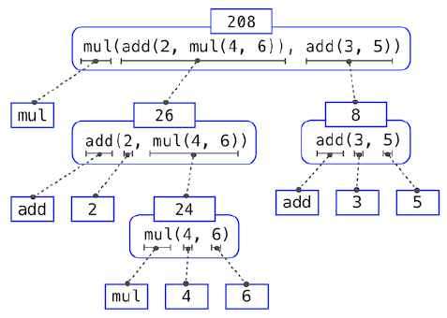
דוגמה להערכה של הרכבה
mul(add(2, mul(4, 6)), add(3, 5))
mul(add(2, mul(4, 6)), 8)
mul(add(2, 24), 8)
mul(26, 8)
208

