Slide 1
Principles of Programming Languages
Lesson 4
Data Abstraction

Slide 2
סקירה
מה זה אלמנט מסדר ראשון (first class element)?
מה היא פונקציה מסדר גבוה (high-order fun.)? האם היא אלמנט מסדר ראשון?
מה הוא תחום לקסיקאלי (lexical scope)?
מה אלטרנטיבה לתחום לקסיקאלי?
איך מודל סביבות מאפשר תחום לקסיקאלי?
מה זה lambda?

Slide 3
Data vs. Functions
What is a difference?
Functions
Used as a data
Data
Has behavior
We used functions as a data
We will build data from functions ?!

Slide 4
The Object Metaphor
documents, relationships, cities, etc.
Real-world phenomena have complex structure - compound data types.
Objects = information, but also behave
like the abstract concepts that they represent
The object metaphor is implemented in Python through specialized object syntax and associated terminology

Slide 5
Example
A date is a kind of simple object.
>>> from datetime import date
>>> today = date(2020, 11, 17)
>>> str(date(2018, 11, 17) - today)
'-731 days, 0:00:00'
class
instance
constructor

Slide 6
The Object Metaphor in Python
Objects have attributes
Python’s dot notation:
<expression> . <name>
Attribute names are not available in the general environment:
>>> today.year
2018
object
attribute

Slide 7
The Object Metaphor in Python
Objects also have methods
Results are depend from both their arguments and the object’s local state:
>>> today.strftime(’%A, %B %d’)
'Tuesday, November 13'

Slide 8

Native Data Types
Every object in Python has a type.
>>> type(today)
< class 'datetime.date'>
>>> type(date.strftime)
<class 'method_descriptor'>
>>> type(date)
<class 'type'>
>>> type(type)
<class 'type'>
Python built-in primitive or native data types
Details will be studied in the lab sessions

Slide 9

Data Abstraction
Most of things have compound structure
Example: date has year, a month, and a day
To represent date in programming language = capacity to create a compound data value
Data abstraction is a methodology of isolating how a compound data object is used from the details of how it is constructed.

Slide 10
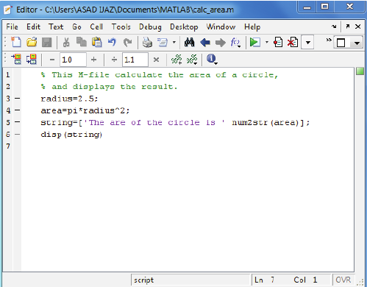
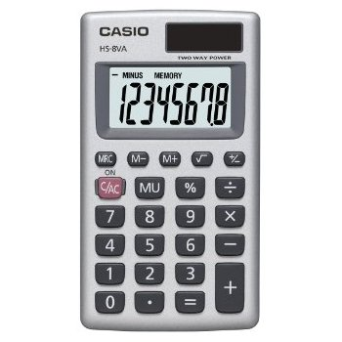
Think about …
Writing a program that operates numbers
do you need to know HOW are they implemented?
Implementing numbers
do you need to know HOW programs will use them?
How to combine?
Interface/API

Slide 11
Our goal
Interface for Rational Numbers

Slide 12
Example: Arithmetic on Rational Numbers
<numerator>/<denominator>
>>> 1/3
0.3333333333333333
>>> 1/3 == 0.333333333333333300000 # Beware of approximations
True

Slide 13
Beware of approximations
>>> 1/3 == 0.3333333333333333
True
>>> 1/3 == 0.3333333333333333333333
True
>>> 1/3 == 0.3333333333333333000000
True
>>> 1/3 == 0.33333333333333
False

Slide 14

Implementation
wishful thinking
Assume that the constructor and selectors are available:
make_rat(n, d) returns the rational number with numerator n and denominator d.
numer(x) returns the numerator of the rational number x.
denom(x) returns the denominator of the rational number x.

Slide 15
Implementation
We could then add, multiply, and test equality of rational numbers by calling:
>>> def add_rat(x, y):
nx, dx = numer(x), denom(x)
ny, dy = numer(y), denom(y)
return make_rat(nx * dy + ny * dx, dx * dy)
>>> def mul_rat(x, y):
return make_rat(numer(x) * numer(y), denom(x) * denom(y))
>>> def eq_rat(x, y):
return numer(x) * denom(y) == numer(y) * denom(x)

Slide 16

Implementation
We need to glue together a numerator and a denominator into a unit
How?
first attempt: We’ll use a built-in data type - tuple

Slide 17
Tuple = Sequence/Array
>>> (1, 2, 3)
(1, 2, 3)
>>> pair = (1, 2)
>>> pair
(1, 2)

Slide 18
Unpacking
Multiple assignment
>>> pair = (1, 2)
>>> pair
(1, 2)
>>> x, y = pair
>>> x
1
>>> y
2
By index
>>> pair[0]
1
>>> from operator import getitem
>>> getitem(pair, 0)
1
>>> pair[1]
2

Slide 19
Representing Rational Numbers
Implementation of constructor and selectors by manipulating 2-element tuples:
>>> def make_rat(n, d):
return (n, d)
>>> def numer(x):
return getitem(x, 0)
>>> def denom(x):
return getitem(x, 1)
return n,d SAME!
return x[0] SAME!

Slide 20
Printing rational numbers using our implementation
>>> def str_rat(x):
"""Return a string ’n/d’ for numerator n and denominator d."""
return ’{0}/{1}’.format(numer(x), denom(x))
return ’{0}/{1}’.format(x[0], x[1])
Violation
הפרה להפשטת נתונים
Notes:
A function for printing rational numbers completes our implementation of this abstract data type.

Slide 21

Manipulation of rational numbers using our implementation
>>> half = make_rat(1, 2)
>>> str_rat(half)
’1/2’
>>> third = make_rat(1, 3)
>>> str_rat(mul_rat(half, third))
’1/6’
>>> str_rat(add_rat(third, third))
’6/9’

Slide 22

Improving of division operation
// expresses integer division, which rounds down the fractional part of the result of division
>>> 1//2
0
>>> from fractions import gcd
>>> def make_rat(n, d):
g = gcd(n, d)
return (n//g, d//g)
Now we have
>>> str_rat(add_rat(third, third))
’2/3’

Slide 23


Abstraction Barriers
The underlying idea of data abstraction:
For each data type:
to identify a basic set of operations for manipulating of values of that type, and then
to use only those operations in manipulating the data

Slide 24
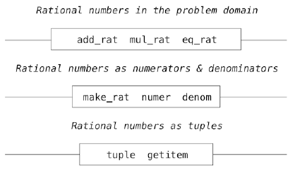

The structure of the rational number system as a series of layers
Implementation of whatever using rational numbers
???
Abstraction
barrier
API
Implementation of arithmetic operations on rational numbers
Abstraction
barrier
API
Implementation of rational numbers
Abstraction
barrier
API
We will replace it by our own type!!!
???
Implementation of tuple

Slide 25
Abstraction Barriers
tuples enable the implementation of the selectors and constructor
how tuples are implemented is irrelevant to the rest of the layers
Abstraction barriers are expressed as sets of functions = interface, depend upon
the representation above them (their use)
the implementation below them (their definitions)

Slide 26
Advantages
Makes programs much easier to maintain and to modify
fewer functions that depend on a particular representation => fewer changes are required when one wants to change that representation
Easy to extend
Easy to integrate

Slide 27
The Properties of Data
We need to guarantee the right behavior:
x = make_rat(n,d) numer(x)/denom(x) = n/d.
x is constructed from n and d
valid representation

Slide 28

Pairs Implementation
We needed a form of glue for two integers, which had the following behaviour:
IF p = pair (x, y) THEN
getitem_pair(p, 0) = x,
getitem_pair(p, 1) = y

Slide 29

Implementation of make_pair
>>> def make_pair(x, y):
"""Return a function that behaves like a pair."""
def dispatch(m):
if m == 0:
return x
elif m == 1:
return y
return dispatch
We use environment as a container! Function that was defined in the same environment as x and y has an access to them!!!

Slide 30
Implementation of getitem_pair
>>> def getitem_pair(p, i):
"""Return the element at index i of pair p."""
return p(i)
Function dispatch has an access to bindings of x and y !!!

Slide 31
Creation and manipulation of pairs
>>> p = make_pair(1, 2)
>>> getitem_pair(p, 0)
1
>>> getitem_pair(p, 1)
2

Slide 32
Important point
Returned value of make_pair – function called dispatch
takes an argument m (0 or 1) and returns either x or y.
getitem_pair calls this function to retrieve the appropriate value
The ability to manipulate functions as values automatically provides us the ability to represent compound data

Slide 33
Dig deeper
First attempt to glue two number together was to use a tuple
Second attempt (alternative)?
How to implement?
Do it at home!
Rational number as a pair – implement!

