Slide 1
Graphor

Slide 2
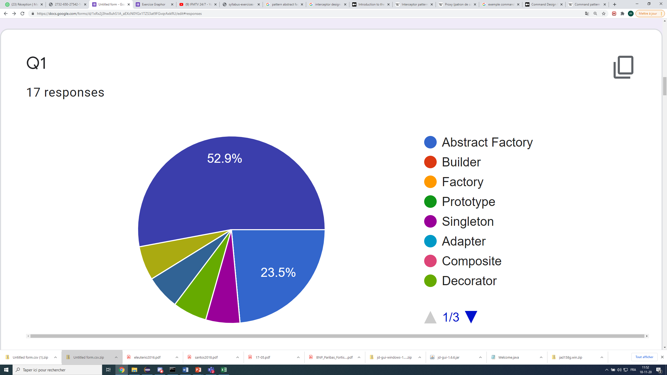
Observer
Strategy
Abstract Factory
Configuration
Decorateur
Singleton

Slide 3
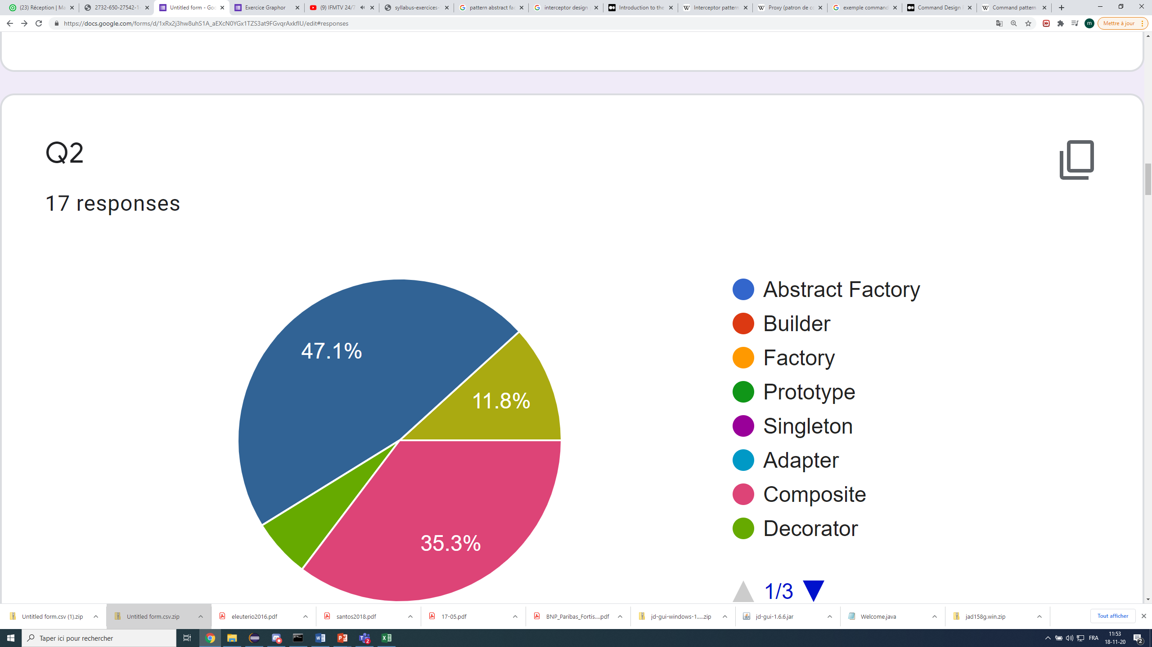
configuration
Strategy
composite
Decorateur

Slide 4
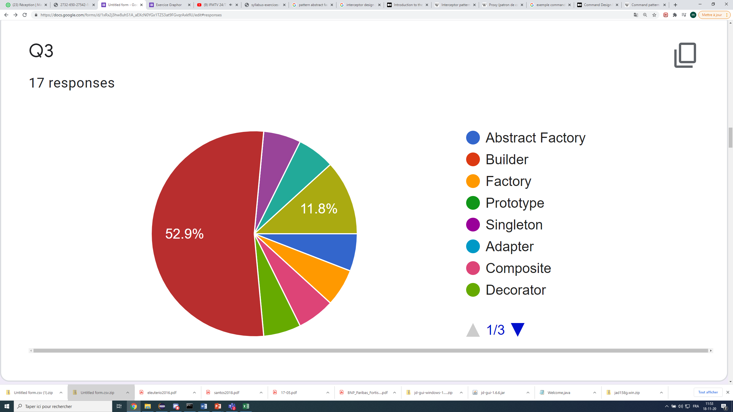
Player role
State
Strategy
Proxy
Abstract-factory
Factory
Decorateur
composite

Slide 5
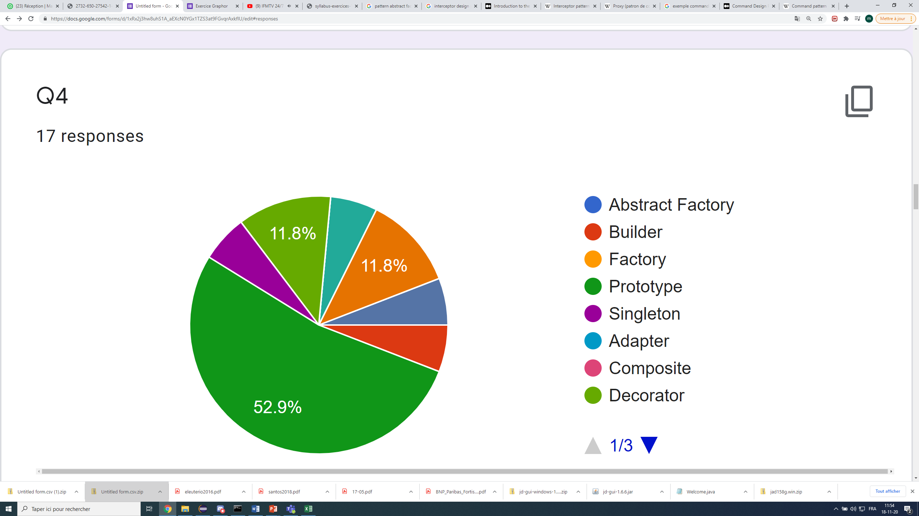
Decorateur
State
Interceptor
Singleton
Memento
Builder
prototype

Slide 6
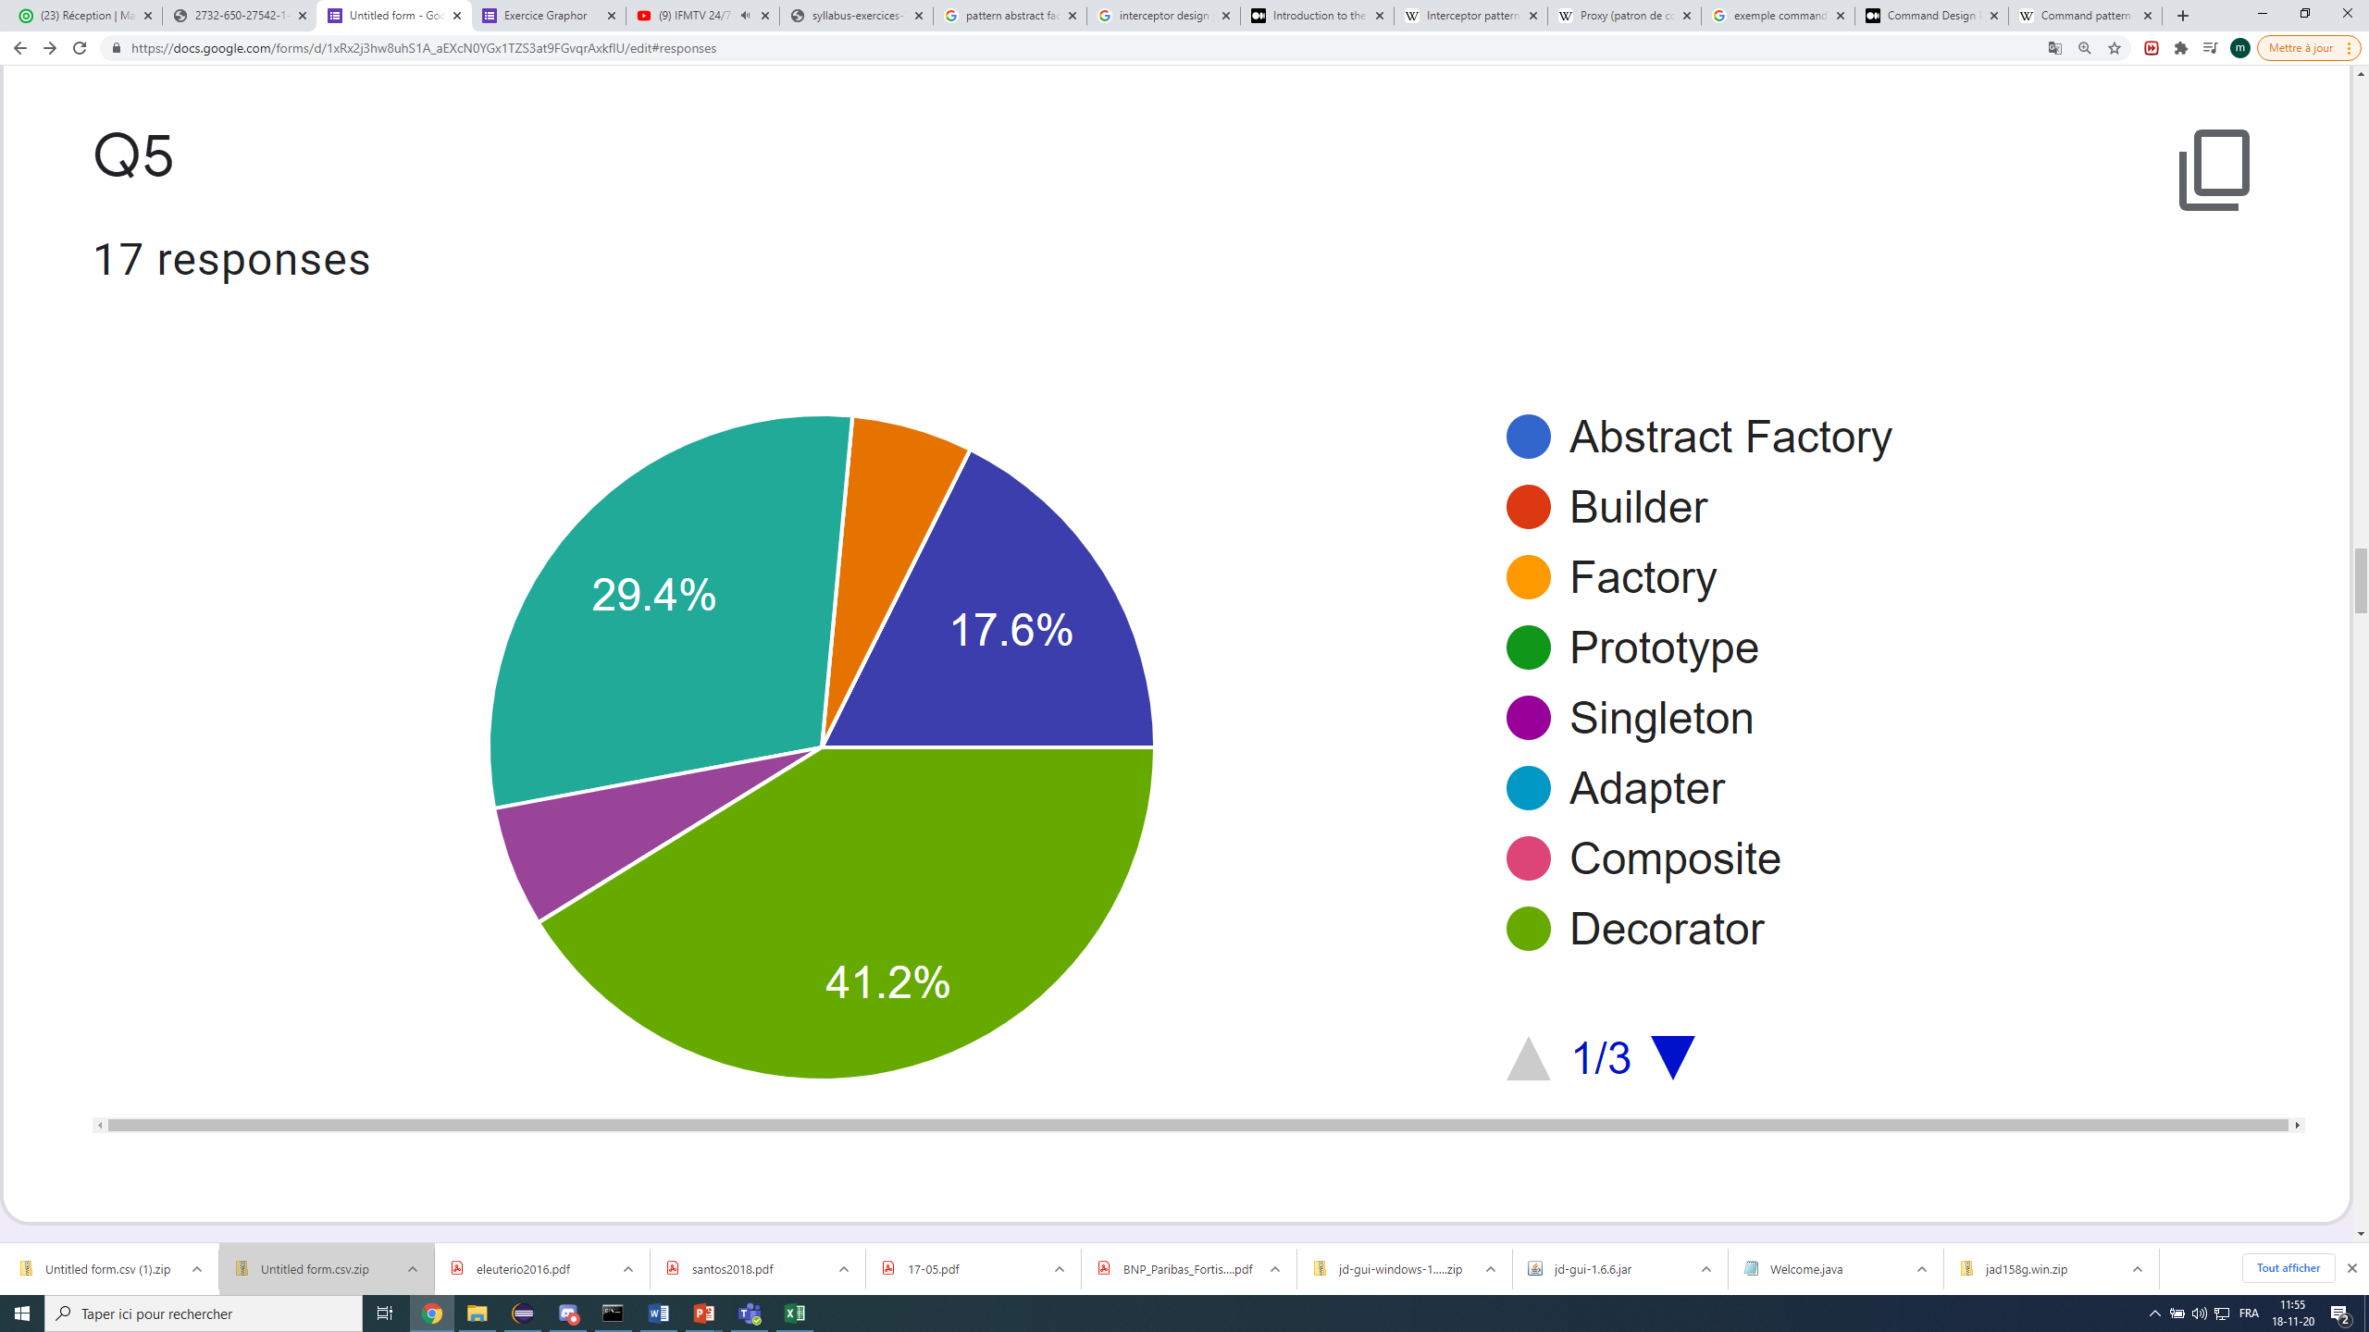
Interceptor
Configuration
State
Player role
Decorateur

Slide 7
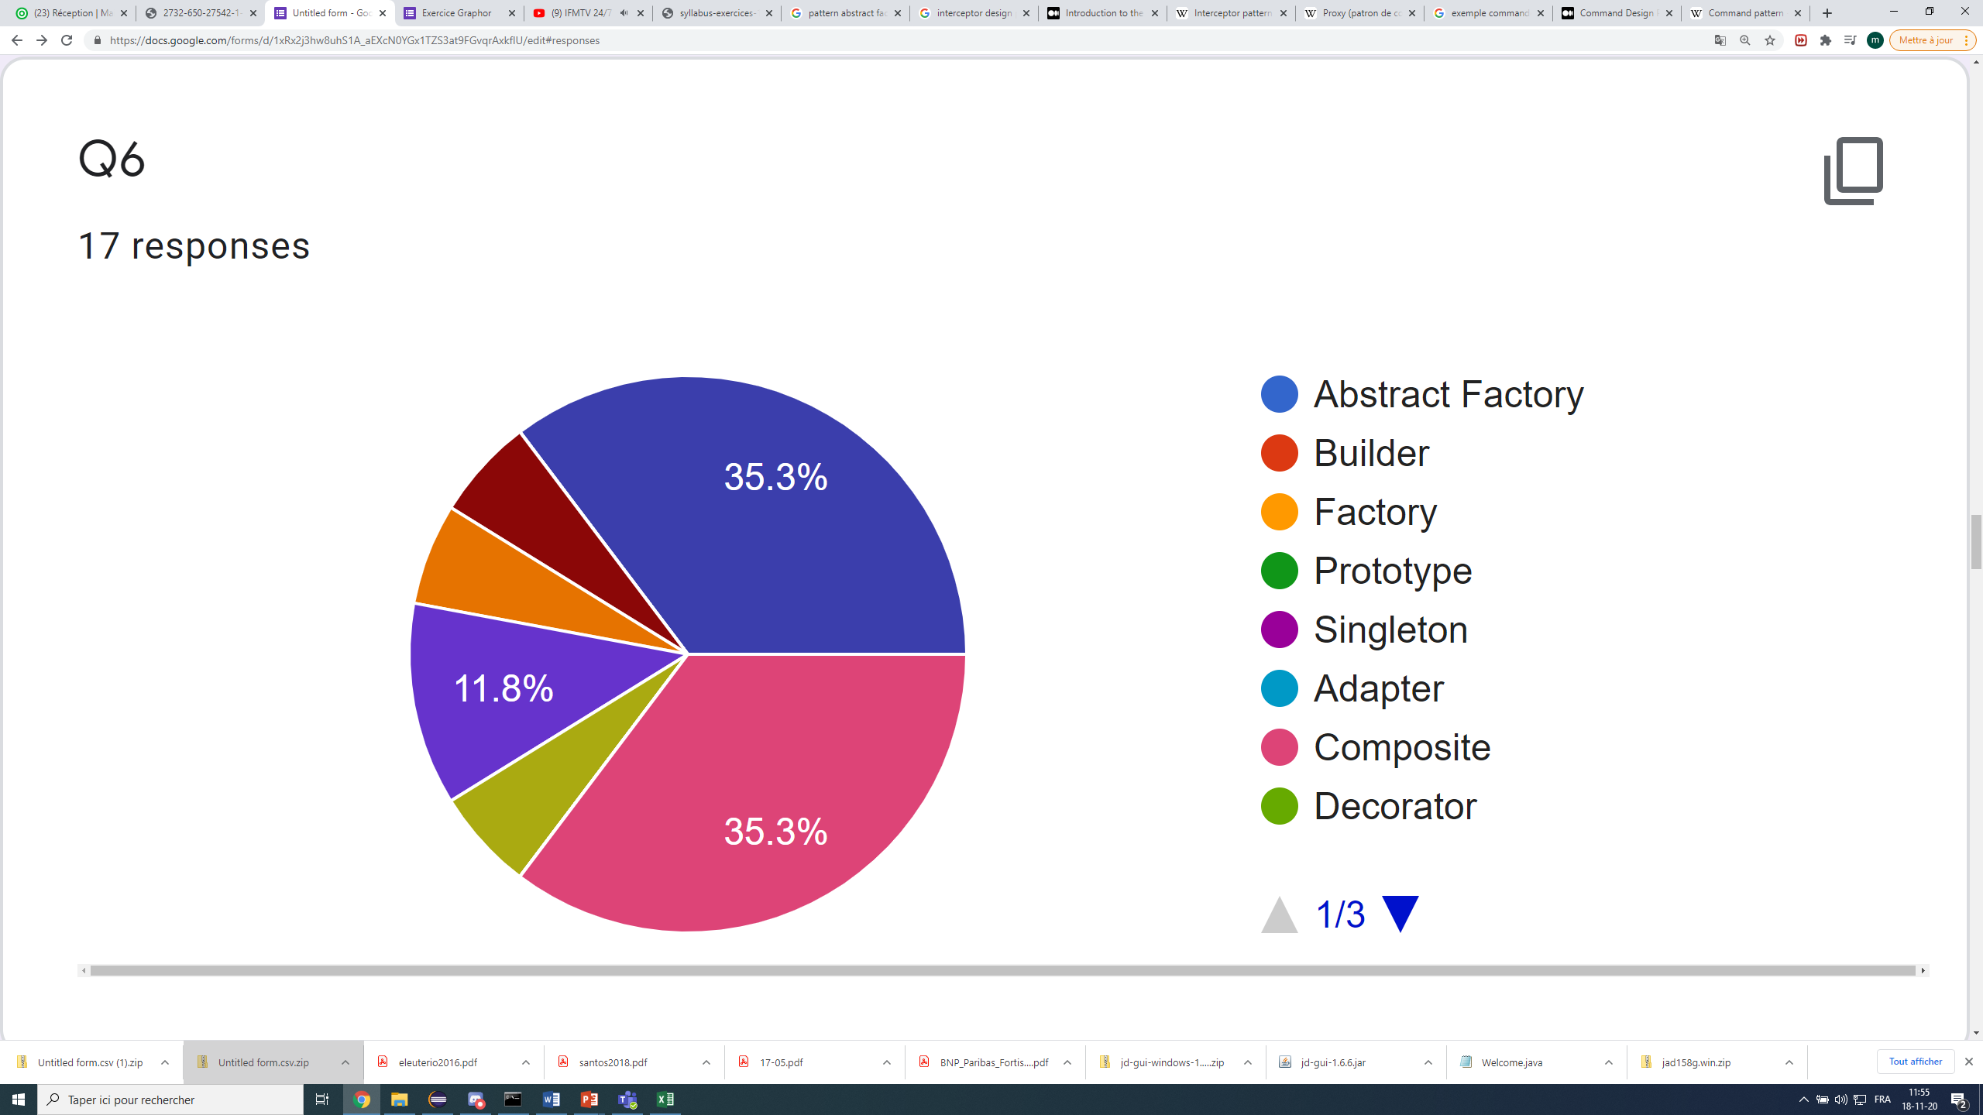
Observer
Command
Interceptor
Visitor
composite
Strategy

Slide 8
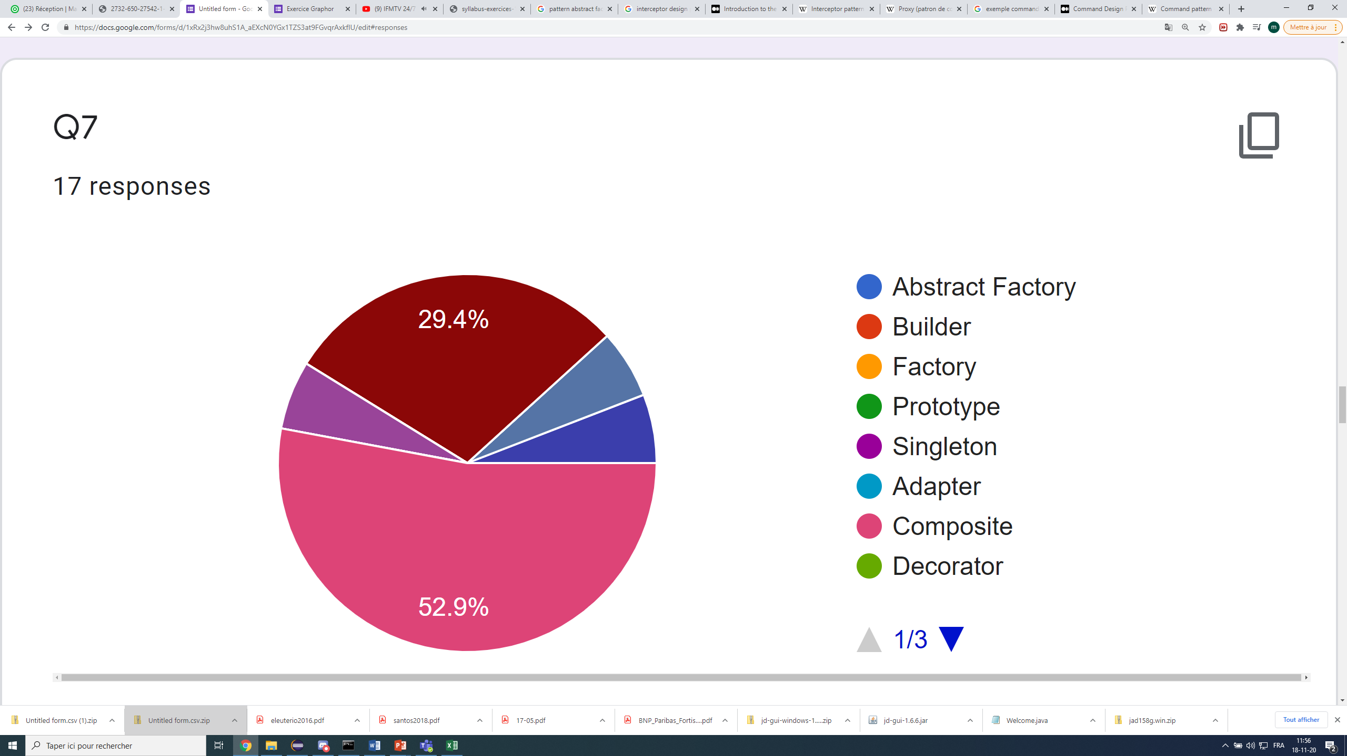
Command
Memento
Player role
Visitor
Composite

Slide 9
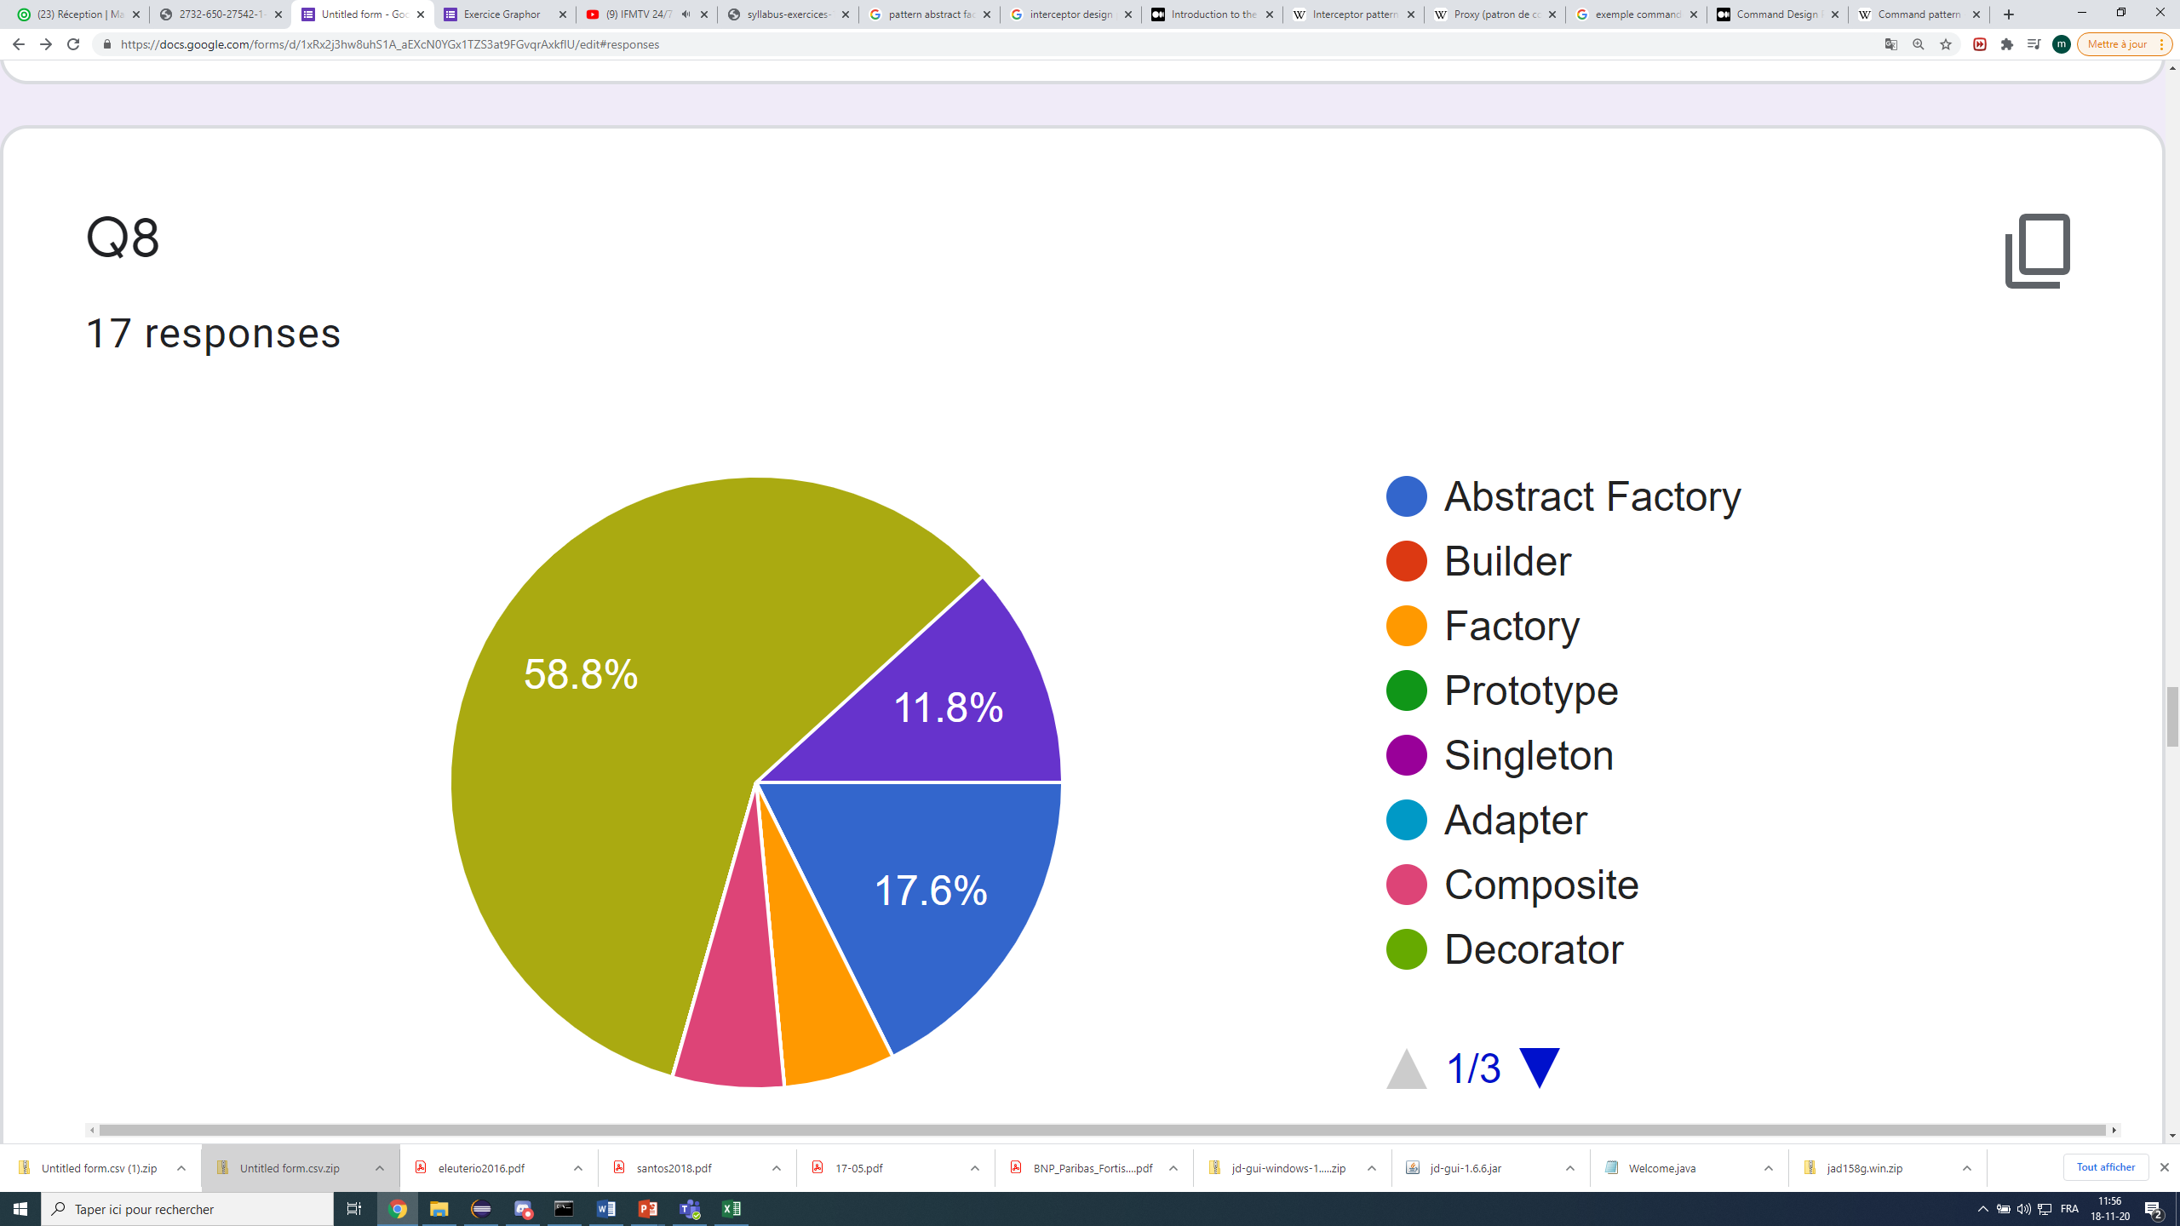
Strategy
Visitor
Abstract factorty
Composite
Factory

Slide 10
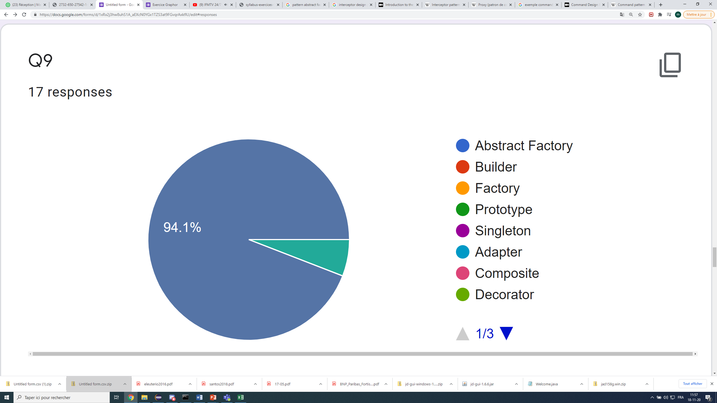
Memento
State

Slide 11
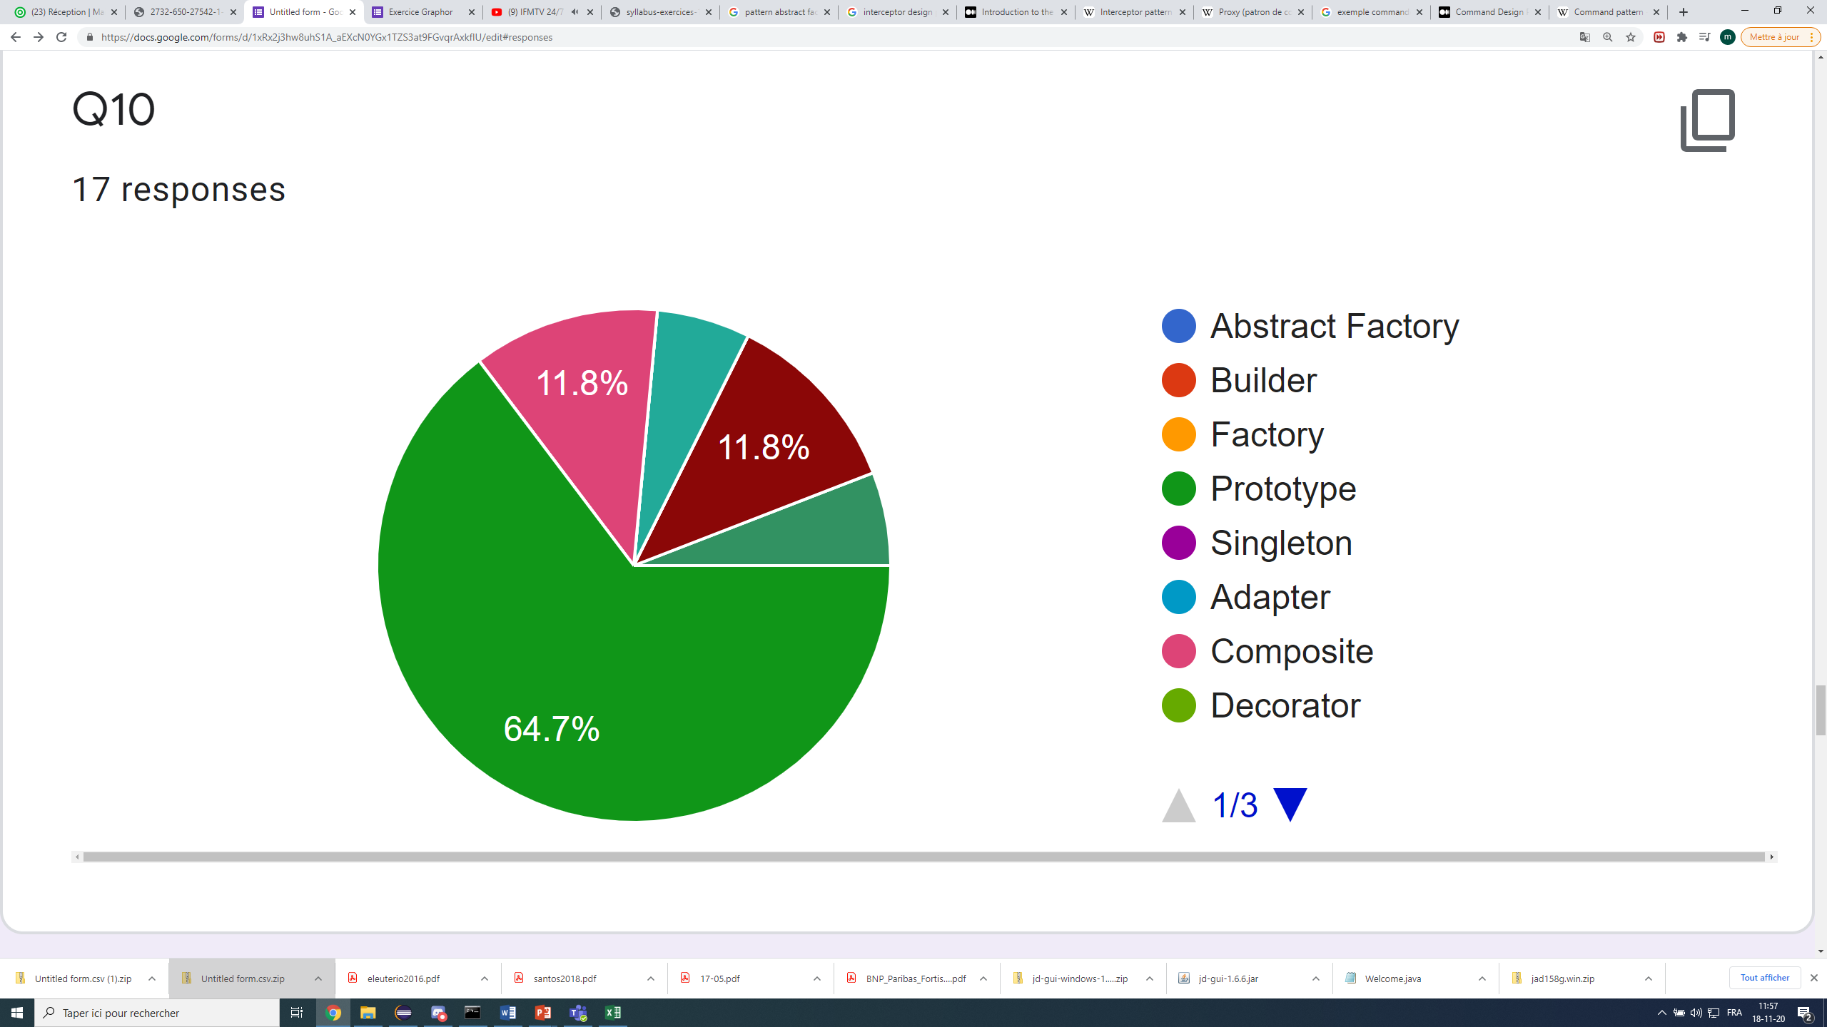
State
Composite
Command
Prototype
Mediator

Slide 12
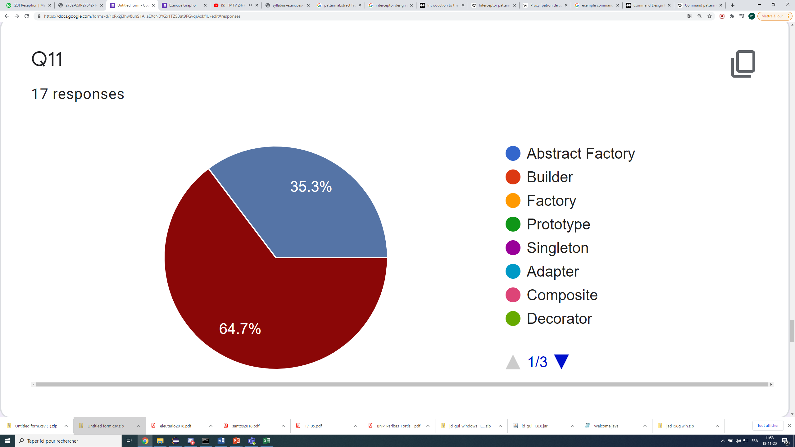
Memento
Command

Slide 13
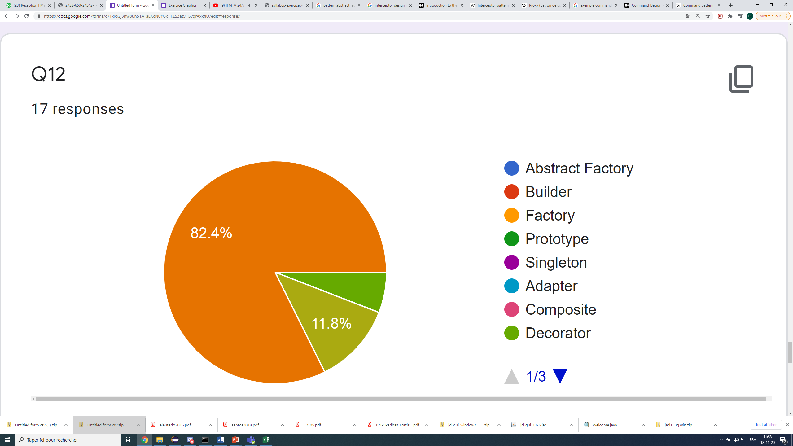
Interceptor
Decorator
Strategy

Slide 14
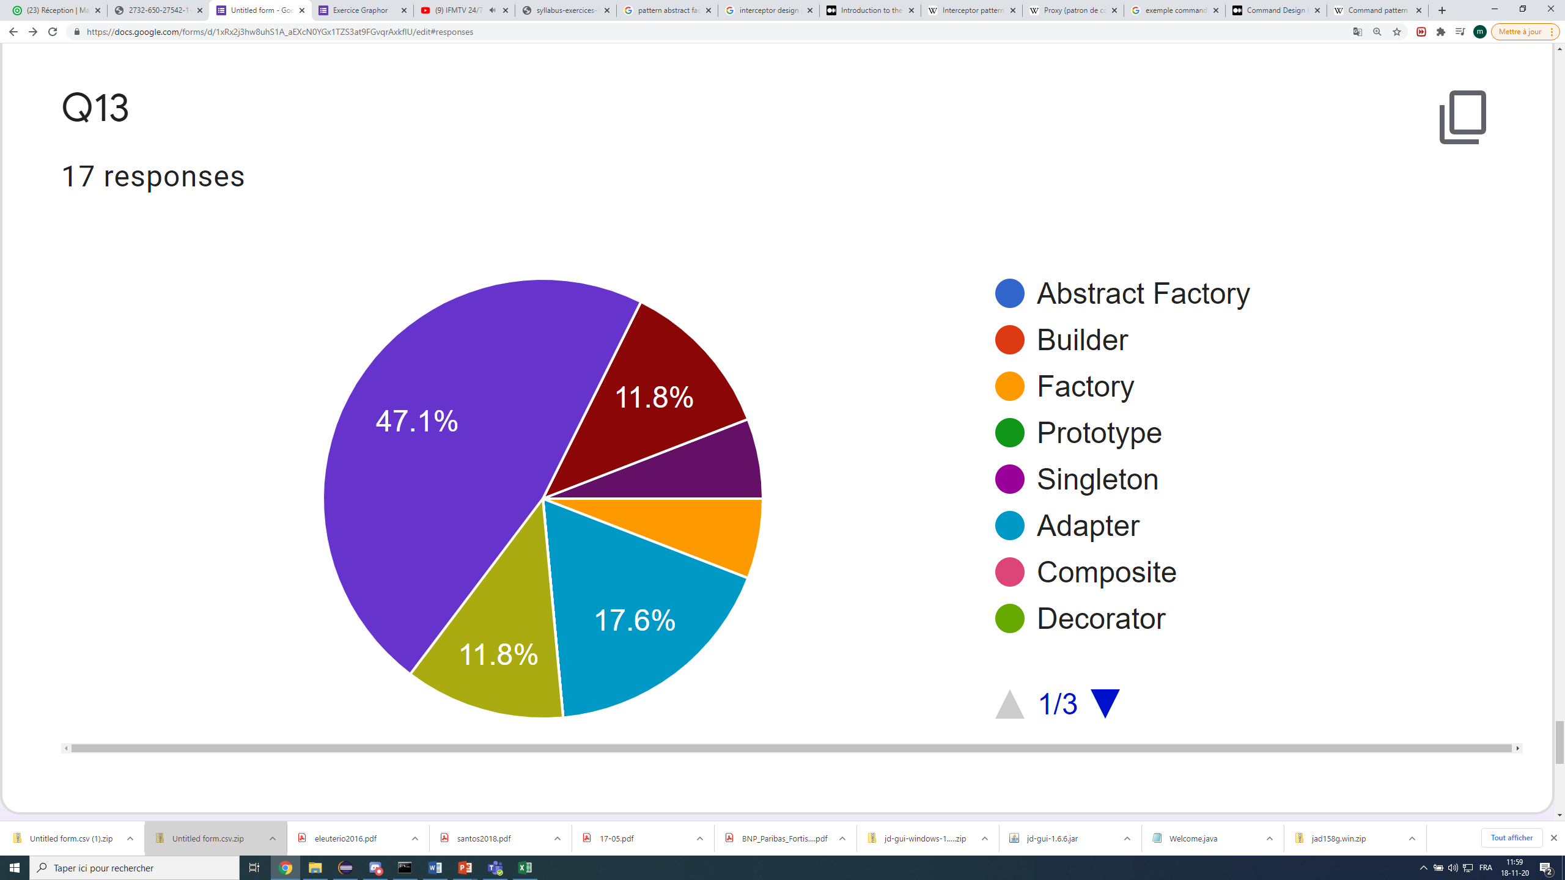
Command
Visitor
Interpreter
Factory
Adapter
Strategy

Slide 15
