Slide 1

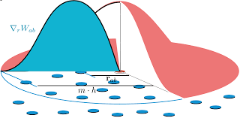
Presentation by
Two-scale particle simulation using SPH
MAOUCHE Mounir
mounir.maouche@etu.sorbonne-univeriste.fr
SU M1 IMA
21315128
23/04/2024

Slide 2
Contents
Aim of the paper
Our implementation
Results

Slide 3
Context
SPH:
A computational method for simulating fluids
Based on neighbour search to calculate the properties of each particle
Problem
Accuracy depends on the number of particles in the simulation
Big computational costs !

Slide 4
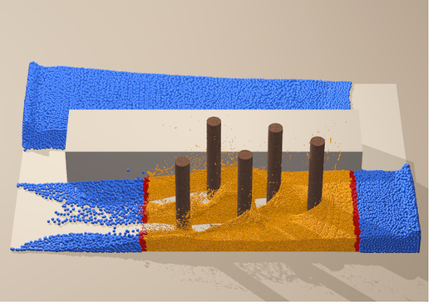
Intuition
Allocate more computing resources where accuracy is needed

Slide 5
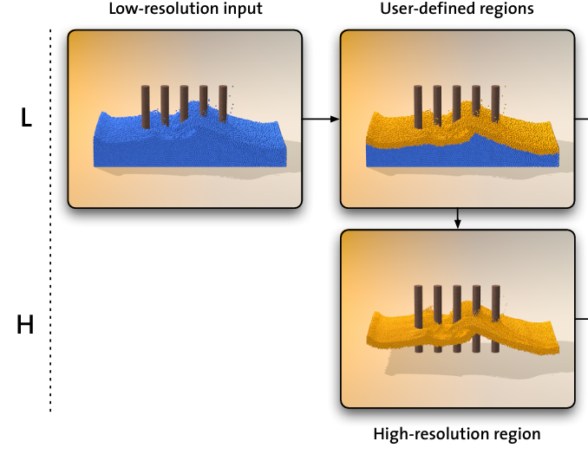
Solution (Solenthaler & Gross)
Two-scale SPH simulations
Define a region of interest
Compute a basic resolution simulation for all the particles
Compute a high resolution simulation for the region of interest
Merge the two simulations

Slide 6
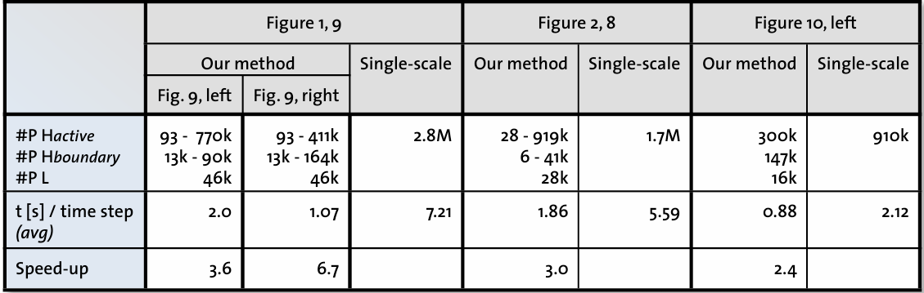
Solution (Solenthaler & Gross)
Results show effective time reduction using this method compared to simple scale resolution

Slide 7
Implementation
Difficulties of some of the studied methods lie in the fact that they don’t reproduce exactly the physical phenomenon.
We adopt a slightly different approach while still applying a two-scale method: instead of altering the particles, we alter the rendering by displaying only a certain amount of the particles outside of the interest area while still computing them.
That way, we preserve the integrity of the dynamic model while gaining computational time.
Notes:
Those difficulties are in [Solenthaler & Gross, 2011] and [Adams et al. 2007] when splitting and merging particles and comparing particles of different sizes

Slide 8
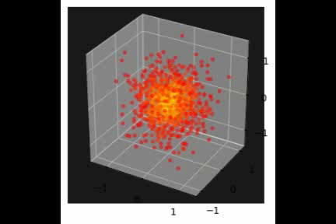
Implementation
Our implementation represents a star simulation evolving into a stable state, based on a work by P. Mocz

Slide 9
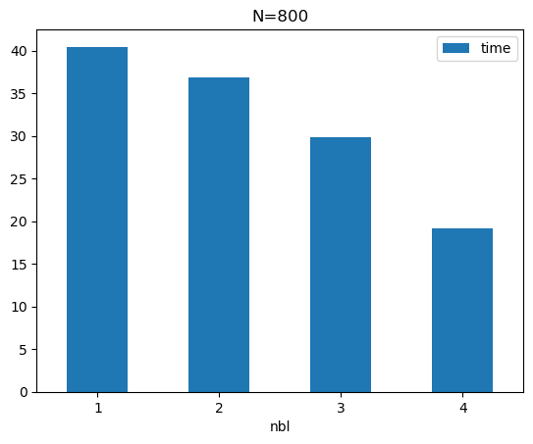
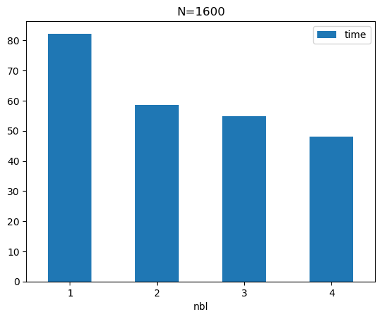
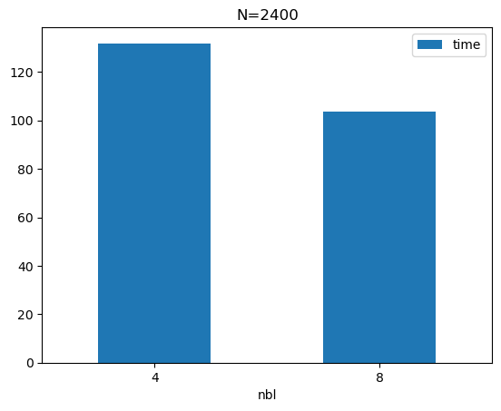
Results
Our implementation shows improvement in computation time compared to coarse simulation
Notes:
Here we can see that the two-scale resolution has allowed more efficiency as the computing time is clearly lowering as we raise the resolution coefficient, from 1, corresponding to the basic one scale simulation, to 8, which means that only ⅛ of the particles outside the interest zone will be rendered.
Plus, this technique allowed us to compute more complex simulations as the 2400 particles mark was not reachable before.

