Slide 1

Code of Gotham

Slide 2
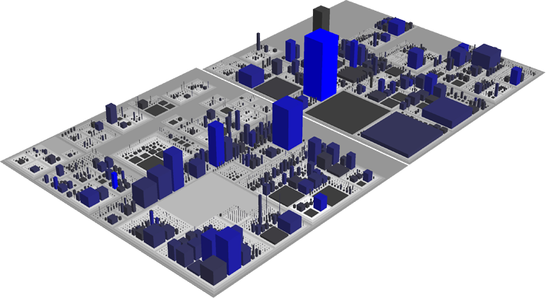
The Idea
Visualize Software as a City.
Code City: http://www.inf.usi.ch/phd/wettel/codecity.html Written in SmallTalk Painful to analyze Java code Last update: 13 June 2011
Code City in Java using Sonar Metrics

Slide 3




Code of Gotham
> mvn sonar:sonar
REST
Your Fancy Project
Code of Gotham
?

Slide 4
Code of Gotham
SonarService: Gets packages, classes and metrics from sonar rest api.
LayoutSolver: Calculates placement of neighborhoods and houses.
CityBuilder: Visualizes the city in 3D.
Class (House)
Lines of Code
Package (Neighborhood)
# Functions

Slide 5

Demo
Public Sonar Service: http://nemo.sonarqube.org/
Source Code on GitHub: https://github.com/canoo/code-of-gotham

