Slide 1
PKES Software-Projekt 1
Counterwechsel bei Tastendurck

Slide 2
Counterwechsel bei Tastendurck
C :
  LEDs ansteuern
Assembler :
  Tasten auswerten

Slide 3
Kurzeinführung Assembler
Intex Syntax
mov eax,1
mov ebx,0ffh
int 80h
AT&T Syntax
movl $1,%eax
movl $0xff,%ebx
int $0x80

Slide 4
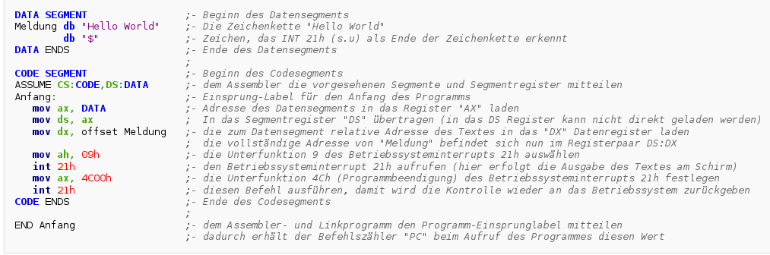
Programmaufbau
Quelle: http://de.wikipedia.org/wiki/Assemblersprache

Slide 5
1_let_there_be_light.S
#define __SFR_OFFSET 0
#include "avr/io.h"
.global main
main:
ldi r16, 0xFF
out DDRB, r16
out PORTB, r16
loop:
rjmp loop

Slide 6
2_counter.S
#define __SFR_OFFSET 0
#include "avr/io.h"
#define temp r16 // .dec
#define time r17 // .dec
.global main
main:
ldi temp, 0xFF
out DDRB, temp
loop:
rcall pause
rcall led_switch
rjmp loop
; toggle led light ...
led_switch:
sbi PINB, 7
ret
pause:
ldi time, 0xFF
pause_run:
dec time
cpse time1, r0
rcall pause_run
ret

Slide 7
3_timer.S
#define __SFR_OFFSET 0
#include "avr/io.h"
#define temp r16
.global main
main:
ldi temp, 0xFF
out DDRB, temp
; set prescaler to 1024
ldi temp, 0b00000101
out TCCR0B, temp
loop:
rcall led_switch
rcall pause
rjmp loop
led_switch:
sbi PINB, 7 ; FLIP THE 7 BIT
ret
pause:
; wait timer overrun
in temp, TIFR0
andi temp, 0b00000010
breq pause ; branch if equal
ldi temp, 0b00000010 ; reset flag
out TIFR0, temp
ret

Slide 8
Wichtige Befehle
LDI/LDS
SBIC/SBIS
DEC/INC
JMP/RJMP
MOV
TST/CPI
OR/ORI
IN/OUT
RCALL
BRNE/BREQ
AND/ANDI
ADD/SUB
SEI/RET/RETI
...

Slide 9
Weitere Quellen
http://www.mikrocontroller.net/attachment/35293/AVR-ASM-Tutorial_16_05_08_v2.pdf
http://www.atmel.com/images/doc2549.pdf
http://www.avr-asm-tutorial.net/
http://www.mikrocontroller.net/
http://www.ai.uga.edu/mc/microcontrollers/avr/AVRnotebook.pdf

Slide 10
Make
$ make program FILE=2_counter # ohne .S

