Slide 1



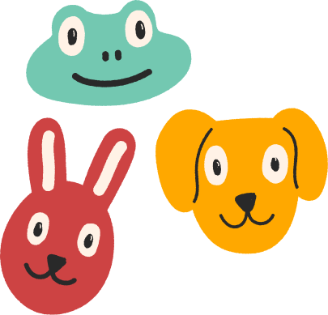
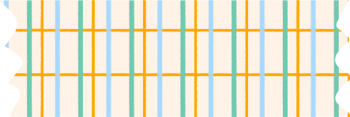
AN INTRODUCTION TO
See Eye
A kindergarten Education
Journey Has Been Made Simple

Slide 2
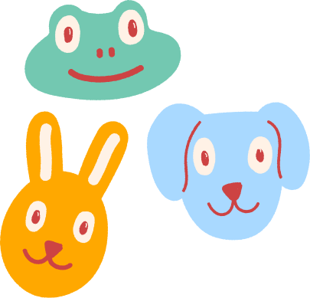
Educators are uniquely
positioned
to inspire and support
children
in their academic
and social life,
Most importantly they
should feed their
curiosities with
equivalent
information

Slide 3


Children at an early age are fascinated by things Which makes interesting noises, And
Things that
are capable of interacting with them and Be unpredictable in what they do and how they behave

Slide 4
aside from
people
Study has shown that
animals are The
most Important
"thing"
Which children Find
interesting at an early
age

Slide 5
Upon my research I
Found That
that Children
respond More effectivity
to visual information
as compared to
text only materials

Slide 6
Problem Statement
When teaching Children about
Biodiversity They Always
Have Questions Which
Are Difficult to Be Answered
In Their level of
understanding

Slide 7
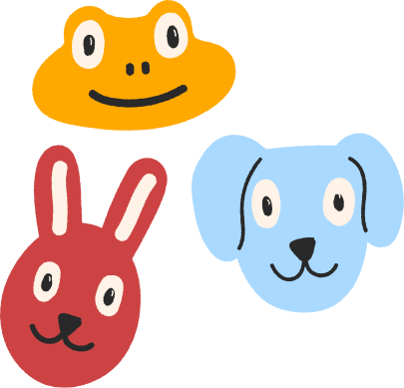
Solution
System Which will help them
explore a world
With a simulated vision
of different Species.
That will enhance their
interest in learning more
about animals

Slide 8




methodology
For a Snake vision, a Canny Edges will be
used to Extract image Features and add red color effect Which will be used to simulate their sensation to blood heat
For a Bat vision, a Grayscale will be
used to create a Black and white image
For a fly vision, a dilation will be
used to create a blur image

Slide 9
Video Link
https://youtu.be/qY_gxzAmxYg

